Slide 1





F A
# 1. Integrated Information
F A
# 2-1. Program Log
Customer Index
1. Customer Segmentation
F A
# 2-2. Motion Log
MTL
2. Emergency Predictions
# 3. Emergency Call

Slide 2
Main Task 1) Monthly Predictions
Main Task 2) Time-based Predictions
Emergency call on January
Emergency call on December
Emergency call at Dawn
Emergency call at Night
Task Specific Layer ( Sub-Task 1-1 )
…
Task Specific Layer ( Sub-Task 1-M )
Task Specific Layer ( Sub-Task 2-1 )
…
Task Specific Layer ( Sub-Task 2-N )
…
…
Shared Layers ( Main Task 1 )
Shared Layers ( Main Task 2 )
Shared Layers
Input Data

Slide 4
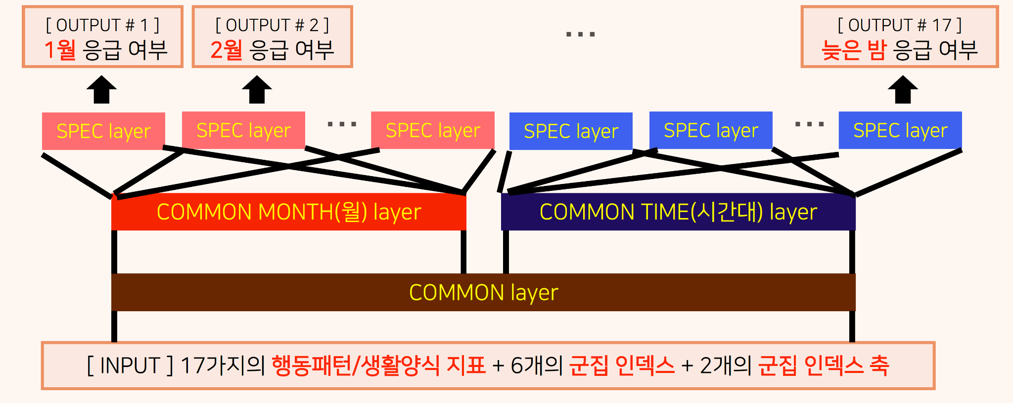

Slide 5
