Slide 1
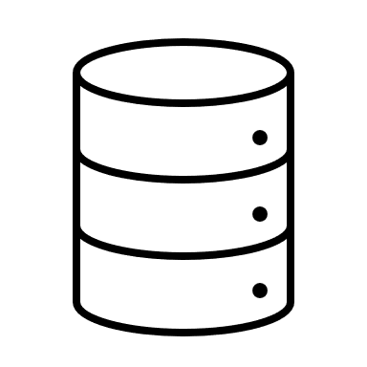








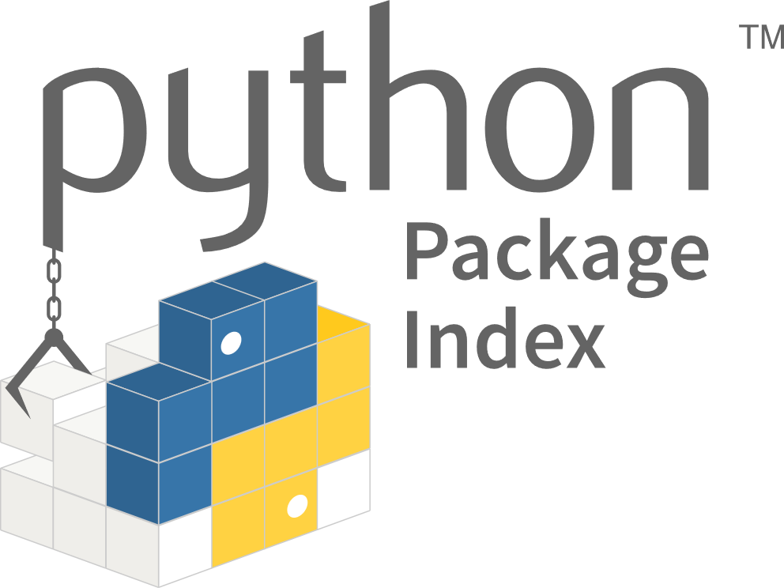
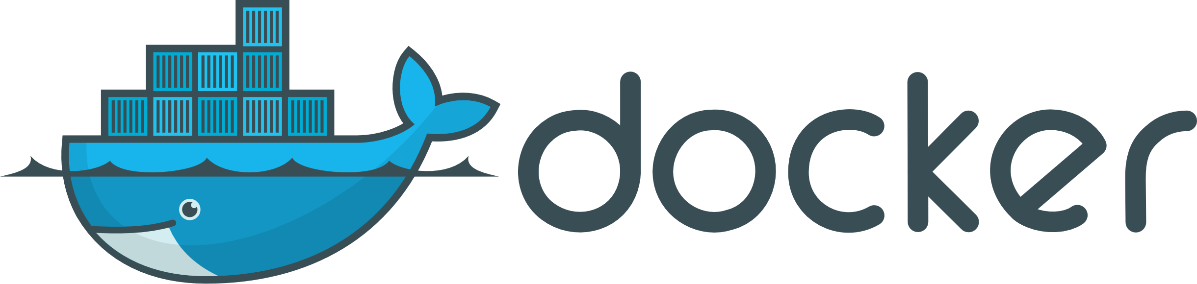
Object Storage
Cluster
Node-1
Node-2
producer
Spark SQL
scheduler
Data Frame
Dag
broker
API
topic
consumer
webserver
Spark streaming
operate

