Slide 1
GPU based OpenGL
Sang Il Park
Dept. of Software

Slide 2
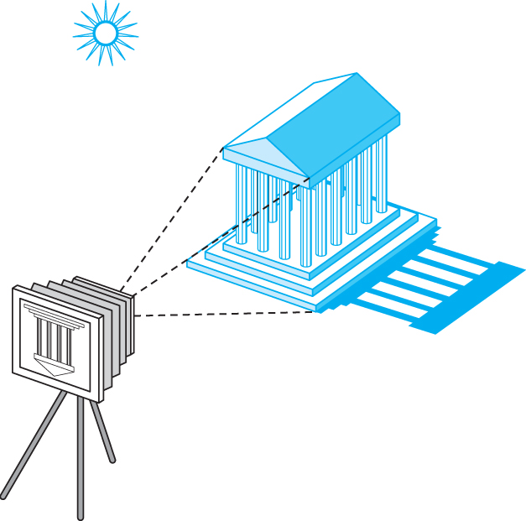
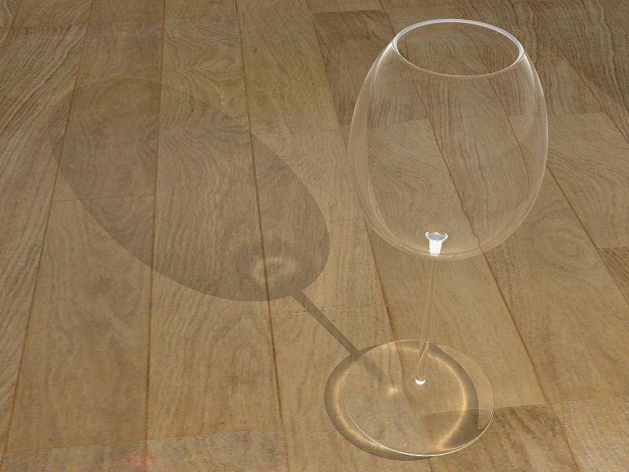
Review: Elements of Image Formation
Objects
Viewer
Light source(s)
Attributes (materials)
  govern how light interacts with the materials in the scene
Attributes is getting more important

Slide 3
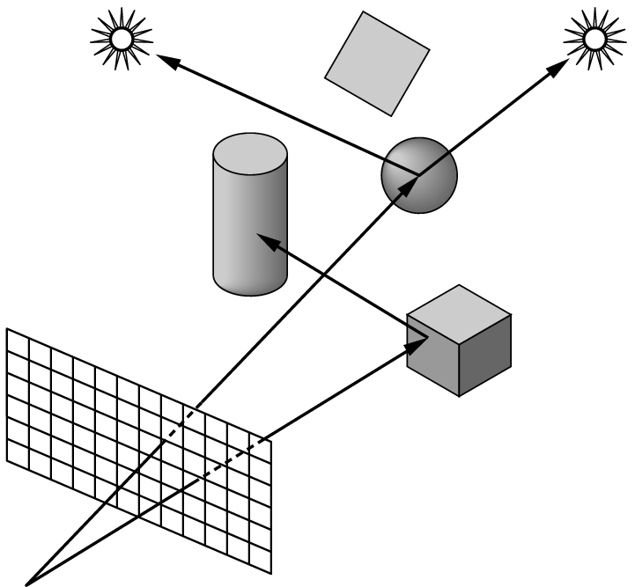
Review: Ray tracing
Ray tracing: follow rays of light from center of projection until they either are absorbed by objects or go off to infinity
  Can handle global effects
    Multiple reflections
    Translucent objects
  Slow
  Must have whole data base
  available at all times

Slide 4
“Simplified” Practical Approach
Process objects one at a time in the order they are generated by the application
  Can consider only local lighting
Pipeline architecture
All steps can be implemented in hardware on the graphics card
E. Angel and D. Shreiner: Interactive Computer Graphics 6E © Addison-Wesley 2012

Slide 5
Vertex (vertices) Processing
Much of the work in the pipeline is in converting object representations from one coordinate system to another
  Object coordinates
  Camera (eye) coordinates
  Screen coordinates
Every change of coordinates is equivalent to a matrix transformation
PROJECTION
E. Angel and D. Shreiner: Interactive Computer Graphics 6E © Addison-Wesley 2012

Slide 6
Rasterization
If an object is visible, the appropriate pixels in the frame buffer must be assigned colors
Rasterizer produces a set of fragments for each object
Fragments are “potential pixels”
  Have a location in frame bufffer
  Color and depth attributes
Vertex attributes are interpolated over objects by the rasterizer

Slide 7
Fragment Processing
Fragments are processed to determine the color of the corresponding pixel in the frame buffer
Colors can be determined by texture mapping or interpolation of vertex colors
Fragments may be blocked by other fragments closer to the camera
  Hidden-surface removal

Slide 8
OpenGL: the API

Slide 9
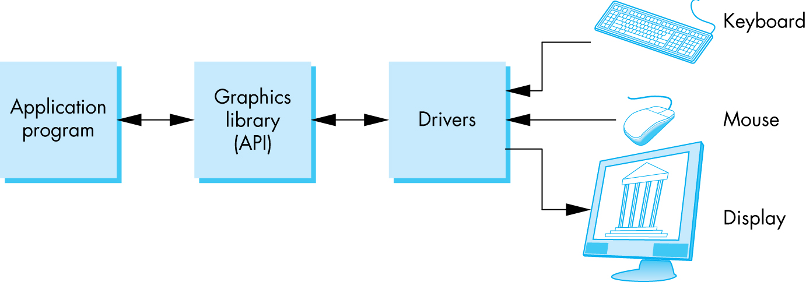
The Programmer’s Interface
Programmer sees the graphics system through a software interface: the Application Programmer Interface (API)

Slide 10
API Contents
Functions that specify what we need to form an image
  Objects
  Viewer
  Light Source(s)
  Attributes (Materials)
Other information
  Input from devices such as mouse and keyboard
  Capabilities of system
E. Angel and D. Shreiner: Interactive Computer Graphics 6E © Addison-Wesley 2012

Slide 11
Object Specification
Most APIs support a limited set of primitives including
  Points (0D object)
  Line segments (1D objects)
  Polygons (2D objects)
  Some curves and surfaces
    Quadrics
    Parametric polynomials
All are defined through locations in space or vertices
E. Angel and D. Shreiner: Interactive Computer Graphics 6E © Addison-Wesley 2012

Slide 12
Object Specification (old style)
type of object
location of vertex
glBegin(GL_POLYGON)
glVertex3f(0.0, 0.0, 0.0);
glVertex3f(0.0, 1.0, 0.0);
glVertex3f(0.0, 0.0, 1.0);
glEnd( );
end of object definition
E. Angel and D. Shreiner: Interactive Computer Graphics 6E © Addison-Wesley 2012

Slide 13
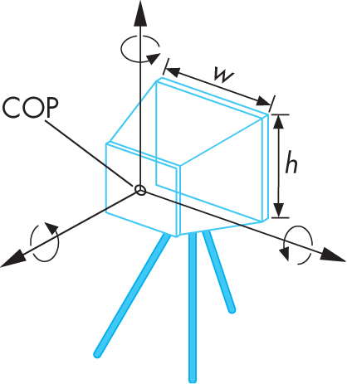
Camera Specification (old style)
Six degrees of freedom
  Position of center of lens
  Orientation
Lens
Film size
Orientation of film plane
→ glPerspective(…), gluLookAt(…)
E. Angel and D. Shreiner: Interactive Computer Graphics 6E © Addison-Wesley 2012

Slide 14
Lights and Materials (old style)
Types of lights
  Point sources vs distributed sources
  Spot lights
  Near and far sources
  Color properties
Material properties
  Absorption: color properties
  Scattering
    Diffuse
    Specular
→ glLight(…), glMaterial(…)

Slide 15
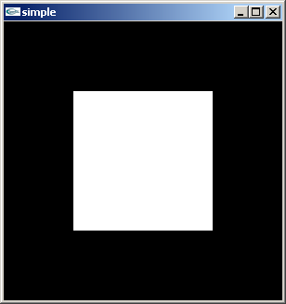
A Simple Program ( old style)
Generate a square on a solid background
E. Angel and D. Shreiner: Interactive Computer Graphics 6E © Addison-Wesley 2012

Slide 16
Let’s start to CODE it!
Preparation
Download necessary libraries
  Header files: Include folder
  LIB files : lib folder
  DLL files : bin(or system32) folder
Change the project setting
  Directory setting

Slide 17
Required Libraries
freeglut: http://freeglut.sourceforge.net/
GLEW: http://glew.sourceforge.net/
I put both of them and more at our homepage:
freeglut_and_glew.zip
➔ Download it and unzip it at “c:/cg2/”

Slide 18

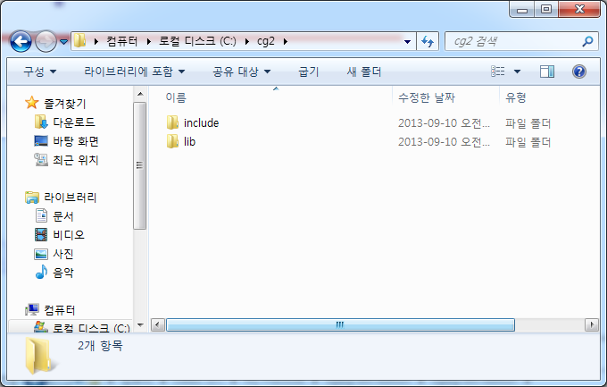
What you should have in your “c:/cg2/” folder:

Slide 19
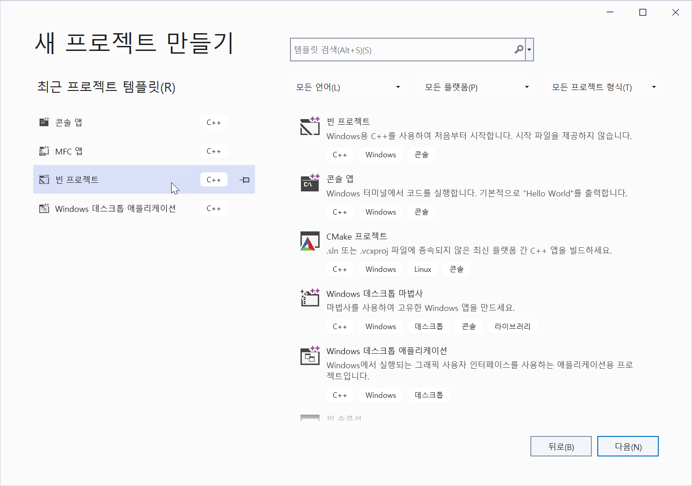
Project Setting:
Start a new project with a
“console application” project
with an empty project option.

Slide 20
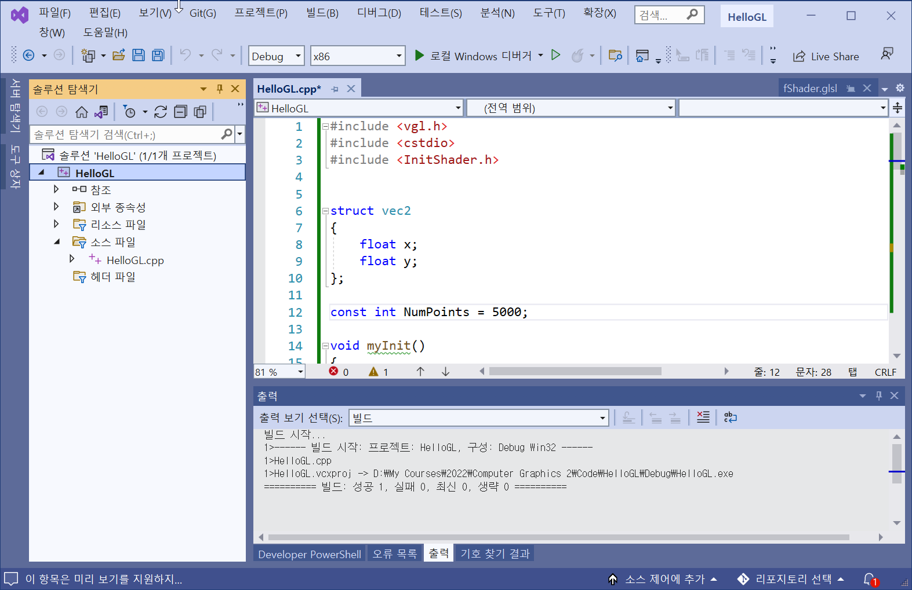
Set Target Platform: x86
다음과 같이 반드시 Target Platform을 x86으로 설정 (x64 아님!)

Slide 21
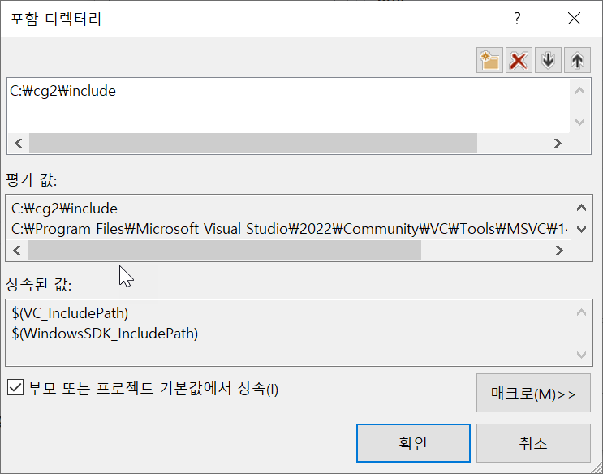
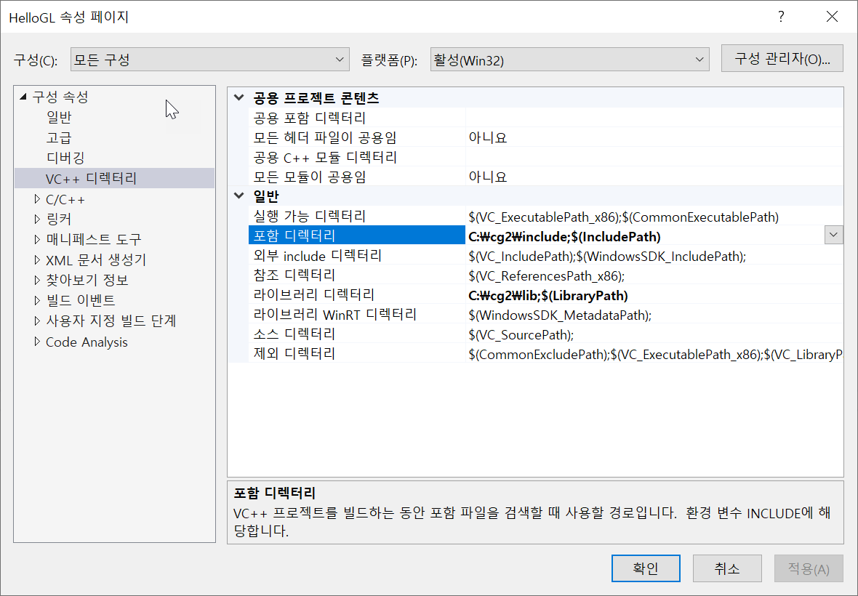
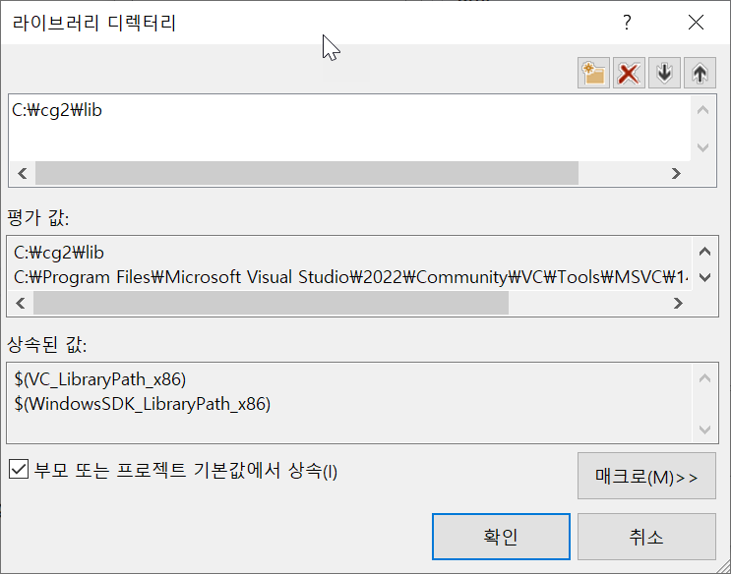
Project Setting
Set the directories:

Slide 22
Create a new main.cpp file
And add the following line at the beginning of the code:
#include <vgl.h>
Now ALL SET!!!!

Slide 23
Hello GL Program:
#include <vgl.h>
void display()
{
glClear(GL_COLOR_BUFFER_BIT);
glBegin(GL_TRIANGLES);
glVertex2f(-0.5, -0.5);
glVertex2f(0.5, -0.5);
glVertex2f(-0.5, 0.5);
glVertex2f(0.5, -0.5);
glVertex2f(0.5, 0.5);
glVertex2f(-0.5, 0.5);
glEnd();
glFlush();
}
int main(int argc, char** argv)
{
glutInit(&argc, argv);
glutInitDisplayMode(GLUT_SINGLE | GLUT_RGBA);
glutInitWindowSize(512, 512);
glutCreateWindow("Hello GL");
glutDisplayFunc(display);
glutMainLoop();
return 0;
}

Slide 24
Summary
OpenGL Setting for libraries
  Set include/lib folder
  #include <vgl.h>
With OpenGL, drawing was done by just sending the data into the predefined pipeline
Notes:
In order to initiate the rendering of primitives, you need to issue a drawing routine. While there are many routines for this in OpenGL, we’ll discuss the most fundamental ones. The simplest routine is glDrawArrays(), to which you specify what type of graphics primitive you want to draw (e.g., here we’re rending a triangle strip), which vertex in the enabled vertex attribute arrays to start with, and how many vertices to send.
This is the simplest way of rendering geometry in OpenGL Version 3.1. You merely need to store you vertex data in sequence, and then glDrawArrays() takes care of the rest. However, in some cases, this won’t be the most memory efficient method of doing things. Many geometric objects share vertices between geometric primitives, and with this method, you need to replicate the data once for each vertex. We’ll see a more flexible, in terms of memory storage and access in the next slides.

