Slide 1
Object-Oriented Programming
2022.11.25 Prof : Muhammad Bilal
Teaching Assistant : Seungpil Choi
Email : csp213@hufs.ac.kr

Slide 2
Contents
Event Handling
Event Handling example
Lab08 – Three tasks

Slide 3
Event Handling
Event
GUIs generate events when the user interacts with GUI
Clicking buttons, moving the mouse, closing window etc..
In java, events are represented by Objects
ActionEvent => clicking a button
WindowEvent => Doing something with window e.g. closing , minimizing
Both AWT and swing components (not all) generate events
java.awt.event.*;
javax.swing.event.*;

Slide 4
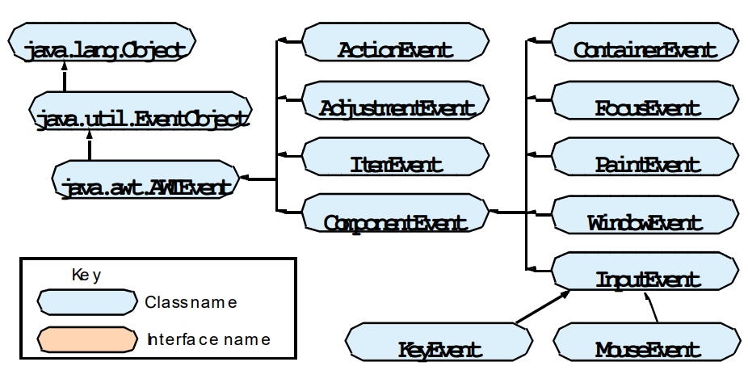
Event Handling
Event classes

Slide 5
Event Handling
Event handling steps
Step1
Create components which can generate events
Step2
Build component (objects) that can handle events (Event Handlers)
Step3
Register (subscribe) handlers with generators

Slide 6
Event Handling
Event Listeners
Java defines interfaces for every event type
If a class needs to handle an event, It needs to implement the corresponding listener interface
To handle “ActionEvent” a class needs to implement “ActionListener”
To handle “KeyEvent” a class needs to implement “KeyListener”
To handle “MouseEvent” a class needs to implement “MouseListener”

Slide 7
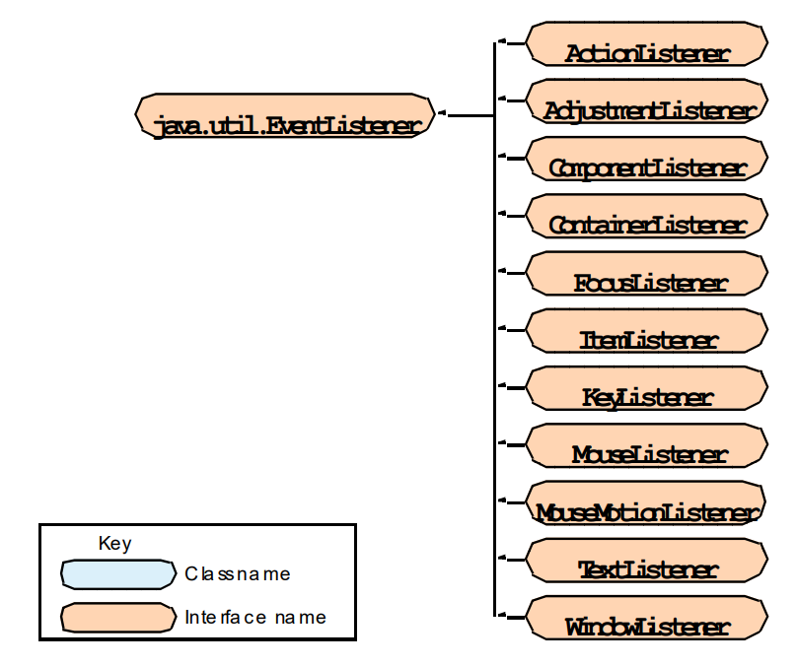
Event Handling
Event Listeners

Slide 8
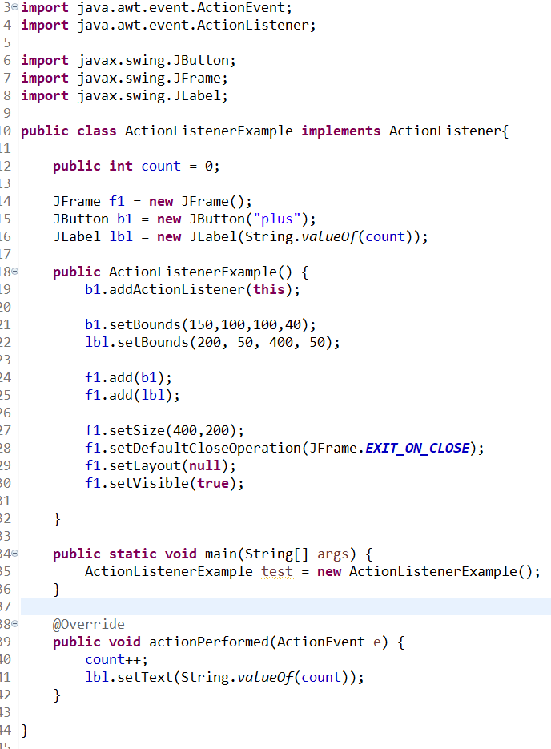
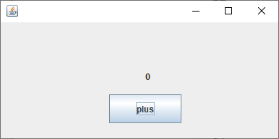

Event Handling – Example1

Slide 9
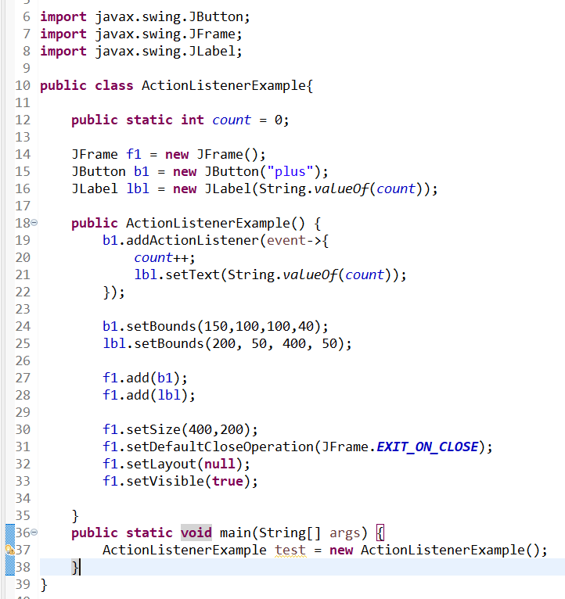
Event Handling – Example2

Slide 10
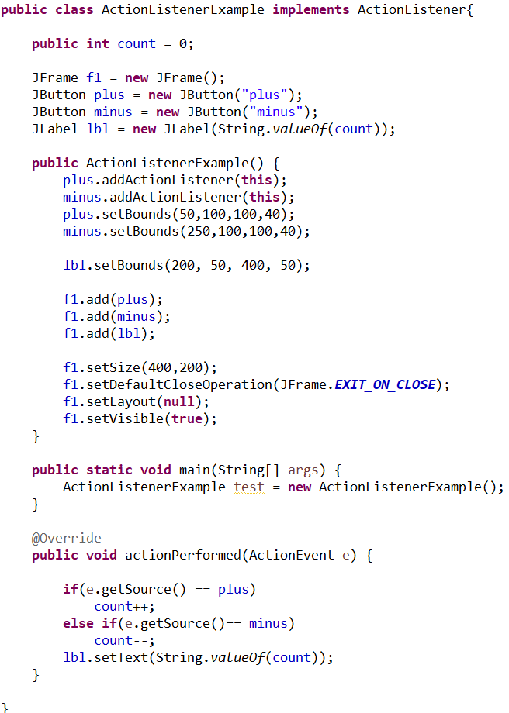
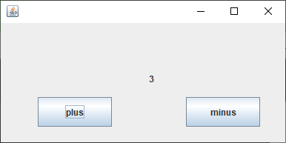
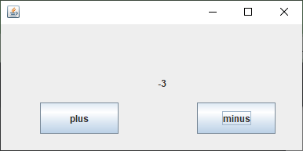
Event Handling – Example3

Slide 11
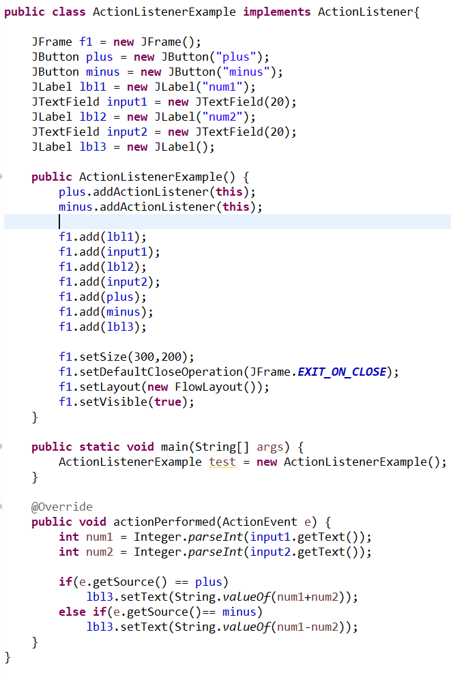
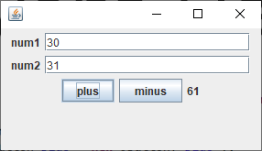
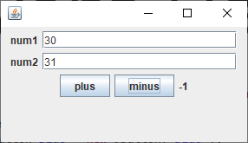
Event Handling – Example4

Slide 12
Lab08
Lab08-01 : Time
Lab08-02 : Calculate the day of the week of future
Lab08-03 : Rock-scissor-paper

Slide 13
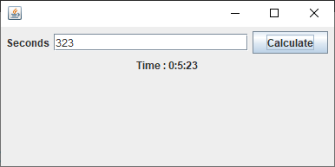
Lab08-01 : Time
Input n seconds in the text field.
Show the hours, minutes, and seconds when clicking “calculate” button.

Slide 14
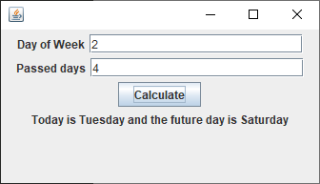
Lab08-02 : Calculate the day of the week of future
The first input is one of day of the week :
0=Sunday, 1=Monday, 2=Tuesday, 3=Wednesday, 4=Thursday, 5=Friday, 6=Saturday
The second input is the number of days passed since today(the first input).
The result is the day of the week passed since today.

Slide 15
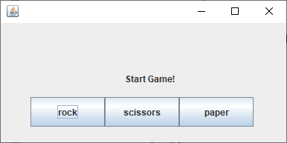
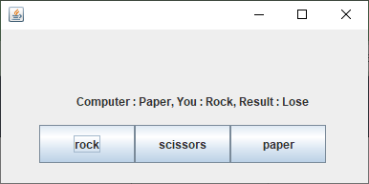
Lab08-03 : Rock-scissor-paper
Change randomly the computer’s Rock-Siccsors-Paper type when you click button.

