Slide 1
Object-Oriented Programming
2022.11.18 Prof : Muhammad Bilal
Teaching Assistant : Seungpil Choi
Email : csp213@hufs.ac.kr

Slide 2
Contents
Interfaces
Interface based Polymorphism
Basic GUI using swing library
Lab07 – Three tasks

Slide 3
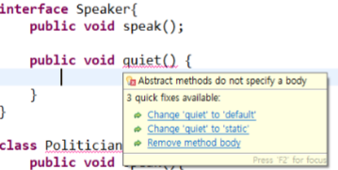
Interfaces
Defines a set of method prototypes, but does not provide the implementation for the prototypes
Essentially, all the methods inside an interface are Abstract Methods or we can say that an interface is like a pure abstract class (Zero Implementation)

Slide 4
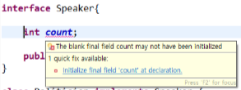
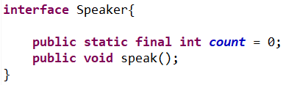
Interfaces
Can also define static final constants

Slide 5
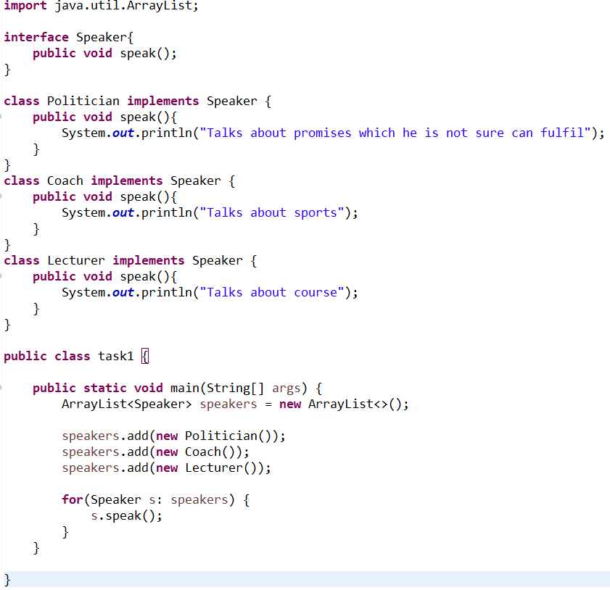
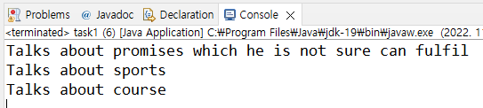
Interface based Polymorphism

Slide 6
Interfaces
Interfaces vs. Abstract classes
Fairly similar uses
designed to group behavior, allow upcasting, exploit polymorphism
Rules of thumb
Choose abstract class if we have shared code and logical “is a” relationship
Choose interface if only want to ensure design structure (method signatures) and/or it is not logical to use “is a “ relationship.

Slide 7
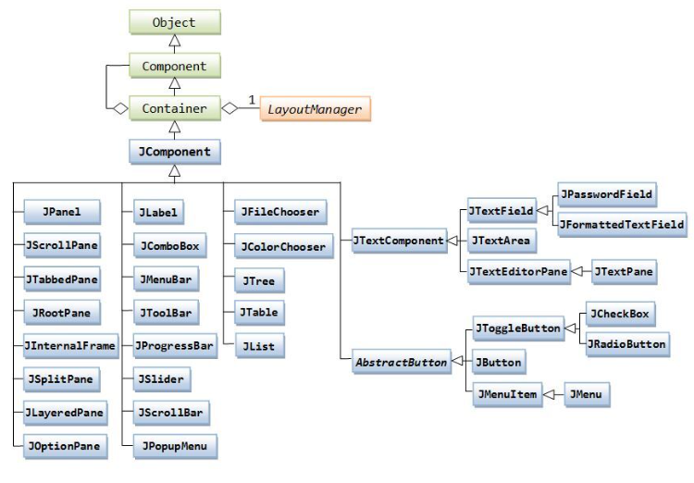
Basic GUI using swing library
Java supports for GUI : AWT, Swing library
Swing
Newest GUI components, Names start with J can be identified

Slide 8
Basic GUI using swing library
Swing GUI creation step:
Step1 : import required package
Step2 : Setup the top-level container
Step3 : Get the component Area of the top-level Container
Step4 : Apply layout to that Area
Step5 : Create & add components
Step6 : Set size of Frame and make it Visible

Slide 9
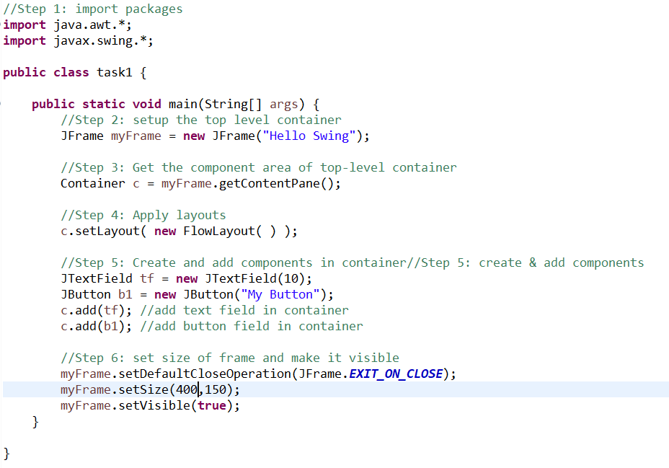
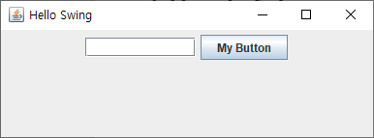
Basic GUI using swing library

Slide 10
Lab07
Lab07-01 : Bank System
Lab07-02 : Shape
Lab07-03 : Public Transport

Slide 11
Lab07-01 : Bank System
There are three bank classes. : KB, IBK, NH
Bank classes implement “BankFunc” class.
There are three methods in BankFunc class : withdraw, deposit, info
Input Bank number, method number, and money until input of bank number is ”-1”.
Bank number => 0=KB, 1=IBK, 2=NH
Method number => 0=withdraw, 1=deposit
Print “lack of balance.” when there is not enough money.
Finally, print each bank name and balance by using info method.

Slide 12
Lab07-02 : Shape
There are three shape classes : Circle, Triangle, Rectangle.
Shape classes implement “Calculation” class.
Input shape number, the shape’s member variable until input of shape number is “-1”.
Shape number => 0=Circle, 1=Triangle, 2=Rectangle.
Shape’s member variable
Circle=radius / Triangle=sideA, sideB, sideC / Rectangle=sideA, sideB
Finally, print each shape name and area.
Round circle and triangle area to two decimal places.

Slide 13
Lab07-03 : Public Transport
There are two public transport classes : Subway, Bus
Public transport classes implement “PublicTransportMethod” class.
Input person name, public transport number and method number until input of person name is “-1”.
Public transport number => 0=Subway, 1=Bus
Method number => 0=riding, 1=quit
Finally, print each public transport name, number of passenger and passenger’s name.

