Slide 1
Object-Oriented Programming
2022.11.11 Prof : Muhammad Bilal
Teaching Assistant : Seungpil Choi
Email : csp213@hufs.ac.kr

Slide 2
Contents
Streams
Abstract Classes
Lab06 – Three tasks

Slide 3
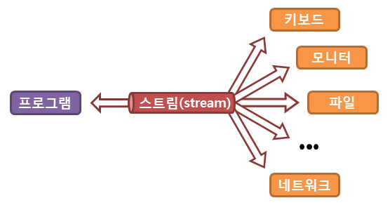
Streams
In Java, the input/output of a file or console is not directly handled, but is handled through a flow called a stream.
A stream refers to an idealized flow of data in which an actual input or output is expressed.
In other words, a stream is a virtual link created by the operating system and acts as an intermediary.

Slide 4
Streams
Byte Stream | Character Stream
They process the data byte by byte. | They process the data character by character.
They read/write data 8 bits maximum at a time. | They read/write data 16 bits maximum at a time.
They are most suitable to process binary files.(sound, images, etc.) | They are most suitable to process text files.
All byte stream classes in Java are descendants of InputStream and OutputStream. | All character stream classes in Java are descendants of Reader and Writer.

Slide 5
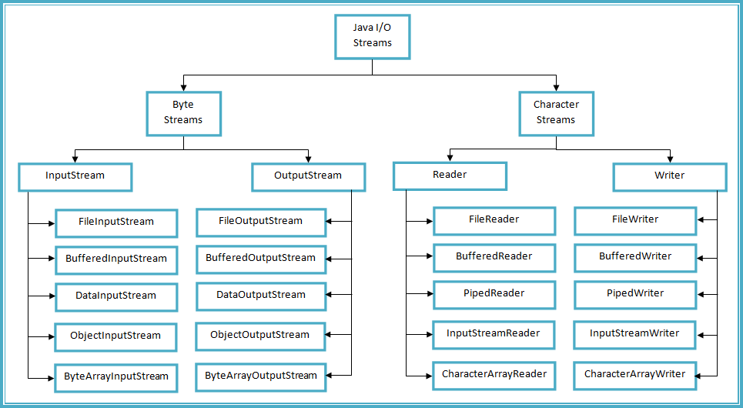
Streams

Slide 6
Streams – InputStream Class
Class | Description
FileInputStream | This class provides methods to read bytes from a file.
BufferedInputStream | This class provides methods to read bytes from the buffer.
DataInputStream | This class provides methods to read Java primitive data types.
ObjectInputStream | This class provides methods to read objects.
ByteArrayInputStream | This class provides methods to read bytes from the byte array.

Slide 7
Streams – InputStream Class methods
Method | Description
int read() | This method returns an integer, an integral representation of the next available byte of the input. The integer -1 is returned once the end of the input is encountered.
int read (byte buffer []) | This method is used to read the specified buffer length bytes from the input and returns the total number of bytes successfully read. It returns -1 once the end of the input is encountered.
int read (byte buffer [], int loc, int nBytes) | This method is used to read the 'nBytes' bytes from the buffer starting at a specified location, 'loc'. It returns the total number of bytes successfully read from the input. It returns -1 once the end of the input is encountered.
int available () | This method returns the number of bytes that are available to read.
void mark(int nBytes) | This method is used to mark the current position in the input stream until the specified nBytes are read.
void reset () | This method is used to reset the input pointer to the previously set mark.
long skip (long nBytes) | This method is used to skip the nBytes of the input stream and returns the total number of bytes that are skipped.
void close () | This method is used to close the input source. If an attempt is made to read even after the closing, IOException is thrown by the method.

Slide 8
Streams – OutputStream Class
Class | Description
FileOutputStream | This class provides methods to write bytes to a file.
BufferedOutputStream | This class provides methods to write the bytes to the buffer.
DataOutputStream | This class provides methods to write the java primitive data types.
ObjectOutputStream | This class provides methods to write objects.
ByteArrayOutputStream | This class provides methods to write bytes to the byte array.

Slide 9
Streams – OutputStream Class methods
Method | Description
void write (int i) | This method is used to write the specified single byte to the output stream.
void write (byte buffer [] ) | It is used to write a byte array to the output stream.
void write(bytes buffer[],int loc, int nBytes) | It is used to write nByte bytes to the output stream from the buffer starting at the specified location.
void flush () | It is used to flush the output stream and writes the pending buffered bytes.
void close () | It is used to close the output stream. However, if we try to close the already closed output stream, the IOException will be thrown by this method.

Slide 10
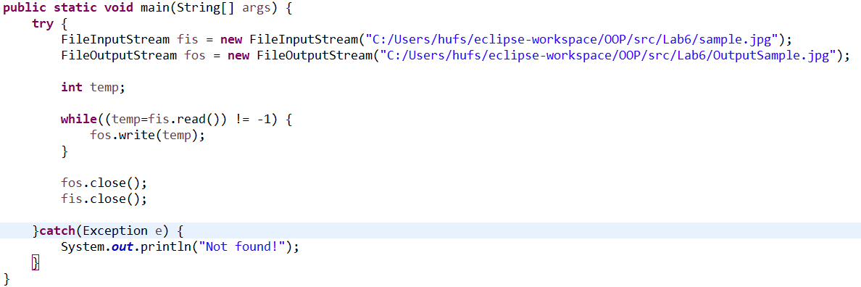
Streams – Bytes Stream example

Slide 11

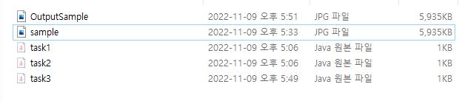


Streams – Bytes Stream example

Slide 12
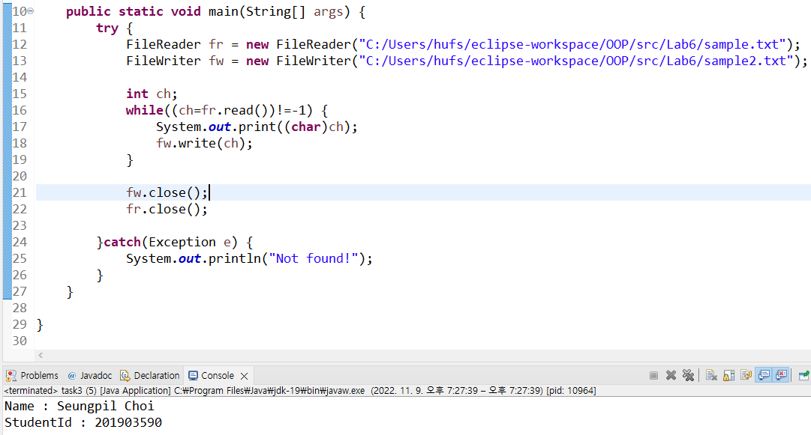
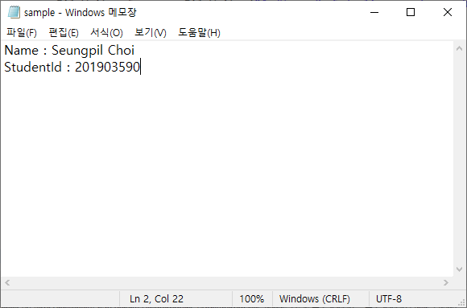
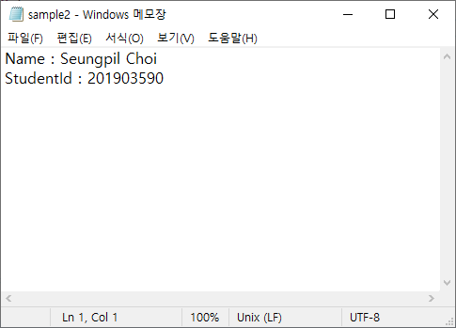
Streams – Character Stream example

Slide 13
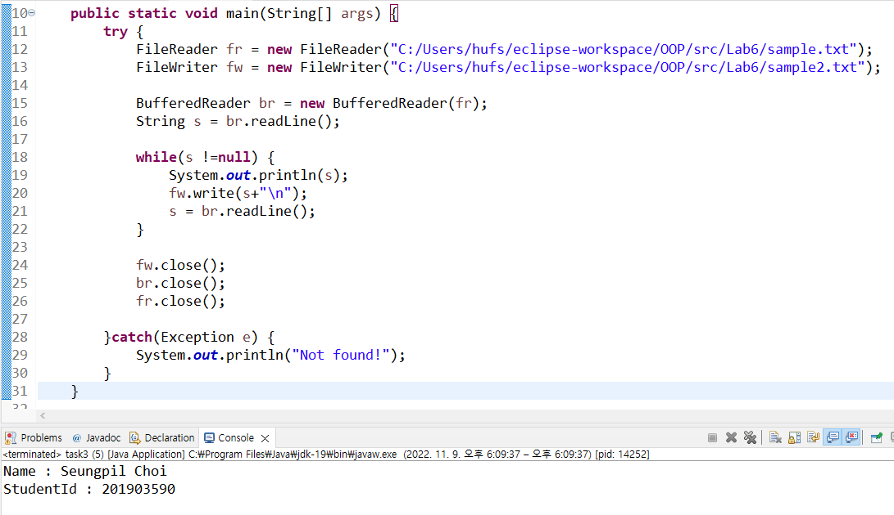
Streams – Character Stream example

Slide 14
Abstract Classes
To define only part of an implementation.
Can contain instance variables & methods that are fully implemented
Leaving the subclasses to provide the details.

Slide 15
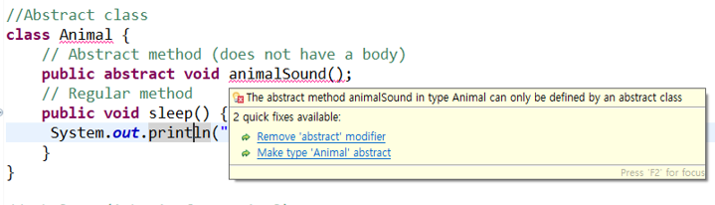
Abstract Classes
Any class with an abstract method must be declared abstract.
However, you can declare a class abstract that has no abstract method.

Slide 16
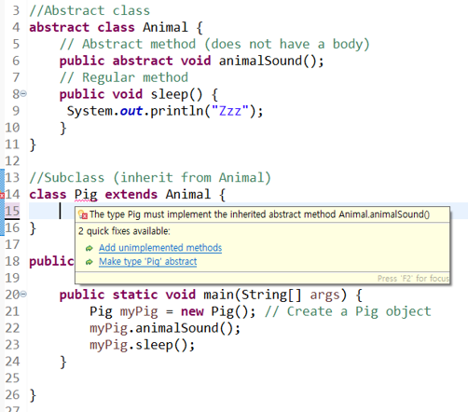
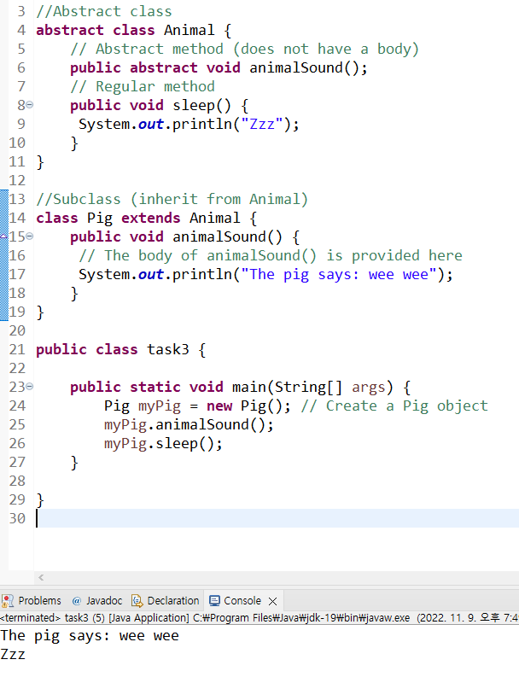
Abstract Classes
Subclasses must implement the inherited abstract method.

Slide 17
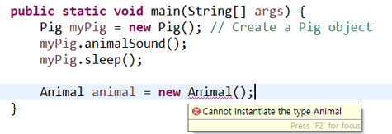
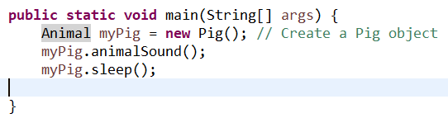
Abstract Classes
Abstract classes cannot be instantiated.
However, references to an abstract class can be declared

Slide 18
Lab06
Lab06-01 : Simple arithmetic
Lab06-02 : Phone book
Lab06-03 : Movie reservation

Slide 19
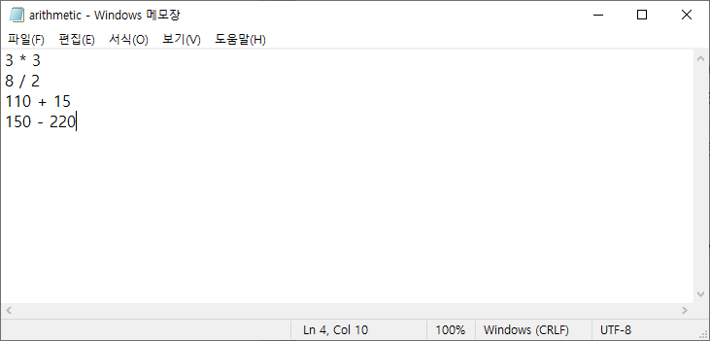
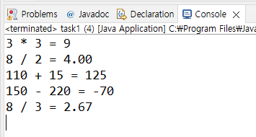
Lab06-01 : Simple arithmetic
Read “arithmetic.txt”.
Calculate simple arithmetic line by line.
Round result of division to two decimal places.

Slide 20
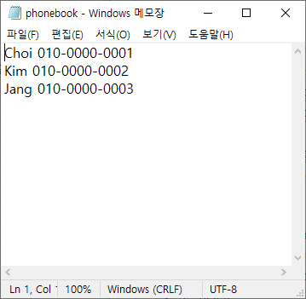
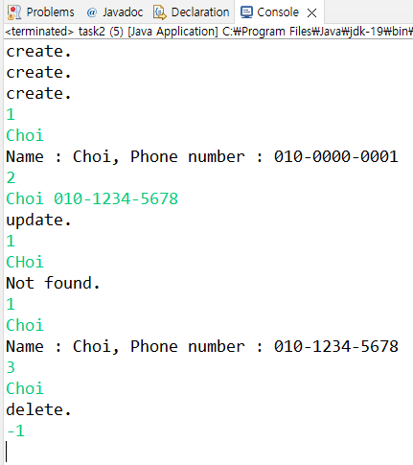
Lab06-02 : Phone book
Read “phonebook.txt” that has names and phone numbers.
Make functions for load, read, update, delete about phone book.
At first, load “phonebook.txt” line by line – if each loading is successful, print “create.
Input: name, phone number
1 = read
Print the specific data in phone book.
If there is no data, print "Not found"
Input: name
2 = update
If update is successful, print "update."
If there is no data, print "Not found."
Input: name, phone number
3 = delete
If delete is successful, print "delete."
If there is no data, print "Not found."
Input: name
-1 = exit

Slide 21
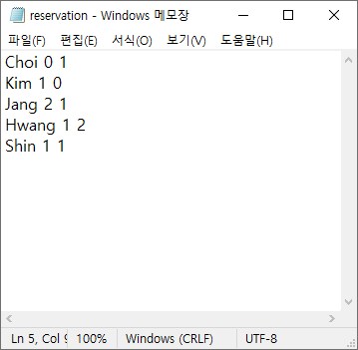
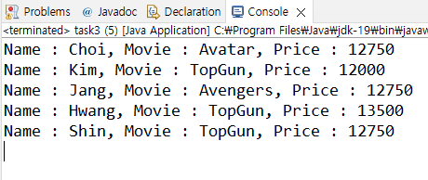
Lab06-03 : Movie reservation
Read “reservation.txt” that has customer’s name, movie number and a discount policy.
Movie number :
0=Avatar, 1=TopGun, 2=Avengers
The movie price is 15000.
There are three discount policies:
0 = Credit card discount(20%)
1 = Time discount(15%)
2 = Coupon(10%)
-1 = nothing(0%)
Input customer's name, movie number and a discount policy.
Print customer name, movie name and movie price.

