Slide 1
Object-Oriented Programming
2022.09.23 Prof : Muhammad Bilal
Teaching Assistant : Seungpil Choi
Email : csp213@hufs.ac.kr

Slide 2
Contents
Taking in Command Line Arguments
Wrapper Class
Introductory Swing
Scanner Class
Lab01 – four tasks

Slide 3
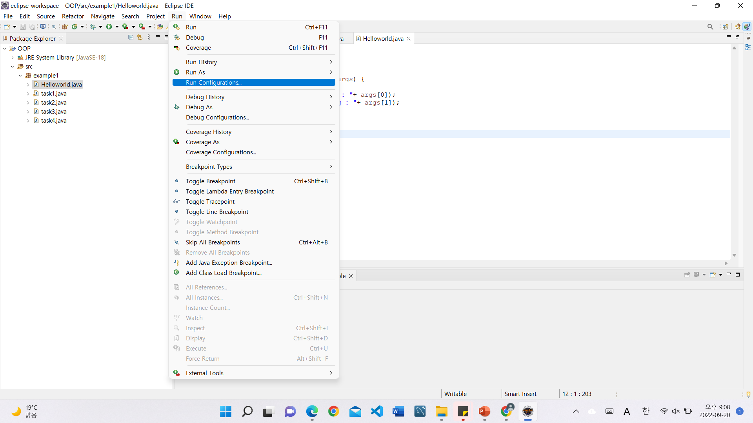
Taking in Command Line Arguments
Run -> Run Configuration

Slide 4
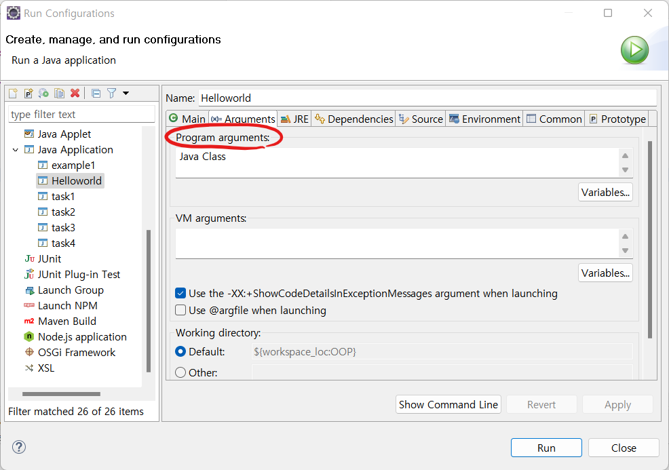
Taking in Command Line Arguments
Write command line arguments in Program arguments

Slide 5
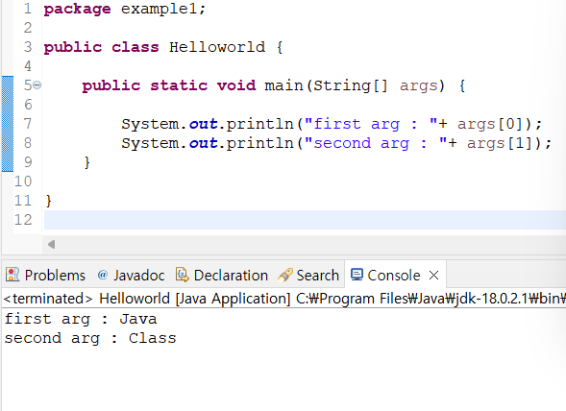
Taking in Command Line Arguments

Slide 6
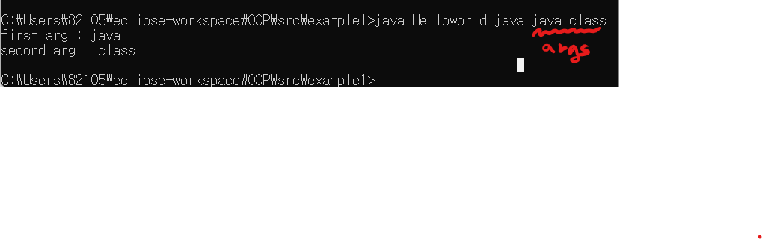
Taking in Command Line Arguments
In command line, write java Classname.java Arguments.

Slide 7
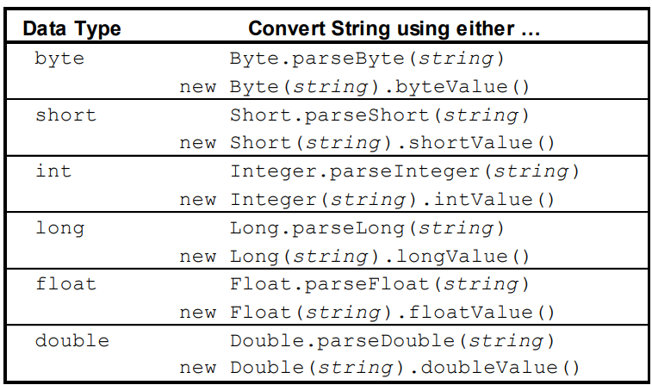
Wrapper Class
Wrapper class is used to handle primitive types to object.

Slide 8
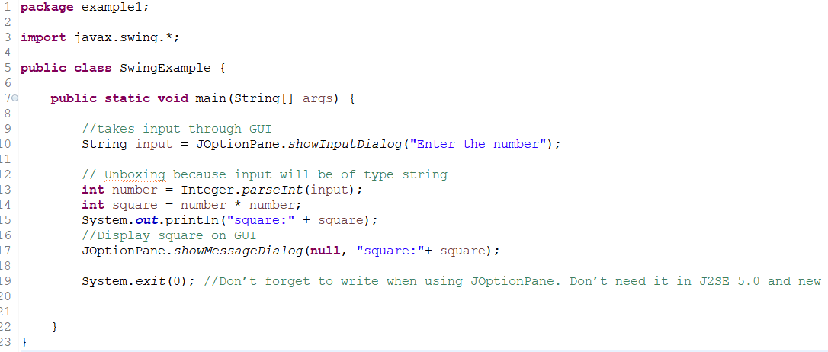
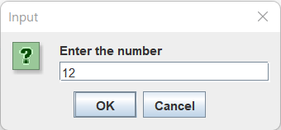
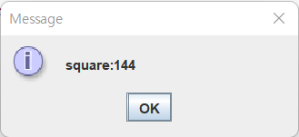
Introductory Swing
Swing is the representative tool for GUI in Java.

Slide 9
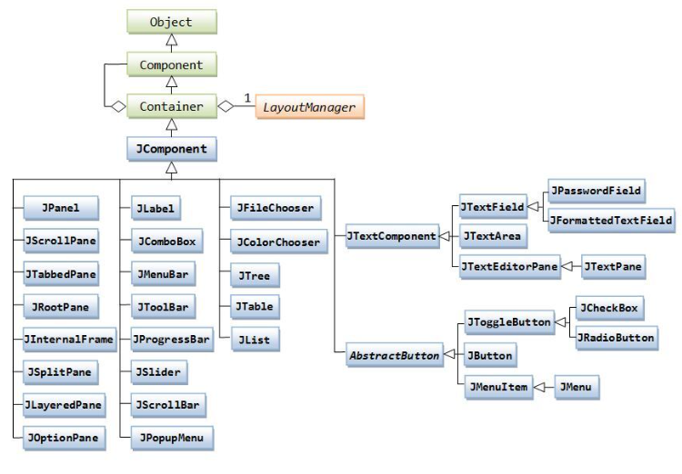
Introductory Swing

Slide 10
System.in : reads data input by the user
: 키보드 장치를 직접 제어하고 키 입력을 받는 표준 입력 스트림 객체
-> Scanner 필요
-> To use System.in, a Java Scanner is used that will get the inputs.
import java.util.Scanner; //프로그램 맨 앞줄에 입력
Scanner scanner = new Scanner(System.in);
//Scanner 객체 생성
- Scanner는 키 입력을 공백으로 구분된 토큰 단위로 끊어 읽는다.

Slide 11
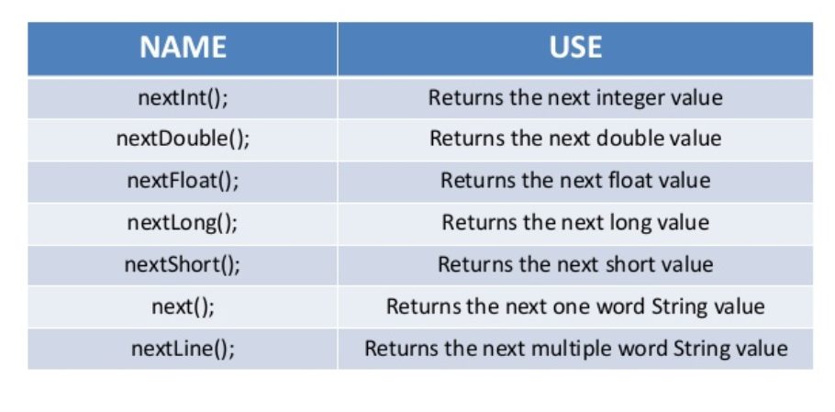
Scanner Methods

Slide 12
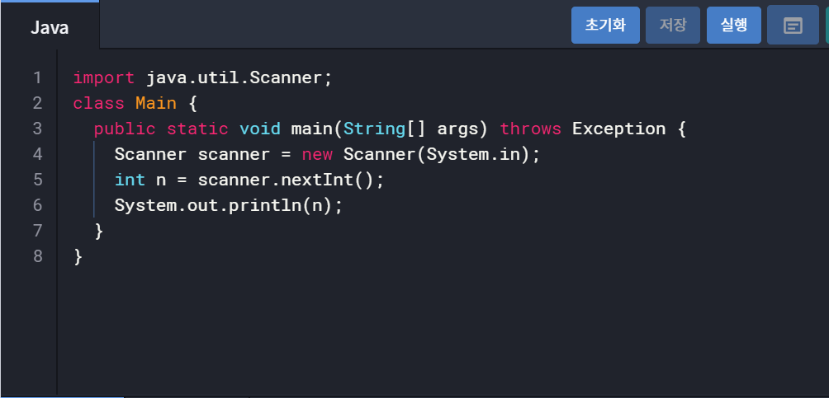
Scanner example

Slide 13
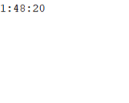
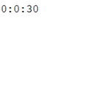
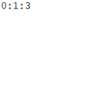
Lab01-1 : Time
Input n seconds through command line argument.
Print the hours, minutes, and seconds.
Command line argument : 6500 30 63
Output =>

Slide 14
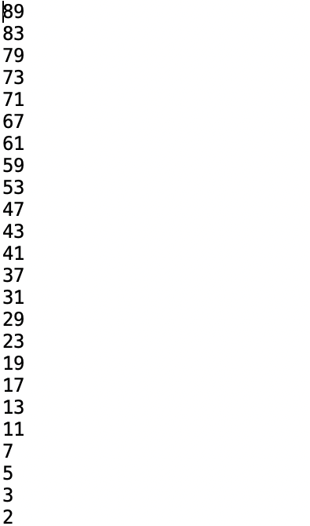

Lab01-2 : Prime number
Input a natural number through command line argument.
Print all prime numbers less than or equal the number.
Conmand line argument : 5
Command line argument : 90
Output =>
Output =>

Slide 15
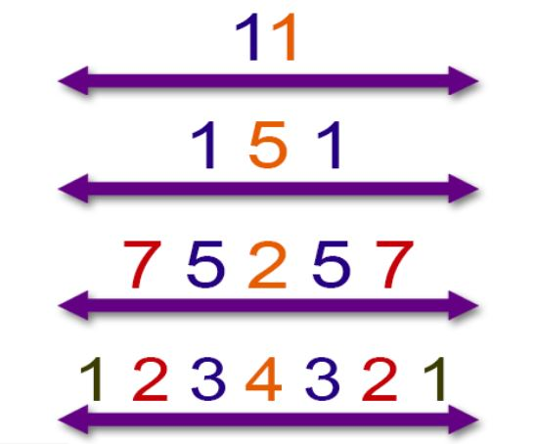
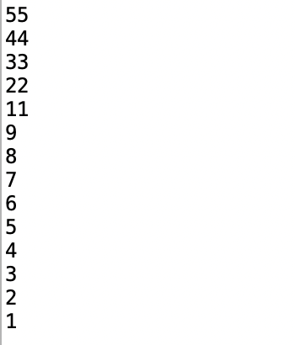
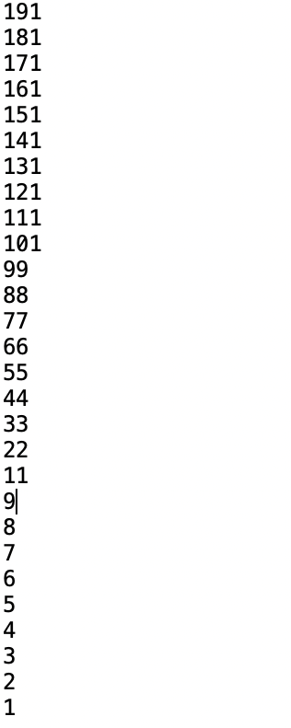
Lab01-03 : Palindrome
Input a natural number n through command line argument.
Print all palindromic number from 1 to n.
Command line argument : 55
Command line argument : 200
Output =>

Slide 16
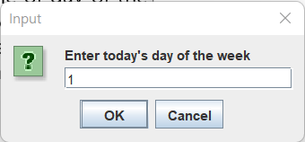
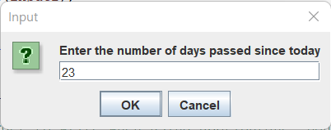
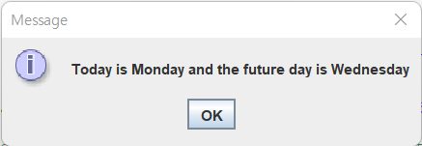
Lab01-04 : Calculate the day of the week of future
The first input is one of day of the week :
0=Sunday, 1=Monday, 2=Tuesday, 3=Wednesday, 4=Thursday, 5=Friday, 6=Saturday
The second input is the number of days passed since today(the first input).
The result is the day of the week passed since today.

