Slide 1
Object-Oriented Programming
2022.09.30 Prof : Muhammad Bilal
Teaching Assistant : Seungpil Choi
Email : csp213@hufs.ac.kr

Slide 2
Contents
Selection Structures if-else and switch
Control Structures for, while & do-while
Scanner Class
Lab01 Solution
Lab02 – four tasks

Slide 3
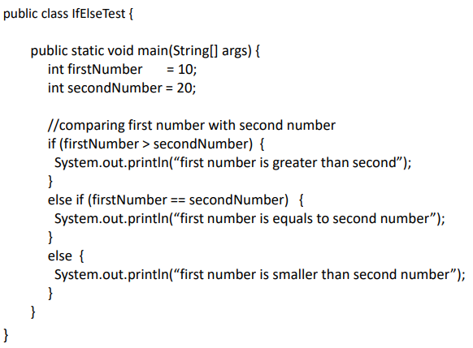
Selection Structures if-else and switch
If-else Selection Structure
Need a conditional sentence returning Boolean.

Slide 4
Selection Structures if-else and switch
If-else Selection Structure – Boolean operator
==, !=
Equality, inequality. In addition to comparing primitive types, == tests if two objects are identical (the same object), not just if they appear equal (have the same fields). More details when we introduce objects.
<=, >, >=
Numeric less than, less than or equal to, greater than, greater than or equal to.
&&, ||
Logical AND, OR. Both use short-circuit evaluation to more efficiently compute the results of complicated expressions.
!
Logical negation.

Slide 5
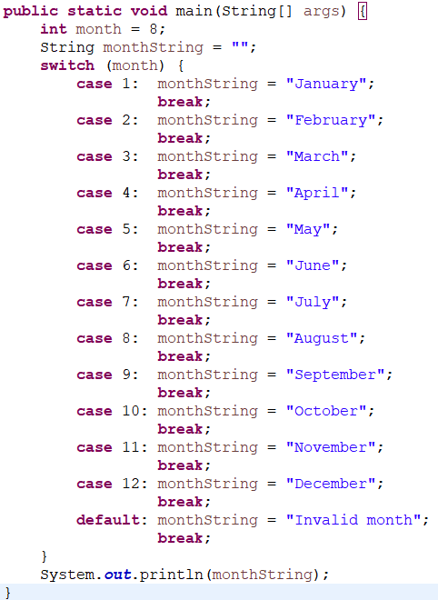
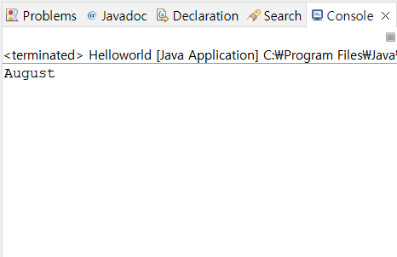
Selection Structures if-else and switch
Switch selection structure
Output

Slide 6
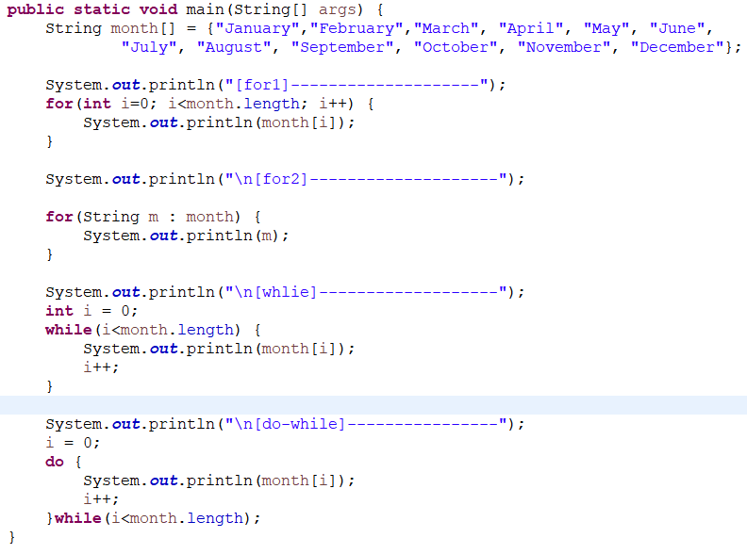
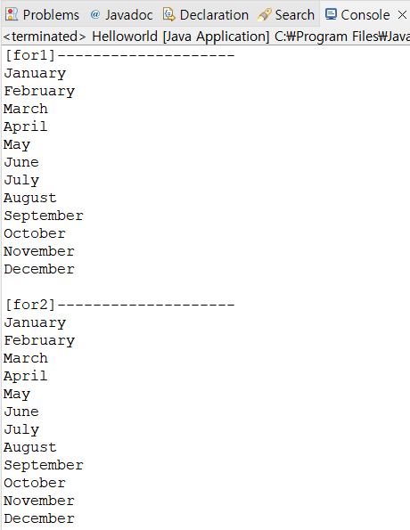
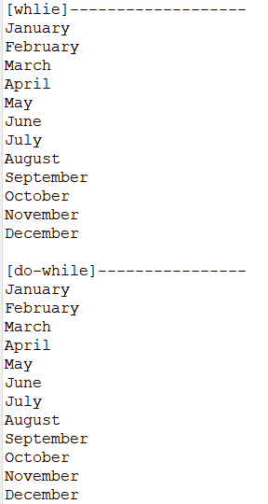
Control Structures for, while & do-while

Slide 7
Scanner Class
System.in : reads data input by the user
: 키보드 장치를 직접 제어하고 키 입력을 받는 표준 입력 스트림 객체
-> Scanner 필요
-> To use System.in, a Java Scanner is used that will get the inputs.
import java.util.Scanner;
Scanner scanner = new Scanner(System.in);
//Create Scanner object
- Scanner는 키 입력을 공백으로 구분된 토큰 단위로 끊어 읽는다.

Slide 8
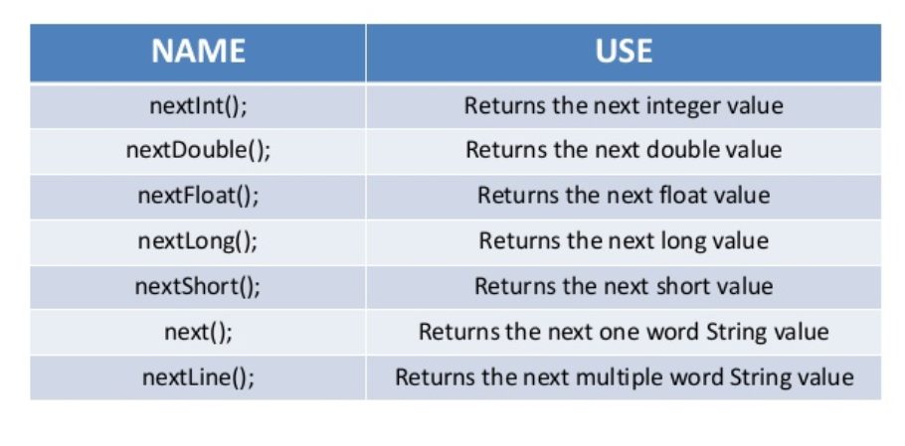
Scanner Methods

Slide 9
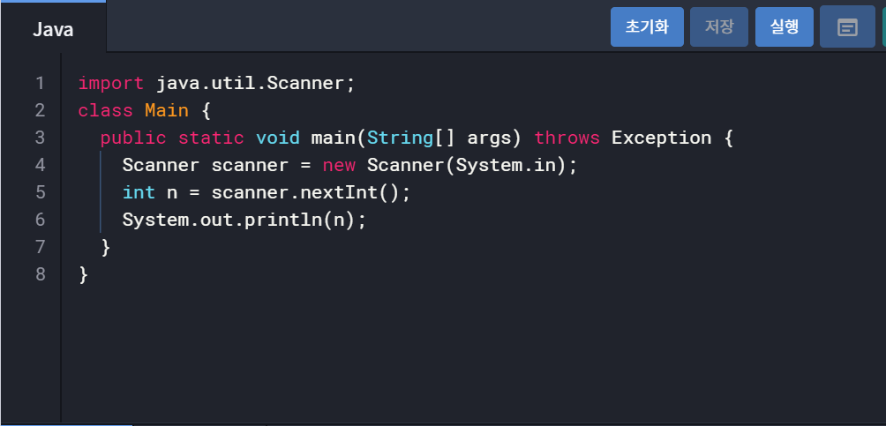
Scanner example

Slide 10
Lab01 Solution
Lab01-01 : Time
Lab01-02 : Prime number
Lab01-03 : Palindrome
Lab01-04 : Calculate the day of the week of future

Slide 11
Lab01-01 : Time
package Lab1;
public class task1 {
public static void main(String[] args) {
int seconds = Integer.parseInt(args[0]);
int second = seconds % 60;
int minute = (seconds / 60) % 60;
int hour = (seconds / 60) / 60;
System.out.println(hour+":"+minute+":"+second);
}
}

Slide 12
Lab01-02 : Prime number
package Lab1;
public class task2 {
static boolean is_prime(int n) {
for(int i=2; i*i<=n; i++) {
if(n%i==0)
return false;
}
return true;
}
public static void main(String[] args) {
int num = Integer.parseInt(args[0]);
for (int i = num; i > 1; i--) {
if(is_prime(i))
System.out.println(i);
}
}
}

Slide 13
Lab01-03 : Palindrome
package Lab1;
public class task3 {
public static void main(String[] args) {
int num = Integer.parseInt(args[0]);
int num_reverse = 0;
for (int i = num; i > 0; i--) {
num_reverse = 0;
for(int j = i; j>0; j/=10) {
num_reverse *= 10;
num_reverse += (j%10);
}
if (num_reverse == i)
System.out.println(num_reverse);
}
}
}

Slide 14
Lab01-04 : Calculate the day of the week of future
package Lab1;
import javax.swing.*;
public class task4 {
public static void main(String[] args) {
String input1 = JOptionPane.showInputDialog("Enter today's day of the week");
String input2 = JOptionPane.showInputDialog("Enter the number of days passed since today");
String[] dayOfWeek= {"Sunday","Monday", "Tuesday", "Wednesday", "Thursday", "Friday", "Saturday"};
int day1 = Integer.parseInt(input1);
int day2 = Integer.parseInt(input2);
JOptionPane.showMessageDialog(null, "Today is "+dayOfWeek[day1]+" and the future day is "+dayOfWeek[(day1+day2)%7]);
System.exit(0);
}
}

Slide 15
Lab02
Lab02-01 : Check password
Lab02-02 : Multiply matrix
Lab02-03 : Decimal to Hexadecimal or Binary
Lab02-04 : Sum of multiples of n under 100

Slide 16
Lab02-01 : Check password
Input a password.
Check whether this password is correct format.
Condition
Length(2~8)
the number of digit and letter is equal to or more than 1.

Slide 17
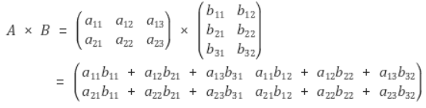
Lab02-02 : Multiply matrix
Input two matrix.
Mat1 = A x B, Mat2 = B x C
Print Mat1 x Mat2

Slide 18
Lab02-03 : Decimal to Hexadecimal or Binary
Input “Hex” or “Bin”.
And input a natural number.
If the first input is “Hex”, change the number to Hexadecimal number.
Hexadecimal -> 0, 1, 2, 3, 4, 5, 6, 7, 8, 9, A, B, C, D, E, F
If the first input is “Bin”, change the number to Binary number.

Slide 19
Lab02-04 : Sum of multiples of n under 100
Input a natural number n.
Print sum of multiples of n under 100.
Ex) if n = 9, print “9 + 18 + 27 + 36 = 90”

