Slide 1
Object-Oriented Programming
2022.10.14 Prof : Muhammad Bilal
Teaching Assistant : Seungpil Choi
Email : csp213@hufs.ac.kr

Slide 2
Contents
Class
Object initialization using the default, parameterized, and copy constructor
Finalize method
System.gc() call and its usage-related task
Inheritance
Lab03 – Three tasks

Slide 3
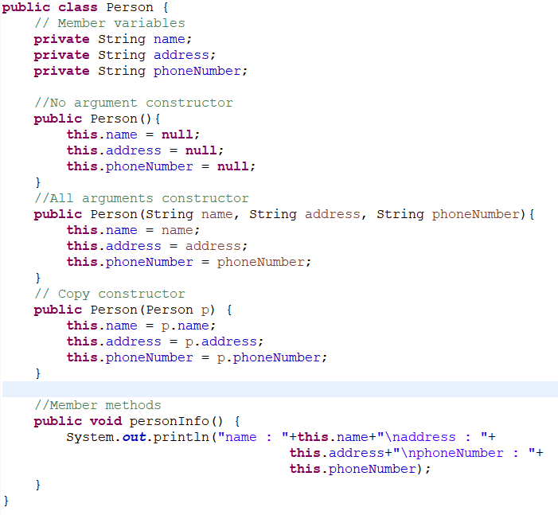
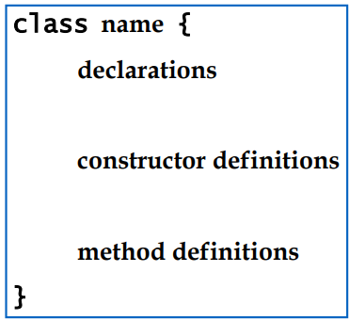
Class
In OOP, a class is an extensible program-code-template for creating objects, providing initial values for state(member variables) and implementations of behavior(member methods). -wikipedia
Example

Slide 4
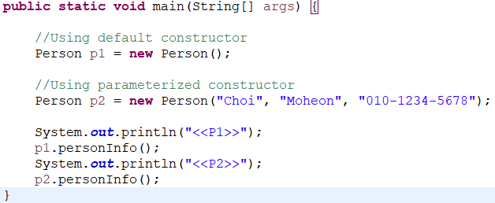
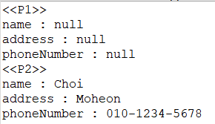
Object initialization using the default, parameterized, and copy constructor
Using the default and parameterized constructor

Slide 5
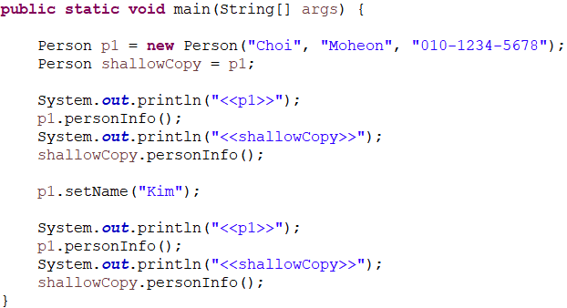
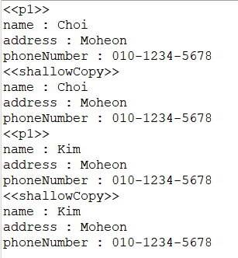
Object initialization using the default, parameterized, and copy constructor
Objects cannot be copied through assignment operation.
shallowCopy and p1 indicate the same object.

Slide 6
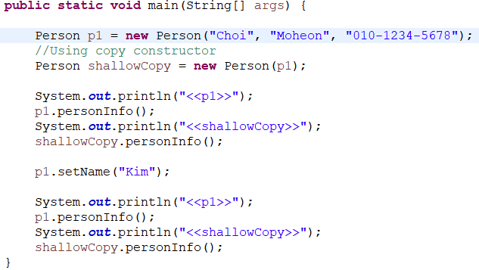
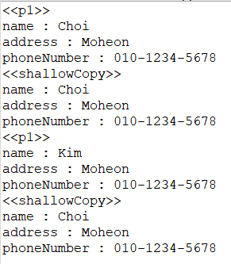
Object initialization using the default, parameterized, and copy constructor
Using the copy constructor

Slide 7
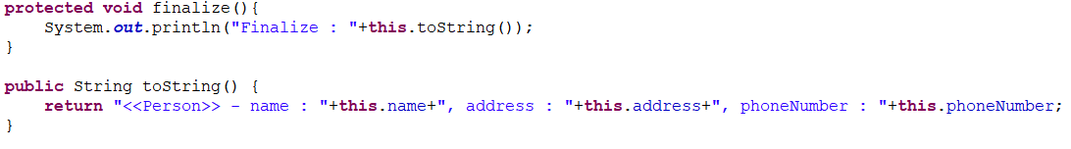
Finalize method
Override Java.lang.Object.finalize
The method is automatically executed when the instance is removed.
A garbage collector reclaims objects in any order or never reclaim them.

Slide 8
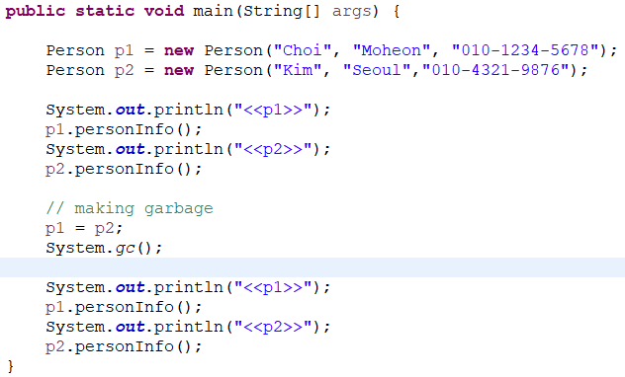
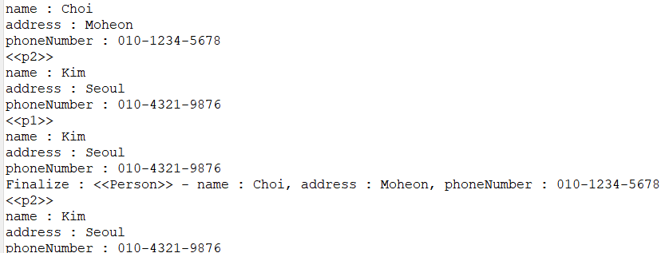
System.gc() call and its usage-related task
System.gc() - Request the JVM to run the garbage collector

Slide 9
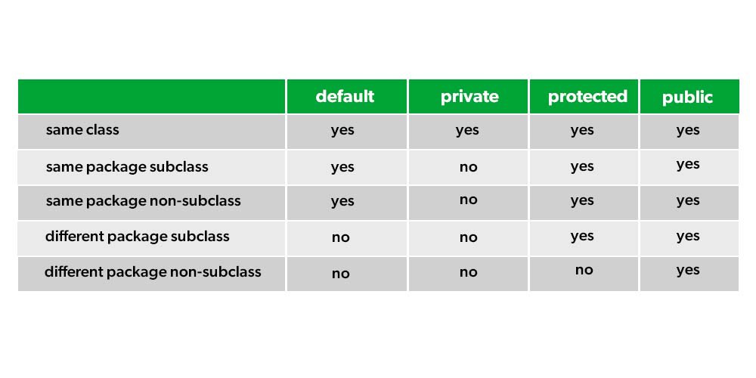
Inheritance
Access modifier

Slide 10
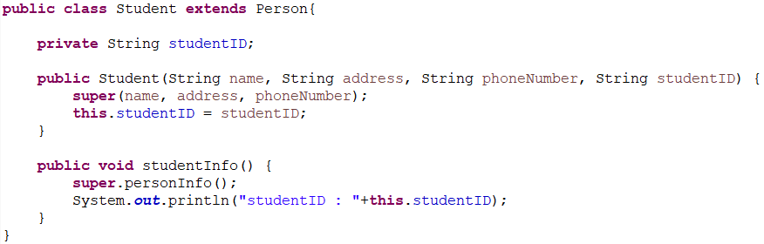
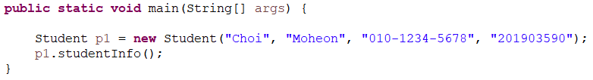

Inheritance
Use extends keyword for inheritance.
Parent’s method is used through super keyword.

Slide 11
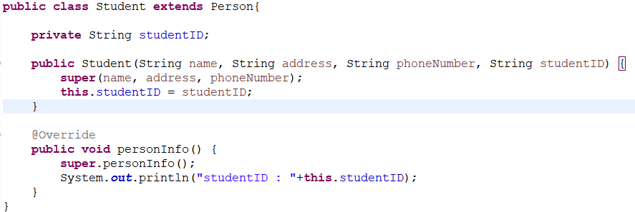


Inheritance
Method overriding is used by redefining parent’s methods in a child class.

Slide 12
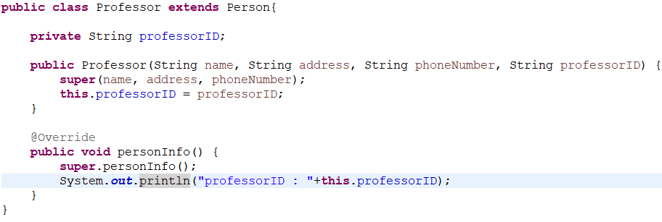
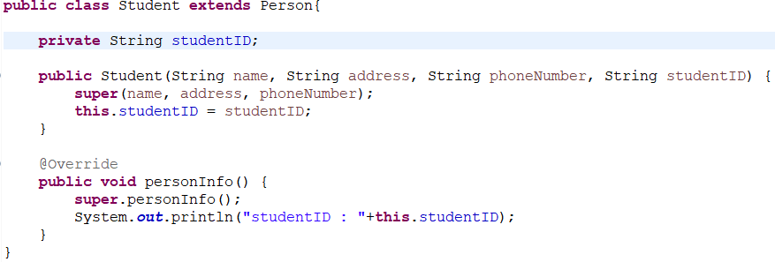
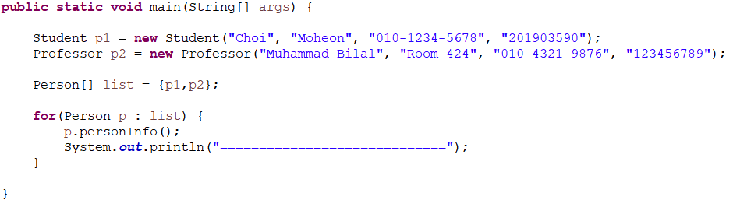
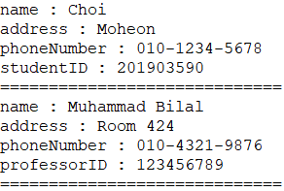
Inheritance - polymorphism

Slide 13
Lab03
Lab03-01 : Shape area
Lab03-02 : GPA
Lab03-03 : Movie reservation

Slide 14

Lab03-01 : Shape area
Input n(number of shapes).
Input n shapes. ex) “triangle 3 4 5 rectangle 4 3 circle 5”
Input a shape number to print.
0=triangle, 1=rectangle, 2=circle, 3=all shapes.
Print the shape’s area corresponding the shape number.
Round triangles and circles to two decimal places.
instanceof keyword
if(A instanceof B) -> Checking whether object A is class B.
Triangle area -> s = (a+b+c) / 2,

Slide 15
Lab03-02 : GPA
Input n(number of students).
Input student name and five subjects(subject name, score, credit) per student.
Ex) “Choi
algorithm A+ 3
OOP D 2
ComputerProgramming B+ 3
OS C+ 2
WebProgramming A 2”
Print all student’s name and GPA.
GPA calculation – sum of (score x credit) ÷ sum of credit
Score : A+ = 4.5, A = 4.0, B+ = 3.5, B = 3.0, C+ = 2.5, C = 2.0, D+ = 1.5, D = 1.0, F = 0
Round GPA to two decimal places.

Slide 16
Lab03-03 : Movie reservation
Input n number(number of customers).
Movie number : 0=Avatar, 1=TopGun, 2=Avengers
The movie price is 15000\.
There are three discount policies :
0=Credit card discount(20%), 1=Time discount(15%), 2=Coupon(10%), -1=nothing(0%)
Input customer’s name, movie number and a discount policy.
Ex) “Choi 0 1 Kim 1 0 Jang 2 1 Hwang 1 2 Shin 1 1”
Print customer name, movie name and movie price.

