Slide 1
Object-Oriented Programming
2022.10.28 Prof : Muhammad Bilal
Teaching Assistant : Seungpil Choi
Email : csp213@hufs.ac.kr

Slide 2
Contents
Type casting
ArrayList
HashMap
Lab04 – Four tasks

Slide 3
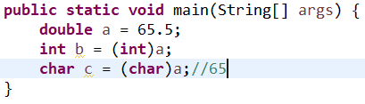
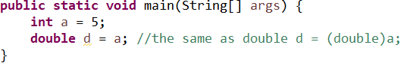
Type casting in primitive type.
Explicit type-casting
Primitive types can do type-casting each other except boolean type.
Implicit type-casting

Slide 4
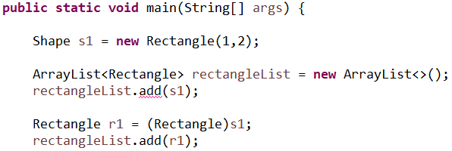
Type casting in Class.
Up-casting
Down-casting
Up-casting must be preceded first.
Error

Slide 5
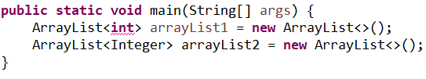
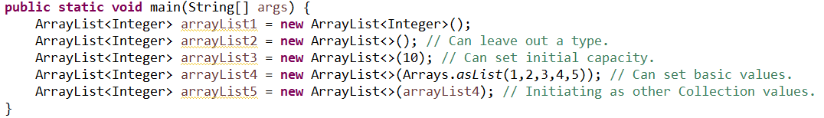
ArrayList
Array’s size is static, but ArrayList’s size is dynamic.
ArrayList cannot have primitive types.
Declaration

Slide 6
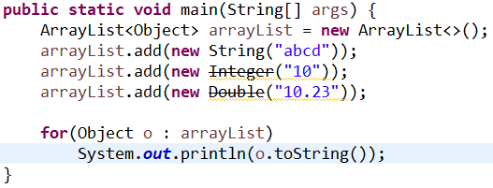

ArrayList
Implicit upcasting

Slide 7
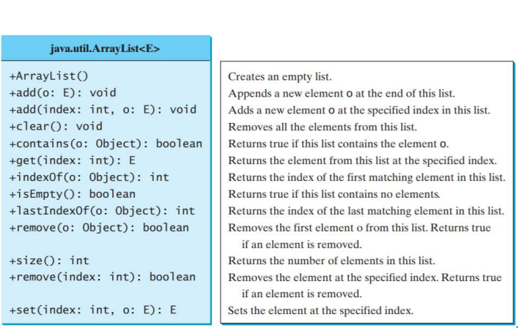
ArrayList
Methods

Slide 8
HashMap
Stores key & value in pair form.
When storing data, the result of a hash function is used to determine where to store it.
So HashMap is fast, because we immediately know the specific data location from hash function.
Cannot contain duplicate keys.
Keys and Values are stored as Objects(not primitive types).
Order of data is not constant.

Slide 9
HashMap - Methods
Methods | Description
HashMap() | Creates an empty HashMap.
void clear() | Returns the number of key-value mappings in this map.
Object clone() | Returns a shallow copy of this HashMap instance: the keys and values themselves are not cloned.
Object put(Object key, Object value) | Associates the specified value with the specified key in this map. If the map previously contained a mapping for the key, the old value is replaced.
Object remove(Object key) | Removes the mapping for the specified key from this map if present.
Object get(Object key) | Returns the value to which the specified key is mapped, or null if this map contains no mapping for the key.
Object replace(Object key, Object value) | Replaces the entry for the specified key only if it is currently mapped to some value.
int size() | Returns the number of key-value mappings in this map.
Collection keySet() | Returns a Set view of the keys contained in this map.
Collection values() | Returns a Collection view of the values contained in this map.
Boolean isEmpty() | Removes all of the mappings from this map. The map will be empty after this call returns.

Slide 10
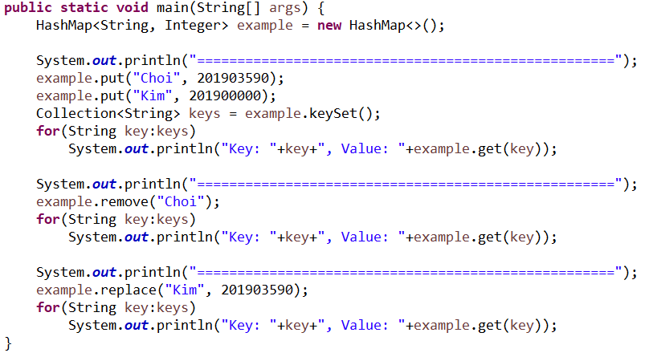
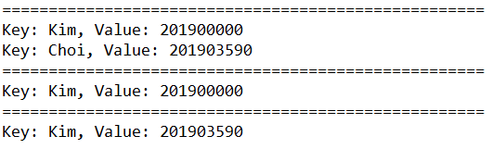
HashMap - example
Result =>

Slide 11
Lab04
Lab04-01 : Print the number that is more than half
Lab04-02 : Salary
Lab04-03 : Class with the highest average score
Lab04-04 : Phone book

Slide 12
Lab04-01 : Print the number that is more than half.
Input 10 integer numbers.
Print the number that is more than half.
Example
input: “1, 1, 3, 4, 1, 1, 4, 5, 1, 1”, output: 1
input: “1, 1, 3, 4, 1, 1, 4, 5, 3, 1”, output: “There is no the number that is more than half.”

Slide 13
Lab04-02 : Salary
Input n(the number of employees)
Input n employees.
Input: name, salary, department number.
Print the department number that is the highest average salary.
There is only one department with the highest average salary.

Slide 14
Lab04-03 : Class with the highest average score
Input n (the number of students)
Input n students and their Math, Science, English score.
Input: name, class name, Math score, Science score, English score.
Input a subject number
0 = Math, 1 = Science, 2 = English
Print the class with the highest average score corresponding the subject number.
There is only one class with the highest average score.

Slide 15
Lab04-04 : Phone book
Make functions for create, read, update, delete about phone book.
0=create – if create is successful, print “create”. If the data already exists, print “Already exist name.”
Input: name, phone number
1=read – print the specific data in phone book. If there is no data, print “Not found.”
Input: name
2=update – if update is successful, print “update”. If there is no data, print “Not found.”
Input: name, phone number
3=delete – if delete is successful, print “delete”. If there is no data, print “Not found.”
Input: name
-1=exit

