Slide 1
Object-Oriented Programming
2022.11.04 Prof : Muhammad Bilal
Teaching Assistant : Seungpil Choi
Email : csp213@hufs.ac.kr

Slide 2
Contents
Intro to Exception
Java Exceptions Handling
Lab05 – Three tasks

Slide 3
Intro to Exception
Types of Programming Errors
Syntax Errors: arise because the rules of the language are not followed.
Logic Errors: arise because the program does perform the way it was intended to.
Runtime Errors: arise because the program tries to perform an operation that is impossible to carry out.
Runtime Errors cause Exceptions and may be handled at runtime.

Slide 4
Intro to Exception - Exceptions
An exception is an event that describes an unusual or erroneous situation at runtime.
Exceptions are wrapped up as objects.
Why Use Exceptions?
Uses of exception handling.
Process exceptions from program components
Handle exceptions in a uniform manner in large projects
Remove error-handling code from “main line” of execution

Slide 5
Intro to Exception – Two types of exceptions
Checked Exception - ex) IOException, SQLException, etc.
Must be explicitly caught or declared in a throws clause.
Unchecked Exception - ex) NullPointerException, IllegalArgumentException, etc.
Not need to be caught or declared in a throws clause.
In most cases, unchecked exceptions reflect programming logic errors that are not recoverable.
For example, a NullPointerException is thrown if you access an object through a reference variable before an object is assigned to it.

Slide 6
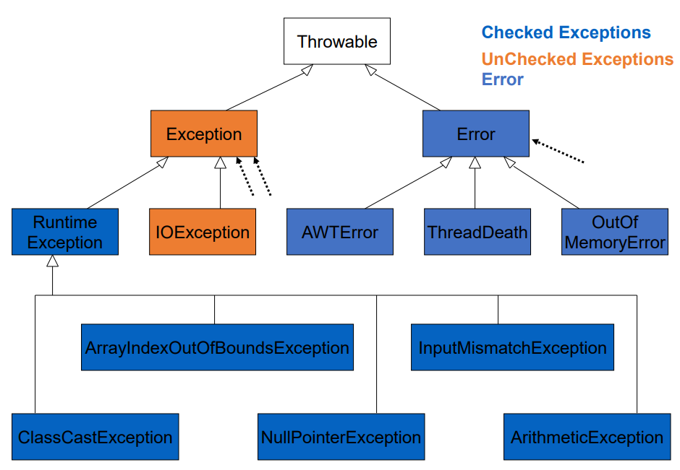
Intro to Exception – Two types of exceptions

Slide 7
Java Exceptions Handling
Try-catch-finally
The try statement defines the code block to run.
The catch statement defines a code block to handle any error.
The finally statement defines a code block to run regardless of the result
throw-throws
The throw keyword is used to occur Exception.
The throws keyword is used to throw an exception to superior methods.

Slide 8
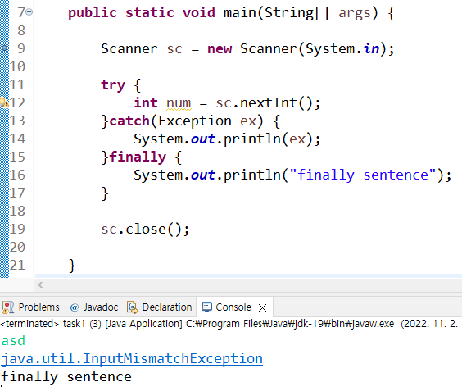
Java Exceptions Handling – Try-catch-finally

Slide 9
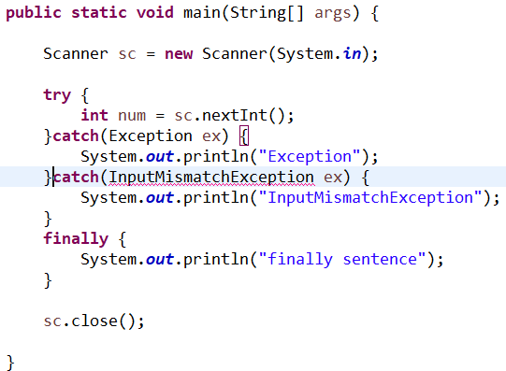
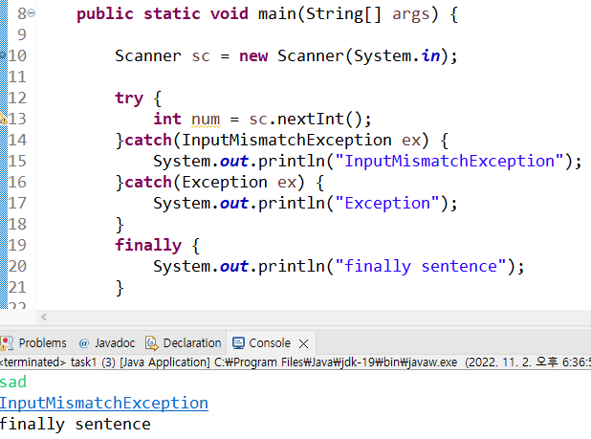
Java Exceptions Handling – Try-catch-finally
The Exception class is the base class of all exceptions
Unreachable catch block

Slide 10
Java Exceptions Handling - The throws clause
Method doesn’t want to handle exception itself.
It throws the exception.
the caller should handle this exception or throws the exception itself.
A method should specify the exceptions it throws by placing a throws clause after the parameter list.

Slide 11
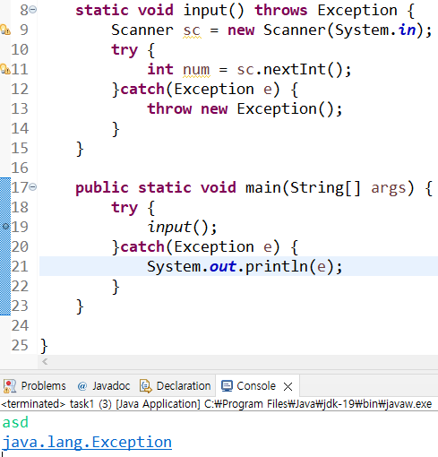
Java Exceptions Handling - The throws clause

Slide 12
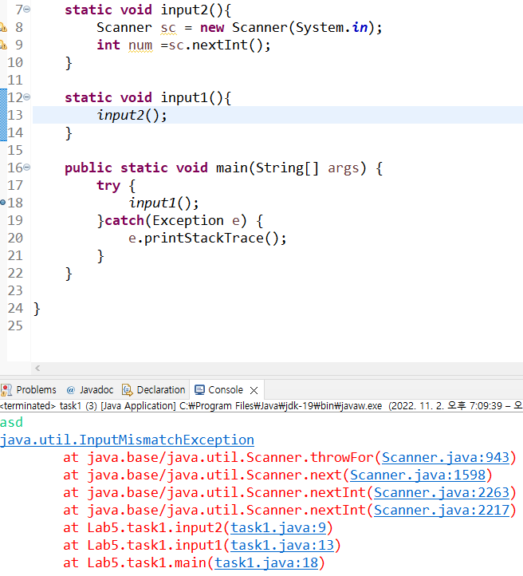
Java Exceptions Handling - The throws clause
When dealing with exceptions
Especially when debugging
printStackTrace() will:
Show you the full calling history
With line numbers
What if main() also throw the exception?
It is the same as not handling an exception.

Slide 13
Lab05
Lab05-01 : Exception handling – Phone book
Lab05-02 : Exception handling – Check password
Lab05-03 : Exception handling – Bank
Notes:
이제 과제설명드리겠습니다. 과제는 총4개입니다.

Slide 14
Lab05-01 : Exception handling – Phone book
Write catch sentence for create, read, update, delete about phone book.
0=create – if create is successful, print “create”. If the data already exists, print “Already exist name.”
Input: name, phone number
1=read – print the specific data in phone book. If there is no data, print “Not found.”
Input: name
2=update – if update is successful, print “update”. If there is no data, print “Not found.”
Input: name, phone number
3=delete – if delete is successful, print “delete”. If there is no data, print “Not found.”
Input: name
-1=exit

Slide 15
Lab05-02 : Exception handling – Check password
Write isValid method in LoginSystem and catch sentence in main class.
Input n (number of users)
Input n users
Input: username, password
Check whether this password is correct format and there is no same username.
Password Condition
Length(2~8)
The number of digit and letter is equal to or more than 1.
If create is successful, print “Create success.”
If create is failed, print “Create fail.”

Slide 16
Lab05-03 : Exception handling – Bank
Write catch sentence for withdraw method about bank.
Input a type
0=deposit
Input: money
1=withdraw
Input: money
2=print balance
-1=exit
If the balance is lack, print “lack of balance”.

