Slide 1
Fashion Classification
Seungju Han, Cameron Meziere

Slide 2
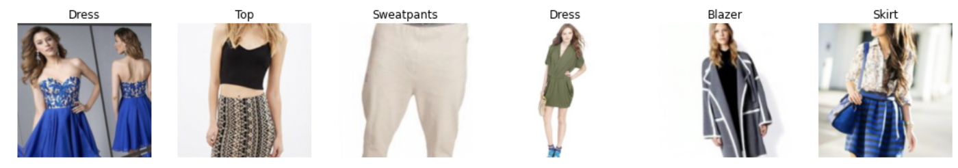
The Goal
Classify Type of clothing from an image as shown below

Slide 3
Data
Source:
DeepFashion: Attribute Prediction
Multimedia Laboratory, The Chineses University of Hong Kong
Size:
289,222 images
46 clothing categories
6GB

Slide 4
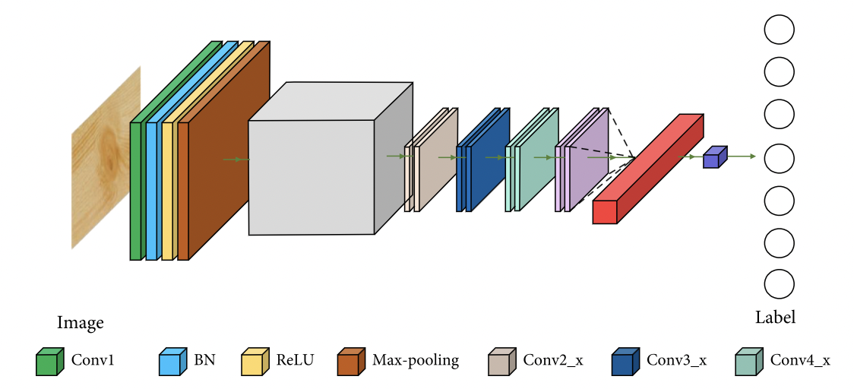
What We Did
Transfer Learning using Pre-trained ResNet18 model
Partially Frozen
Replace Classification layer with our Linear Classification layer
Train model on small data (~2,200 images with 8 classes) to test
Train on ~250,000 images to predict 46 different classes for final model using GPU

Slide 5
What Didn’t Go Well
Loading Data From AWS S3
Half of training time is loading images from AWS S3
AWS Access Keys would get blocked
Augmentations
Albumentations package wouldn’t load on Google Colab for full model
Training
Training even with a GPU takes ~9 hours per epoch (full dataset)
Run out of Google Colab GPU allocation after 1 epoch

Slide 6
What Went Well
Trained on full set of data and got an validation accuracy about 50% for 46 classes
Relatively high accuracy for so many categories & 1 epoch
The highest accuracy we could find for someone’s model using this dataset was 62%

Slide 7
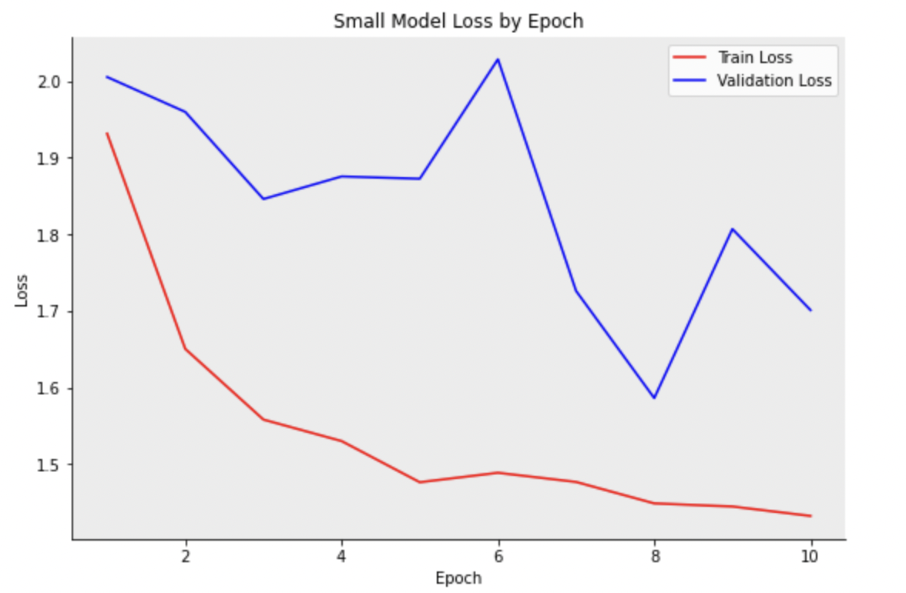
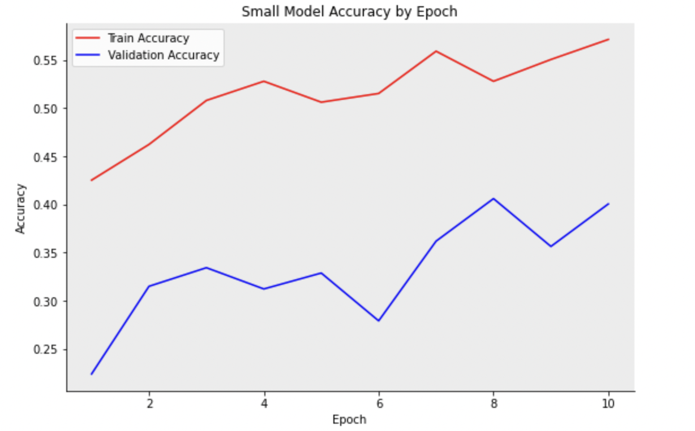
Performance
Full Model: ~50% Validation Accuracy

Slide 8
Thank You!

