Slide 1
owners
id (PK) firstName lastName address city telephone
pets
id (PK) name birth_data type_id (FK) owner_id (FK)
types
id (PK) name
다대일
- Pet이 없는 type이 있을 수 있다
visits
id (PK) visit_date description pet_id (FK)
일대다
- Pet이 없는 owner가 있을 수 있다
일대다
- 방문한 적이 없는 pet이 있을 수 있다

Slide 2
[객체 연관관계]
Owner
id (PK) firstName lastName address city telephone List<pet> pets
Pet
id (PK) name birthDate type Set<Visit> visits
0…*
연관관계 매핑
[테이블 연관관계]
owners
id (PK) firstName lastName address city telephone
pets
id (PK) name birth_date type_id (FK) owner_id (FK)

Slide 3
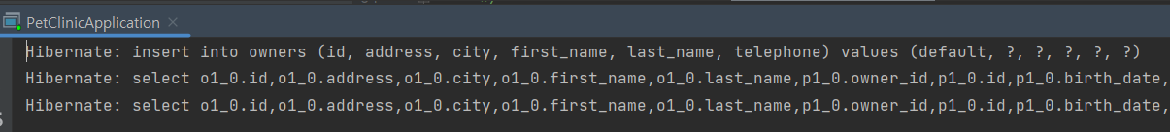
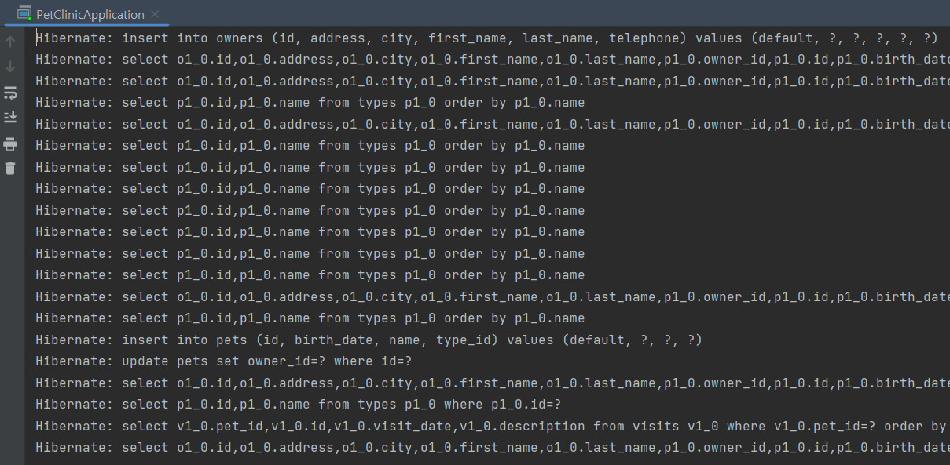

Slide 4
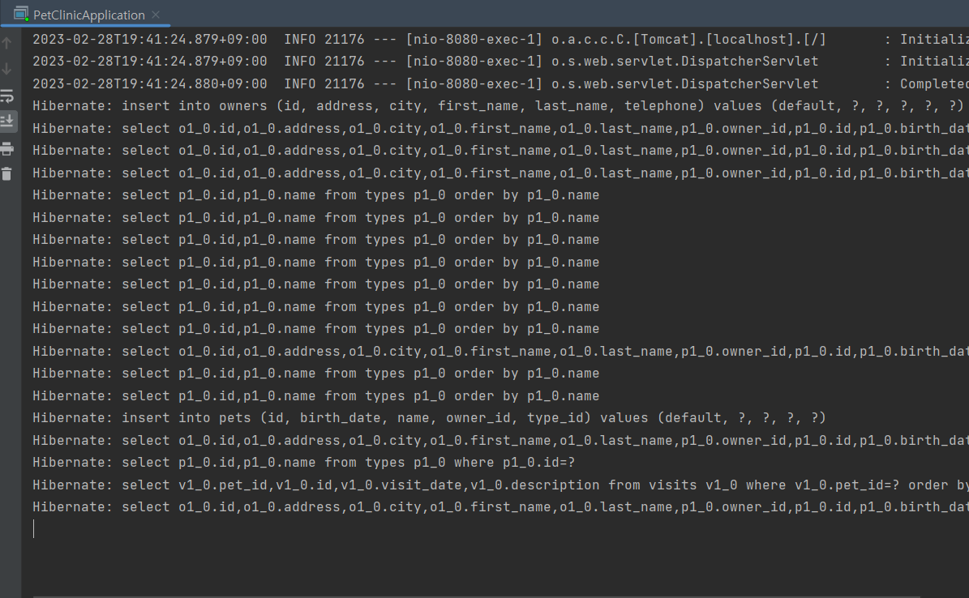
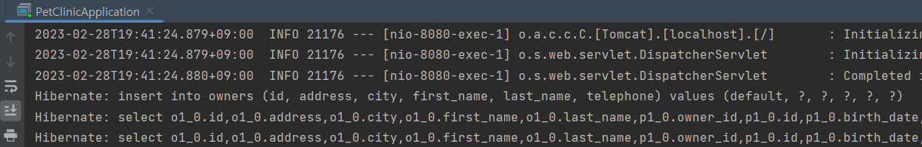

Slide 5
[객체 연관관계]
Owner
id (PK) firstName lastName address city telephone List<pet> pets
Pet
id (PK) name birthDate type Set<Visit> visits Owner owner
0…*
1
연관관계 매핑
[테이블 연관관계]
owners
id (PK) firstName lastName address city telephone
pets
id (PK) name birth_date type_id (FK) owner_id (FK)

