Slide 1

EXCIGENT WEBSITE
CONTENT STRUCTURE

Slide 2



BRAND GUIDE
Primary logo | Secondary icon | Secondary icon with stem
Use for proposals, reports, presentations, website headers, and formal sales materials. | Use for favicon, social avatar, profile mark, section divider, or compact merch applications. | Use where the full stem detail is desired and vertical space is available.
Alternate Gothic ATF is the official typeface used in the Excigent logo artwork.

Slide 3
BRAND GUIDE
Use | Primary recommendation | Notes / fallback
Logo / custom artwork | Alternate Gothic ATF | Reserved for logo files and designer-built branded treatments
Headlines in documents | Aptos Bold | Fallback office-safe standard for Word and PowerPoint
Subheads | Aptos SemiBold | Clean and readable for structured business content
Body copy | Aptos Regular | Use 10–11 pt in documents and proposals
Data tables / forms | Aptos 9–10 pt | Keep tables clean and highly legible
Swatch | Name | HEX | RGB | Recommended use
 | Primary Blue | #0061B3 | 0, 97, 179 | Icon, descriptor line, emphasis, section identifiers
 | Deep Navy | #004569 | 0, 69, 105 | Wordmark, titles, anchor color
 | Light Blue | #B8DBFF | 184, 219, 255 | Highlight shapes, soft accents
 | Soft Tint | #EAF3FB | 234, 243, 251 | Panels, background fields, callouts

Slide 4
WEBSITE STRUCTURE
HOME
About us
Who we are
Why companies engage us
Territories/Markets
Interactive map to highlight coverage
How is done
Leadership
Services
Channel & Business development
Market positioning
Marketing, visibility and support
Products/Partners
Media/Press
Where to find us (upcoming events)
Blogs
Videos/Photos
Interviews
Connect with us
Phone #
Location
Email
Social media

Slide 5
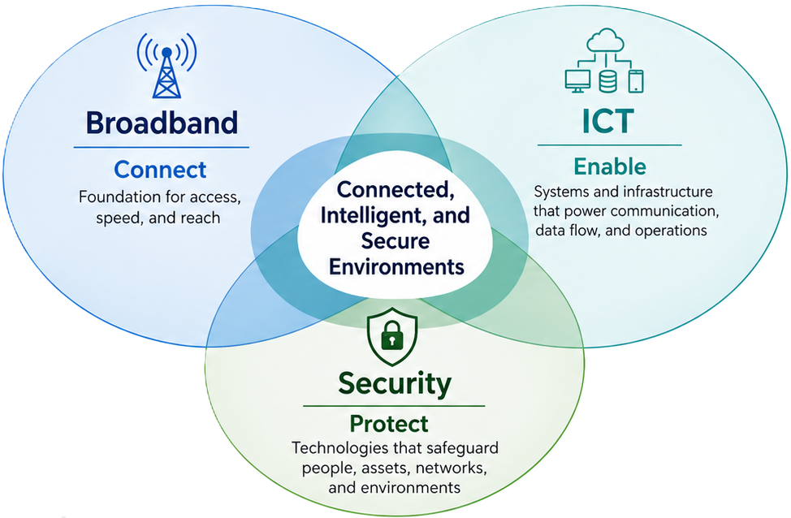
WEBSITE STRUCTURE - HOME
Next-Generation Technology Leadership
-Carrousel with upcoming events
-Brief overview of what Excigent does
-Sign up for communications
-Full name
-email

Slide 6
WEBSITE STRUCTURE – ABOUT US
WHO WE ARE: “Excigent Tech Partners is a commercial agency and market development partner helping innovative companies expand across North America, Latin America, and the Caribbean through strategy, channel development, market positioning, and disciplined commercial execution.”
WHY COMPANIES ENGAGE US:
Commercial agency and market development focus​
Senior leadership experience across broadband, ICT, and security​
Channel-building orientation, not just transactional representation​
Cross-border market engagement capability across North America, Latin America, and the Caribbean​
Bilingual English- and Spanish-language capability to support cross-border engagement​
Partner-driven model that expands technical and commercial capability​
Disciplined execution supported by market insight and strong industry relationships

Slide 7
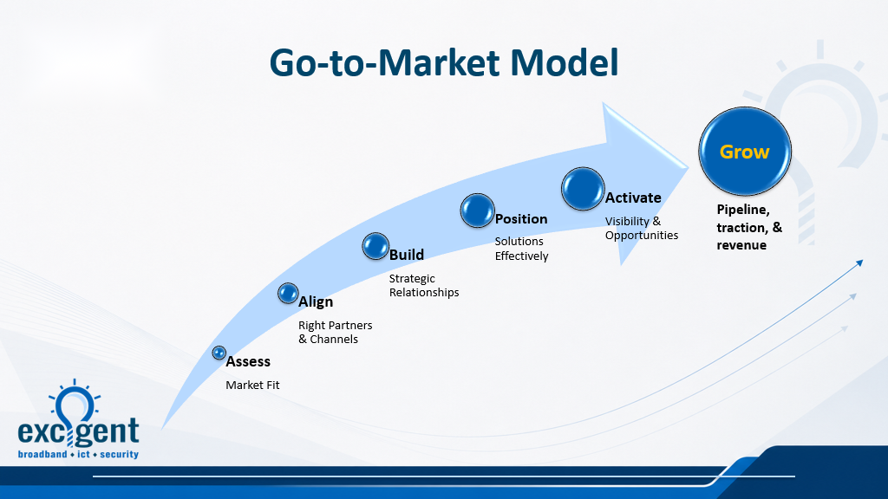
WEBSITE STRUCTURE – ABOUT US
HOW IS DONE:
LEADERSHIP:
Robert Lopez, Broadband engineering and design leader with 20+ years of experience supporting major network deployments and delivering construction-ready infrastructure solutions.​
Paul Weintraub, RCDD, RTPM, ESS, TECH, Digital infrastructure leader with 30+ years of experience across broadband, ICT, data center, security, and communications markets.​
John Centofanti, Security industry leader with 30+ years of experience in sales, business development, and program leadership across commercial and public-sector markets.
Include headshots

Slide 8
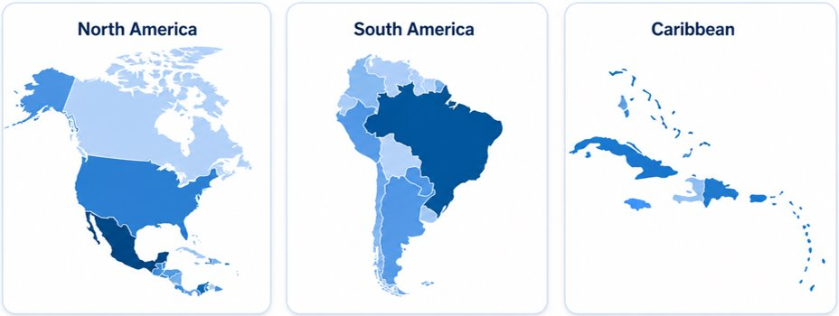
WEBSITE STRUCTURE – TERRITORIES/MARKETS
Interactive map highlighting coverage

Slide 9
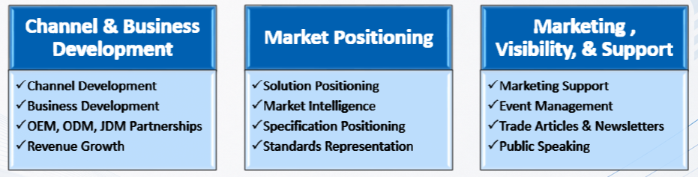
WEBSITE STRUCTURE - SERVICES
“We help principals establish channels, position solutions effectively, and expand visibility through disciplined commercial and market development support.”

Slide 10
WEBSITE STRUCTURE
MEDIA/PRESS
Upcoming events
Blogs
Videos
Photos
interview
CONNECT WITH US
Phone #
Email
Social media icons

