Slide 1
Slab #1

Slide 2
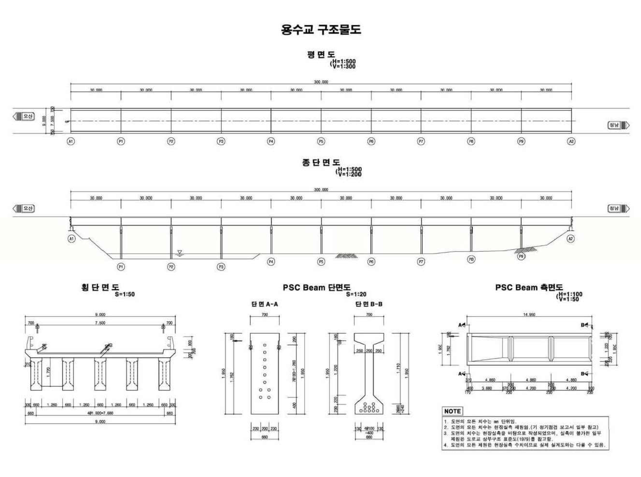
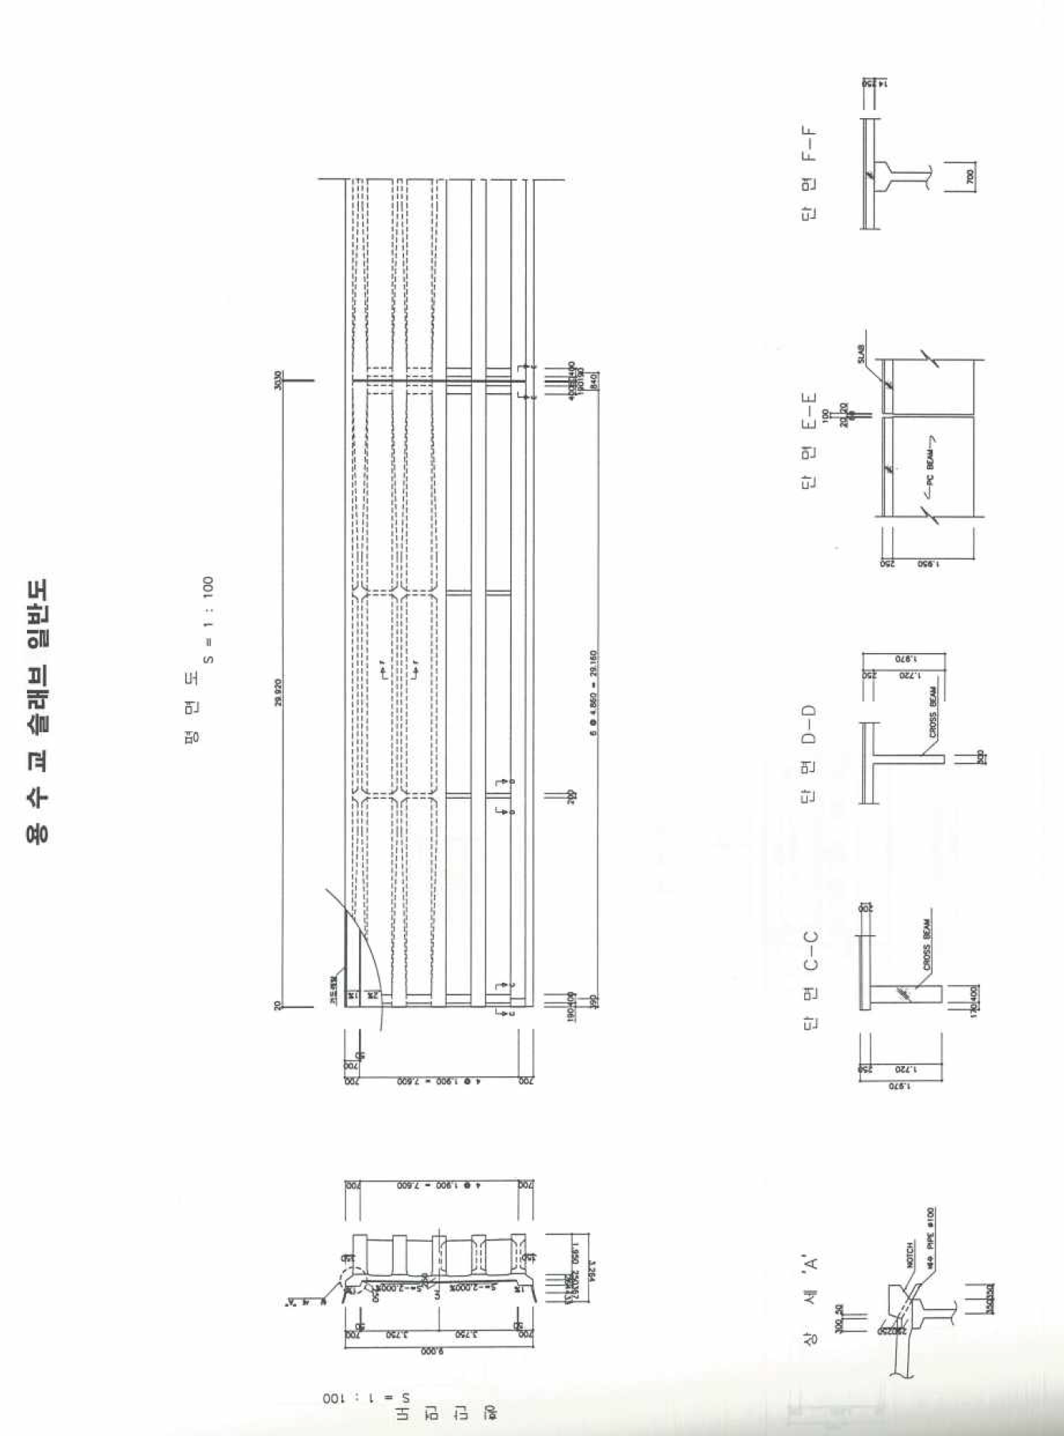

Slide 3
30,000 (30 m) = 2,400@2 + 25,200
(unit: mm)
(1)
(2)
(3)
(4)
(5)
(6)
(7)
(8)
(9)
(10)
(11)
(12)
GFRP 광섬유센서
(FBG + BOCDA)
25,200=1,800@11EA(# 센서 간격)
2,400
FBG 센서
2,400
30,000
(Unit: mm)
DISP 1
DISP 1
1,900
DISP 2
FBG1, BOCDA1
DISP 2
9,000
DISP 3
DISP 4
DISP 5
DISP 3, 4, 5
DISP 6
FBG2, BOCDA2
DISP 6
DISP 7
DISP 7
Expansion Joint
7,500
화성
15,000
오산
22,500
DISP 3
DISP 1, 2,4, 6, 7
DISP 5

Slide 4
(Unit: mm)
30,000
750
950
3,750
LC1
LC2
LC3
1,855
9,000
LC7
1,890
3,750
LC5
1,855
950
750
29,950
7,500
화성
15,000
오산
22,500

Slide 5
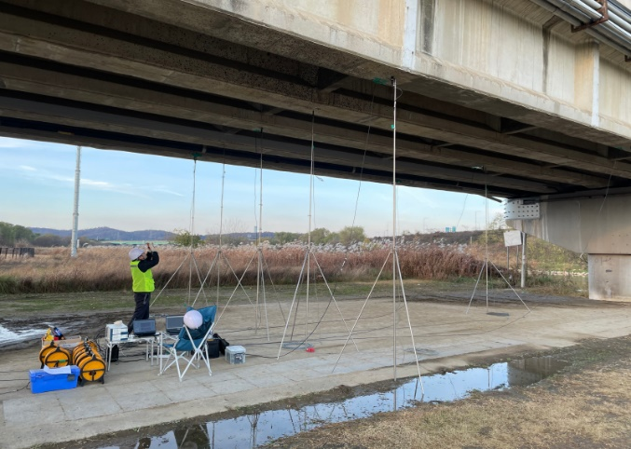
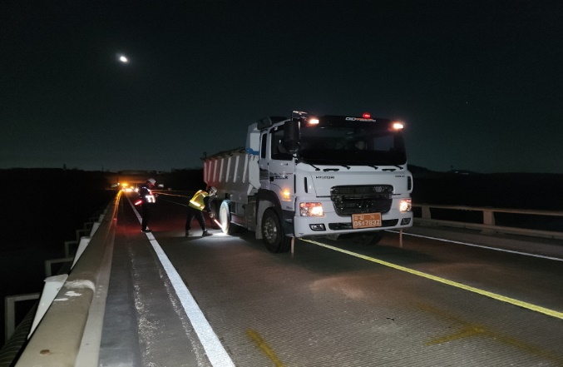
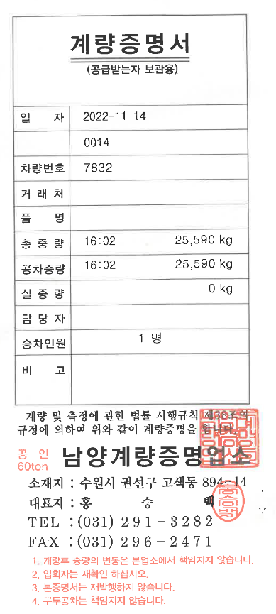
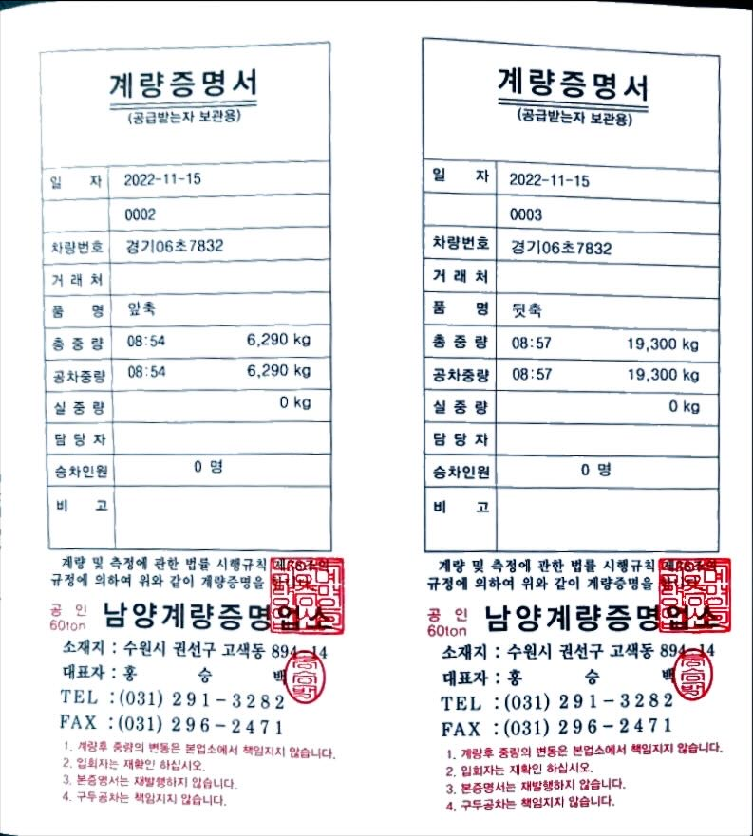
총중량
1축
2축+3축
변위계 설치
재하시험
1축 | 2축 | 3축 | 총중량 | 단위
6.29 | 9.65 | 9.65 | 25.59 | Ton
61.6 | 94.6 | 94.6 | 250.8 | kN (9.8kN/Ton)

Slide 6
30,000
750
(Unit: mm)
950
3,750
LC1
LC2
1,855
9,000
LC4
1,890
3,750
LC3
1,855
950
750

Slide 7
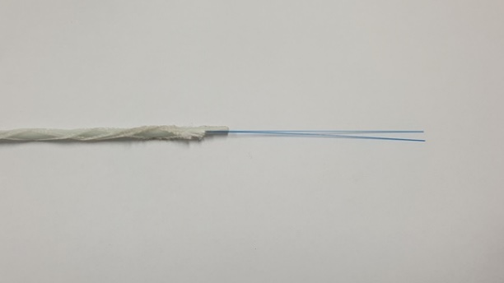
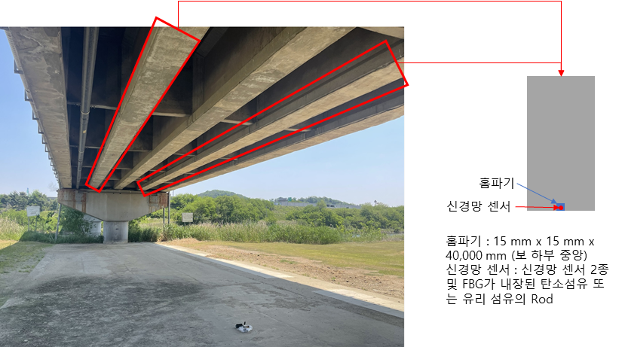
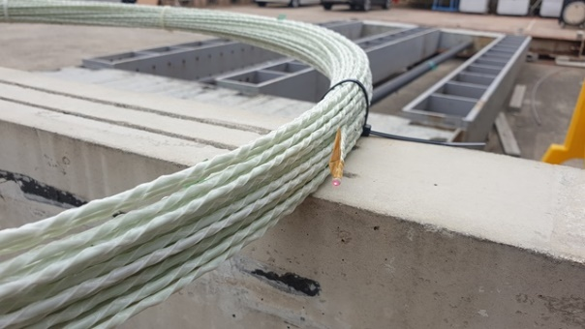
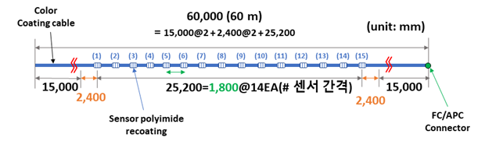
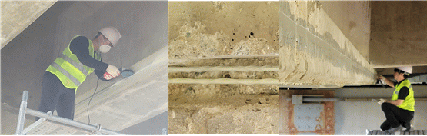

Slide 8
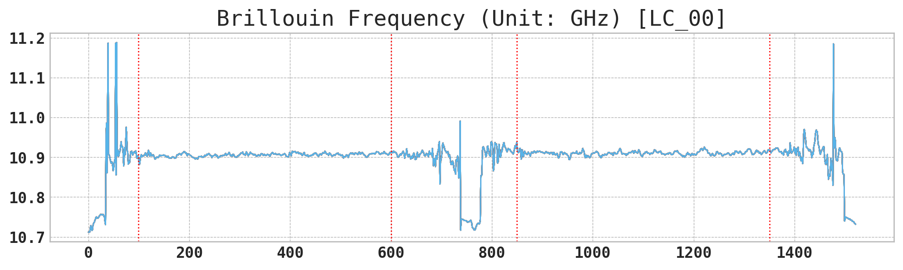
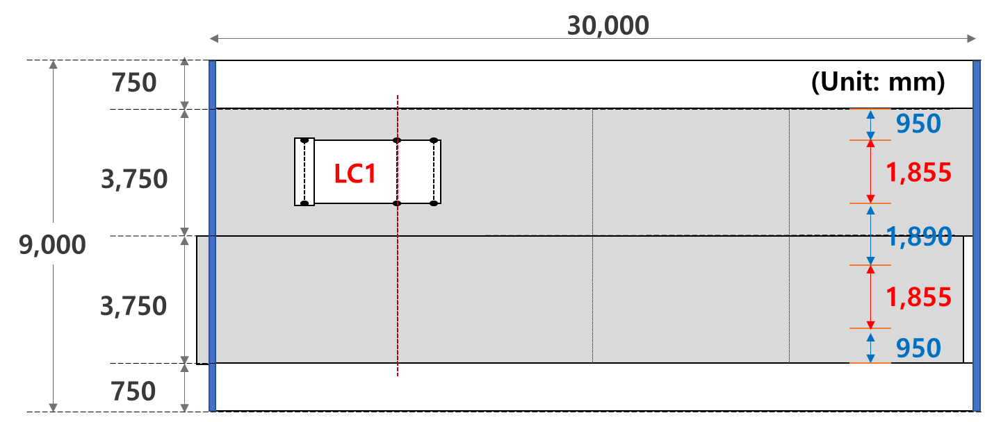
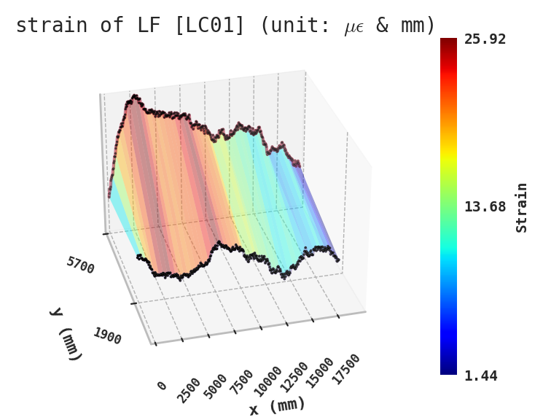
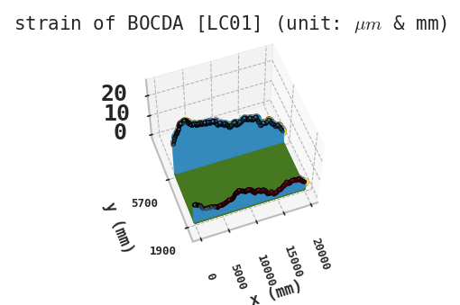
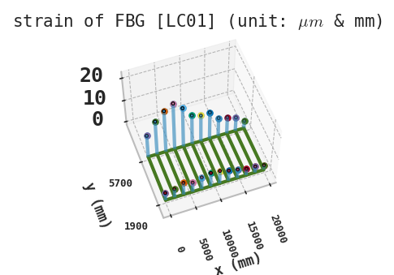

Slide 9
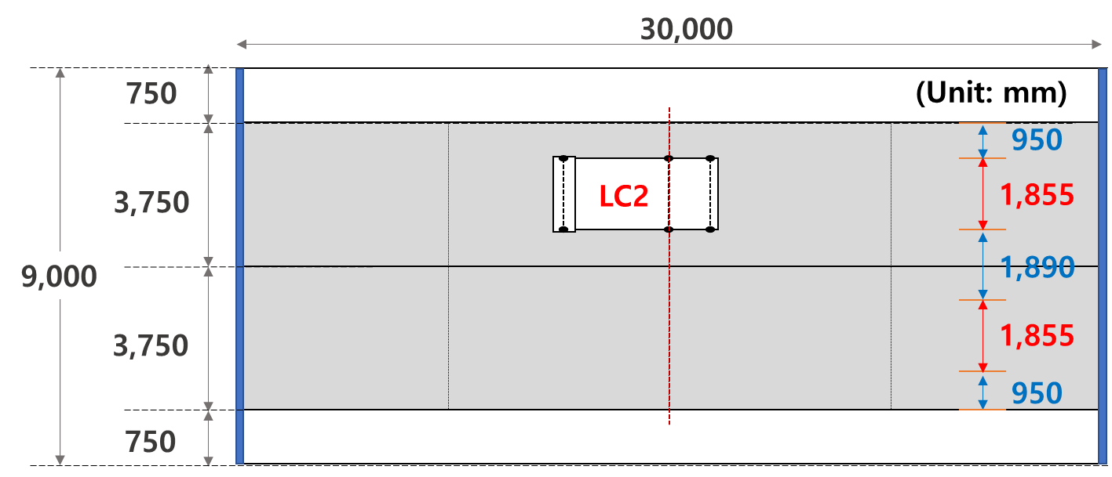
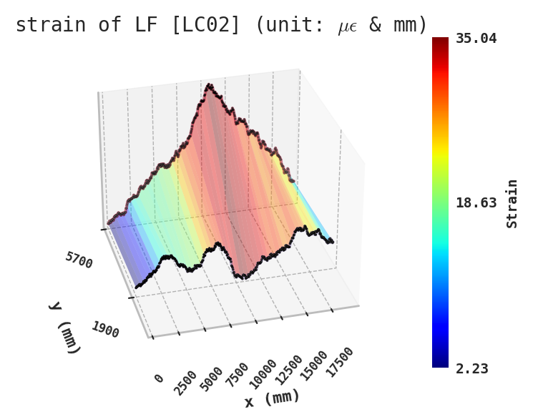
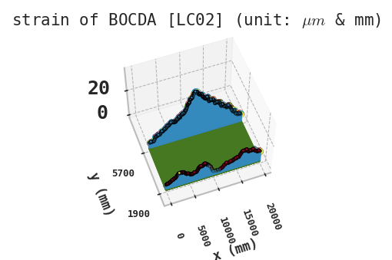
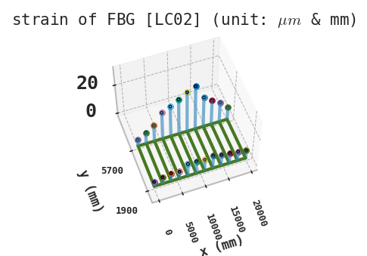

Slide 10
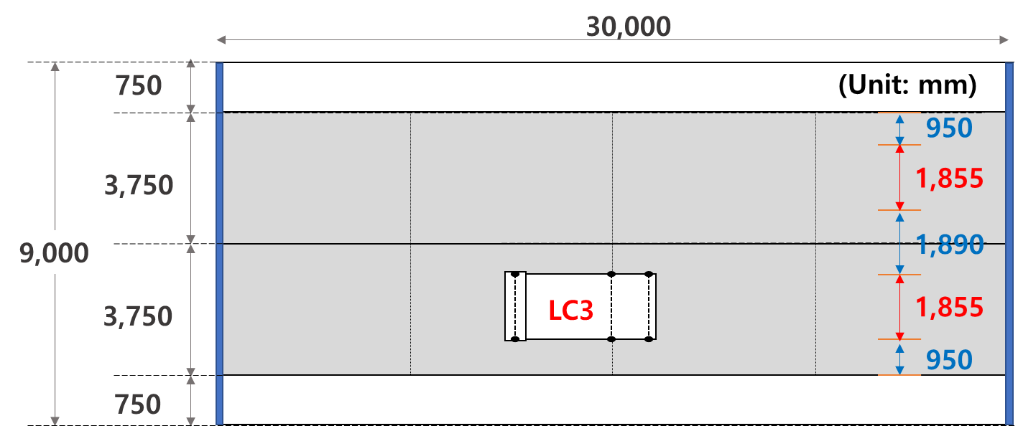
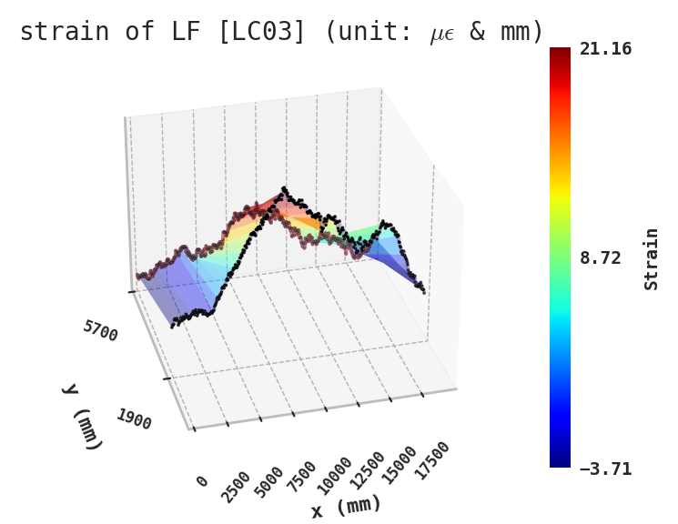
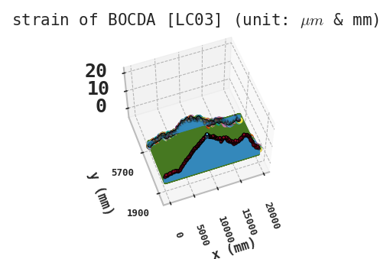
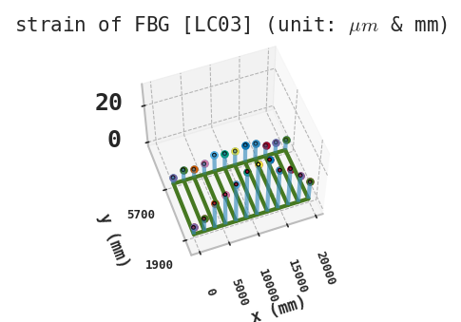

Slide 11
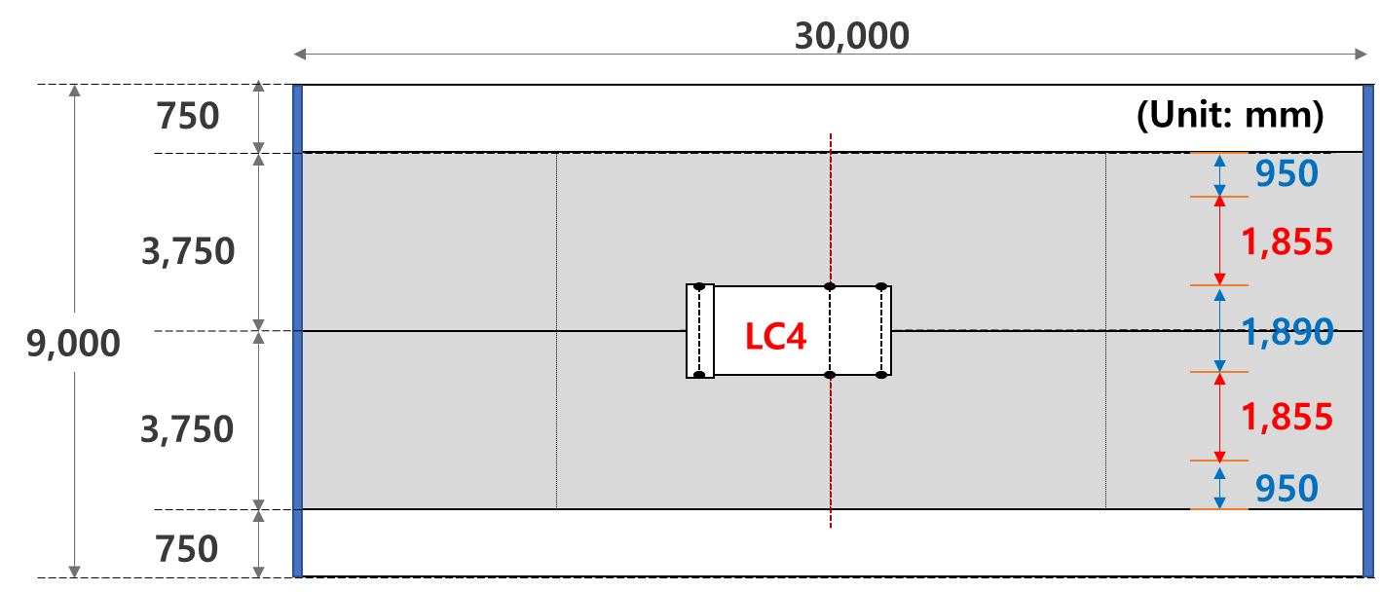
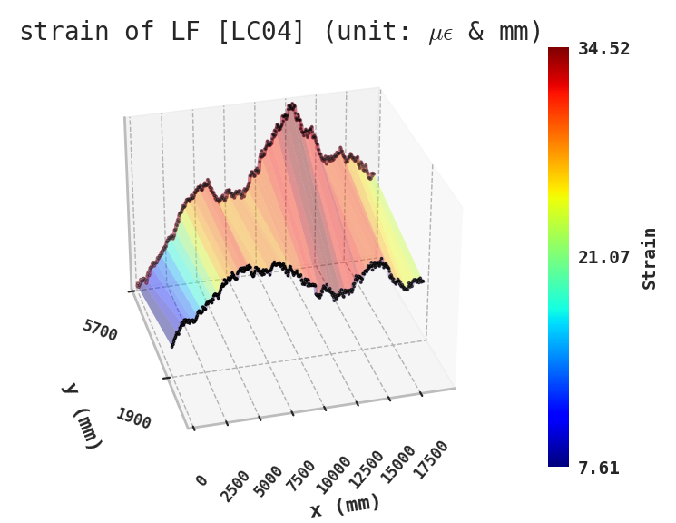
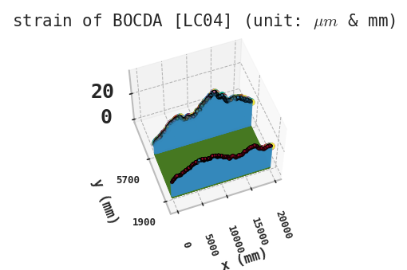
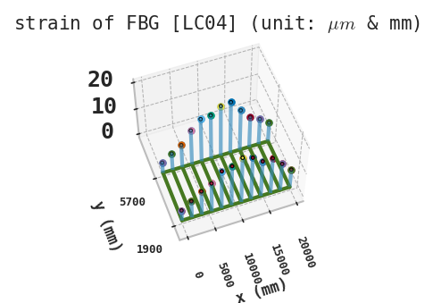

Slide 12
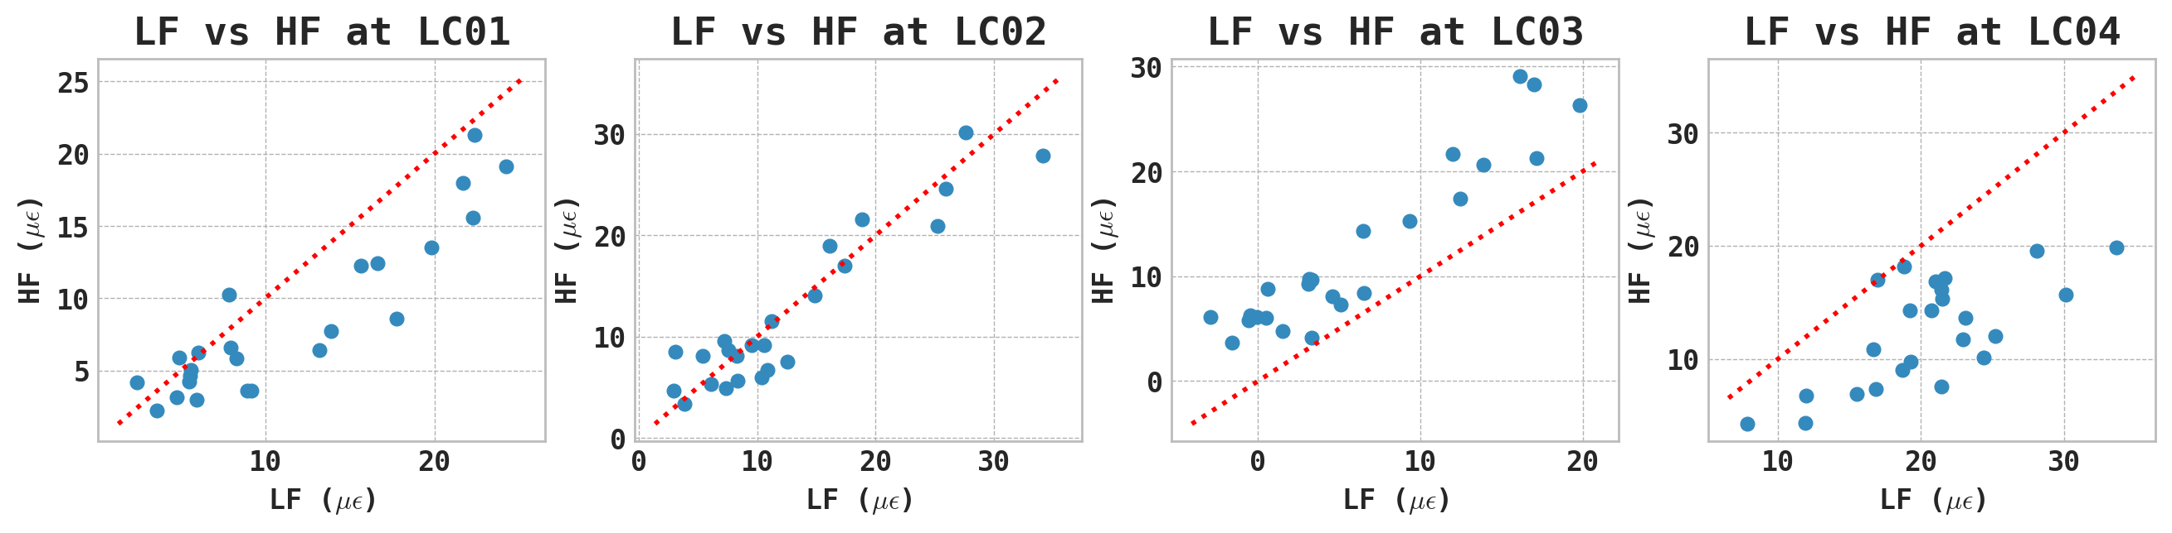

Slide 13
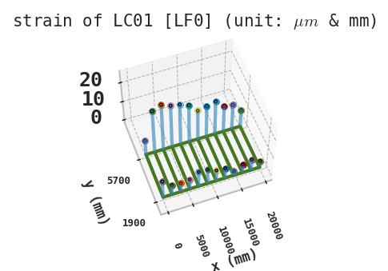
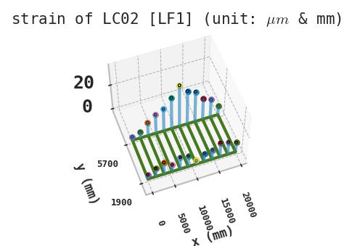

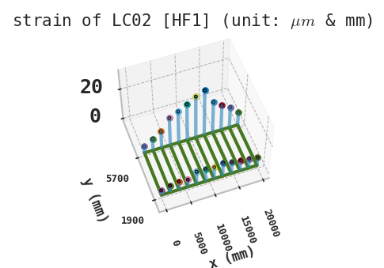

Slide 14
