Slide 1

$$ε$$
Spatial Resolution
Real strain profile
Sensing distance
Fiber

Slide 2
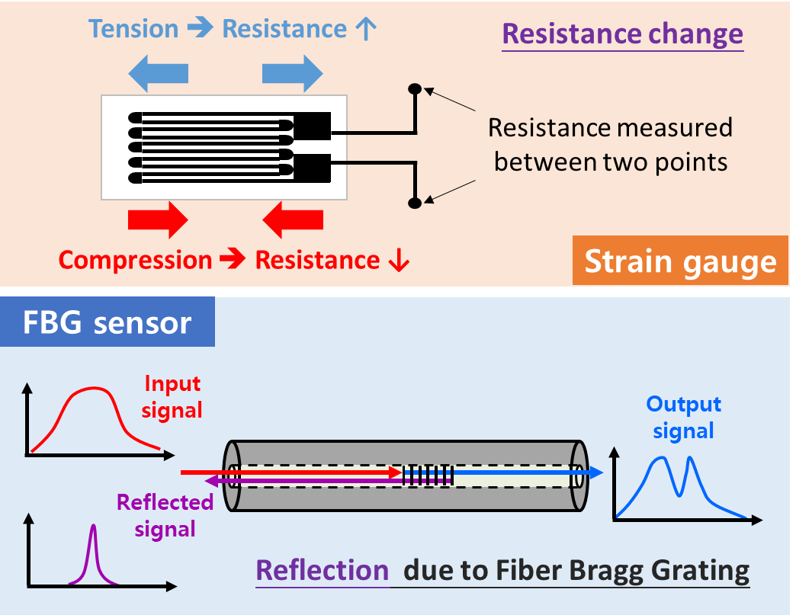
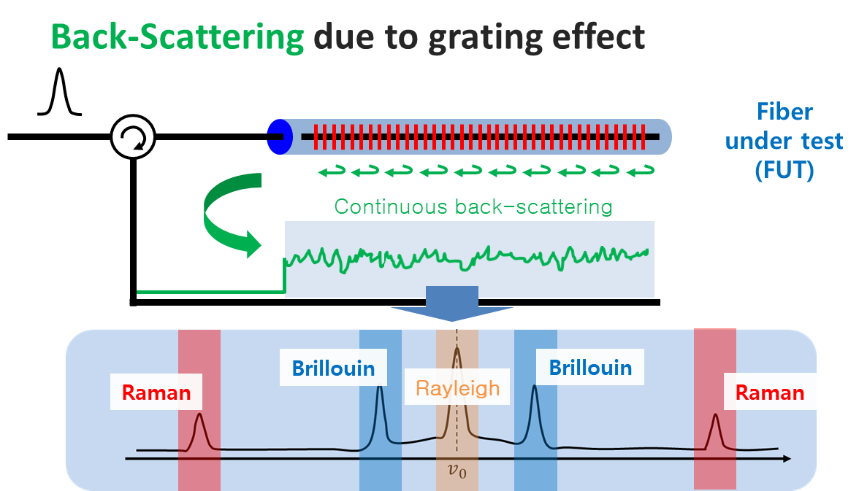
Point strain sensor
Distributed strain sensor
High accuracy with high SNR
Limited sensing points
(only work at discrete points)
Low accuracy with low SNR
Not limited to sensing points
(Any point can be sensor)
High accuracy
Low spatial information
Low accuracy
High spatial information
Strain gauge
FBG (Fiber Bragg Grating)
BOTDA (Brillouin Optical Time Domain Analysis)
BOCDA (Brillouin Optical Correlation Domain Analysis)

Slide 3




















Linear Mapping
Gaussian Process Mapping
X
$$θ_{LF}$$
X
$$θ_{LF}$$
$${GPR}_{LF}\left(X\right)\sim$$
$$f_{LF}$$
$$ρ$$
$$θ_{δ_{d}}$$
feeding
input
$$f_{LF}$$
$$\sim {GPR}_{LF}\left(X\right)$$
$$θ_{δ_{d}}$$
$$θ_{ρ}$$
dot
$$δ_{d}$$
$$\sim {GPR}_{δ_{d}}\left(X\right)$$
$${GPR}_{ρ}\left(f_{LF}\left(X\right),X\right)\sim$$
$$δ_{d}$$
$$\sim {GPR}_{δ_{d}}\left(X\right)$$
$${\hat{f}}_{ρ}\left({\hat{f}}_{LF}\left(x\right),x\right)$$
plus
plus
$$f_{HF}$$
$$f_{HF}$$
$f_{HF}\left(x\right)$ = $ρ∙f_{LF}\left(x\right)+δ_{d}\left(x\right)$
$f_{HF}\left(x\right)$ =$f_{ρ}\left(f_{LF}\left(x\right),x\right)+δ_{d}\left(x\right)$

Slide 4






















$$X$$
$$f^{1}\left(∙\right)$$
$$f^{1}\left(X\right)$$
$$f^{2}\left(∙\right)$$
$Y$ =$f^{2}\left(f^{1}\left(X\right),X\right)$
1st GPR
2nd GPR
Input-connected
hidden layer
with infinitely units
Hidden layer
with infinitely units
$$x_{1}$$
Inputs
$$\text{Outputs}$$
$$w_{1}^{1}$$
$$w_{1}^{2}$$
$$x_{1}$$
$$f_{1}^{1}$$
$$y_{1}$$
$$w_{2}^{1}$$
$$w_{2}^{2}$$
$$x_{2}$$
$$⋮$$
$$f_{2}^{1}$$
$$⋮$$
$$y_{2}$$
$$w_{∞}^{1}$$
$$w_{∞}^{2}$$
$$x_{2}$$

Slide 5
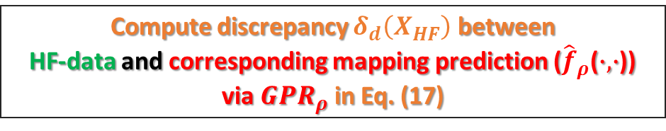
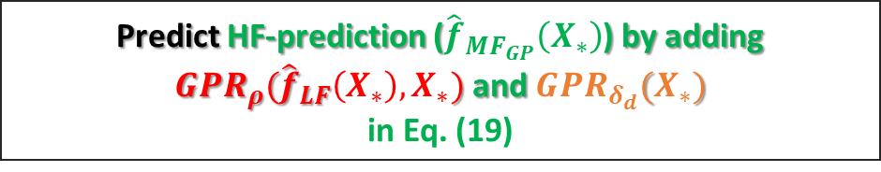


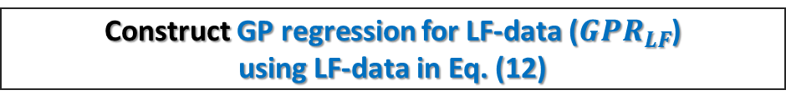




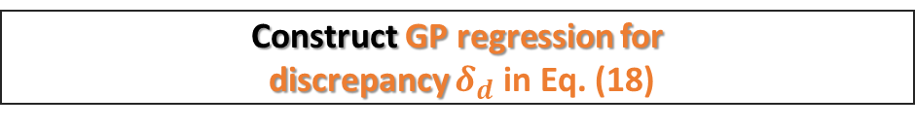
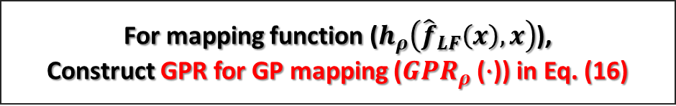

Input
Output
Perform measurement for
both point and distributed strain sensor
Distribtued sensor (LF-data): $D_{LF}=[X_{LF} ⇒ Y_{LF}]$
Point sensor (HF-data): $D_{HF}=[X_{HF}⇒Y_{HF}]$
Construct GP regression for LF-data (${GPR}_{LF}$)
using LF-data in Eq. (12)
$D_{LF}=[X_{LF}⇒Y_{LF}]$ ➔ ${GPR}_{LF}(X)$
For mapping function ($h_{ρ}\left({\hat{f}}_{LF}\left(x\right),x\right)$),
Construct GPR for GP mapping (${GPR}_{ρ}$ ($∙$)) in Eq. (16)
${\hat{f}}_{LF}\left(X_{HF}\right)$ $\sim$ ${GPR}_{LF}(X_{HF})$
$D_{ρ}=[\left({\hat{f}}_{LF}\left(X_{HF}\right), X_{HF}\right)⇒Y_{HF}]$ ➔ ${GPR}_{ρ}({\hat{f}}_{LF}\left(X\right),X)$
Compute discrepancy $δ_{d}\left(X_{HF}\right)$ between
HF-data and corresponding mapping prediction (${\hat{f}}_{ρ}$($∙,∙$)) via ${GPR}_{ρ}$ in Eq. (17)
${\hat{f}}_{ρ}\left({\hat{f}}_{LF}\left(X_{HF}\right),X_{HF}\right)$ $\sim$ ${GPR}_{ρ}({\hat{f}}_{LF}\left(X_{HF}\right),X_{HF})$
$$δ_{d}\left(X_{HF}\right)=Y_{HF}\left(X_{HF}\right)−{\hat{f}}_{ρ}\left({\hat{f}}_{LF}\left(X_{HF}\right),X_{HF}\right)$$
Construct GP regression for
discrepancy $δ_{d}$ in Eq. (18)
$D_{d}=$ [$X_{HF}$ $⇒$ $δ_{d}\left(X_{HF}\right)$] ➔ ${GPR}_{δ_{d}}(X)$
Predict HF-prediction (${\hat{f}}_{{MF}_{GP}}\left(X_{∗}\right)$) by adding ${GPR}_{ρ}({\hat{f}}_{LF}\left(X_{∗}\right),X_{∗})$ and ${GPR}_{δ_{d}}(X_{∗})$
in Eq. (19)
$${\hat{f}}_{ρ}\left({\hat{f}}_{LF}\left(X_{∗}\right),X_{∗}\right)\sim {GPR}_{ρ}({\hat{f}}_{LF}\left(X_{∗}\right),X_{∗})$$
$${\hat{f}}_{δ_{d}}\left(X_{∗}\right)\sim {GPR}_{δ_{d}}(X_{∗})$$
$${\hat{f}}_{{MF}_{GP}}\left(X_{∗}\right)={\hat{f}}_{ρ}\left({\hat{f}}_{LF}\left(X_{∗}\right),X_{∗}\right)+{\hat{f}}_{δ_{d}}\left(X_{∗}\right)$$

Slide 6
(a)
(b)
(c)

Slide 7
(a)
(b)

Slide 8
(a)
(b)

Slide 9
(a)
(b)
(c)

Slide 10
(a)
(b)

Slide 11
(a)
(b)

Slide 12
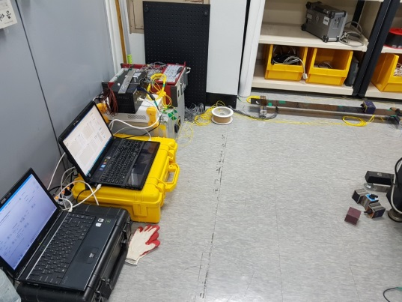
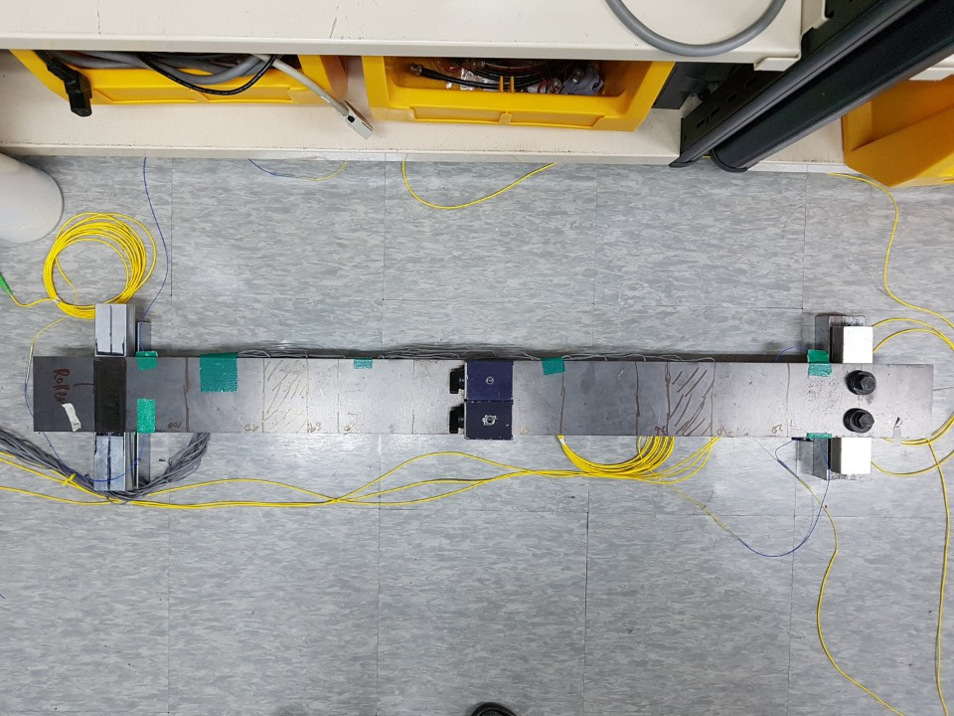
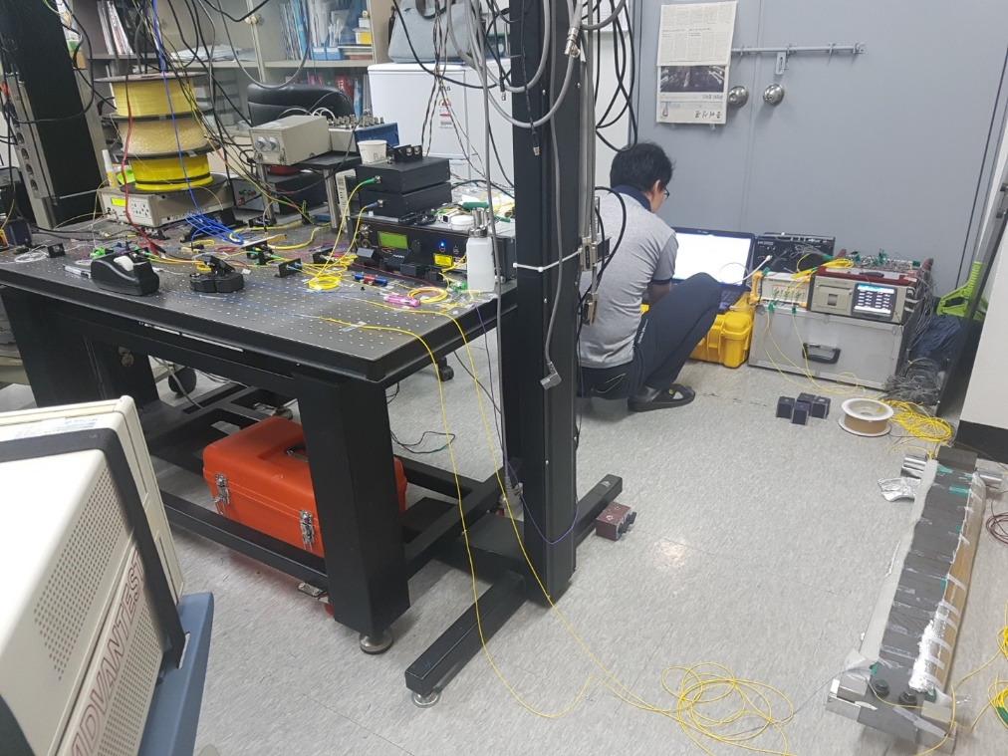
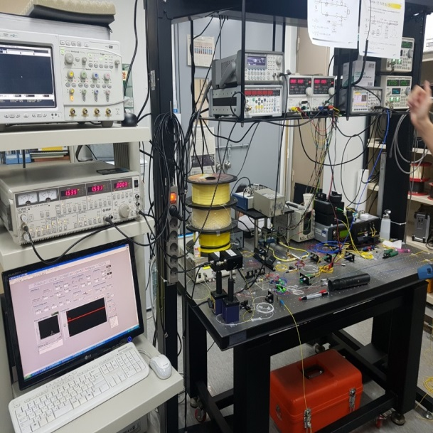
Specimen
BOCDA
(Distributed sensor)
Strain gauge
(Point sensor)

Slide 13
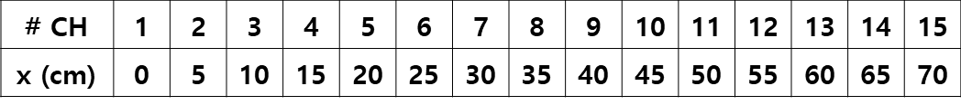
20cm
5cm
35cm
35cm
5cm
20cm
CH #4
CH #8
CH #12
y
CH #1
CH #15
10cm
x
Support
Region
x
Support
Region
<Experimental study #1: Asymmetric distribution>
1.97 kg
(0.987*2EA)
z
x
<Experimental study #2: Symmetric distribution>
5.922 kg
(0.987*6EA)
z
0.5cm
x
120cm
Low-fidelity data: BOCDA (15EA)
High-fidelity data: Strain gauge (15EA)

Slide 14
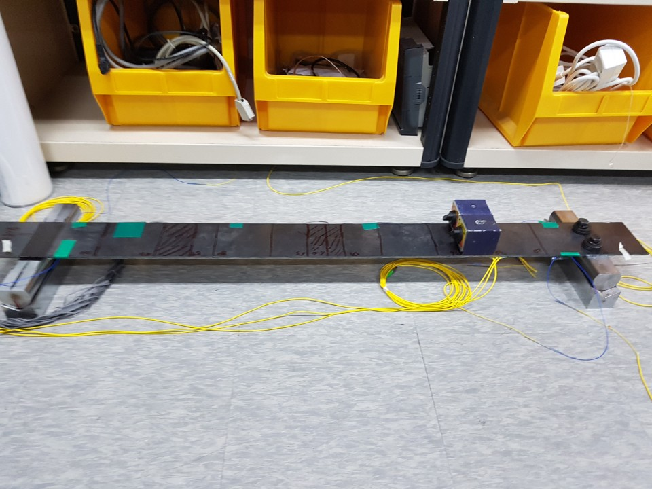
(a)
(b)
CH #1
CH #15
58 cm
X=0 cm
X=70 cm
(c)
(d)

Slide 15
(a)
(b)

Slide 17
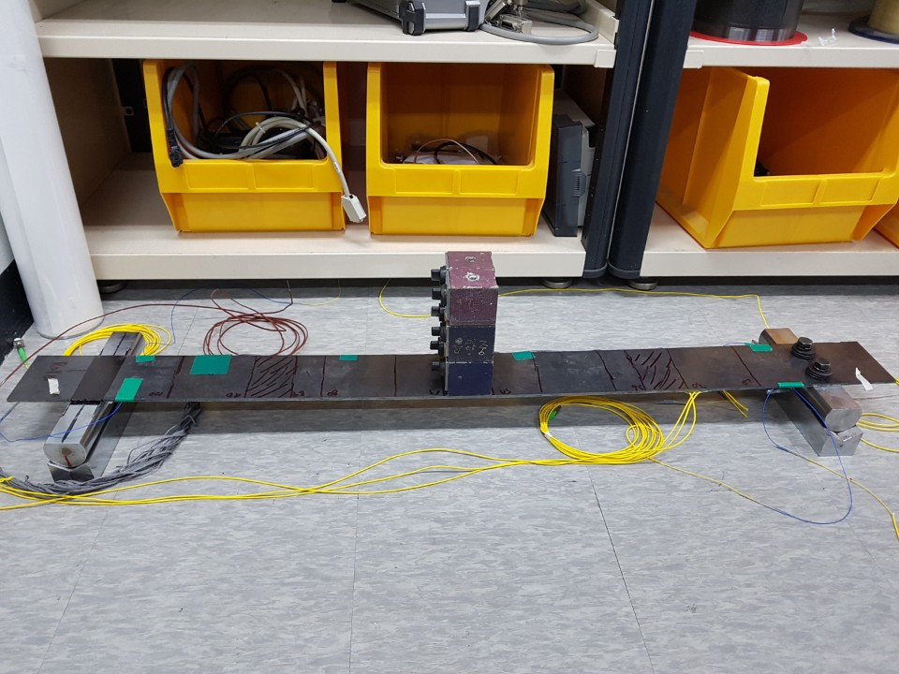
(a)
(b)
CH #1
CH #15
30 cm
X=0 cm
X=70 cm
(c)
(d)

Slide 18
(a)
(b)

