Slide 1
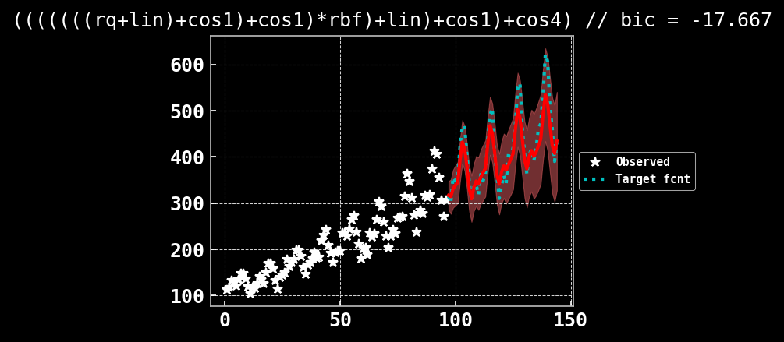
## Failed at test fcnt #6
cos_ken1 = CosineKernel(active_dims = i, period_length_prior = periodlength_prior, period_length_constraint = gpytorch.constraints.LessThan(min_dist_x))
cos_ken2 = CosineKernel(active_dims = i, period_length_prior = periodlength_prior, period_length_constraint = gpytorch.constraints.LessThan(1/min_dist_x))
cos_ken3 = CosineKernel(active_dims = i, period_length_prior = periodlength_prior, period_length_constraint = gpytorch.constraints.LessThan(max_dist_x))
cos_ken4 = CosineKernel(active_dims = i, period_length_prior = periodlength_prior, period_length_constraint = gpytorch.constraints.LessThan(1/max_dist_x))

Slide 2
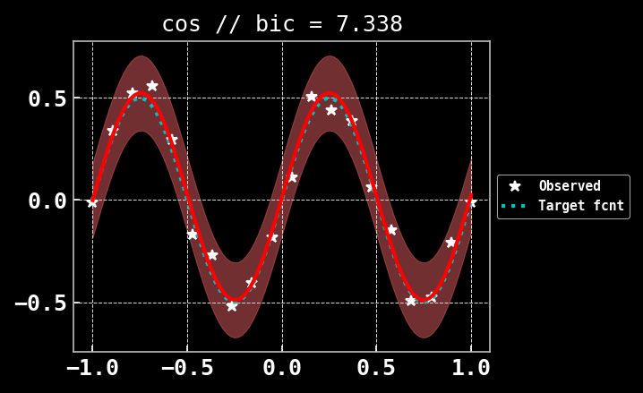
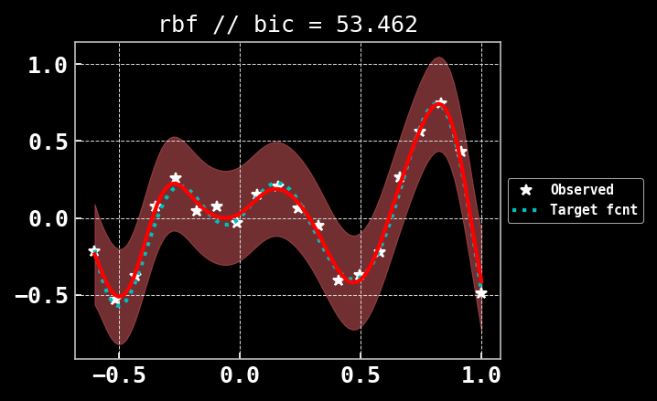
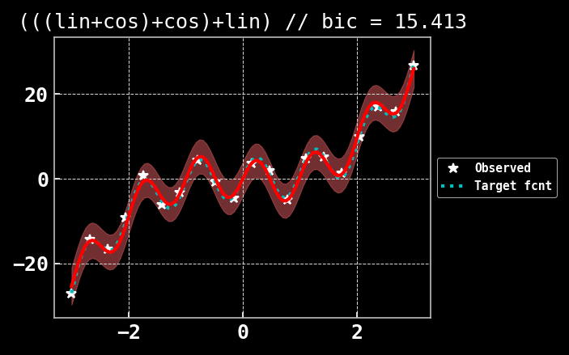
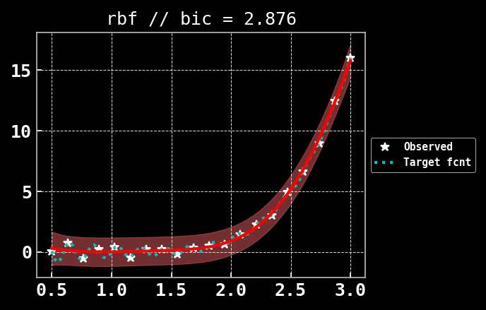
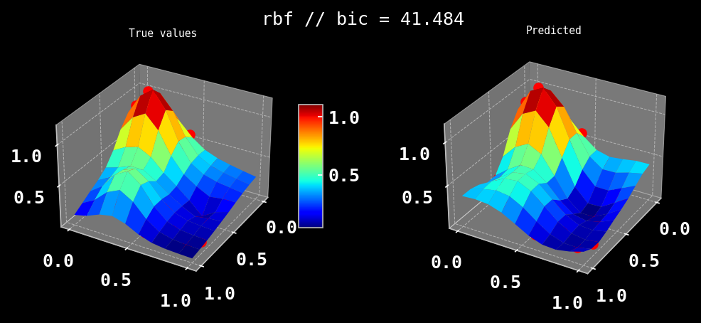
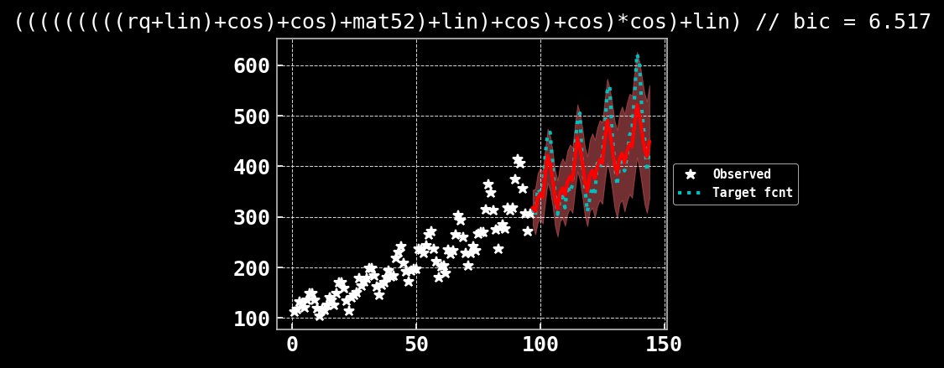
cos_ken = CosineKernel(active_dims = i, period_length_prior = periodlength_prior, period_length_constraint = gpytorch.constraints.LessThan(min_dist_x))

Slide 3
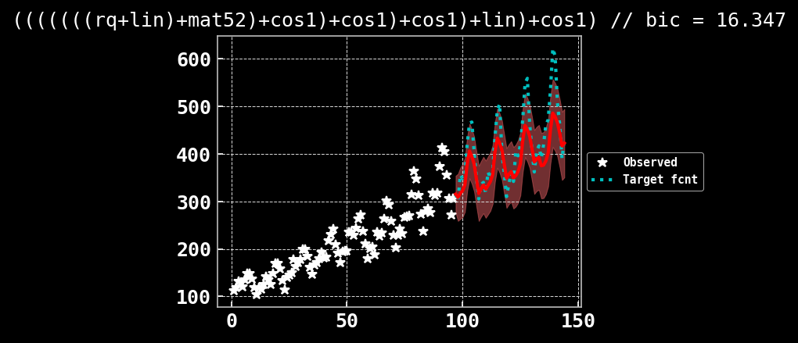
## Failed at test fcnt #6
cos_ken1 = CosineKernel(active_dims = i, period_length_prior = periodlength_prior, period_length_constraint = gpytorch.constraints.GreaterThan(min_dist_x))
cos_ken2 = CosineKernel(active_dims = i, period_length_prior = periodlength_prior, period_length_constraint = gpytorch.constraints.GreaterThan(1/min_dist_x))
cos_ken3 = CosineKernel(active_dims = i, period_length_prior = periodlength_prior, period_length_constraint = gpytorch.constraints.GreaterThan(max_dist_x))
cos_ken4 = CosineKernel(active_dims = i, period_length_prior = periodlength_prior, period_length_constraint = gpytorch.constraints.GreaterThan(1/max_dist_x))

Slide 4
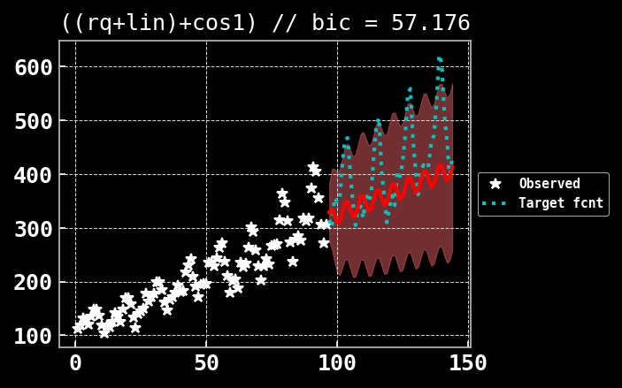
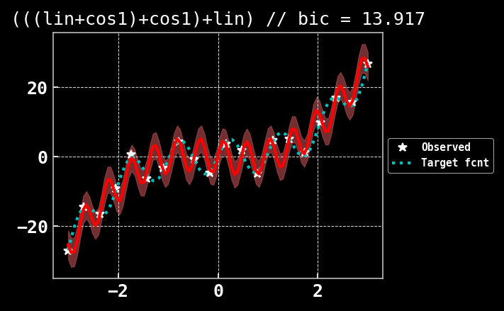
## Failed at test fcnt #6
cos_ken1 = CosineKernel(active_dims = i, period_length_prior = periodlength_prior, period_length_constraint = gpytorch.constraints.GreaterThan(min_dist_x))

Slide 5
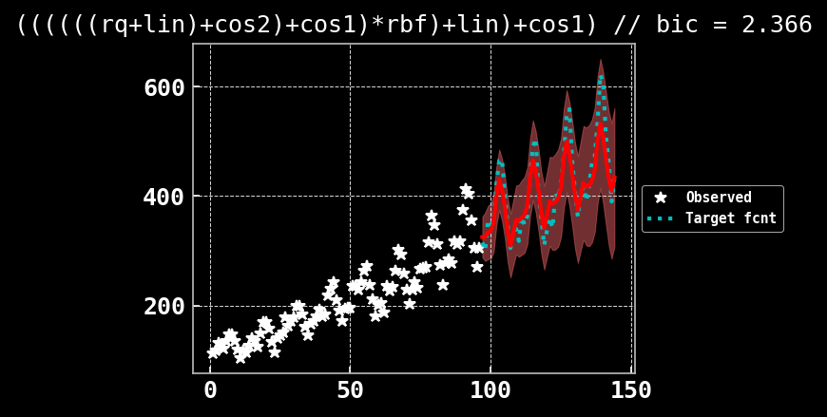
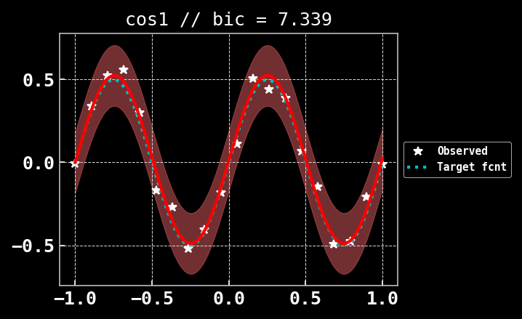
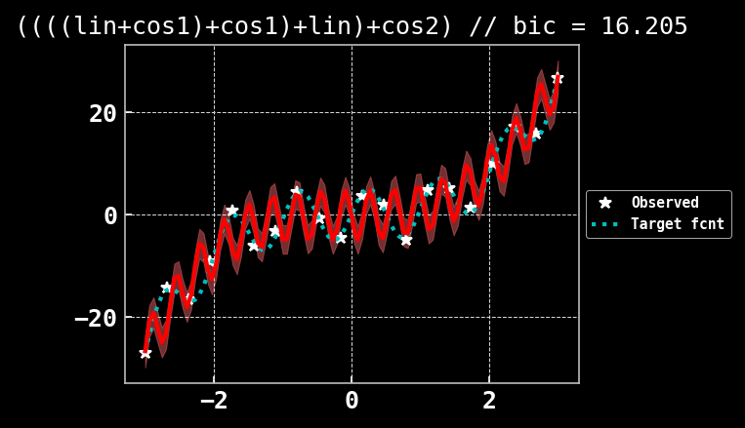
## Failed at test fcnt #6
cos_ken1 = CosineKernel(active_dims = i, period_length_prior = periodlength_prior, period_length_constraint = gpytorch.constraints.Interval(min_dist_x, max_dist_y))
cos_ken2 = CosineKernel(active_dims = i, period_length_prior = periodlength_prior, period_length_constraint = gpytorch.constraints.Interval(1/max_dist_y, 1/min_dist_x))

Slide 6
