Slide 1
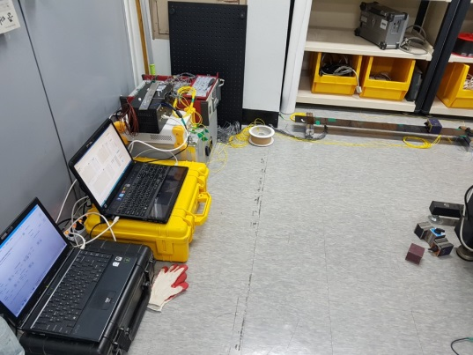
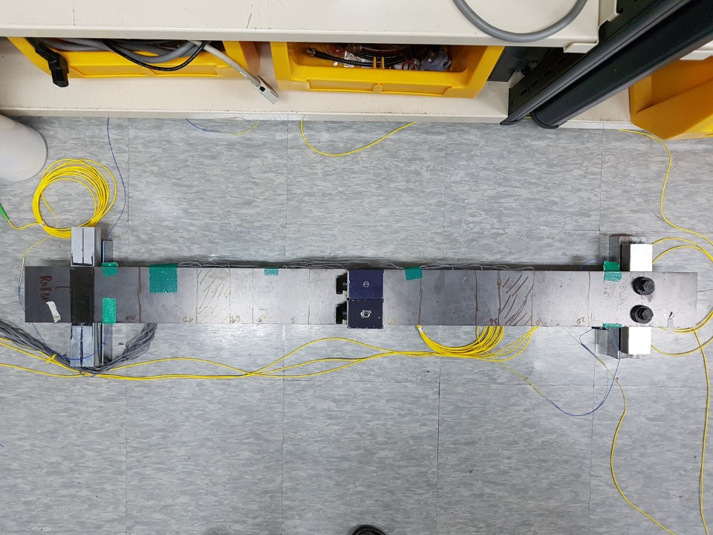
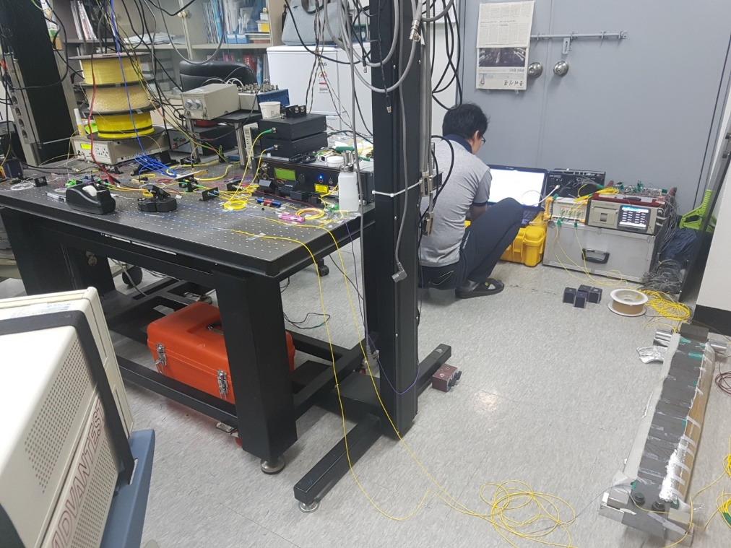
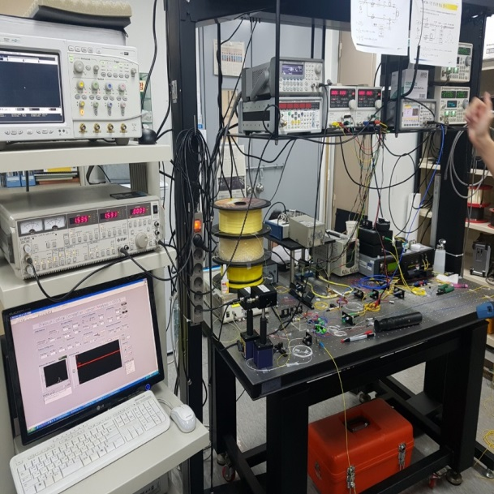
Specimen
BOCDA
(Distributed sensor)
Strain gauge
(Point sensor)

Slide 2
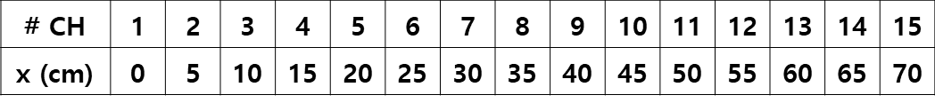
20cm
5cm
35cm
35cm
5cm
20cm
CH #4
CH #8
CH #12
y
CH #1
CH #15
10cm
x
Support
Region
x
Support
Region
<Experimental study #1: Asymmetric distribution>
1.97 kg
(0.987*2EA)
z
x
<Experimental study #2: Symmetric distribution>
5.922 kg
(0.987*6EA)
z
0.5cm
x
120cm
Low-fidelity data: BOCDA (15EA)
High-fidelity data: Strain gauge (15EA)

Slide 3
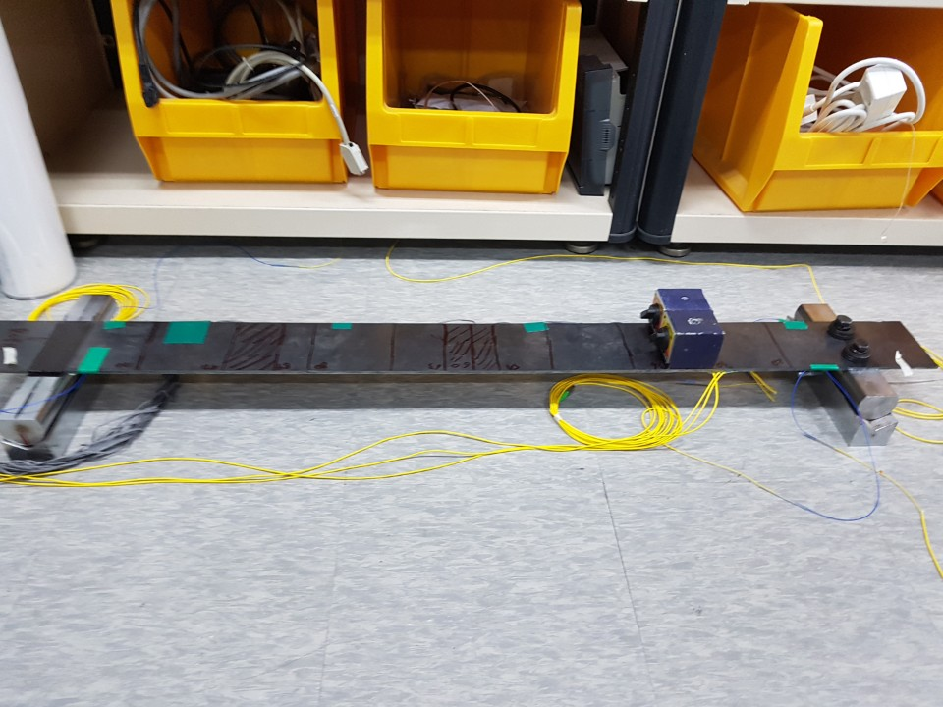
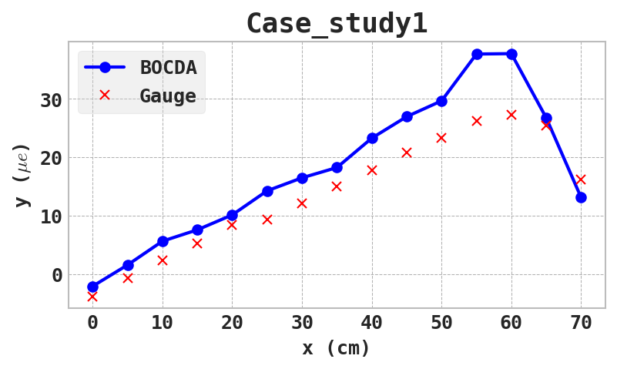
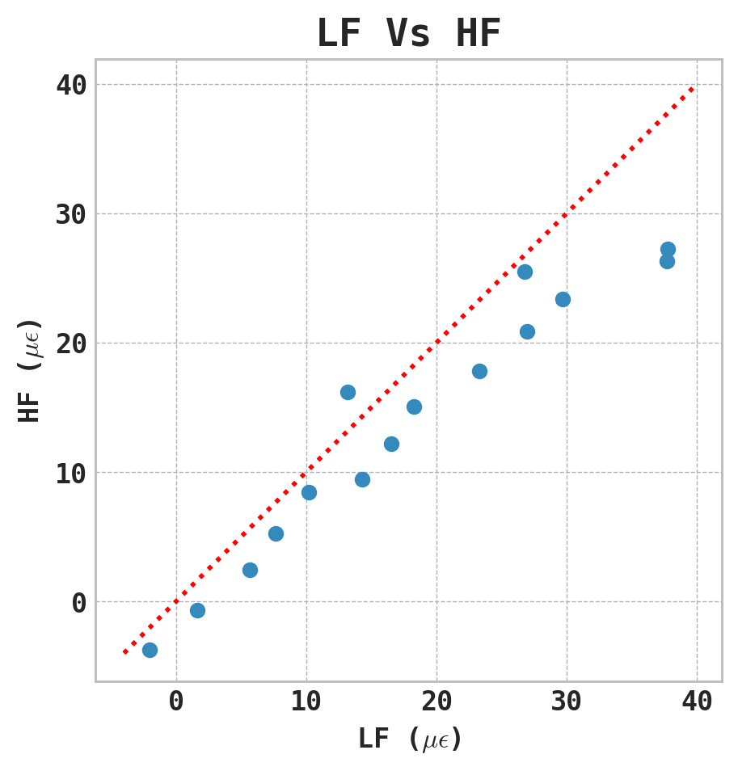
CH #1
CH #15
58 cm
X=0 cm
X=70 cm

Slide 4
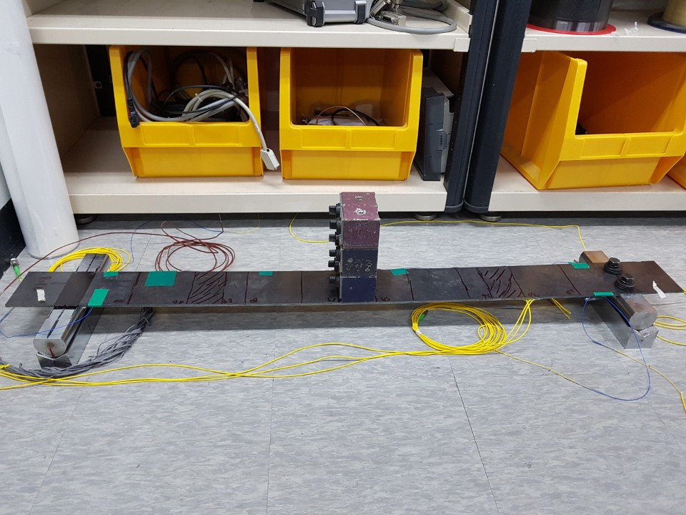
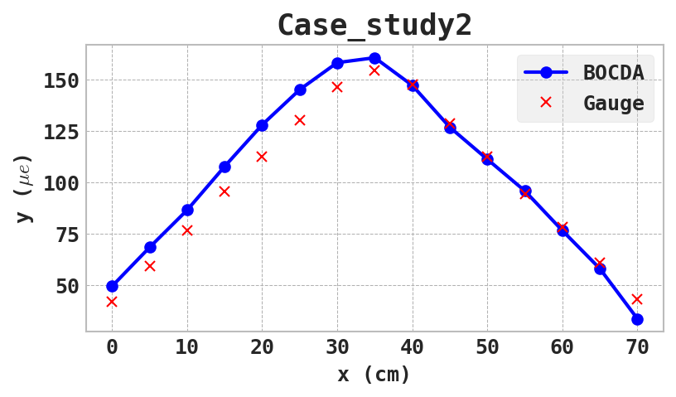
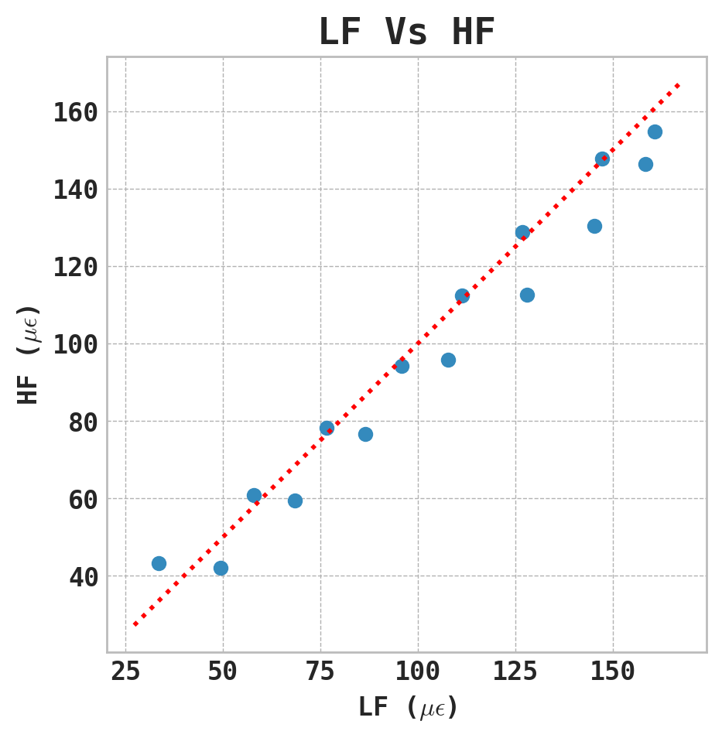
CH #1
CH #15
30 cm
X=0 cm
X=70 cm

