Slide 1
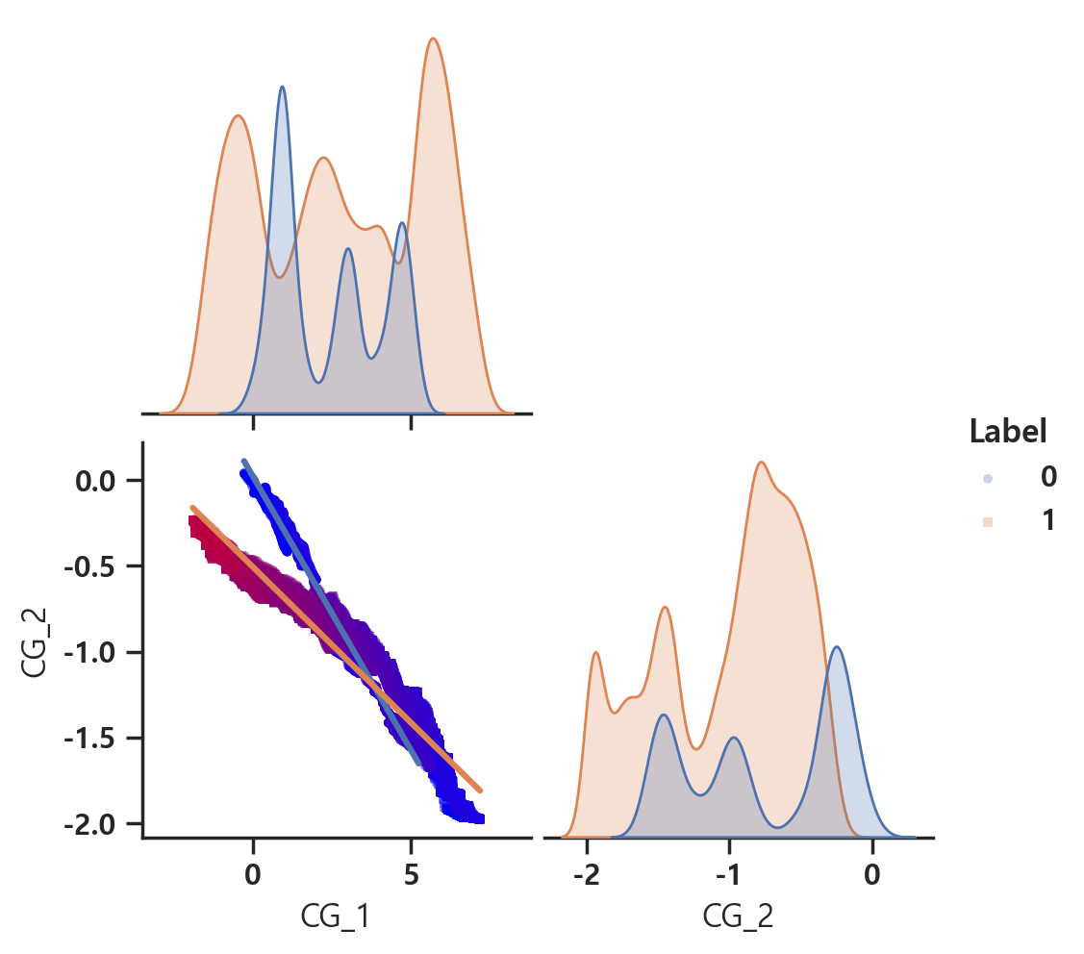
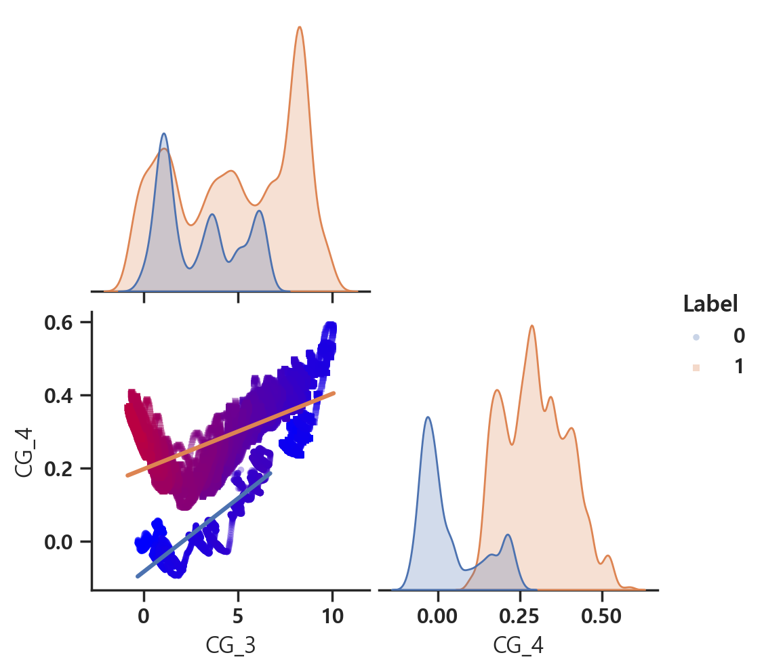
fn_name = 'J_Dataset_1101_0630.csv'

Slide 2
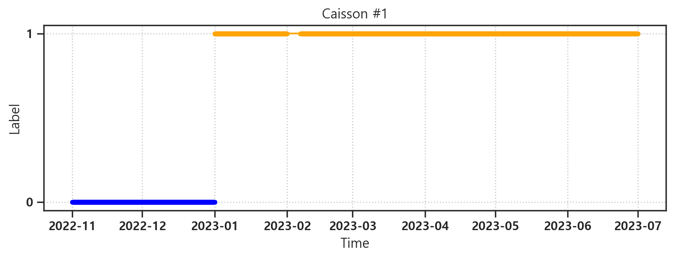
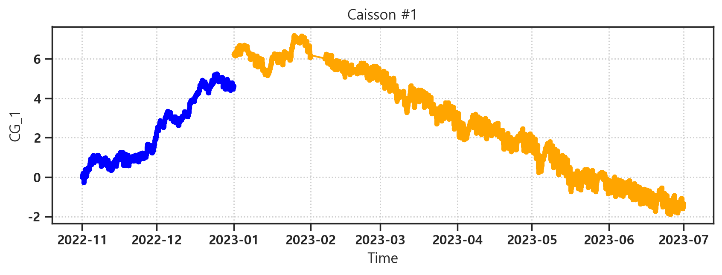
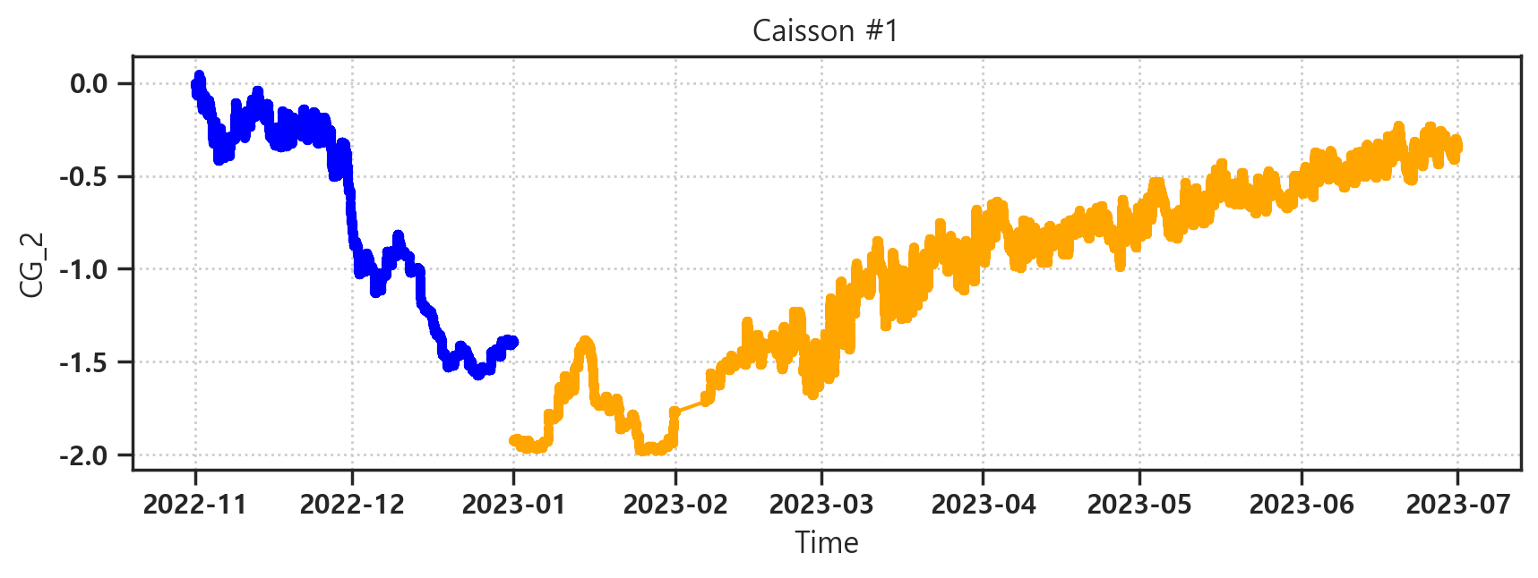

Slide 3
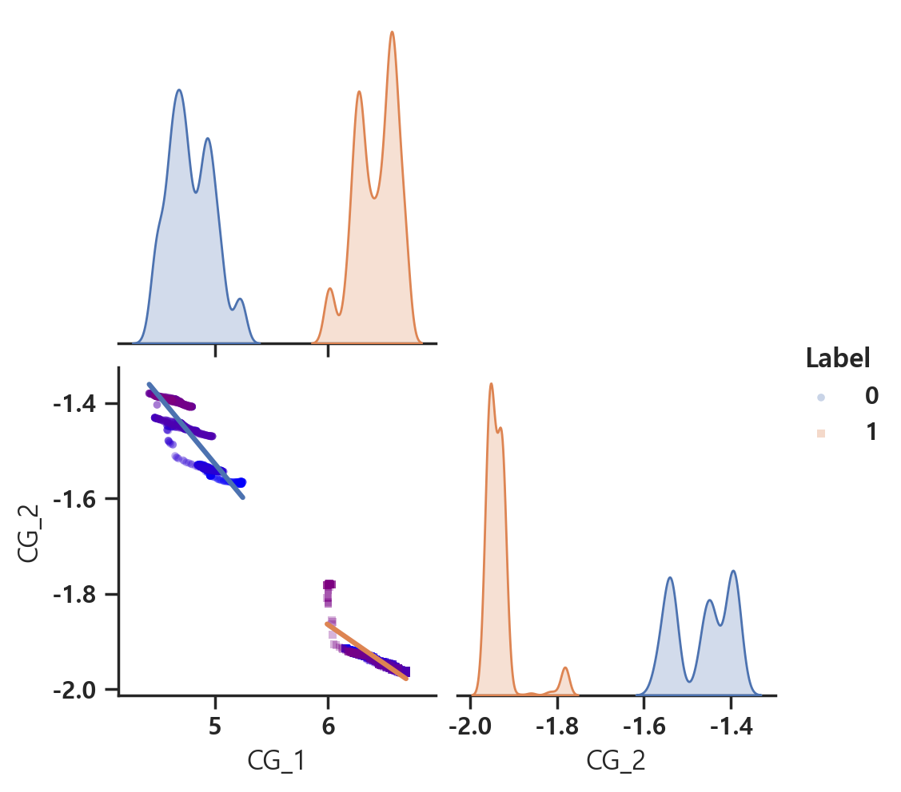
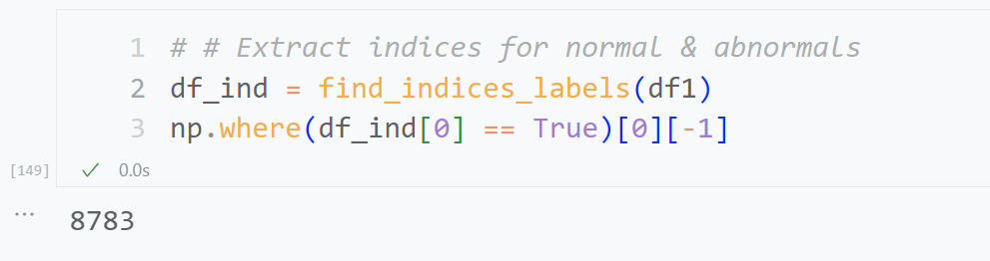
df_interest = df1.iloc[8000:10000, :]

Slide 4
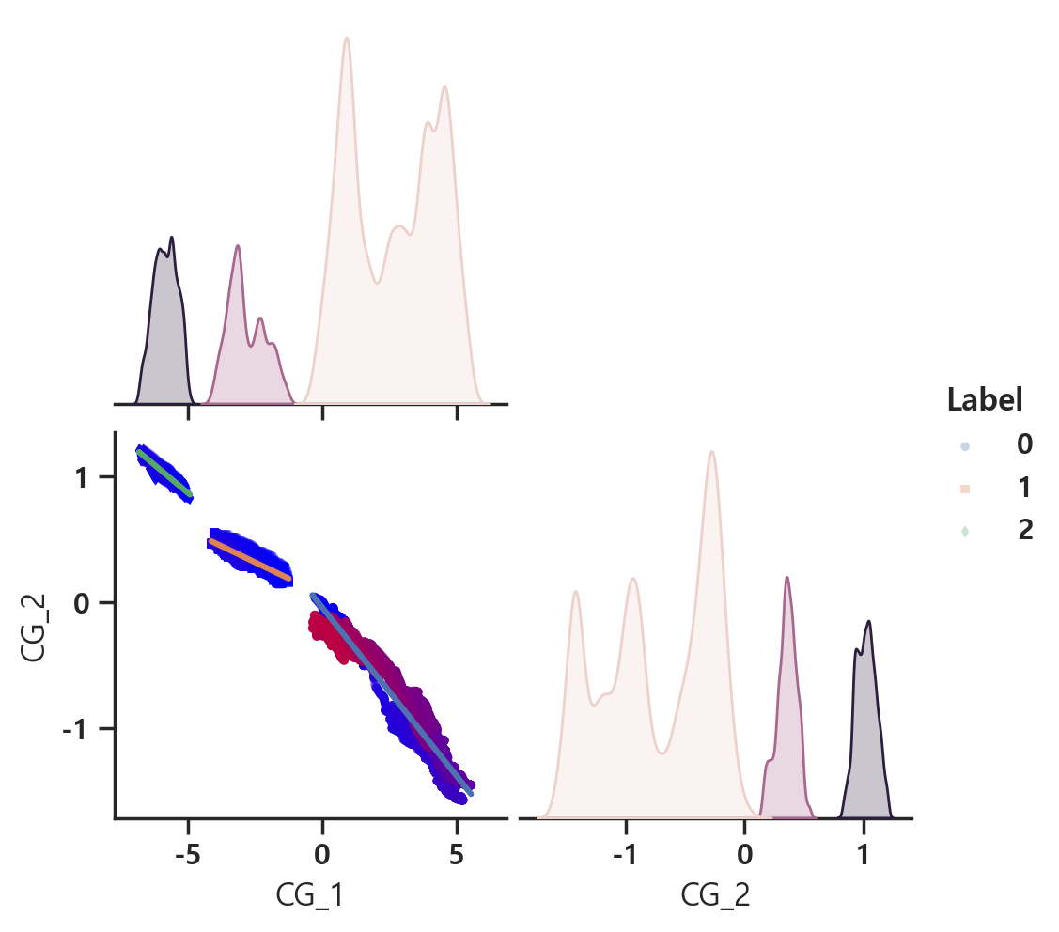
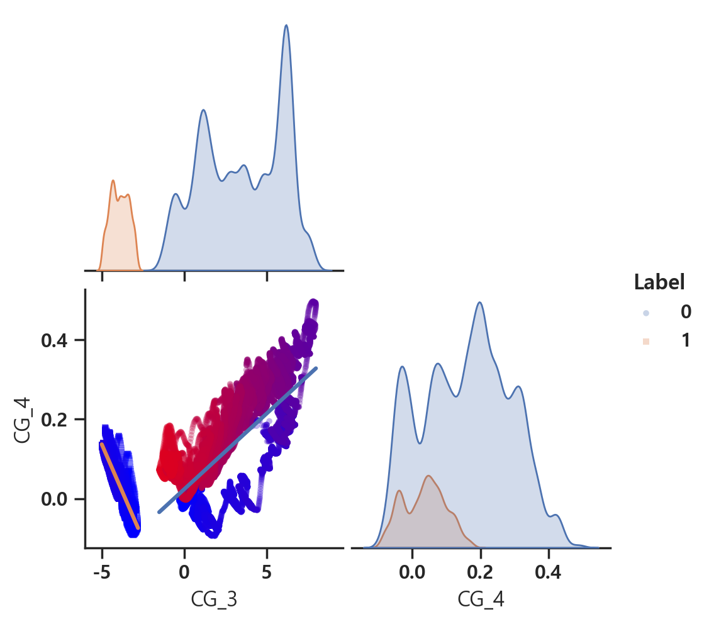
fn_name = 'J_Dataset_1101_0630_outlier_1sig.csv'

Slide 5
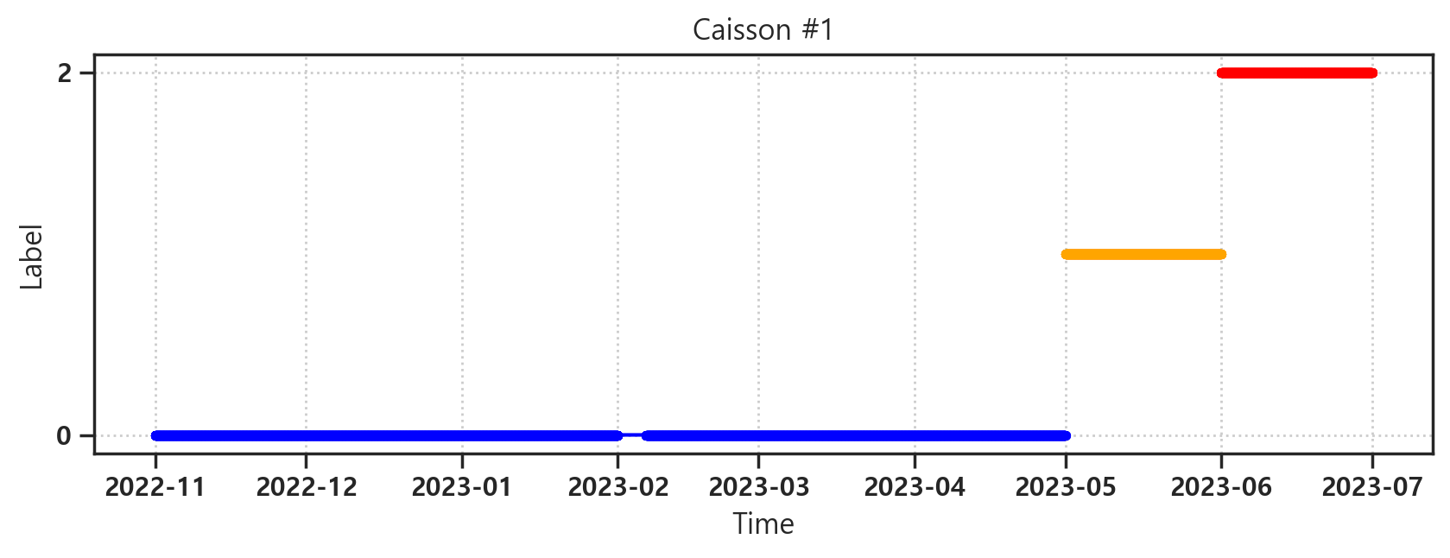
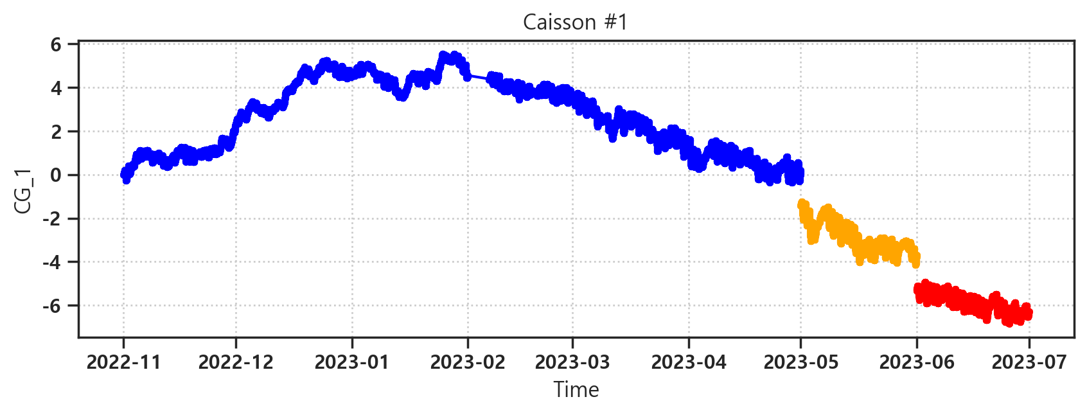
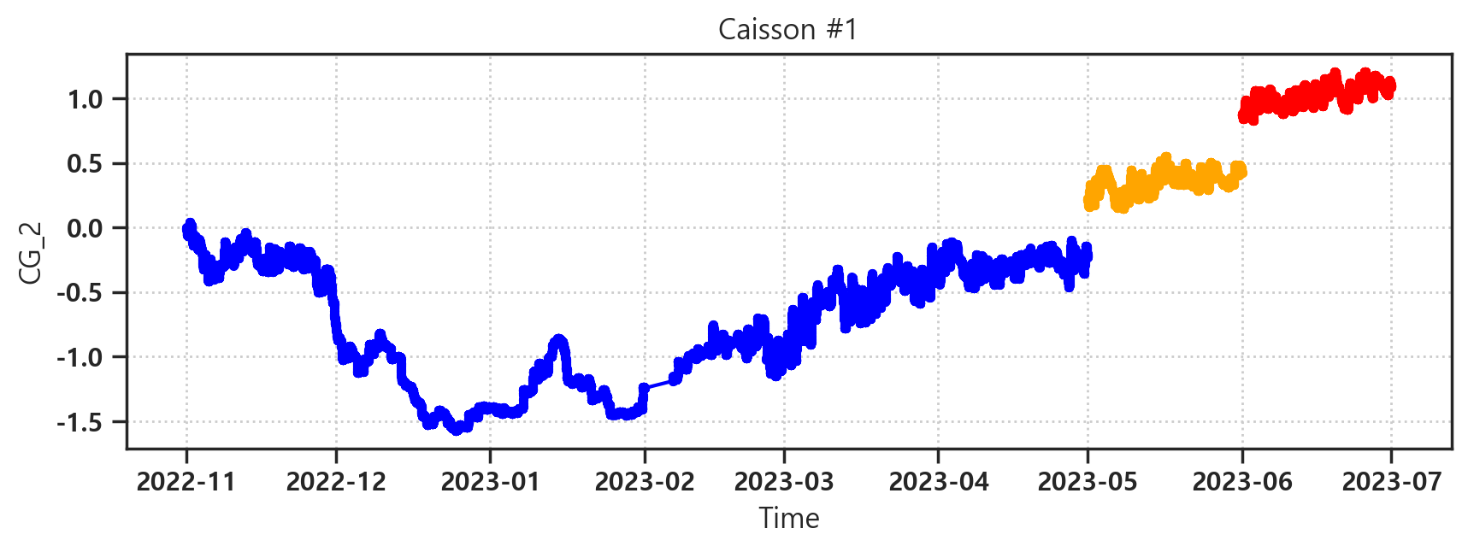

Slide 6
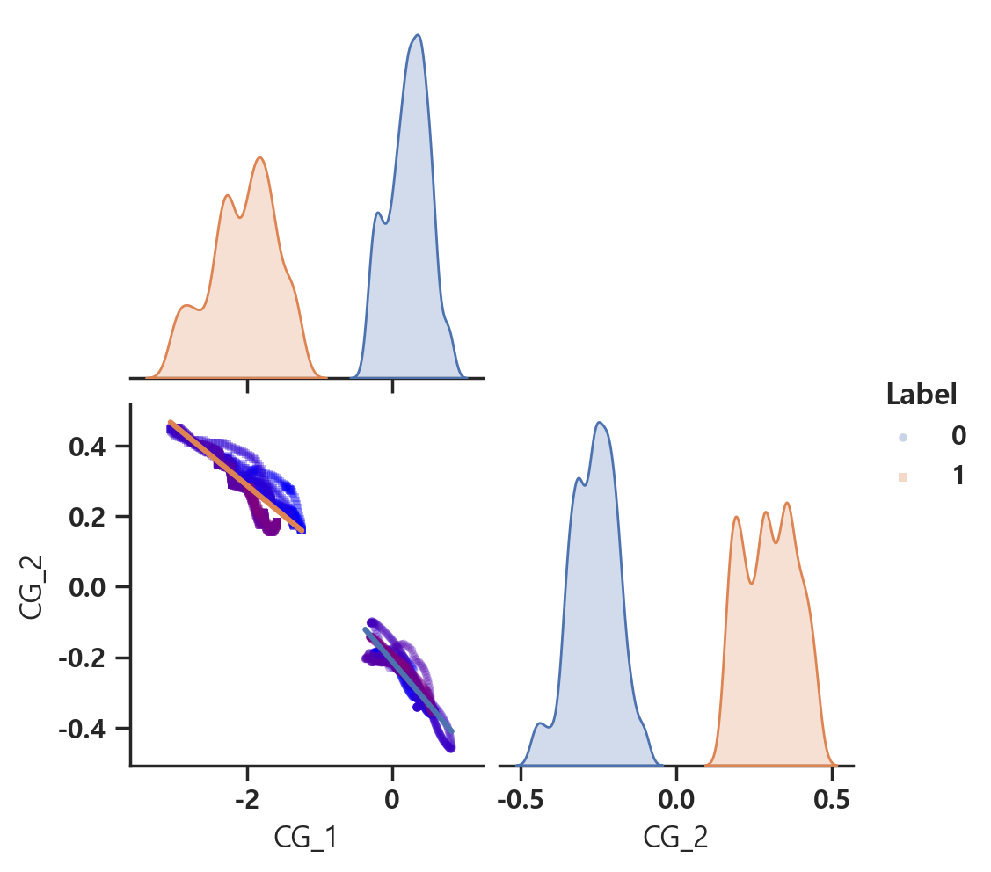
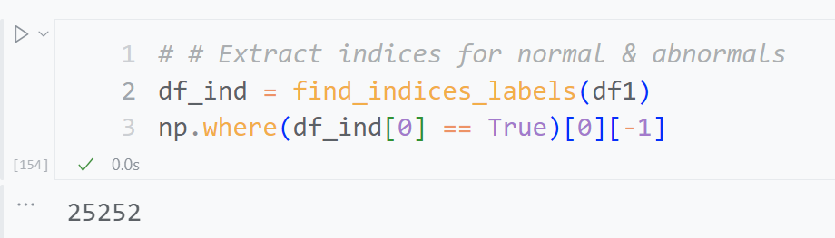
df_interest = df1.iloc[24252:26252, :]

Slide 7
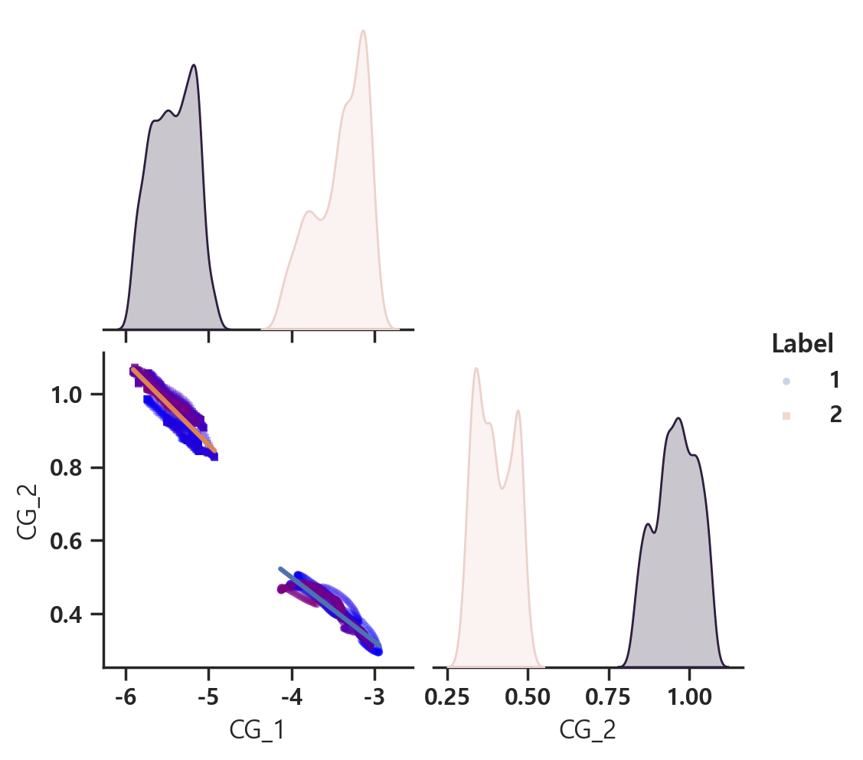
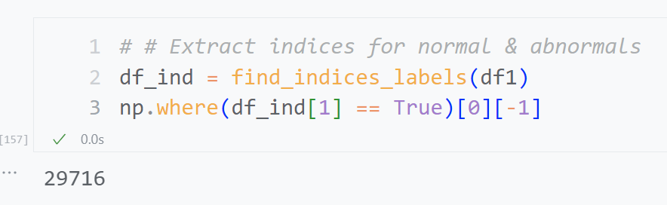
df_interest = df1.iloc[28716:30716, :]

Slide 8
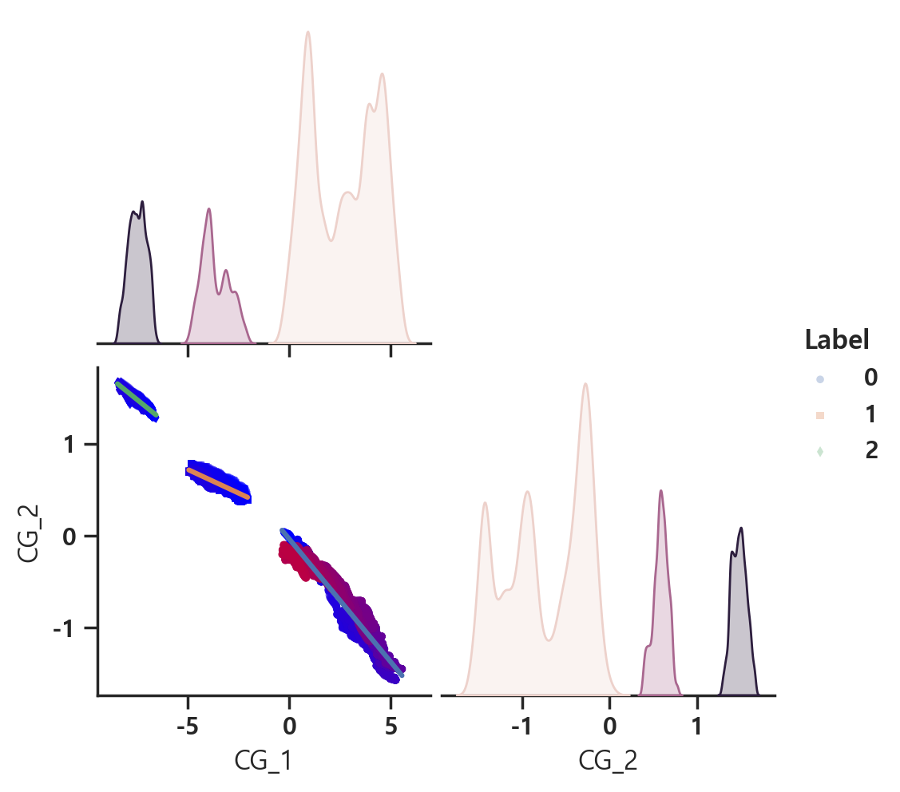
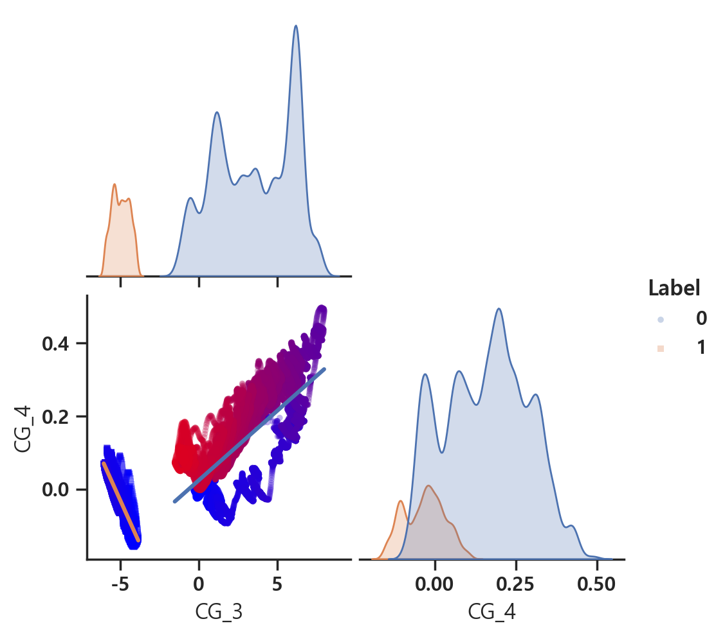
fn_name = 'J_Dataset_1101_0630_outlier_3sig.csv'

Slide 9
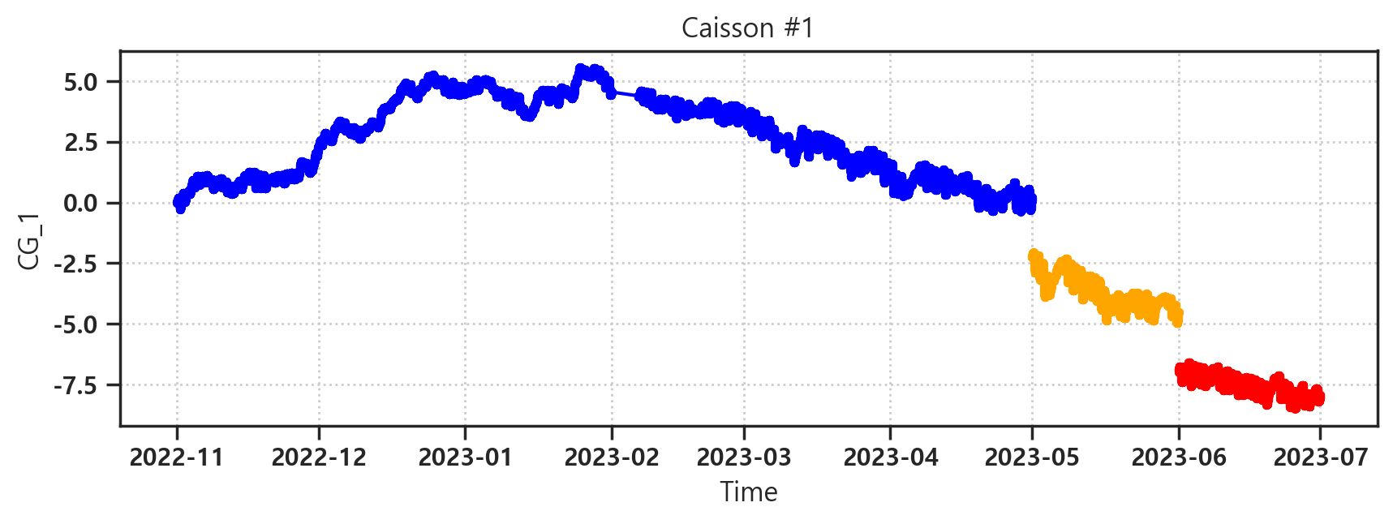
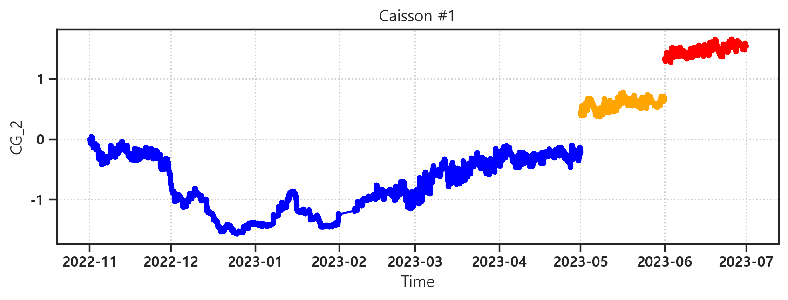

Slide 10
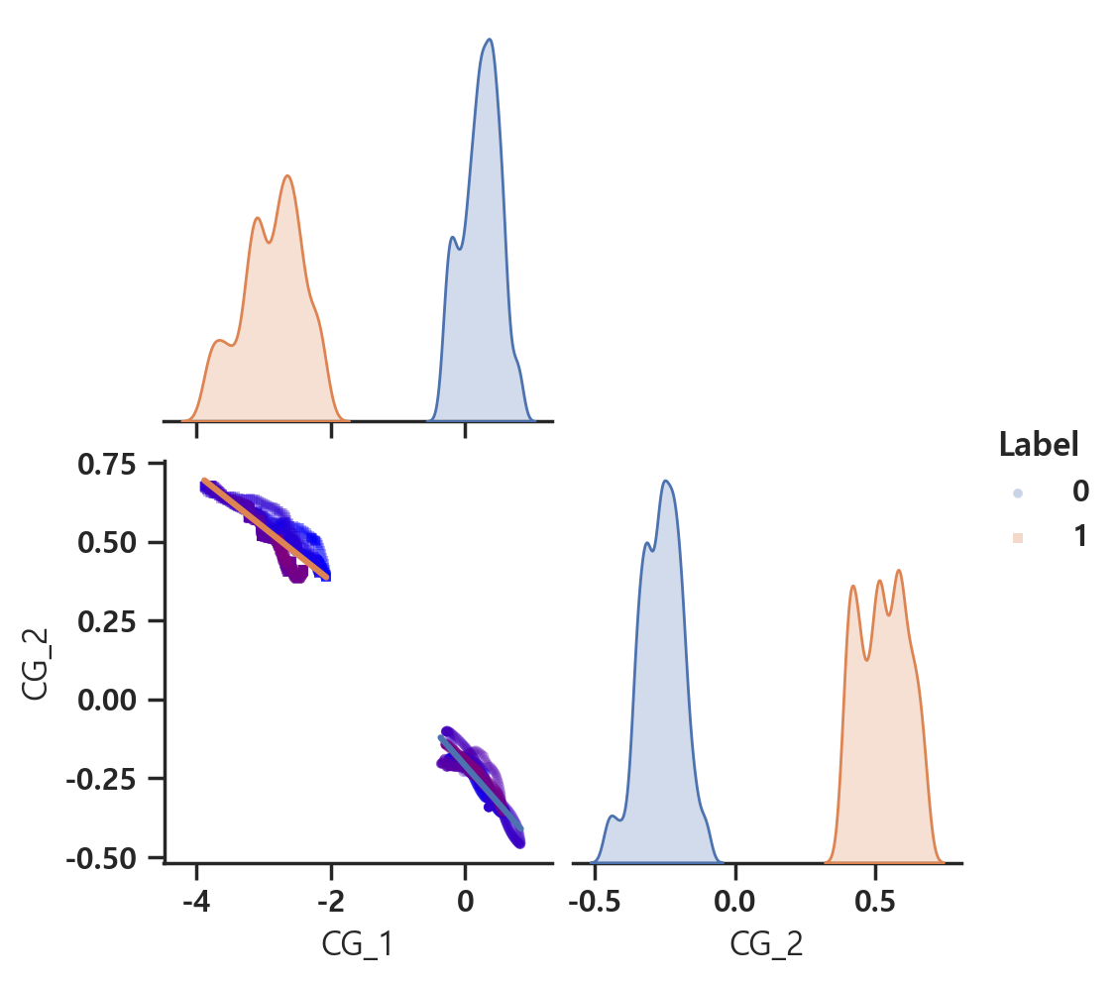
df_interest = df1.iloc[24252:26252, :]

Slide 11
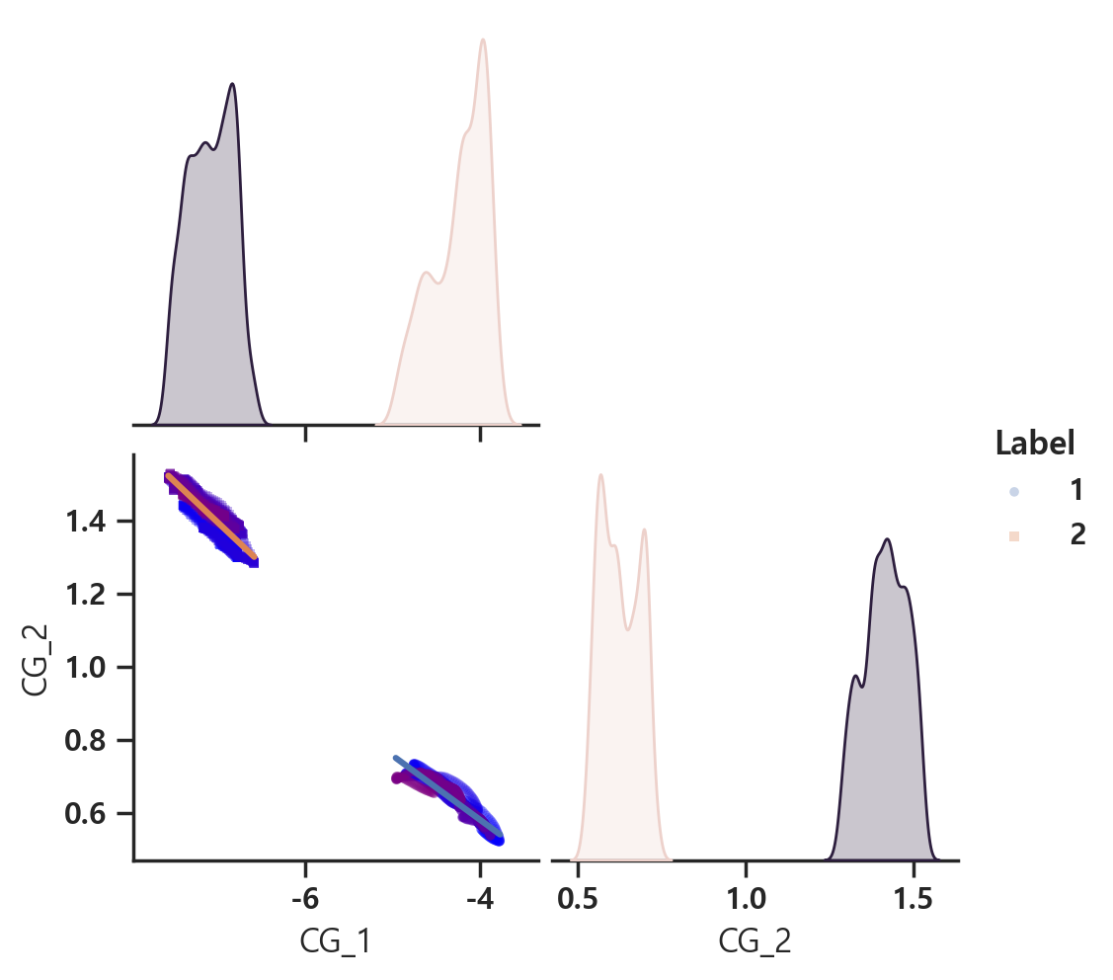
df_interest = df1.iloc[28716:30716, :]

Slide 12
참고용~

Slide 13
fn_name = 'J_Dataset_1101_0630_outlier_1sig.csv'

Slide 14

fn_name = 'J_Dataset_1101_0630_outlier_2sig.csv'

Slide 15
fn_name = 'J_Dataset_1101_0630_outlier_3sig.csv'

