Slide 1
Thresholding Based Efficient Outlier Robust PCA
Yeshwanth Cherapanamjeri, Prateek Jain, Praneeth Netrapalli
Microsoft Research India

Slide 2








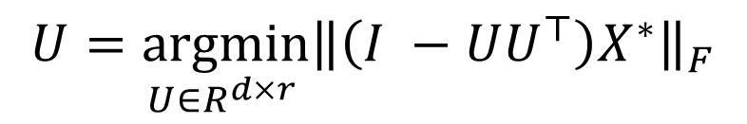
Vanilla PCA
Given $n$ data points, $X^{∗}=[x_{1}, …,x_{n}]$, compute the rank-$r$ subspace that best describes the data
Formally:
$$x_{1}$$
$$x_{2}$$
$$x_{3}$$
$$x_{4}$$
$$x_{n}$$
$$X^{∗}=$$
$$d$$
$$U=\underset{U∈R^{d×r} }{argmin}{{\left\|\left(I −UU^{⊤}\right)X^{∗}\right\|}_{F}}$$

Slide 3

Vanilla PCA
Can be solved efficiently in $O(ndr)$ time via SVD
Even faster algorithms possible via input-sparsity time algorithms
However, PCA is brittle to the presence of outliers

Slide 4



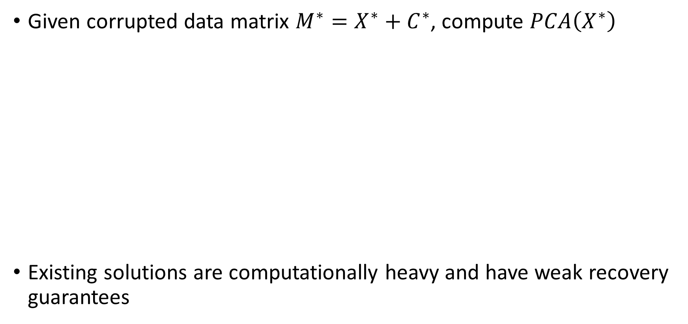





Outlier Robust PCA
Given corrupted data matrix $M^{∗}=X^{∗}+C^{∗}$, compute $PCA\left(X^{∗}\right)$
Existing solutions are computationally heavy and have weak recovery guarantees
$$x_{1}$$
$$x_{2}$$
$$x_{n−γn}$$
$$c_{1}$$
$$c_{γn}$$
$$M^{∗}=$$
$$\left(1−γ\right)n$$
$$γn$$

Slide 5
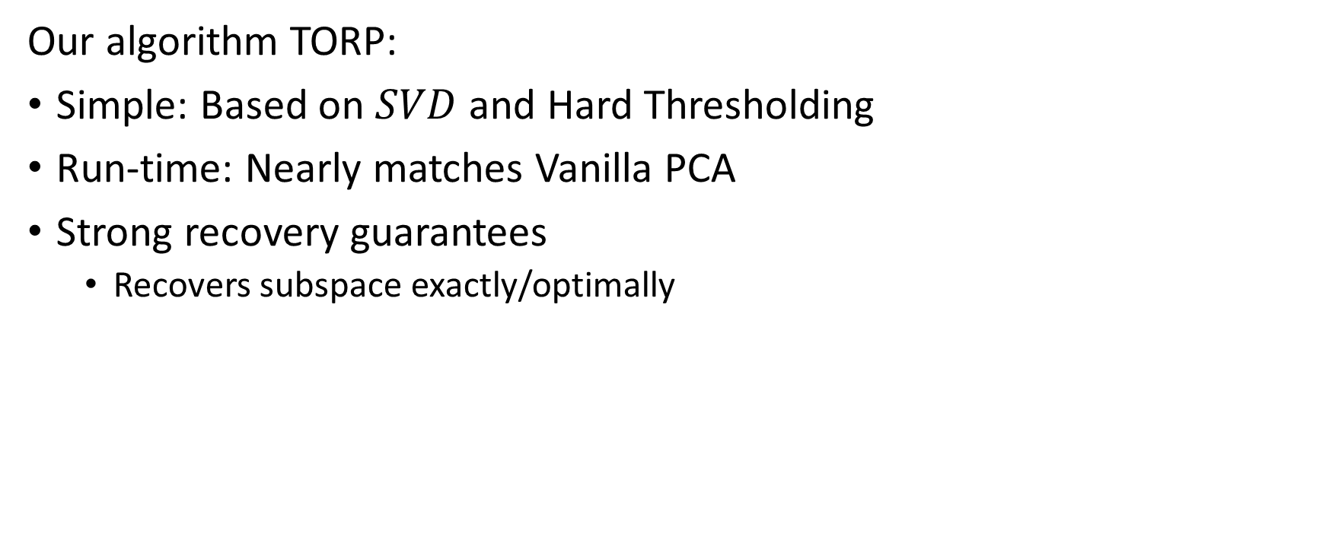
Our Contributions
Our algorithm TORP:
Simple: Based on $SVD$ and Hard Thresholding
Run-time: Nearly matches Vanilla PCA
Strong recovery guarantees
Recovers subspace exactly/optimally

Slide 6



Outlier Effects – Blatant Outliers
Outliers with large contribution to the principal subspace
Can be easily detected via projection onto $U$
Outliers with
large contribution
$$U$$
$$U^{∗}$$

Slide 7
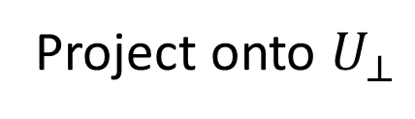


Outlier Effects – Subtle Outliers
Outlier with small contribution to principal subspace
Earlier strategy doesn’t work
$$U$$
Project onto $U_{⊥}$
$$U^{∗}$$
$$U_{⊥}$$

Slide 8



Outlier Effects – Subtle Outliers
Outliers generally have larger residual than inliers
$$U$$
$$U$$
$$U^{∗}$$
$$U^{∗}$$
$$U_{⊥}$$
$$U_{⊥}$$

Slide 9





Algorithm (TORP)
Threshold Points
Initialize $C←0$
For t = 0 . . . T
$\left[U, Σ, V\right]←SVD_{r}\left(M_{∖C}\right)$
$e_{i}←\left\|Σ^{−1}U^{⊤}M_{i}^{∗}\right\|$ (Contribution)
$$U^{∗}$$
$$U^{∗}$$
$$U$$
$$U$$

Slide 10





Algorithm (TORP)
Initialize $C←0$
For t = 0 . . . T
$\left[U, Σ, V\right]←SVD_{r}\left(M_{∖C}\right)$
$e_{i}←\left\|Σ^{−1}U^{⊤}M_{i}^{∗}\right\|$ (Contribution)
$r_{i}←\left\|\left(I−UU^{⊤}\right)M_{i}^{∗}\right\|$ (Residual)
$$U$$
$$U$$
$$U^{∗}$$
$$U^{∗}$$
$$U_{⊥}$$
$$U_{⊥}$$
Threshold
Points

Slide 11


Algorithm (TORP)
Initialize $C←0$
For t = 0 . . . T
$\left[U, Σ, V\right]←SVD_{r}\left(M_{∖C}\right)$
$e_{i}←\left\|Σ^{−1}U^{⊤}M_{i}^{∗}\right\|$ (Contribution)
$r_{i}←\left\|(I−UU^{⊤})M_{i}^{∗}\right\|$ (Residual)
$C←\left\{Top αn e_{i}\right\}∪\{$Top$αn r_{i}\}$
Return top-$r$ left singular vectors of $M$
$$U$$
$$U^{∗}$$

Slide 12


Theorem - Noiseless Case
If the inliers belong exactly to a low dimensional space, i.e $X^{∗}=L^{∗}$
$$U^{∗}$$

Slide 13
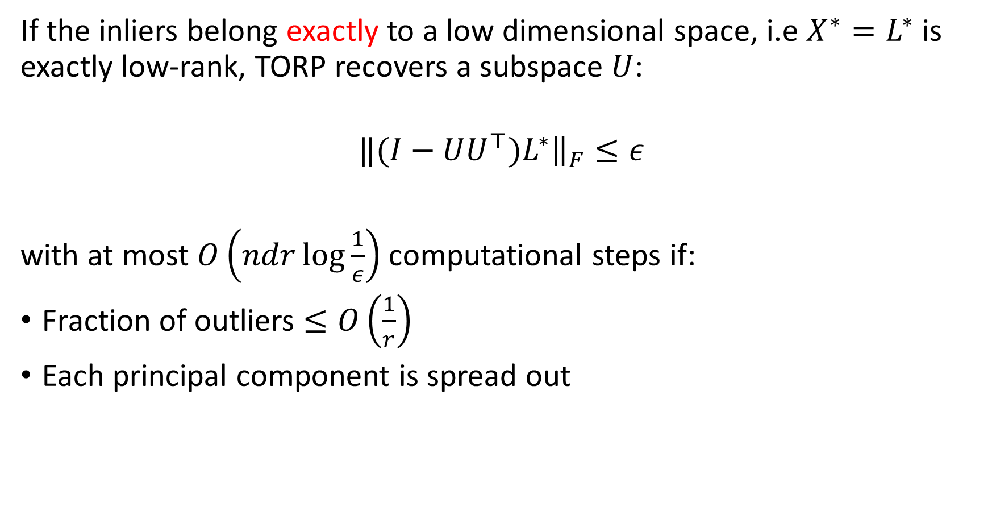
Theorem - Noiseless Case
If the inliers belong exactly to a low dimensional space, i.e $X^{∗}=L^{∗}$ is exactly low-rank, TORP recovers a subspace $U$:
$$‖(I−UU^{⊤})L^{∗}{\left.​\right\|}_{F}≤ε$$
with at most $O\left(ndr\log{\frac{1}{ε}}\right)$computational steps if:
Fraction of outliers $≤O\left(\frac{1}{r}\right)$
Each principal component is spread out

Slide 14

Theorem - Noisy Case
If $X^{∗}=L^{∗}+N^{∗}$ where $L^{∗}$ is low-rank and $N^{∗}$ is a noise matrix,

Slide 15
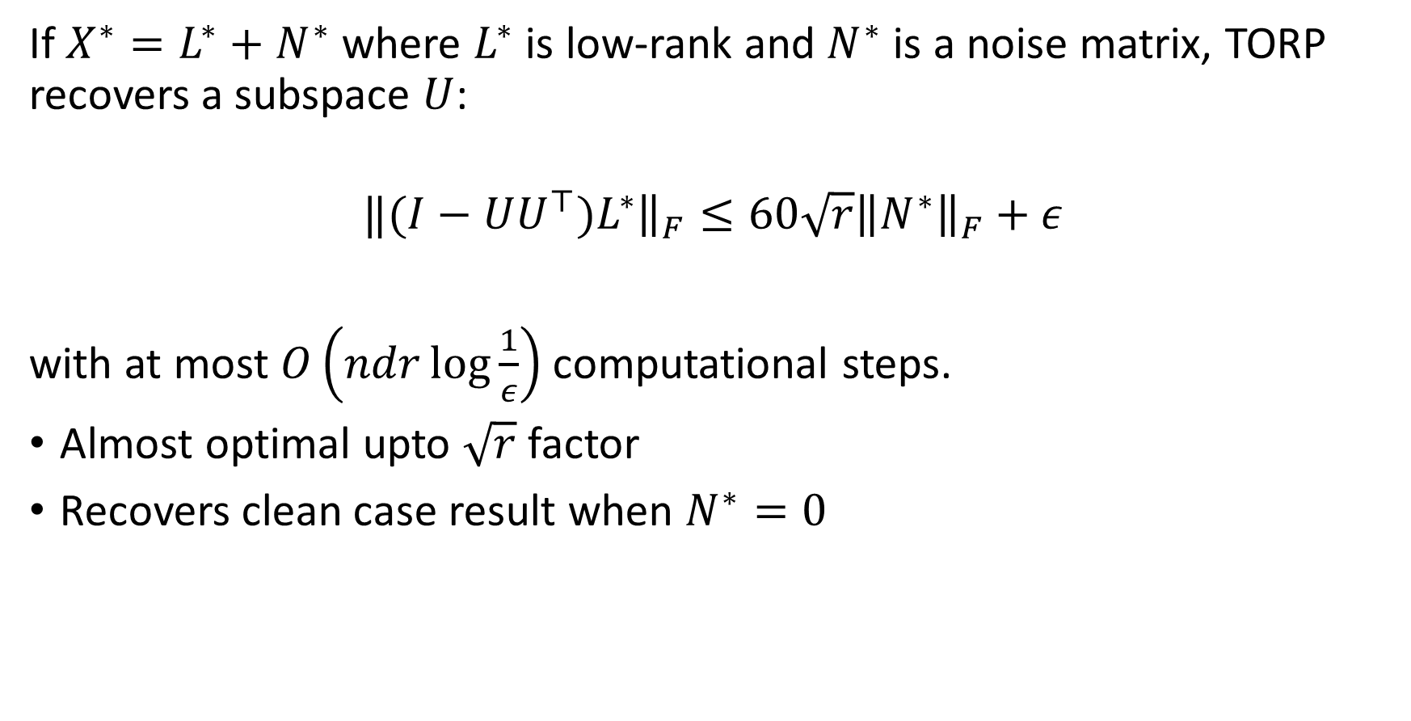
Theorem - Noisy Case
If $X^{∗}=L^{∗}+N^{∗}$ where $L^{∗}$ is low-rank and $N^{∗}$ is a noise matrix, TORP recovers a subspace $U$:
$$‖(I−UU^{⊤})L^{∗}{\left.​\right\|}_{F}≤60{\sqrt{r}\left\|N^{∗}\right\|}_{F}+ε$$
with at most $O\left(ndr\log{\frac{1}{ε}}\right)$computational steps.
Almost optimal upto $\sqrt{r}$ factor
Recovers clean case result when $N^{∗}=0$

Slide 16
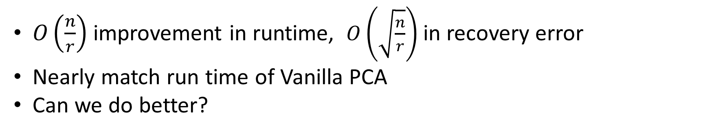
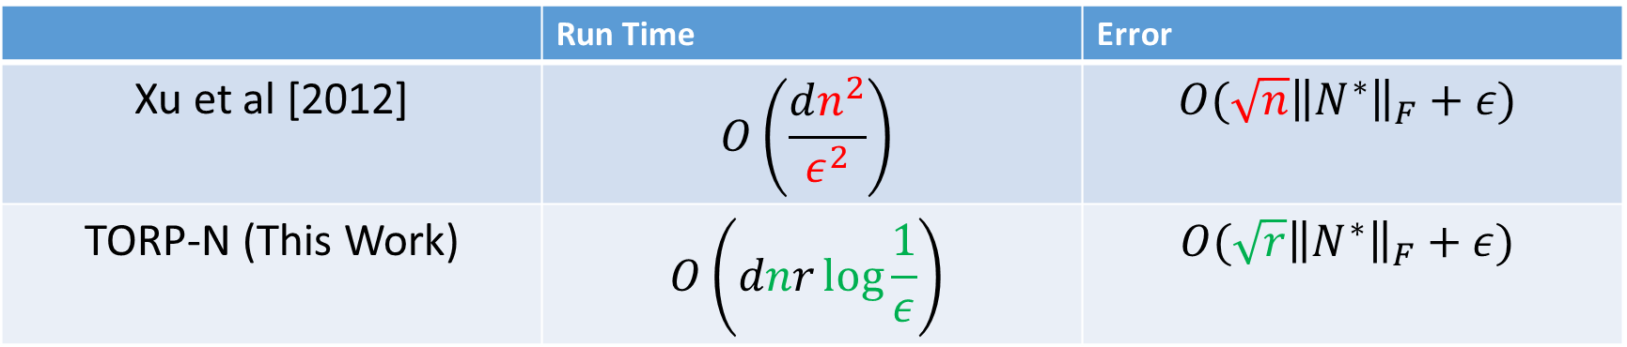
Prior Work
 | Run Time | Error
Xu et al [2012] | $$O\left(\frac{dn^{2}}{ε^{2}}\right)$$ | $$O(\sqrt{n}{\left\|N^{∗}\right\|}_{F}+ε)$$
TORP-N (This Work) | $$O\left(dnr\log{\frac{1}{ε}}\right)$$ | $$O(\sqrt{r}{\left\|N^{∗}\right\|}_{F}+ε)$$
$O\left(\frac{n}{r}\right)$ improvement in runtime, $O\left(\sqrt{\frac{n}{r}}\right)$ in recovery error
Nearly match run time of Vanilla PCA
Can we do better?

Slide 17
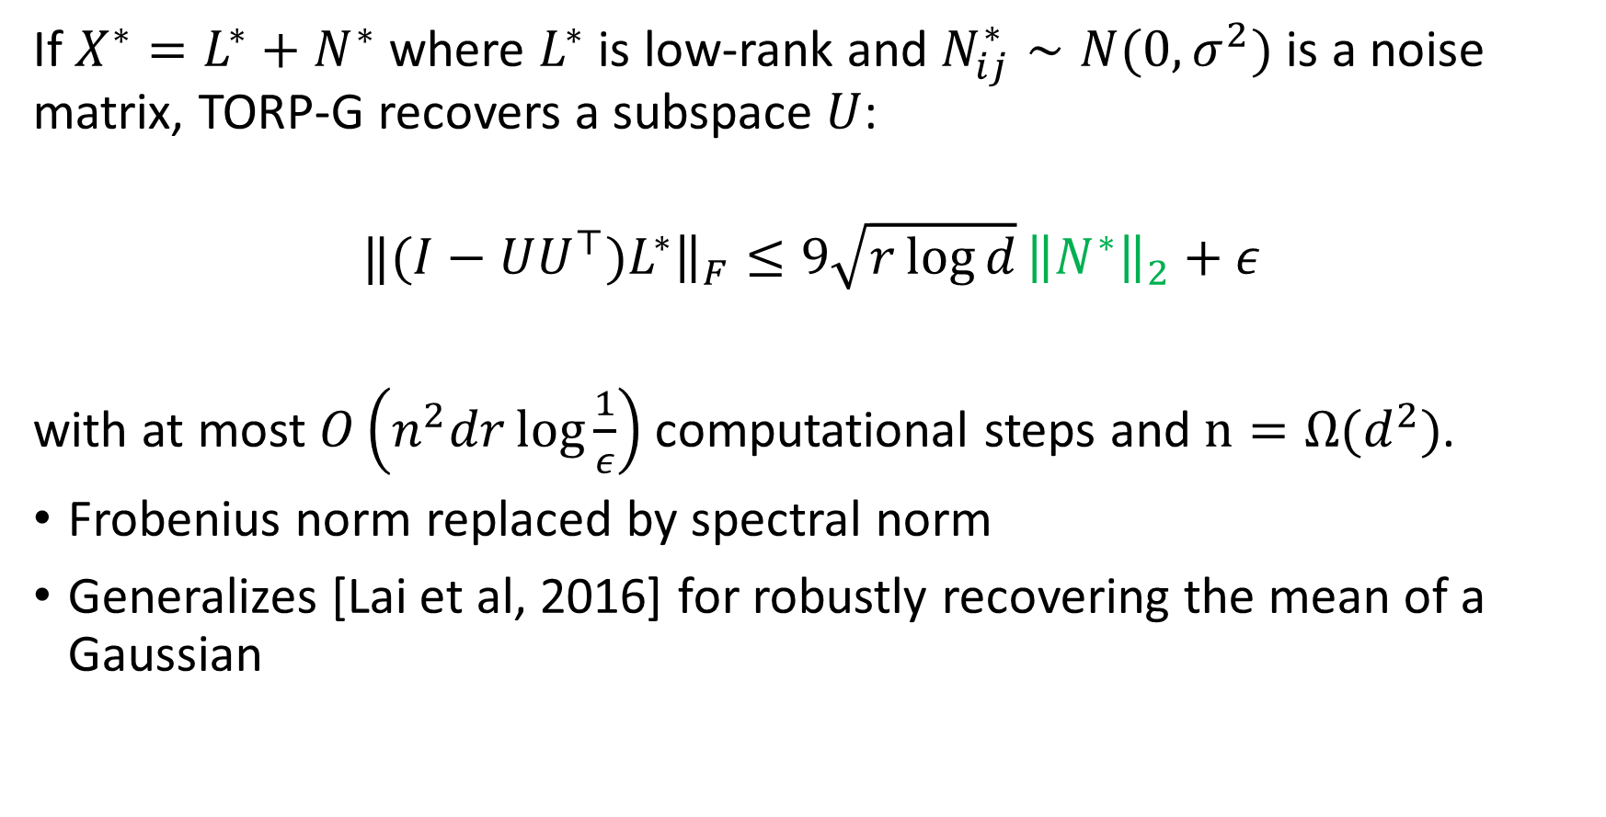
Theorem Gaussian Case
If $X^{∗}=L^{∗}+N^{∗}$ where $L^{∗}$ is low-rank and $N_{ij}^{∗}∼N(0,σ^{2})$ is a noise matrix, TORP-G recovers a subspace $U$:
$$‖(I−UU^{⊤})L^{∗}{\left.​\right\|}_{F}≤9{\sqrt{r\log{d}}\left\|N^{∗}\right\|}_{2}+ε$$
with at most $O\left(n^{2}dr\log{\frac{1}{ε}}\right)$computational steps and $n=Ω(d^{2})$.
Frobenius norm replaced by spectral norm
Generalizes [Lai et al, 2016] for robustly recovering the mean of a Gaussian

Slide 18
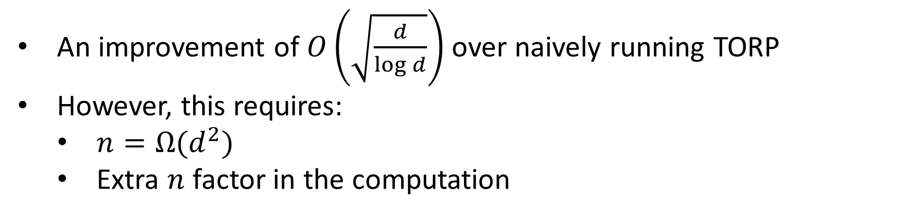
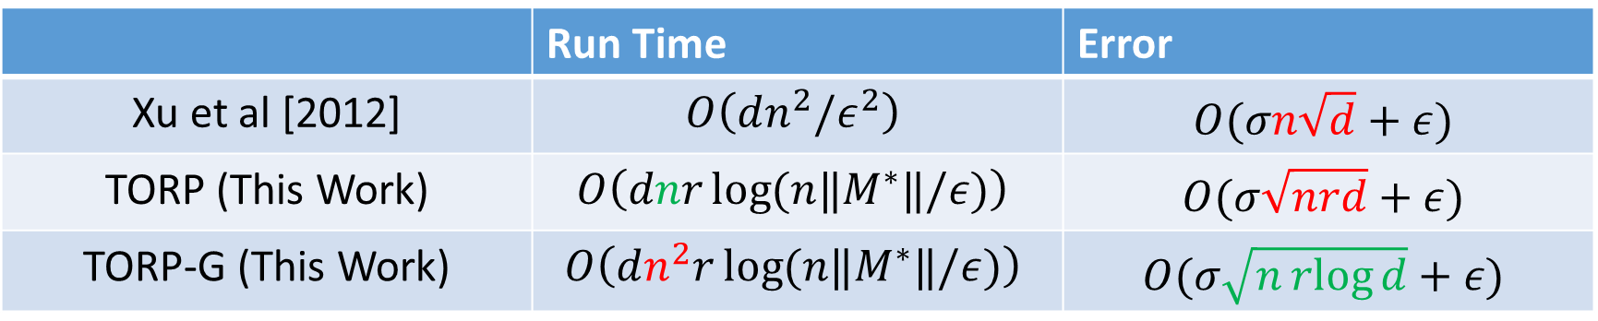
Prior Work (Gaussian Noise Case)
 | Run Time | Error
Xu et al [2012] | $$O\left(dn^{2}/ε^{2}\right)$$ | $$O(σn\sqrt{d}+ε)$$
TORP (This Work) | $$O\left(dnr\log{(n‖M^{∗}‖/ε)}\right)$$ | $$O(σ\sqrt{nrd}+ε)$$
TORP-G (This Work) | $$O\left(dn^{2}r\log{(n‖M^{∗}‖/ε})\right)$$ | $$O(σ\sqrt{n\operatorname{rlog}{d}}+ε)$$
An improvement of $O\left(\sqrt{\frac{d}{\log{d}}}\right)$ over naively running TORP
However, this requires:
$n=Ω(d^{2})$
Extra $n$ factor in the computation

Slide 19
Application to Anomaly Detection
Given a set of URLs, separate good from bad
Hypothesis: Good ones belong to a low dimensional space
Results:
Dataset | Robust PCA | PCA | Dimensionality
Malicious URL | 0.8050 | 0.7693 | 2M
Webspam Data | 0.8873 | 0.8335 | 670K

Slide 20
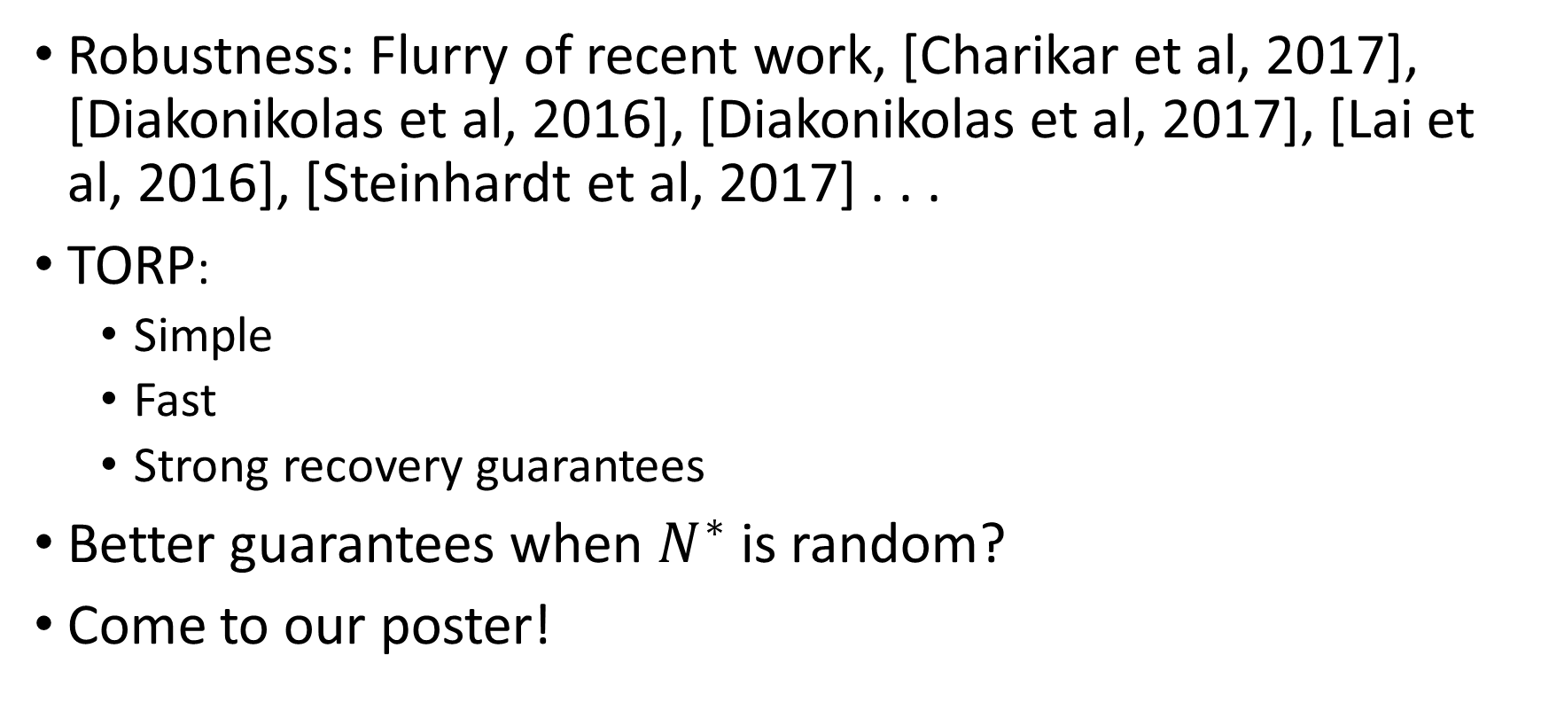
Conclusions
Robustness: Flurry of recent work, [Charikar et al, 2017], [Diakonikolas et al, 2016], [Diakonikolas et al, 2017], [Lai et al, 2016], [Steinhardt et al, 2017] . . .
TORP:
Simple
Fast
Strong recovery guarantees
Better guarantees when $N^{∗}$ is random?
Come to our poster!

Slide 21
Thank You

Slide 22
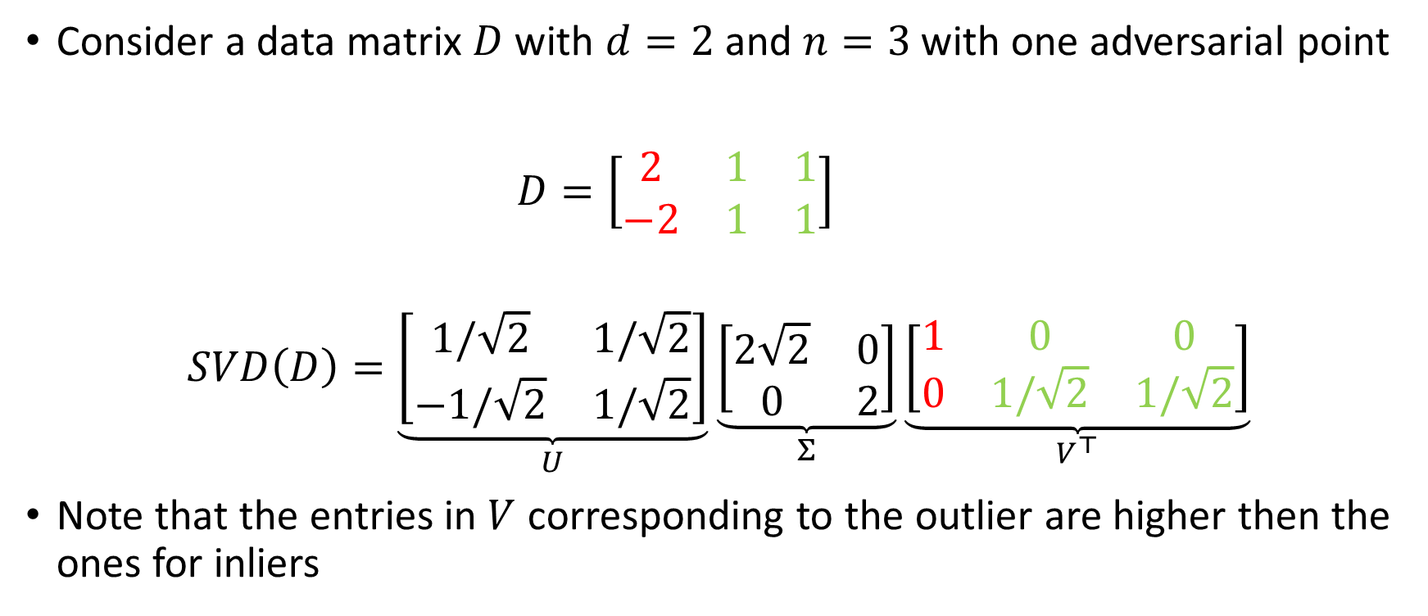
Algorithm – First Pass
Consider a data matrix $D$ with $d=2$ and $n=3$ with one adversarial point
$D=\left[\begin{matrix}2 & 1 & 1 \\ −2 & 1 & 1\end{matrix}\right]$
$$SVD\left(D\right)=\underset{U}{\underbrace{\left[\begin{matrix}1/\sqrt{2} & 1/\sqrt{2} \\ −1/\sqrt{2} & 1/\sqrt{2}\end{matrix}\right]}}\underset{Σ}{\underbrace{\left[\begin{matrix}2\sqrt{2} & 0 \\ 0 & 2\end{matrix}\right]}}\underset{V^{⊤}}{\underbrace{\left[\begin{matrix}1 & 0 & 0 \\ 0 & 1/\sqrt{2} & 1/\sqrt{2}\end{matrix}\right]}}$$
Note that the entries in $V$ corresponding to the outlier are higher then the ones for inliers

Slide 23
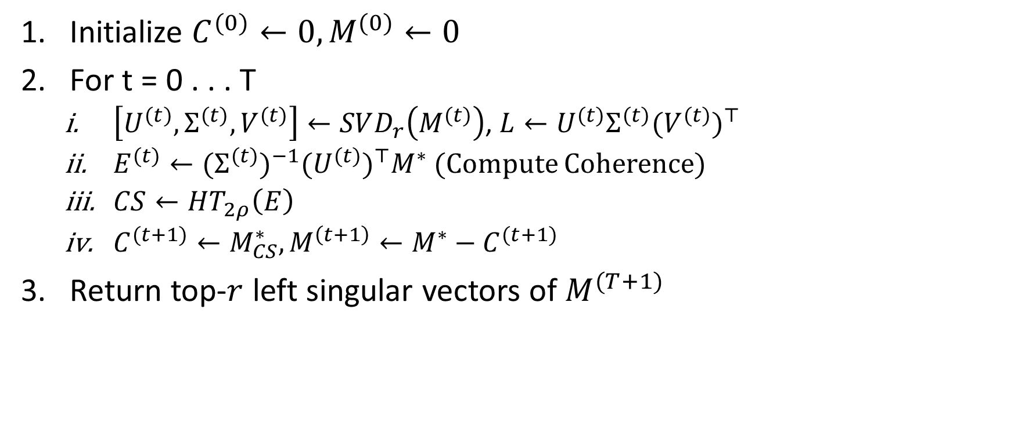
Algorithm 1 – Coherence Based Thresholding
Initialize $C^{(0)}←0, M^{(0)}←0$
For t = 0 . . . T
$\left[U^{(t)}, Σ^{(t)}, V^{(t)}\right]←SVD_{r}\left(M^{(t)}\right)$, $L←U^{(t)}Σ^{(t)}{(V^{(t)})}^{⊤}$
$E^{(t)}←{(Σ^{(t)})}^{−1}{(U^{(t)})}^{⊤}M^{∗}$ (Compute Coherence)
$CS←HT_{2ρ}\left(E\right)$
$C^{(t+1)}←M_{CS}^{∗}, M^{\left(t+1\right)}←M^{∗}−C^{(t+1)}$
Return top-$r$ left singular vectors of $M^{(T+1)}$

Slide 24
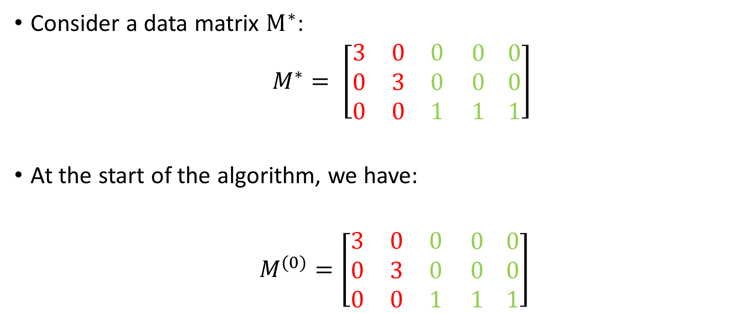
Adversarial Example
Consider a data matrix $M^{∗}$:
$M^{∗}= \left[\begin{matrix}3 & 0 & 0 \\ 0 & 3 & 0 \\ 0 & 0 & 1\end{matrix} \begin{matrix}0 \\ 0 \\ 1\end{matrix} \begin{matrix}0 \\ 0 \\ 1\end{matrix}\right]$
At the start of the algorithm, we have:
$M^{(0)}=\left[\begin{matrix}3 & 0 & 0 \\ 0 & 3 & 0 \\ 0 & 0 & 1\end{matrix} \begin{matrix}0 \\ 0 \\ 1\end{matrix} \begin{matrix}0 \\ 0 \\ 1\end{matrix}\right]$

Slide 25
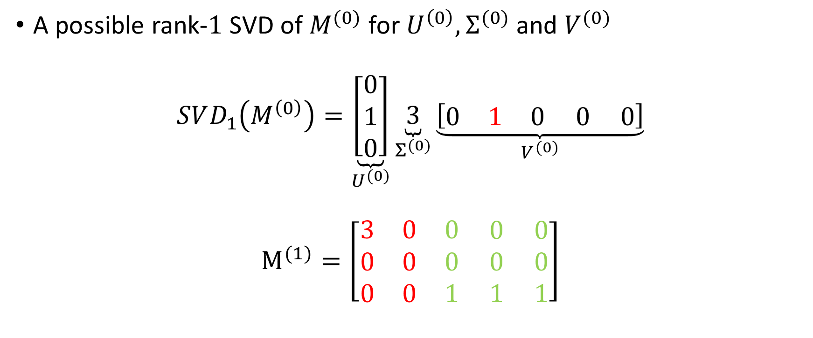
Adversarial Example – Iteration 1
A possible rank-$1$ SVD of $M^{(0)}$ for $U^{\left(0\right)},Σ^{(0)}$and $V^{(0)}$
$$SVD_{1}\left(M^{\left(0\right)}\right)=\underset{U^{(0)}}{\underbrace{\left[\begin{matrix}0 \\ 1 \\ 0\end{matrix}\right]}}\underset{Σ^{(0)}}{\underbrace{3}}\underset{V^{(0)}}{\underbrace{\left[\begin{matrix}0 & 1 & 0 0 0\end{matrix}\right]}}$$
$$M^{(1)}=\left[\begin{matrix}3 & 0 & 0 \\ 0 & 0 & 0 \\ 0 & 0 & 1\end{matrix} \begin{matrix}0 \\ 0 \\ 1\end{matrix} \begin{matrix}0 \\ 0 \\ 1\end{matrix}\right]$$

Slide 26

Adversarial Example – Iteration 2
Rank-$1$ SVD of $M^{(1)}$ for $U^{\left(1\right)},Σ^{(1)}$and $V^{(1)}$
$$SVD_{1}\left(M^{\left(1\right)}\right)=\underset{U^{(1)}}{\underbrace{\left[\begin{matrix}0 \\ 1 \\ 0\end{matrix}\right]}}\underset{Σ^{(1)}}{\underbrace{3}}\underset{V^{(1)}}{\underbrace{\left[\begin{matrix}1 & 0 & 0 0 0\end{matrix}\right]}}$$
$$M^{(2)}=\left[\begin{matrix}0 & 0 & 0 \\ 0 & 0 & 0 \\ 0 & 3 & 1\end{matrix} \begin{matrix}0 \\ 0 \\ 1\end{matrix} \begin{matrix}0 \\ 0 \\ 1\end{matrix}\right]$$

Slide 27
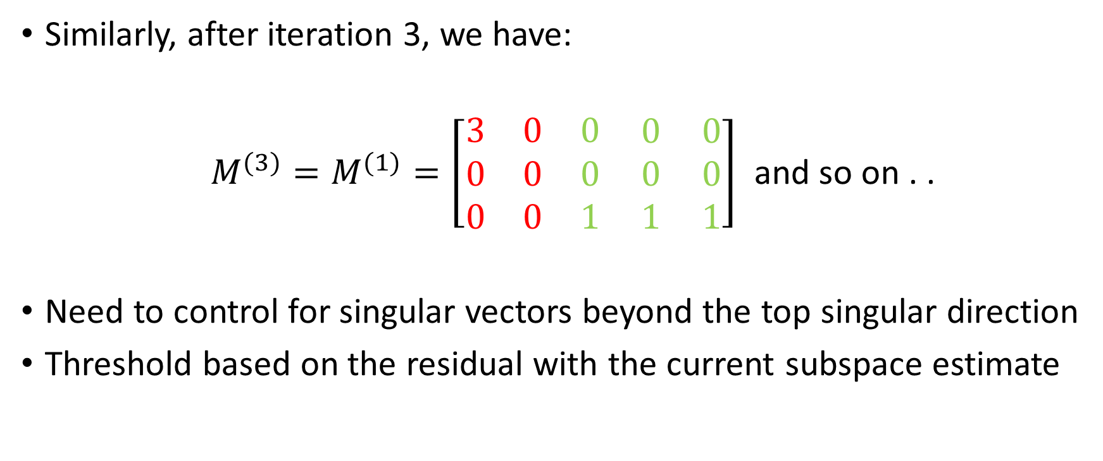
Adversarial Example – Contd
Similarly, after iteration 3, we have:
$M^{(3)}=M^{(1)}=\left[\begin{matrix}3 & 0 & 0 \\ 0 & 0 & 0 \\ 0 & 0 & 1\end{matrix} \begin{matrix}0 \\ 0 \\ 1\end{matrix} \begin{matrix}0 \\ 0 \\ 1\end{matrix}\right]$ and so on . .
Need to control for singular vectors beyond the top singular direction
Threshold based on the residual with the current subspace estimate

Slide 28
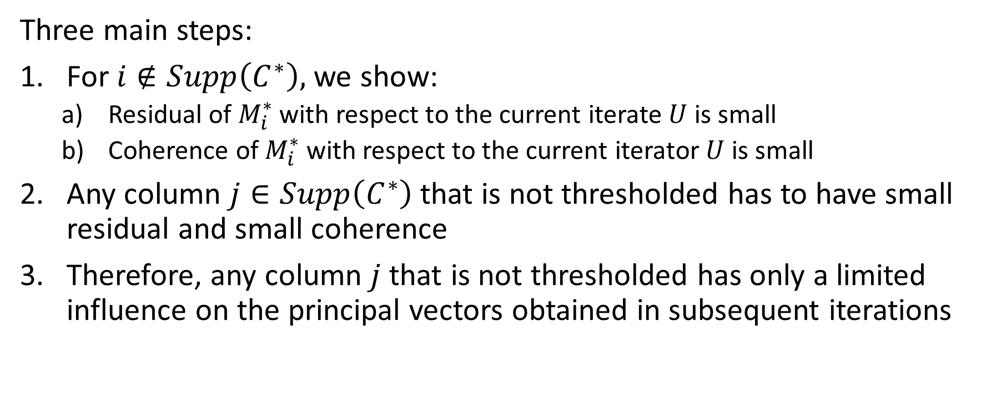
Proof Overview
Three main steps:
For $i∉Supp\left(C^{∗}\right),$we show:
Residual of $M_{i}^{∗}$ with respect to the current iterate $U$ is small
Coherence of $M_{i}^{∗}$ with respect to the current iterator $U$ is small
Any column $j∈Supp\left(C^{∗}\right)$ that is not thresholded has to have small residual and small coherence
Therefore, any column $j$ that is not thresholded has only a limited influence on the principal vectors obtained in subsequent iterations

Slide 29
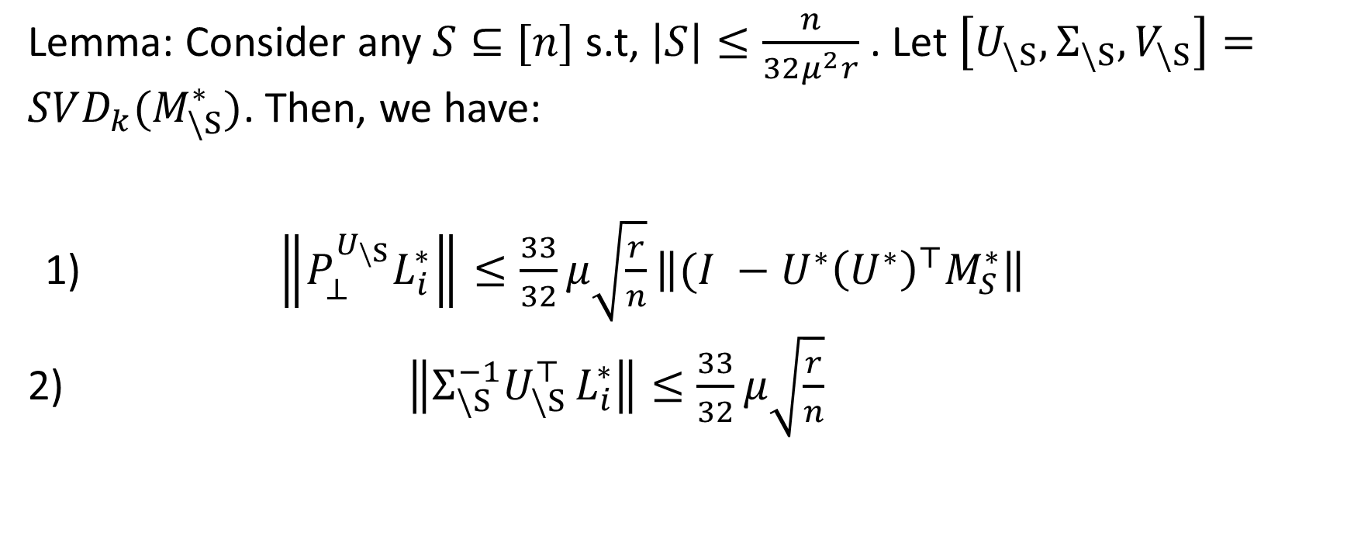
Proof Overview
Lemma: Consider any $S⊆[n]$ s.t, $\left|S\right|≤\frac{n}{32μ^{2}r}$. Let $\left[U_{\backslash S}, Σ_{\backslash S},V_{\backslash S}\right]=SVD_{k}(M_{\backslash S}^{∗})$. Then, we have:
1) $\left\|P_{⊥}^{U_{\backslash S}}L_{i}^{∗}\right\|≤\frac{33}{32}μ\sqrt{\frac{r}{n}}\left\|(I −U^{∗}{\left(U^{∗}\right)}^{⊤}M_{S}^{∗}\right\|$
2) $\left\|Σ_{\backslash S}^{−1}U_{\backslash S }^{⊤}L_{i}^{∗}\right\|≤\frac{33}{32}μ\sqrt{\frac{r}{n}}$

Slide 30
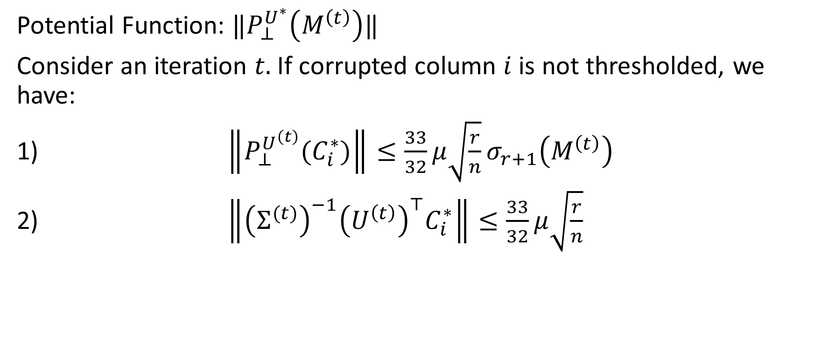
Proof of Theorem
Potential Function: $‖P_{⊥}^{U^{∗}}\left(M^{\left(t\right)}\right)‖$
Consider an iteration $t.$ If corrupted column $i$ is not thresholded, we have:
$\left\|P_{⊥}^{U^{\left(t\right)}}(C_{i}^{∗})\right\|≤\frac{33}{32}μ\sqrt{\frac{r}{n}}σ_{r+1}\left(M^{\left(t\right)}\right)$
$\left\|{\left(Σ^{(t)}\right)}^{−1}{\left(U^{\left(t\right)}\right)}^{⊤}C_{i}^{∗}\right\|≤\frac{33}{32}μ\sqrt{\frac{r}{n}}$

Slide 31
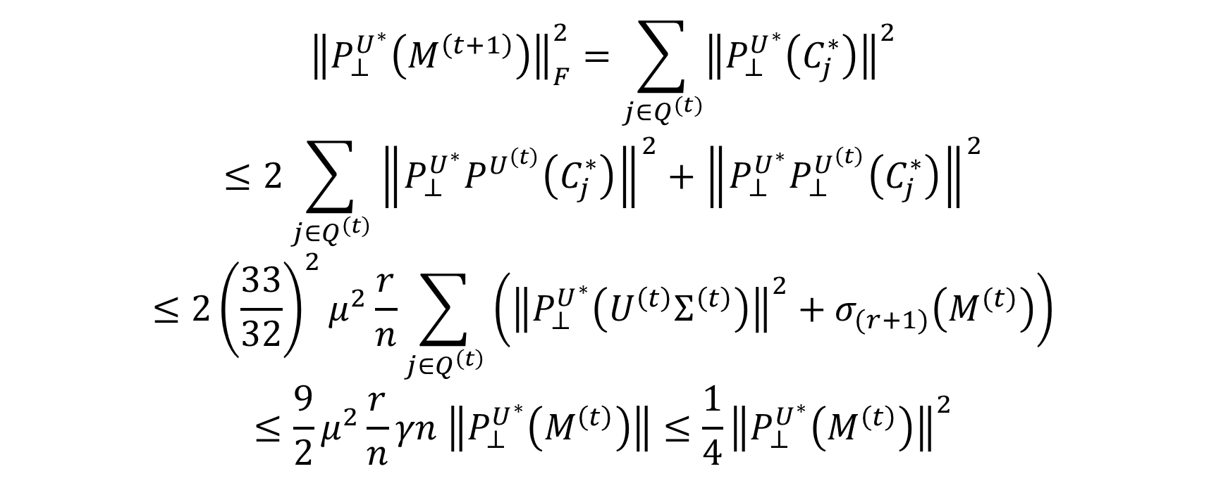
Proof of Theorem
$${\left\|P_{⊥}^{U^{∗}}\left(M^{\left(t+1\right)}\right)\right\|}_{F}^{2}=\sum_{j∈Q^{(t)}}{{\left\|P_{⊥}^{U^{∗}}\left(C_{j}^{∗}\right)\right\|}^{2}}$$
$$≤2\sum_{j∈Q^{\left(t\right)}}{{\left\|P_{⊥}^{U^{∗}}P^{U^{\left(t\right)}}\left(C_{j}^{∗}\right)\right\|}^{2}+{\left\|P_{⊥}^{U^{∗}}P_{⊥}^{U^{\left(t\right)}}\left(C_{j}^{∗}\right)\right\|}^{2}}$$
$$≤2{\left(\frac{33}{32}\right)}^{2}μ^{2}\frac{r}{n}\sum_{j∈Q^{\left(t\right)}}{\left({\left\|P_{⊥}^{U^{∗}}\left(U^{\left(t\right)}Σ^{\left(t\right)}\right)\right\|}^{2}+σ_{(r+1)}\left(M^{(t)}\right)\right)}$$
$$≤\frac{9}{2}μ^{2}\frac{r}{n}γn \left\|P_{⊥}^{U^{∗}}\left(M^{\left(t\right)}\right)\right\|≤\frac{1}{4}{\left\|P_{⊥}^{U^{∗}}\left(M^{\left(t\right)}\right)\right\|}^{2}$$

Slide 33
Appendix and Extra Slides

Slide 34
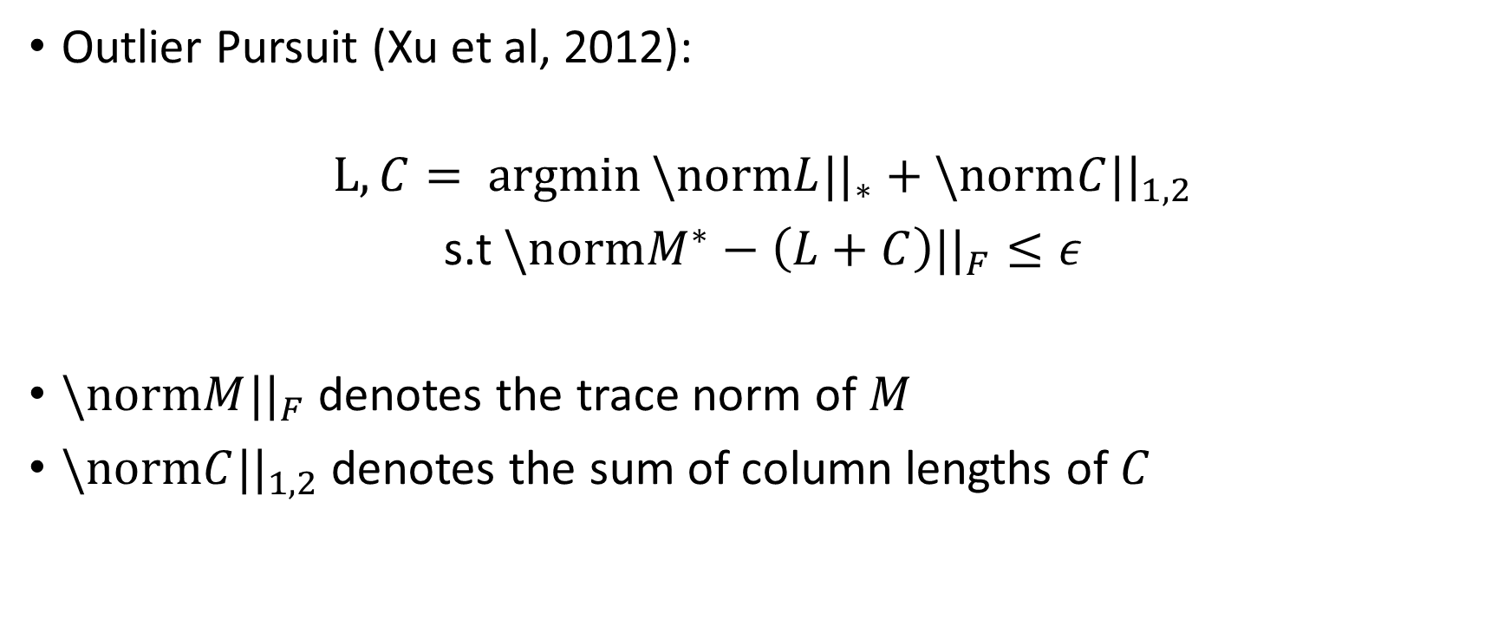
Convex Relaxation (Outlier Pursuit)
Outlier Pursuit (Xu et al, 2012):
$$L, C= \operatorname{argmin}{\backslash normL||_{∗}+\backslash normC||_{1,2}}$$
s.t $\backslash normM^{∗}−\left(L+C\right)||_{F}≤ε$
$\backslash normM||_{F}$ denotes the trace norm of $M$
$\backslash normC||_{1,2}$denotes the sum of column lengths of $C$

Slide 35
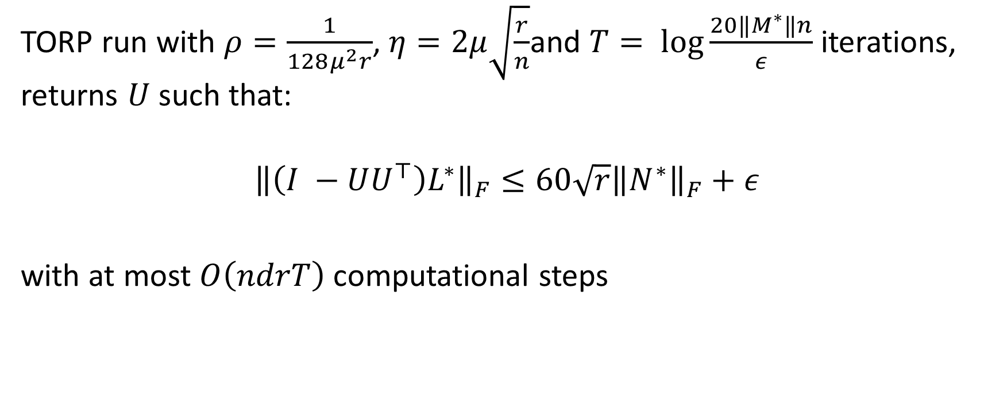
Theorem - TORP
TORP run with $ρ=\frac{1}{128μ^{2}r}$, $η=2μ\sqrt{\frac{r}{n}}$and $T= \log{\frac{20‖M^{∗}‖n}{ε}}$ iterations, returns $U$such that:
$${\left\|\left(I −UU^{⊤}\right)L^{∗}\right\|}_{F}≤60\sqrt{r}{\left\|N^{∗}\right\|}_{F}+ε$$
with at most $O\left(ndrT\right)$computational steps

