Slide 1

Automating Document PDFs with Excel and SAP
A portfolio project to reduce manual work in enterprise reporting

Slide 2


From Manual Pages to One-Click PDF
The Manual Bottleneck
The Operational Friction
In many enterprise environments, engineers and SCM analysts must manually search, open, and review repetitive records inside legacy SAP GUI systems day in and day out.
Exporting PDFs individually and writing back tracking references is slow, dull, and prone to costly human typographical errors.
Hours wasted on mindless clicks
Repeatedly opening SAP transactions
Risk of mismatched files & missing logs
Finding materials & logs one-by-one

Slide 3



Development Style: AI-Assisted "Vibe Coding"
Natural-Language Iteration
Strict Human Governance
Leveraged advanced AI prompts (via Perplexity) to drastically accelerate structural development, design loops, and visual presentation:
While AI acted as a highly competent development accelerator, all critical engineering choices remained 100% human-driven:
Sketched complex VBA error traps
Security & local sanitization constraints
Formulated robust modular code logic
Deep modular layout and API naming design
Re-iterated custom UI/UX design layouts
"AI accelerated documentation, refactoring, and design iterations while all architecture decisions, debugging, SAP integration, testing, and final implementation remained my responsibility. "

Slide 4
Business Value & Benefits
Operation | Before (Manual) | After (Automated)
Navigation | Slow SAP GUI inputs | Instant Macro automation
File Saving | Manual "Save As" clicks | Automatic paths & names
Logging | Manual tracking entries | Auto-filled status logs
Quantified Impact
Reduced Manual Effort : Reduces hours of repetitive manual printing into a single, background execution click.
Absolute Consistency: Standardizes naming rules, folders, and outputs without human error.
Full Traceability: Every exported file has an exact corresponding logged reference in the Master Excel Sheet.

Slide 5


How It Looks in Practice
Master Parameter Sheet
Behind-The-Scenes Loop
A clean, structured Excel dashboard serves as the central control tower for the entire program execution:
When the user triggers the macro, Excel runs a background automation script that directly navigates the SAP GUI in real-time.
Column A: Material ID
PDFs are seamlessly structured and generated directly inside the PC's designated local folders while the operator stays focused on higher-value analysis.
Column B: Raw parameters or descriptors
Column C: Auto-logged Status (Created / N/A / Error)
Column D: Exported Document ID

Slide 6

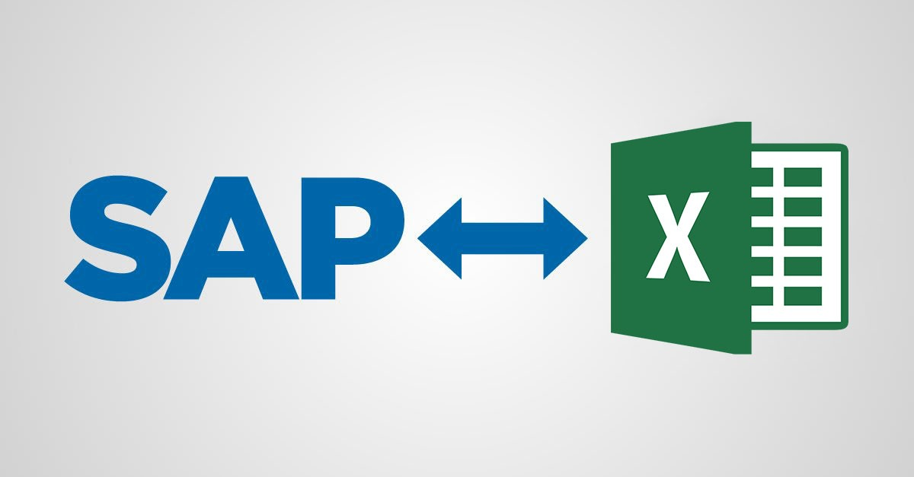
Macro Workflow: From Excel to Local Storage
Chronological Action Pipeline
A unified workflow connecting Excel interfaces, SAP mainframes, and the local Windows OS environment:
Read: Parses raw material lists from Column B.
Navigate: Directs SAP screens to open specific PDF/Document links.
Automate: Intercepts Windows Save Dialogs to input file names automatically.
Log: Updates Columns C & D with status logs and document IDs.
Conceptual workflow built in Canva; no real SAP screens or company data exposed.

Slide 7





How It Was Built
Excel Engine (VBA)
SAP GUI Scripting
Windows OS API
Designed using Visual Basic for Applications to parse target document pools, handle logical branching, and write back execution statuses.
Interfaces directly with SAP's native Scripting API, enabling the Excel macro to programmatically control standard screens, grids, and tabs.
Utilizes low-level Windows API commands to capture print-to-PDF save prompts, auto-typing destination file paths without manual clicking.

Slide 8


Module Architecture: Structured VBA Codebase
modMain
modSAP_Helpers
modWinAPI
modCore_Workflow
The control hub. Handles loop bounds, coordinates input datasets, maps target arrays, and initiates core run sequences.
Establishes SAP session hooks, manipulates text grids, triggers script transactions, and safely checks active windows.
Employs FindWindow and low-level SendKeys API to bypass print dialog prompts, forcing path entry and saving.
Implements core business logic rules, text parsing algorithms, directory verification, and cell update logs.
Clean, modular VBA that can be completely reused for similar SAP-Excel PDF workflows.

Slide 9
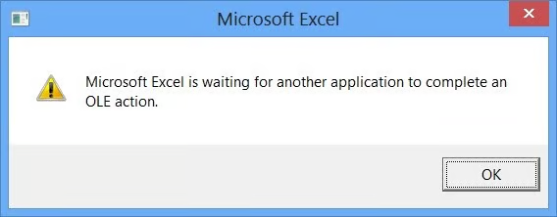
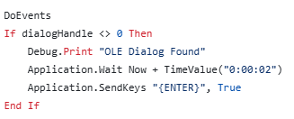
Technical Challenge: OLE Dialogs
Preventing "Server Busy" Deadlocks
Bypassing standard Windows timeout barriers during slow SAP database queries:
The Bottleneck: Database delays or network latency when retrieving PDFs blocks Excel's synchronous execution thread.
The OLE Trigger: If Excel blocks for over 30 seconds, Windows forces a modal alert: "Microsoft Excel is waiting for another application…", freezing the unattended script.
“Auto-press”
when pop up
Solution: Implemented an asynchronous background watcher that detects the Windows OLE "Server Busy" dialog triggered by extended SAP processing delays and dismisses it automatically so execution can continue.
Instant Auto-Enter: Detects and handles the PDF printer save dialog in under 2 seconds, resolving the freeze and completely avoiding OLE timeout thresholds.
Utilized asynchronous background handlers to dismiss Windows prompts instantly and completely prevent OLE timeout thresholds.

Slide 10


System Impact Metrics
Reduced manual processing time
80%
A typical PDF exporting task via SAP can take
Manual efforts - 3 minutes * 1000 PDFs = 50 hours
Automation script - 30 seconds * 1000 PDFs = 8.3 hours
In this case, it saves about 83% of the time ❗
Operational Time Saved

Slide 11
Demonstrated Aspects
Advanced VBA & Excel Architectures: Building reliable, resilient macros that manipulate enterprise datasets cleanly and efficiently.
ERP System Automation: Gaining deep practical scripting expertise with legacy ERP systems (SAP), overcoming interface constraints.
Process & System Design: Analyzing real-world human bottlenecks and translating them into reliable, repeatable software solutions.
Clean & Modular Codebase: Organizing codebase structures into isolated logical modules for easy maintenance, extension, and deployment.

Slide 12


Where This Can Go Next
System Scaling
Advanced Features
The code architecture is modularly decoupled, meaning it can be expanded to automate other core business procedures:
Future development phases can add enterprise-grade reliability and communication protocols:
Enhanced real-time error logging & fail-safes
Expanding to sales orders, shipments, and billing
Windows system dialog or Teams status triggers
Direct cloud / Document Management system sync

Slide 13
Image Sources
https://media.licdn.com/dms/image/v2/C4E12AQF8fb_Io9YHyA/article-cover_image-shrink_720_1280/article-cover_image-shrink_720_1280/0/1643913705813?e=2147483647&v=beta&t=SoCBKCyrgtjpmqvXqlk6dfCST0lafo6-SdMPMxve7hM
Source: https://media.licdn.com/
https://support.central.insightsoftware.com/support/servlet/rtaImage?eid=ka0UO000000IZjx&feoid=00Nf400000PcwAL&refid=0EMf4000001Jb5w
Source: https://support.central.insightsoftware.com/

