Slide 1
Practise Session
Seminar 6

Slide 2
Before Going in…
If I do chapter 6, we will definitely not finish it today.
Therefore, rather going into a new topic, let’s do some recap!
I have prepared some examples from chapters 1 to 5. Some will be easy, but some can be hard.
Good Luck!

Slide 3
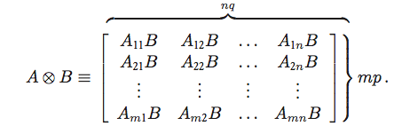
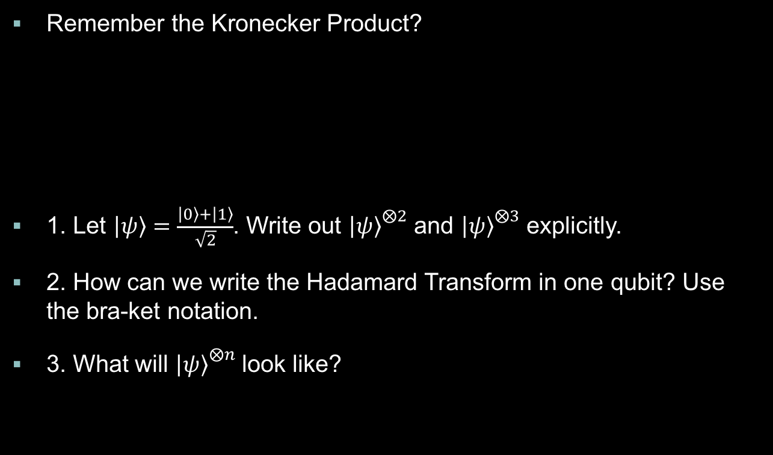
Basics in Quantum Mechanics
Remember the Kronecker Product?
1. Let $\left|\left.ψ\right\rangle \right.=\frac{\left|\left.0\right\rangle \right.+\left|\left.1\right\rangle \right.}{\sqrt{2}}$. Write out ${\left|\left.ψ\right\rangle \right.}^{⨂2}$ and ${\left|\left.ψ\right\rangle \right.}^{⨂3}$ explicitly.
2. How can we write the Hadamard Transform in one qubit? Use the bra-ket notation.
3. What will ${\left|\left.ψ\right\rangle \right.}^{⨂n}$ look like?

Slide 4
Incoherent States
1. Consider a pure ensemble of identically prepared spin ½ systems. Suppose we know the expectation values for Sx and Sz, and the sign of Sy are known. Determine the state vector.
2. Consider a mixed ensemble of spin ½ systems. The ensemble averages are all known. How can we construct the 2-by-2 density matrix?
3. Give an expression for the time evolution of the density operator.
4. In an ensemble of a spin-1 system, how many independent parameters do we need? What must we know except [Sx], [Sy] and [Sz]?

Slide 5
Universality of NAND
1. Construct the NOT gate.
2. Construct the AND gate.
3. Construct the OR gate.
3. Construct the NOR gate. (Inverted OR)
4. Construct the XOR gate.

Slide 6
Single-Qubit Operations
Remember the Pauli matrices and the rotation operators? If not, just look at seminar 3.
1. Show that XYX=-Y. What does this mean?
2. Prove exp(iAx) = cos(x)I + i sin(x)A.

Slide 7
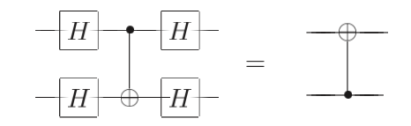
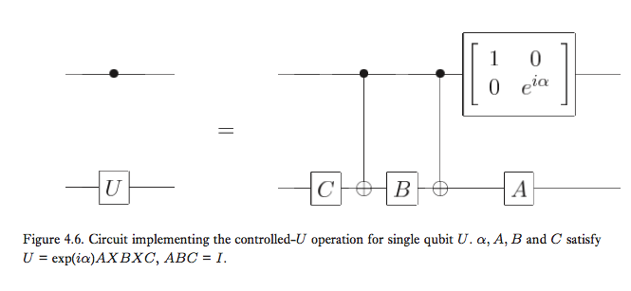
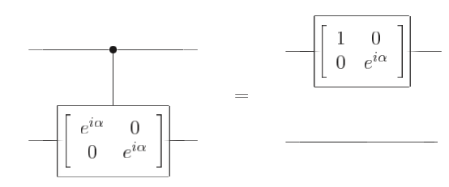
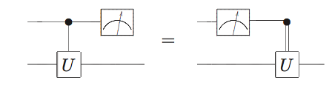
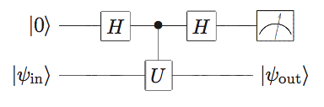
Controlled Gates
Double lines indicate classical bit.

Slide 8
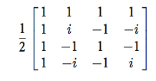
Universality
1. Decompose the following to a two-level gate.
2. Verify

Slide 9
Fourier Transform
1. Fourier tranfrom |00 . . . 0⟩ .
2. Give a decomposition of the controlled-Rk gate into single qubit and CNOT gates.
3. Construct the circuit for the Inverse Fourier Transform.

Slide 10

Factoring
1. Remember U |y⟩ ≡ |xy(mod N )⟩ ? Prove this is unitary.
2. Prove $\frac{1}{\sqrt{r}}\sum_{s=0}^{r−1}{\left|\left.u_{s}\right\rangle \right.}=\left|\left.1\right\rangle \right.$. I’ll give you some hints if required.
3. Factor 91 using Shor’s algorithm. It won’t be the best way you’ve seen :D
4. Recently, scientists factored 15 using NMR. Why 15?

