Slide 1



  BIGDATA TERM PROJECT
WEBTOON RECOMMENDATION SYSTEM
20153262 이현지
20174127 이영재
20170217 이승연

Slide 2
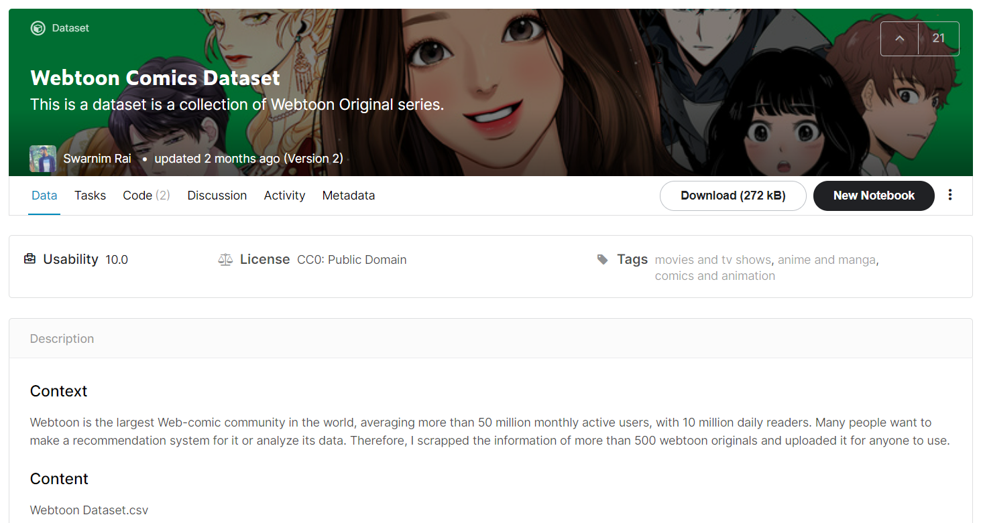
WEBTOON RECOMMENDATION SYSTEM
Data description

Slide 3
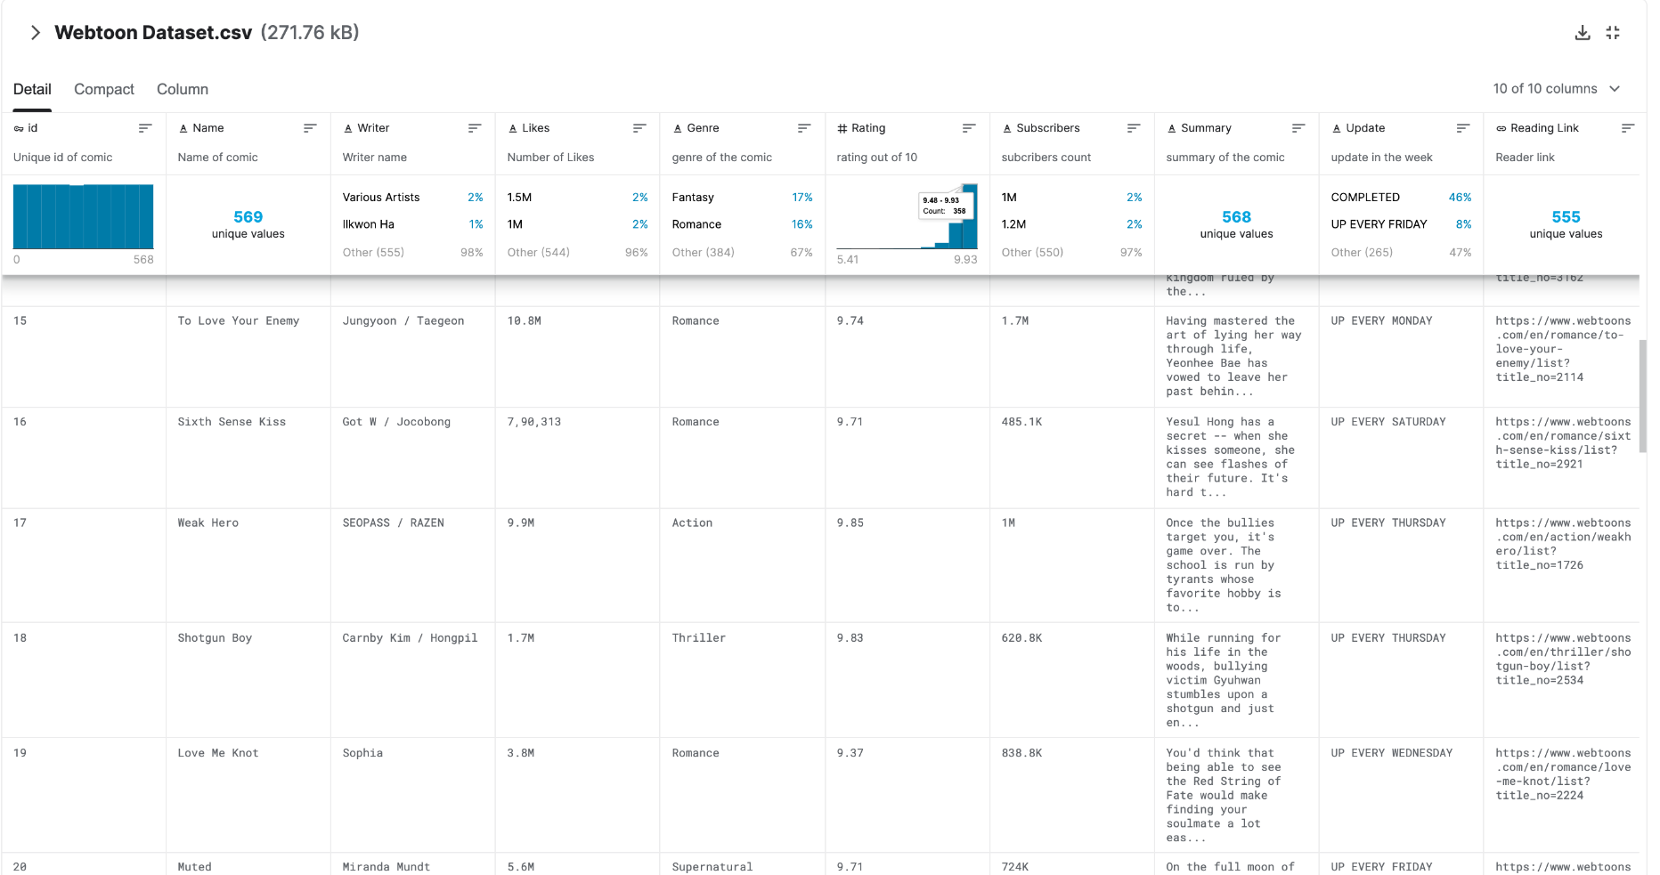
WEBTOON RECOMMENDATION SYSTEM
Data description
< Columns >
- Id
- Name
- Writer
- Likes
- Genre
- Rating
- Subscribers
- Summary
- Update
- Reading Link
Notes:
id - Unique id identifying the comic.
Name - full name of the comic.
Writer- Author of the comic.
Likes- Total no. of Likes
genre - genres for comic.
rating - an average rating out of 10 for the comic.
Subscribers- Total no. of subscribers
Summary- Summary of the comic
Update - Day of the week for an update
Reading Link- Link where you can read the comic

Slide 4
WEBTOON RECOMMENDATION SYSTEM
Problem statement
양산형 장르 웹툰의
인기 편중
웹툰 시장의 거대화
WEBTOON RECOMMENDATION SYSTEM

Slide 5
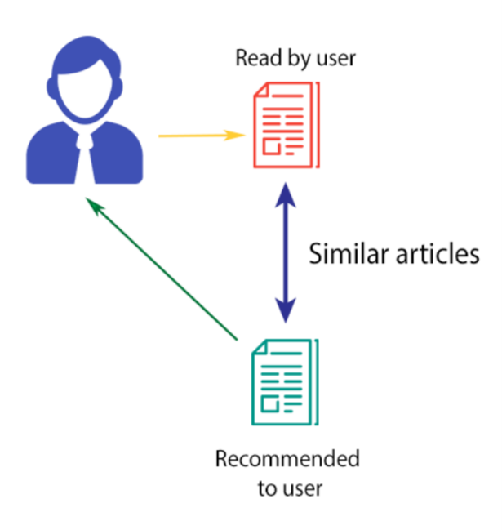
WEBTOON RECOMMENDATION SYSTEM
Methodology overview
CONTENT – BASED FILTERING
사용자에게서 과거에 만족한 웹툰을 입력 받음
-> 입력된 웹툰과 유사도가 높은 웹툰을 선정
-> 선정된 웹툰을 추천
Similar Webtoons

Slide 6
WEBTOON RECOMMENDATION SYSTEM
Analysis plan
< Columns >
- Id
- Name
- Writer
- Likes
- Genre
- Rating
- Subscribers
- Summary
- Update
- Reading Link
Subscribers, Likes 목적에 부합X
Rating, Genre 주요 데이터로 사용
필요시
Summary keyword 추출

Slide 7
END

