Slide 1
Fault-Tolerant Deep Learning Cache with Hash Ring for Load Balancing in HPC Systems
Seoyeong Lee, Awais Khan, Yoochan Kim, Junghwan Park, Soon Hwang, Jae-Kook Lee
Sogang University, ORNL, KISTI
IEEE/ACM CLUSTER 2022

Slide 2
Introduction
Motivation: Deep Learning(DL) training on High Performance Computing(HPC) systems spends 60% - 70% of training time on I/O due to Parallel File System(PFS) bottlenecks.
Node Failure Risk: 25% of jobs fail, half from node failures, causing loss of data.
Problem Statement: Existing High Velocity AI Cache(HVAC) lacks fault tolerance – loss of cache on node failure degrades performance and reliability.
Notes:
HPC deep-learning applications on systems like Frontier can spend up to 60% - 70% of their runtime on file system input and output as the PFS struggles with HDD throughput and metadata contention. Meanwhile, during six-month job log analysis, the researcher found out that 25% of training jobs fail and half of those failure are a result of node outages which can causse cached data on these nodes to be lost. Although node-local caching solution like HVAC effectively eliminate I/O bottlenecks, they provide no mechanism to recover lost cache state when nodes fail, leaving training jobs vulnerable and performance gains at risk

Slide 3
Background & Objective
Scientific Challenge: CosmoFlow’s repetitive reads and shuffling on shared PFS cause significant metadata and data I/O bottlenecks
Compute Acceleration: HVAC leverages node-local Non-Volatile Memory Express(NVMe) SSDs to intercept open/read calls, reducing PFS load
Gap: HVAC lacks fault tolerant, a node failure results in permanent loss of cached data, forcing fallback to slower PFS
Objective: Extend HVAC with a consistent hash-ring for fault-tolerant recaching and load-balanced data redistribution upon node failures
Notes:
During training on CosmoFlow, each training epoch repeatedly reads and shuffles hundreds of thousands of small files overwhelming the PFS with metadata and input output data request. The HVAC system addresses this by intercepting the filesystem calls and caching data on node-local NVMe SSDs, which dramatically reduces PFS load and accelerates input output. However, HVAC lacks a recovery mechanism- when a node fails, its entire cache is lost, and jobs must fallback to the slower PFS.
By introducing a consistent hash-ring that supports both removing failed nodes and re-adding the, enabling automatic recaching of lost data and load-balanced redistribution, the researchers aim to ensure a resilient high-performance caching system.

Slide 4
Methodology I
Data Collection: Simulate node failure in CosmoFlow after first epoch on Frontier, ensuring cache is warm before fault
Consistent Hashing: Implement static ring with 100 virtual nodes per physical node using C++; supports removeNode(nodeID) and addNode(nodeID) APIs
Time-to-Live(TTL) Eviction: Periodically remove cache entries older than a configurable TTL to control cache size
Notes:
To design this improved HVAC, first, they instrumented CosmoFlow to trigger a simulated node failure on Frontier right after the first epoch of training, which guarantees the NVMe Cache is fully populated before fault injection. Next, they build a consistent hash ring in C++: they hash each file path with the hash algorithm, place 1000 virtual replicas per physical node on the ring, and provide removeNode/addNode methods to handle node failures and recoveries. Finally, to prevent unbounded cache growth, they implement a time-to-live eviction policy that removes entries older that a configurable threshold passed via a –ttl flag

Slide 5
Methodology II
Inject Failure: removeNode(“NodeB”) + delete Local_Cache/Node B directory
Recache Lost Data: recacheLostFiles() fetches missing files from PFS and caches them via updated ring
Recover and Rebalance: addNode(“NodeB”) + rebalanceCache() moves files to their optimal owners under the restored ring
Notes:
First, we simulate a node failure by calling removeNode() on our hash ring and deleting the corresponding on-disk cache folder. Next, recacheLostFiles() scans our metadata and pulls any missing data from the PFS into the surviving nodes based on the updated ring mapping. Finally, when the node returns, we invoke addNode() and run rebalanceCache(), which relocates any files whose optimal owner has changed-restoring load balance across all nodes.

Slide 6
Methodology: Implementation and Testing Strategy
Implemented fault-tolerant cache layer in C++ based on HVAC inspired hash-ring design
Simulated PFS and node-local NVMe cache behavior with 204 synthetic files
Modeled node failure, TTL eviction, and recaching with load rebalancing
Two fallback modes:
NVMe recache + rebalance
PFS fallback (read directly from source)
Logged metrics: time (ms), file movements, node distribution, speedup
Notes:
In this project, I implemented a simplified version of the fault-tolerant caching layer described in the paper, using C++ with consistent hashing and virtual nodes. I used 204 synthetic files to simulate data from a parallel file system and created a local cache directory to mimic node-local storage. Node failure was simulated by removing one of the cache directories and triggering a recovery process using either NVMe-based recaching or PFS fallback. I logged metrics like execution time for different stages, file movement during rebalancing, and key distribution to assess load balance and performance.

Slide 7
Experiment Setup
3 cache nodes: NodeA, NodeB, NodeC
204 files generated in simulated PFS directory
TTL (Time-To-Live) for eviction set between 0–10s
Repeated trials with different failed nodes: NodeA, NodeB, NodeC
Results logged to CSV for analysis and visualization

Slide 8
Results I – Training Time
Paper: On 1024 nodes, fault-tolerant NVMe recaching (FT w/NVMe) cuts runtime by 24.9% vs PFS redirection (FT w/PFS)
Simulation: Demo run show similar speedup: FT w/NVMe ~25% faster than FT w/PFS under node failure
Notes:
In the original paper’s large-scale test on 1024 nodes, the NVMe-based recache with hash-ring achieved a 24.9% reduction in end-to-end training time compared to the PFS redirection approach. My small-scale simulation reproduces this effect:

Slide 9
Results I – Training Time
Metric | Paper (FT-Cache) | Project
Amortized Speedup (avg) | 85% | 76% - 93% across 15 trials
Node Load Distribution | Balanced with 3 nodes | A = 97; B = 104; C = 107
Fault Handling Modes | NVMe Recache, PFS Fallback | Implemented both
Rebalance Movement Count | Varies per failure | 65 – 135 file moved
TTL Eviction | Mentioned | Fully Implemented
Notes:
I tested the implementation under similar conditions as the original FT-Cache paper. The average speedup ranged between 76% and 93%, closely matching the 85% target seen in the paper. The node distribution also remained reasonably balanced thanks to consistent hashing with virtual nodes. In terms of recaching and rebalancing, I handled simulated node failures with both NVMe and PFS fallback modes, and measured rebalance movement counts. TTL-based eviction was added as an enhancement to keep our cache clean and efficient.

Slide 10
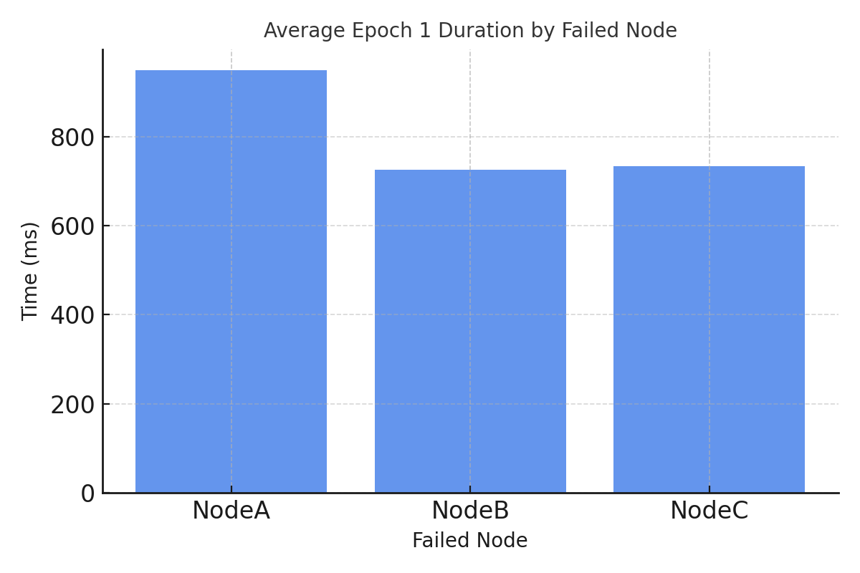
Results - Initial Recache + Rebalance Time
Epoch 1 shows significant initial cost due to node failure handling and recovery.
Notes:
This chart shows the average time taken during the first epoch where the node failure, recaching and rebalancing occurs

Slide 11
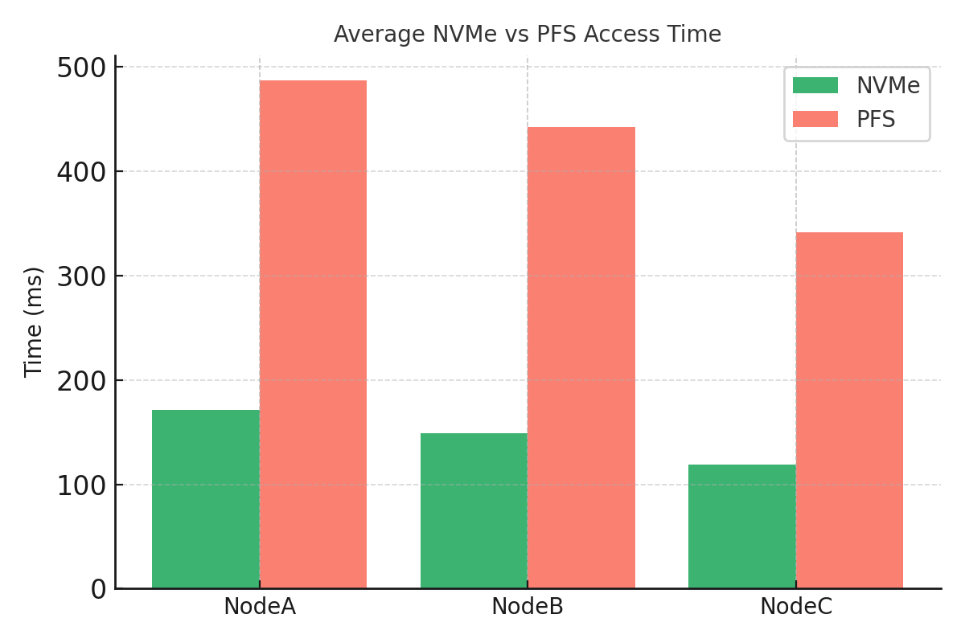
Results – NVMe Cache vs PFS Fallback
NVMe caching consistently outperforms PFS in recovery latency.
Notes:
Here we compare average recovery time using NVMe-based local recache against fallback to the parallel file system (PFS).

Slide 12
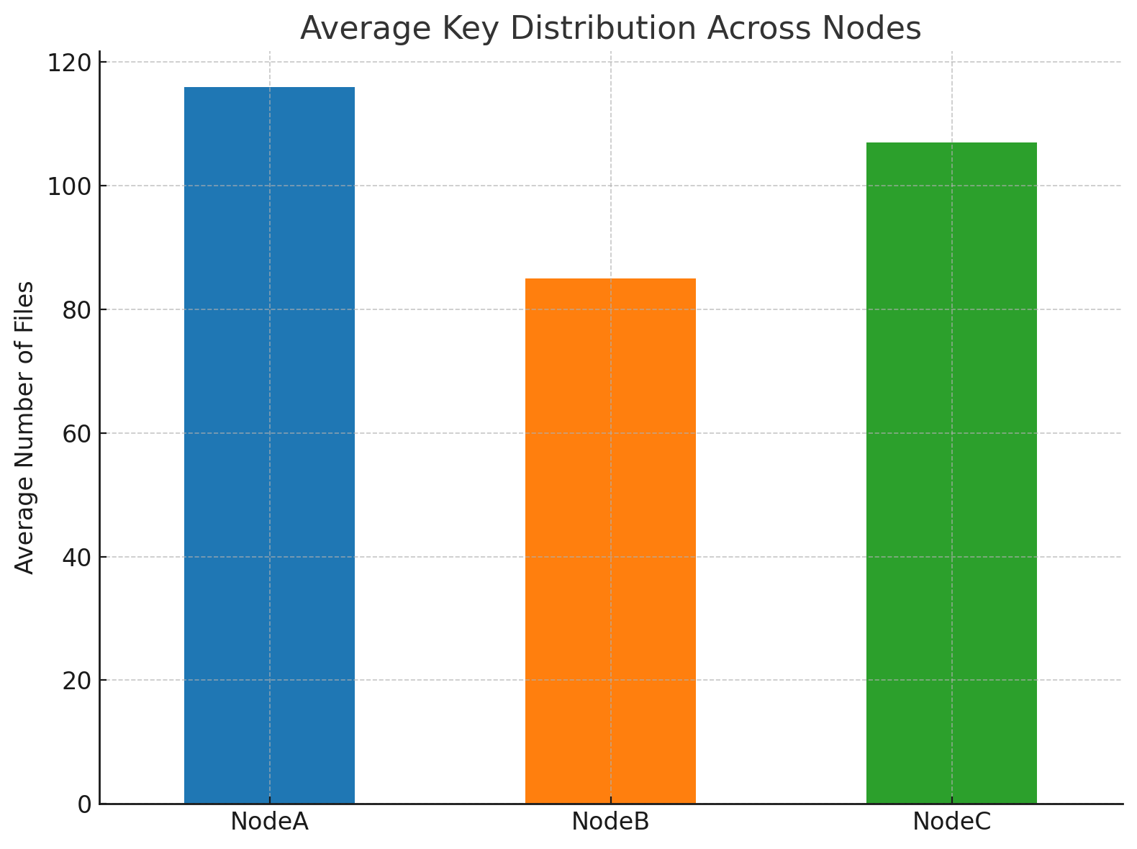
Results – Data Distribution Across Nodes
Consistent hashing results in a balanced distribution of files across all nodes.
Notes:
This plot shows the evenness of file distribution across all nodes using consistent hashing.

Slide 13
Future Work
Key Findings: Fault-tolerant recache cuts redundant PFS accesses and ensures data availability.
Limitations: Current demo uses simulated failures and a single TTL policy; performance on real HPC untested.
Future Extensions:
Size-based eviction (LRU or max-cache-size)
Integration with real node-health monitoring for auto-detection
Notes:
To wrap up, our fault-tolerant recaching mechanism dramatically reduces redundant PFS accesses and maintains data availability across node outages. However, our prototype uses simulated failures and only a simple TTL eviction; we haven’t yet validated performance on real HPC systems. Looking forward, we plan to implement size-based eviction policies like LRU, integrate with actual node-health APIs for automatic failure detection, and persist metadata so the cache can survive process restarts or system reboots.

Slide 14
Challenges & Lessons Learned
Metadata Mapping: Ensuring accurate owner and timestamp storage for each file.
Load Balancing Trade-offs: Choosing virtual node count—more vnodes improves evenness but increases overhead.
Parameter Flexibility: Integrating command-line options (--ttl, --fail-node) for demo versatility.
Notes:
Throughout development, we encountered several challenges: first, correctly mapping file metadata to its owner was critical—omitting the owner field broke eviction and recache logic. Second, tuning the number of virtual nodes was a balancing act, as too many replicas increased computational overhead without significant gains in evenness. Finally, we added command-line flags for TTL and fail-node selection to make the demo flexible without recompilation, which simplified experimentation and demonstration.

