Slide 1
Fault-Tolerant Deep Learning Cache with Hash Ring for Load Balancing in HPC Systems
Seoyeong Lee, Awais Khan, Yoochan Kim, Junghwan Park, Soon Hwang, Jae-Kook Lee
Sogang University, ORNL, KISTI
Published in: SC24-W: Workshops of the International Conference for High Performance Computing, Networking, Storage and Analysis (IEEE)

Slide 2
Introduction
Motivation: Deep Learning(DL) training on High Performance Computing(HPC) systems spends 60% - 70% of training time on I/O due to Parallel File System(PFS) bottlenecks.
Node Failure Risk: 25% of jobs fail, half from node failures, causing loss of data.
Problem Statement: Existing High Velocity AI Cache(HVAC) lacks fault tolerance – loss of cache on node failure degrades performance and reliability.
Notes:
On systems like Frontier, deep learning training jobs spend up to 70% of time on I/O. 25% of these jobs fail — and half of those are due to node outages. Solutions like HVAC cache data locally to avoid PFS load, but they lack fault tolerance. When a node fails, cached data is lost — that’s the problem this work addresses.

Slide 3
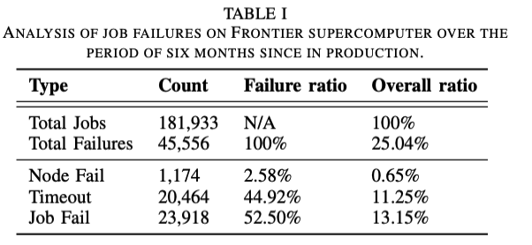
Introduction
Notes:
A six-month Frontier log analysis showed that 25% of training jobs failed — and over 1,100 of those were from node outages. Although node failures represent 2.6% of job failures, it is costly because it erases the local cache, forcing a fallback to slower storage.

Slide 4
Background & Objective
Scientific Challenge: CosmoFlow’s repetitive reads and shuffling on shared PFS cause significant metadata and data I/O bottlenecks
Compute Acceleration: HVAC leverages node-local Non-Volatile Memory Express(NVMe) SSDs to intercept open/read calls, reducing PFS load
Gap: HVAC lacks fault tolerant, a node failure results in permanent loss of cached data, forcing fallback to slower PFS
Objective: Extend HVAC with a consistent hash-ring for fault-tolerant recaching and load-balanced data redistribution upon node failures
Notes:
CosmoFlow which is the deep learning system trained with Frontier repeatedly reads thousands of small files, causing I/O bottlenecks. HVAC solves this with NVMe caching, but it lacks fault recovery. This work extends HVAC using a consistent hash ring to automatically recache lost data and rebalance load after failure.

Slide 5
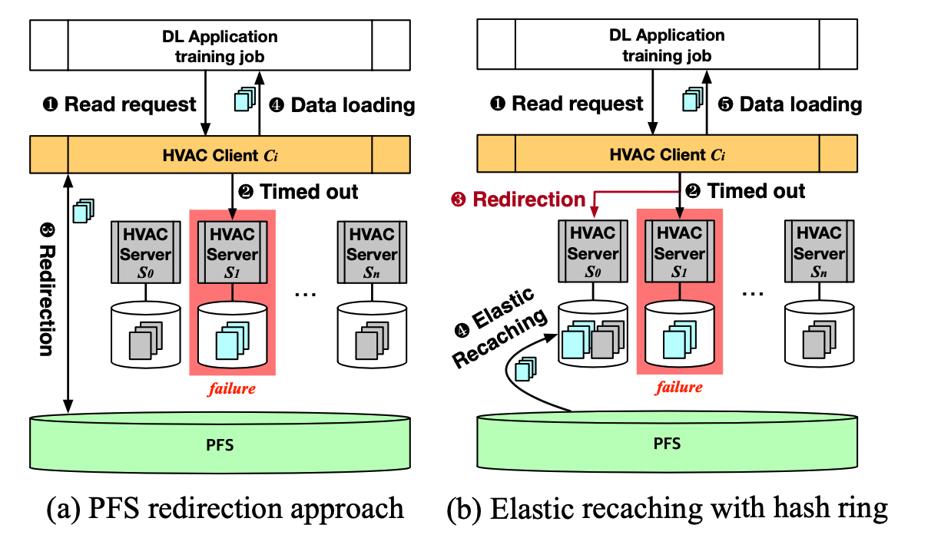
Background & Objective
Notes:
Here’s how the fault-tolerant caching system compares to HVAC. On the left, node failure forces a fallback to PFS. On the right, we use a hash ring to automatically recache lost files and redistribute data to remaining nodes. This avoids unnecessary PFS access and maintains training speed.”

Slide 6
Methodology
Data Collection: Simulate node failure in CosmoFlow after first epoch on Frontier, ensuring cache is populated before injecting fault
Consistent Hashing: Implement static ring with 100 virtual nodes per physical node using C++; supports removeNode(nodeID) and addNode(nodeID) APIs
Time-to-Live(TTL) Eviction: Periodically remove cache entries older than a configurable TTL to control cache size
Notes:
To test this, I simulated a node failure right after the first epoch, same as the research — once the cache was fully populated. I used a hash ring with 100 virtual nodes per physical node, and added TTL-based eviction to remove outdated files from cache”

Slide 7
Methodology
Inject Failure: removeNode(“NodeB”) + delete Local_Cache/Node B directory
Recache Lost Data: recacheLostFiles() fetches missing files from PFS and caches them via updated ring
Recover and Rebalance: addNode(“NodeB”) + rebalanceCache() moves files to their optimal owners under the restored ring
Notes:
Failure is simulated by removing a node and clearing its cache. The system then recaches missing files from PFS using updated ring mapping. When the node returns, we rebalance the cache to restore even distribution.

Slide 8
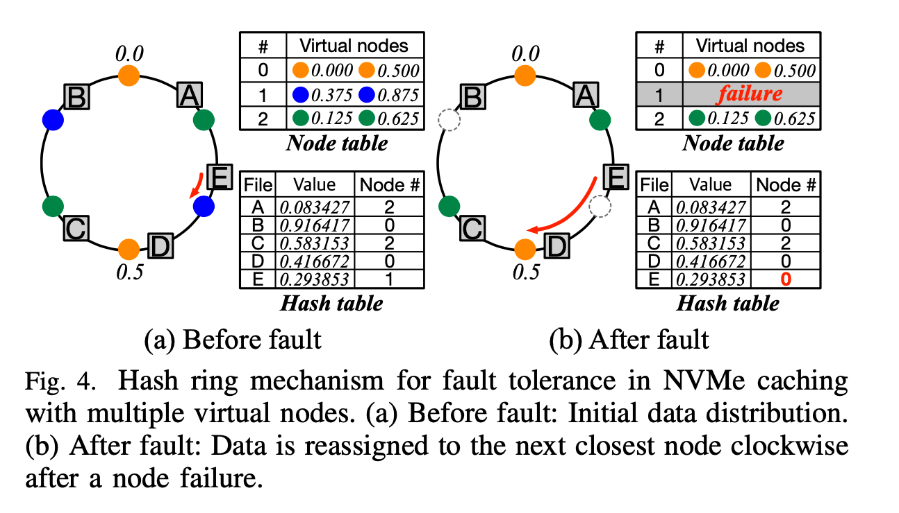
Methodology
Notes:
This diagram shows how our hash ring design handles a node failure and redistributes data.”
“On the left, we see the system before any failure. Each file is hashed into a numeric value and assigned to the closest virtual node moving clockwise on the ring. This results in a balanced, deterministic file distribution across all participating nodes.”
“On the right, we simulate a failure — Node E and its virtual nodes are removed from the ring. When that happens, any files that were mapped to those points — like file E in this example — are reassigned to the next closest surviving node clockwise. This reassignment happens automatically based on the hash ring.”
“So instead of falling back to the PFS, the system recaches lost files to other local caches — preserving speed and resilience. That’s the core of what makes this approach fault-tolerant.”

Slide 9
Methodology
Implemented a fault-tolerant cache layer in C++ inspired by the HVAC system using a consistent hash-ring design
Simulated PFS and node-local NVMe cache behavior with ~300 synthetic files
Modeled
node failure,
TTL-based cache eviction, and
recaching with load rebalancing
Two fallback modes:
NVMe recache + rebalance
PFS fallback (read directly from source)
Logged metrics:
Access time (ms),
file movements during rebalance,
node distribution,
speedup
Notes:
“I implemented a simplified version in C++, using consistent hashing and synthetic file simulation. Recovery was tested in two modes: NVMe recache and PFS fallback. I logged metrics like runtime, file movement, and node load.”

Slide 10
Experiment Setup
Nodes: 3-node simulated environment (NodeA, NodeB, NodeC)
Files: ~300 synthetic files placed in a simulated PFS (PFS_Source)
Cache Type: Node-local cache using consistent hashing and 100 virtual nodes
Failure Simulation: One node (e.g., NodeC) is removed after cache warm-up to simulate failure
Recovery:
Lost data is recached from PFS
Cache is rebalanced using consistent hash ring
Notes:
“The experiment used three simulated nodes and about 300 synthetic files. After cache warm-up, one node was removed to simulate failure. The system then recached and rebalanced using the hash ring.”

Slide 11
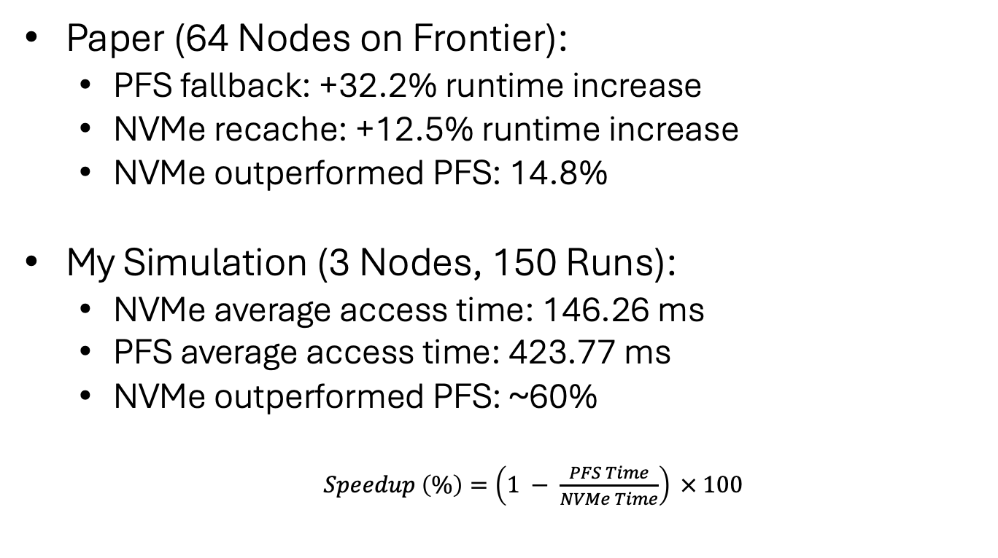
Results
Paper (64 Nodes on Frontier):
PFS fallback: +32.2% runtime increase
NVMe recache: +12.5% runtime increase
NVMe outperformed PFS: 14.8%
My Simulation (3 Nodes, 150 Runs):
NVMe average access time: 146.26 ms
PFS average access time: 423.77 ms
NVMe outperformed PFS: ~60%
$Speedup \left(\%\right)=\left(1 − \frac{PFS Time}{NVMe Time}\right) × 100$
Notes:
Here’s a direct comparison between the results from the original paper and my own simulation.”
“On the Frontier supercomputer with 64 nodes, the paper reported that fallback to PFS added over 32% to training time, while NVMe-based recaching added just 12.5% — meaning it outperformed PFS by about 14.8%.”
“In my 3-node simulation, the performance difference was even more dramatic. The total NVMe access time across four epochs was about 146 milliseconds, while the PFS fallback took nearly 424 milliseconds. That’s a 60% improvement using NVMe recaching.”

Slide 12
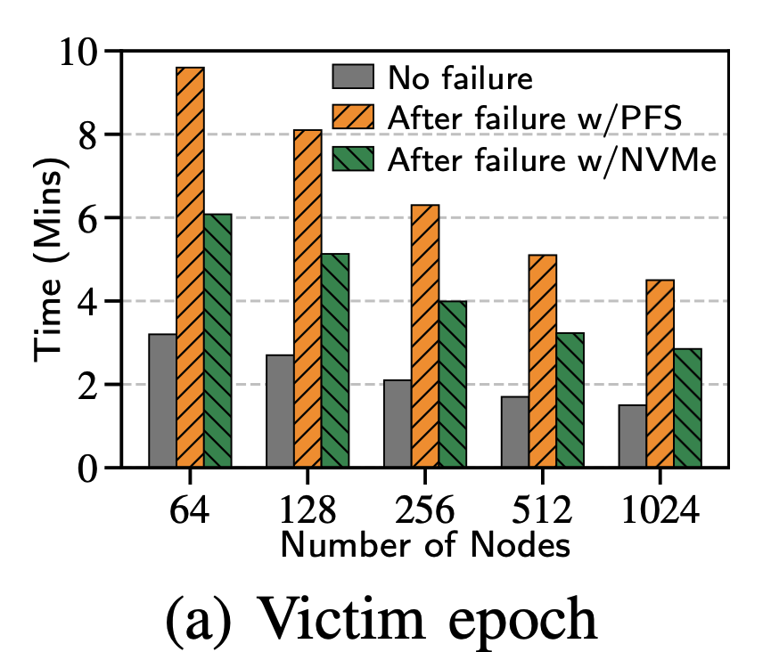
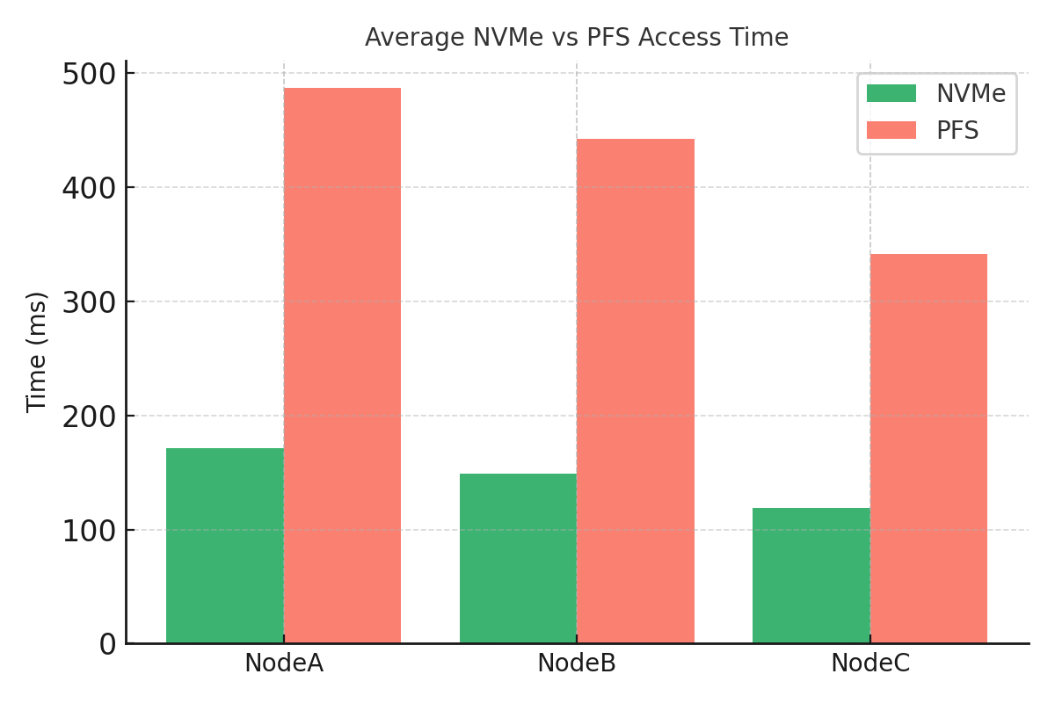
Results – NVMe Cache vs PFS Fallback
NVMe caching consistently outperforms PFS in recovery latency.
Notes:
“Here’s a visual comparison of results from the paper versus my own simulation.”
“On the left,. You can see how the PFS fallback leads to significantly longer recovery times after a failure — while NVMe recache consistently keeps the impact minimal, even as the system scales up to 1024 nodes.”
“On the right, I’ve plotted the average access times for NVMe and PFS in my 3-node setup. Across all three nodes — NodeA, NodeB, and NodeC — NVMe access is consistently faster than fallback to PFS.”
“While my times are in milliseconds and the paper’s are in minutes, the trend is exactly the same: fault-tolerant caching with NVMe outperforms PFS fallback, both in small simulations and at supercomputing scale.”

Slide 13
Future Work
Key Findings: Fault-tolerant recache cuts redundant PFS accesses and ensures data availability.
Limitations: Current demo uses simulated failures and a single TTL policy; performance on real HPC untested.
Future Extensions:
Size-based eviction (LRU or max-cache-size)
Integration with real node-health monitoring for auto-detection
Notes:
“In summary, this fault-tolerant design reduces PFS pressure and ensures data availability after node failures. While this is a prototype, future work includes smarter eviction, health monitoring, and persistent metadata to make the cache truly resilient.”

Slide 14
Challenges & Lessons Learned
Metadata Mapping: Ensuring accurate owner and timestamp storage for each file.
Load Balancing Trade-offs: Choosing virtual node count—more vnodes improves evenness but increases overhead.
Notes:
Along the way, I ran into a few key challenges that shaped the final implementation.”
“First was metadata mapping. To support recovery and eviction, I had to ensure each cached file had an accurate owner field and timestamp. At one point, missing the owner field completely broke the eviction and recaching logic.”
“Second, choosing the number of virtual nodes was a balancing act. More virtual nodes gave better load balancing, but they also introduced computational overhead, especially during rebalance operations. I settled on 100 as a good middle ground.”

Slide 15
Questions?
Thank you for listening!

