Slide 1
Hello World

Slide 2
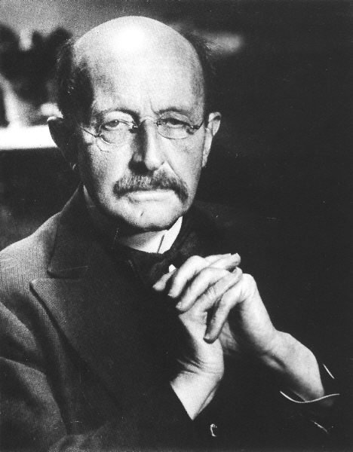
This man was a scientist

