Slide 1
titlu
autori
Logo cerc
Logo poli

Slide 2
contents

Slide 3
Why?
Machine learning and data-driven approaches are becoming very important in many areas. Smart spam classifiers protect our email by learning from massive amounts of spam data and user feedback; advertising systems learn to match the right ads with the right context; fraud detection systems protect banks from malicious attackers; anomaly event detection systems help experimental physicists to find events that lead to new physics. There are two important factors that drive these successful applications: usage of effective (statistical) models that capture the complex data dependencies and scalable learning systems that learn the model of interest from large datasets.

Slide 4
model of interest from large datasets. Among the machine learning methods used in practice, gradient tree boosting [10] 1 is one technique that shines in many applications. Tree boosting has been shown to give state-of-the-art results on many standard classification benchmarks [16]. LambdaMART [5], a variant of tree boosting for ranking, achieves state-of-the-art result for ranking 1Gradient tree boosting is also known as gradient boosting machine (GBM) or gradient boosted regression tree (GBRT) Permission to make digital or hard copies of all or part of this work for personal or classroom use is granted without fee provided that copies are not made or distributed for profit or commercial advantage and that copies bear this notice and the full citation on the first page. Copyrights for components of this work owned by others than ACM must be honored. Abstracting with credit is permitted. To copy otherwise, or republish, to post on servers or to redistribute to lists, requires prior specific permission and/or a fee. Request permissions from permissions@acm.org. KDD ’16, August 13-17, 2016, San Francisco, CA, USA c 2016 ACM. ISBN 978-1-4503-4232-2/16/08. . . $15.00 DOI: http://dx.doi.org/10.1145/2939672.2939785 problems. Besides being used as a stand-alone predictor, it is also incorporated into real-world production pipelines for ad click through rate prediction [15]. Finally, it is the defacto choice of ensemble method and is used in challenges such as the Netflix prize [3].

Slide 5
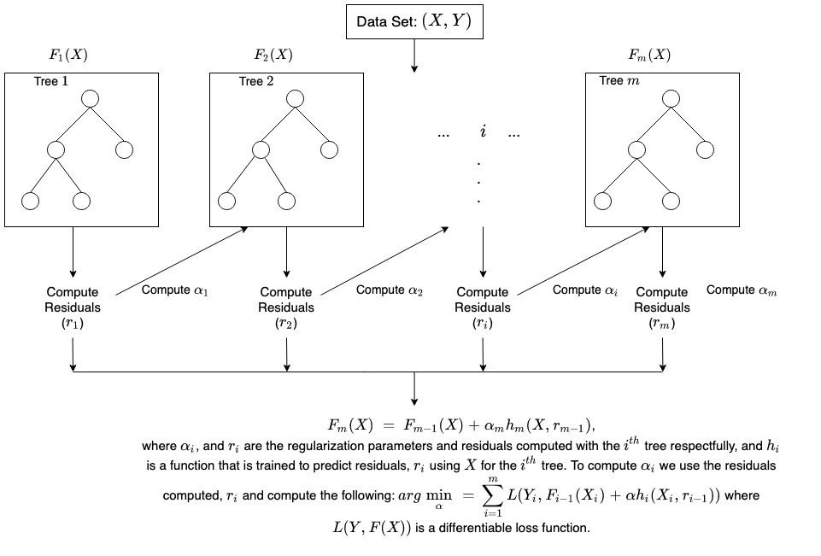
We use a gradient tree boosting method called XGB (Extreme Gradient Boosting)

Slide 6
Parameters for statistical analysis
Mean
Std
Skew
Kurt
variation

Slide 7
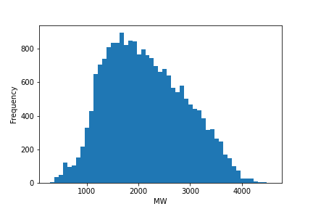
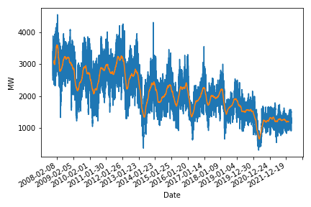
coal
Cum arata pt toata perioada
Histograma toata perioada
Valori analiza statistica
Mean | Std | Skew | Kurtosis | Variation
2143 | 764 | 0.28 | -0.6 | 0.35

Slide 8
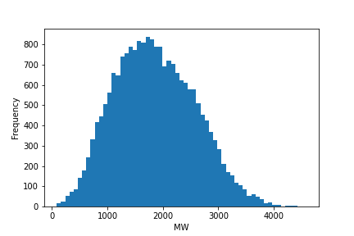
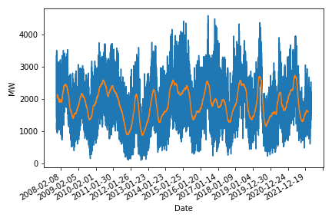
hydo
 | Mean | Std | Skew | Kurtosis | Variation
Hydroelectric | 1859 | 720 | 0.25 | -0.39 | 0.38

Slide 9
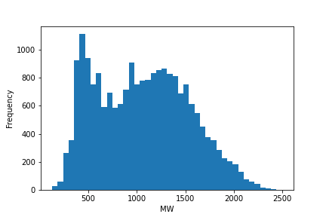
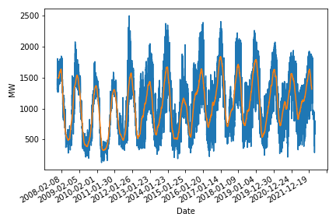
Oil gas
 | Mean | Std | Skew | Kurtosis | Variation
Oil & Gas | 1057 | 471 | 0.21 | -0.84 | 44

Slide 10
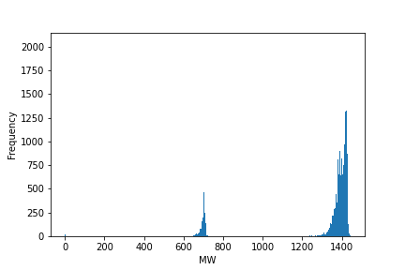
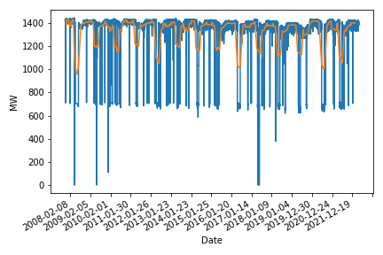
nuclear
 | Mean | Std | Skew | Kurtosis | Variation
Nuclear | 1319 | 224 | -2.48 | 4.68 | 0.17

Slide 11
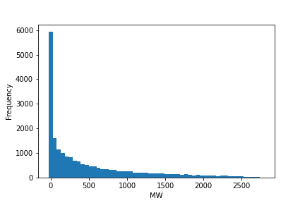
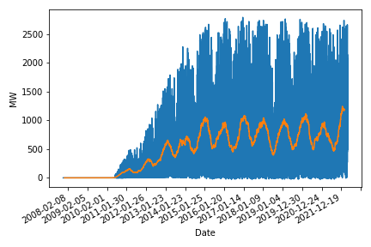
wind
 | Mean | Std | Skew | Kurtosis | Variation
Wind | 488 | 618 | 1.49 | 1.49 | 1.26

Slide 12
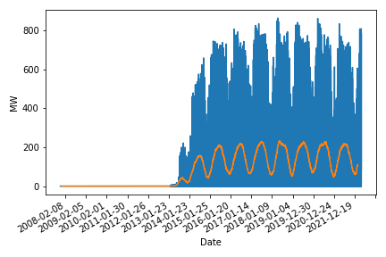
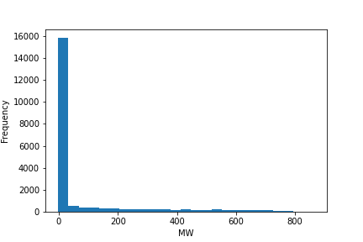
solar
 | Mean | Std | Skew | Kurtosis | Variation
Solar | 80 | 175 | 2.32 | 4.4 | 2.19

Slide 13
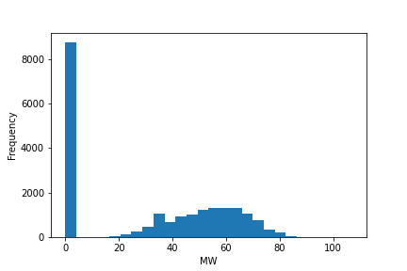
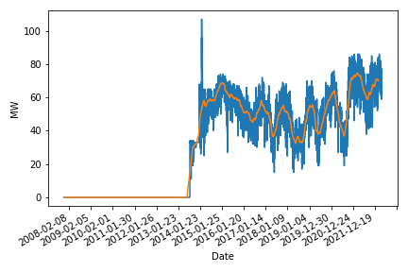
biomass
 | Mean | Std | Skew | Kurtosis | Variation
Biomass | 30 | 28 | 0.04 | -1.62 | 0.91

Slide 14
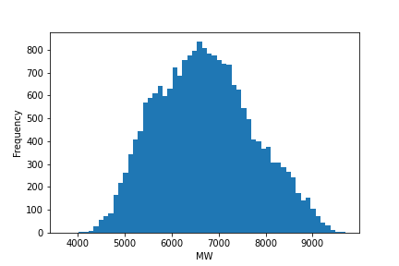
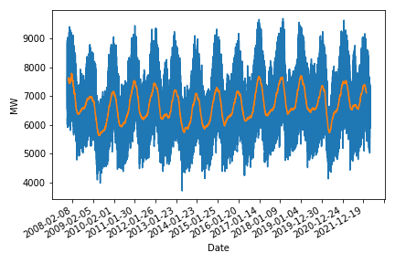
consumption
 | Mean | Std | Skew | Kurtosis | Variation
Consum | 6706 | 1025 | 0.19 | -0.53 | 0.15

Slide 15
Tabel cu toate valoriile analizai statistice
colorez cu verde alea la care ma astept sa fie forecasting bun si cu rosu alea cu forecasting prost (explicatia dc ma astpet la asta e in paper pe care il ai pe email)
 | Mean | Std | Skew | Kurtosis | Variation
Coal | 2143 | 764 | 0.28 | -0.6 | 0.35
Hydroelectric | 1859 | 720 | 0.25 | -0.39 | 0.38
Oil & Gas | 1057 | 471 | 0.21 | -0.84 | 0.44
Nuclear | 1319 | 224 | -2.48 | 4.68 | 0.17
Wind | 488 | 618 | 1.49 | 1.49 | 1.26
Solar | 80 | 175 | 2.32 | 4.4 | 2.19
Biomass | 30 | 28 | 0.04 | -1.62 | 0.91
Consum | 6706 | 1025 | 0.19 | -0.53 | 0.15

Slide 16
Xgb what it is
Scriu eu copiaza intro din xgb paper chen
One of a few nn algorithms with aReal world application ad click through rate prediction [15]. Chen citeaza

Slide 17
Gradient boosting tree

Slide 18
How do the features look like
Scriu eu

Slide 19
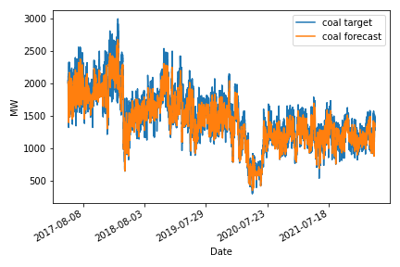
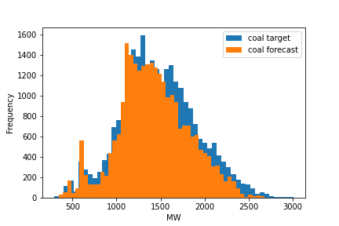
Results coal
Cum arat pt toata perioada
Histograma toata perioada
Valori analiza statistica pe perioada de test vs predicita
 | Mean | Std | Skew | Kurtosis | Variation
target | 1477 | 432 | 0.16 | -0.04 | 0.29
forecast | 1424 | 395 | 0.1 | -0.02 | 0.27

Slide 20
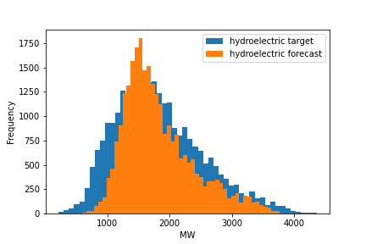
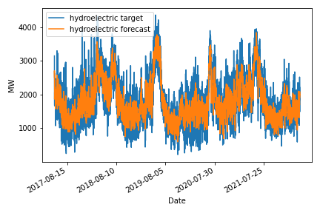
Results hydro
 | Mean | Std | Skew | Kurtosis | Variation
target | 1826 | 703 | 0.6 | 0.02 | 0.38
forecast | 1826 | 565 | 0.94 | 0.5 | 0.3

Slide 21
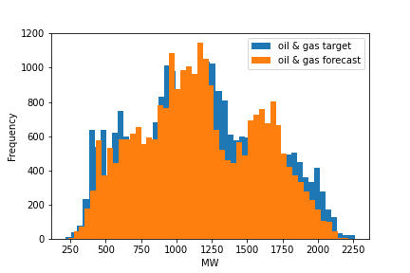
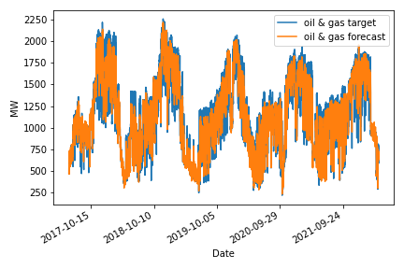
Oil gas
 | Mean | Std | Skew | Kurtosis | Variation
target | 1167 | 450 | 0.12 | -0.81 | 0.38
forecast | 1167 | 418 | 0.08 | -0.84 | 0.35

Slide 22
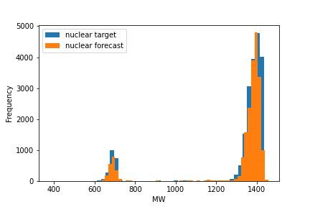
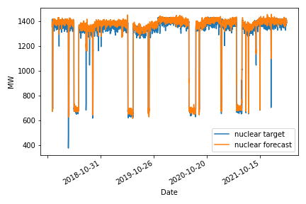
Results nucelar
 | Mean | Std | Skew | Kurtosis | Variation
target | 1311 | 215 | -2.47 | 4.34 | 0.16
forecast | 1311 | 212 | -2.5 | 4.49 | 0.16

Slide 23
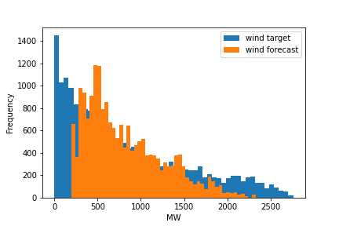
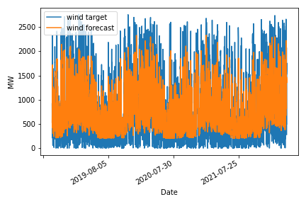
Results wind
 | Mean | Std | Skew | Kurtosis | Variation
target | 815 | 694 | 0.85 | -0.27 | 0.85
forecast | 814 | 450 | 0.84 | -0.03 | 0.55

Slide 24
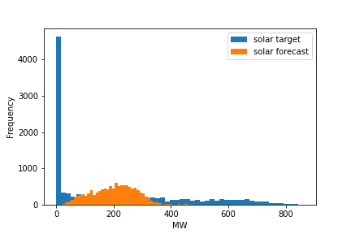
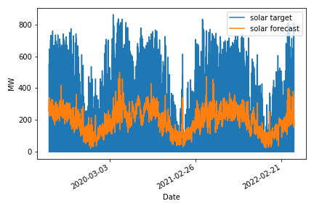
Results solar
 | Mean | Std | Skew | Kurtosis | Variation
target | 203 | 238 | 0.86 | -0.56 | 1.17
forecast | 202 | 77 | 0.2 | -0.28 | 0.38

Slide 25
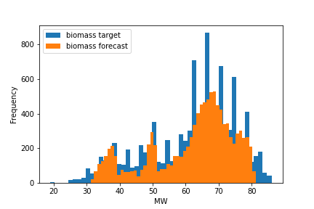
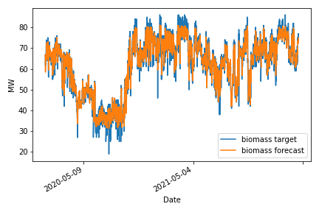
Results biomass
 | Mean | Std | Skew | Kurtosis | Variation
target | 62 | 13 | -0.68 | -0.3 | 0.21
forecast | 62 | 12 | -0.78 | 0.33 | 0.2

Slide 26
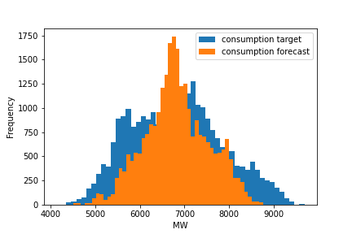
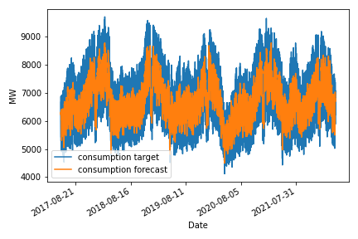
Results consumption
 | Mean | Std | Skew | Kurtosis | Variation
target | 6827 | 1031 | 0.18 | -0.62 | 0.15
forecast | 6827 | 717 | -0.01 | 0.22 | 0.1

Slide 27
conclusions

Slide 28
bibliography
XGBoost: A Scalable Tree Boosting System

