Slide 1
titlu
autori
Logo cerc
Logo poli

Slide 2
contents

Slide 3
Why?

Slide 4
Parameters for statistical analysis
Mean
Std
Skew
Kurt
variation

Slide 5
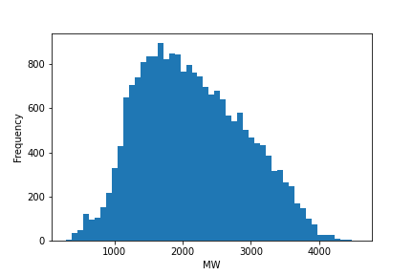
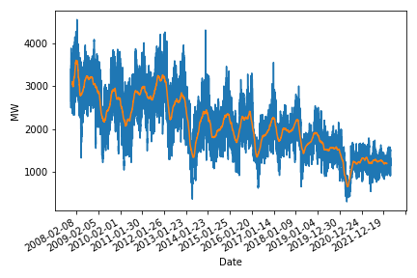
coal
Cum arata pt toata perioada
Histograma toata perioada
Valori analiza statistica
Mean | Std | Skew | Kurtosis | Variation
2143 | 764 | 0.28 | -0.6 | 0.35

Slide 6
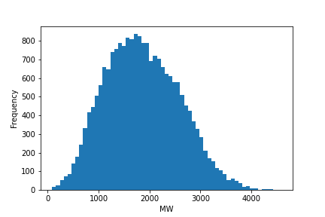
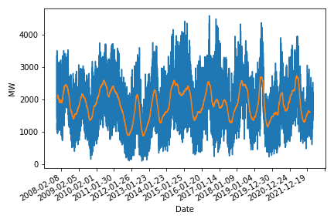
hydo
 | Mean | Std | Skew | Kurtosis | Variation
Hydroelectric | 1859 | 720 | 0.25 | -0.39 | 0.38

Slide 7
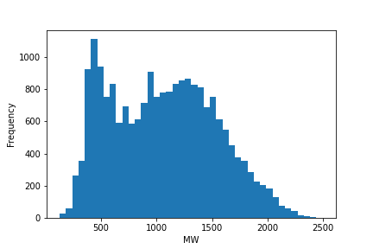
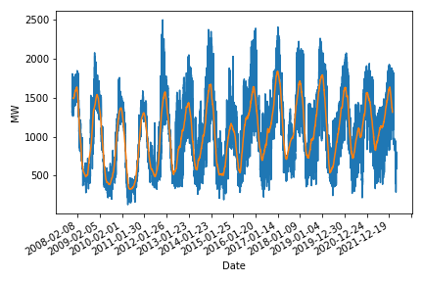
Oil gas
 | Mean | Std | Skew | Kurtosis | Variation
Oil & Gas | 1057 | 471 | 0.21 | -0.84 | 44

Slide 8
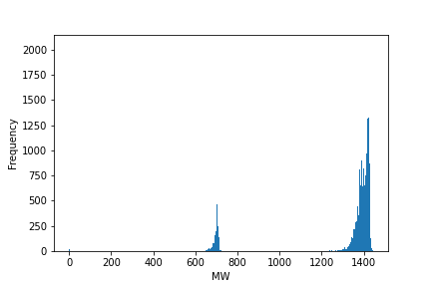
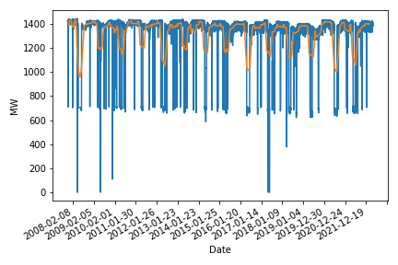
nuclear
 | Mean | Std | Skew | Kurtosis | Variation
Nuclear | 1319 | 224 | -2.48 | 4.68 | 0.17

Slide 9
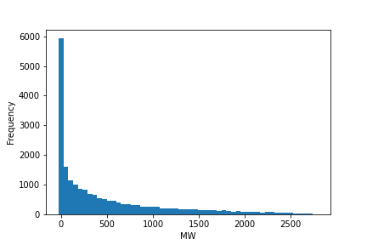
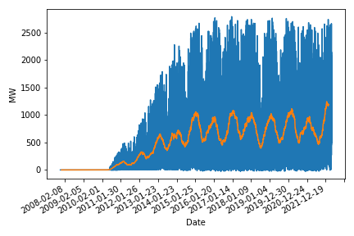
wind
 | Mean | Std | Skew | Kurtosis | Variation
Wind | 488 | 618 | 1.49 | 1.49 | 1.26

Slide 10
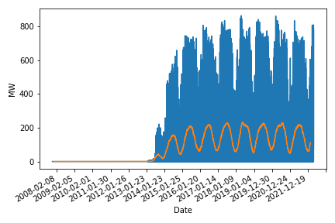
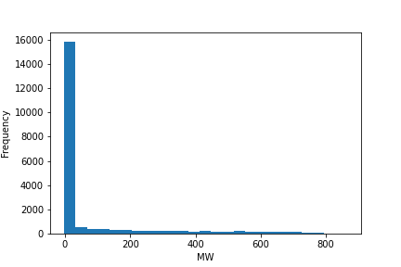
solar
 | Mean | Std | Skew | Kurtosis | Variation
Solar | 80 | 175 | 2.32 | 4.4 | 2.19

Slide 11
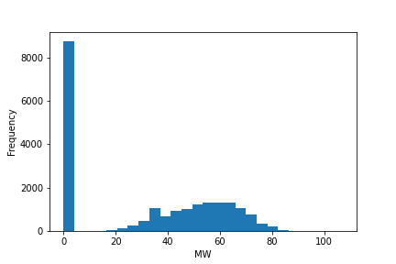
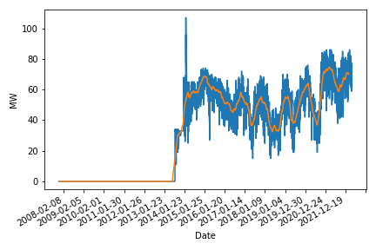
biomass
 | Mean | Std | Skew | Kurtosis | Variation
Biomass | 30 | 28 | 0.04 | -1.62 | 0.91

Slide 12
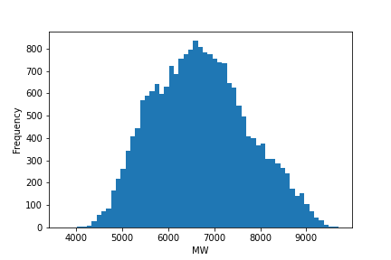
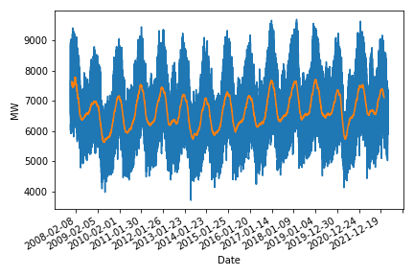
consumption
 | Mean | Std | Skew | Kurtosis | Variation
Consum | 6706 | 1025 | 0.19 | -0.53 | 0.15

Slide 13
Tabel cu toate valoriile analizai statistice
colorez cu verde alea la care ma astept sa fie forecasting bun si cu rosu alea cu forecasting prost (explicatia dc ma astpet la asta e in paper pe care il ai pe email)
 | Mean | Std | Skew | Kurtosis | Variation
Coal | 2143 | 764 | 0.28 | -0.6 | 0.35
Hydroelectric | 1859 | 720 | 0.25 | -0.39 | 0.38
Oil & Gas | 1057 | 471 | 0.21 | -0.84 | 0.44
Nuclear | 1319 | 224 | -2.48 | 4.68 | 0.17
Wind | 488 | 618 | 1.49 | 1.49 | 1.26
Solar | 80 | 175 | 2.32 | 4.4 | 2.19
Biomass | 30 | 28 | 0.04 | -1.62 | 0.91
Consum | 6706 | 1025 | 0.19 | -0.53 | 0.15

Slide 14
Xgb what it is
Scriu eu copiaza intro din xgb paper chen
One of a few nn algorithms with aReal world application ad click through rate prediction [15]. Chen citeaza

Slide 15
Gradient boosting tree

Slide 16
How do the features look like
Scriu eu

Slide 17
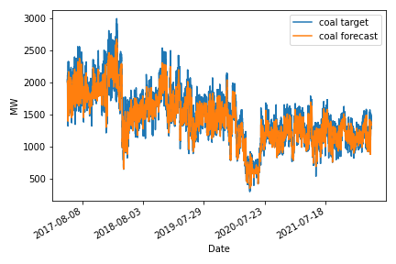
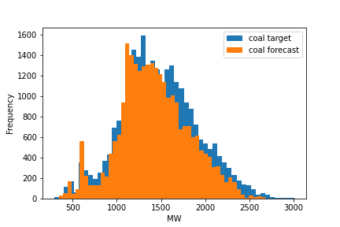
Results coal
Cum arat pt toata perioada
Histograma toata perioada
Valori analiza statistica pe perioada de test vs predicita
 | Mean | Std | Skew | Kurtosis | Variation
target | 1477 | 432 | 0.16 | -0.04 | 0.29
forecast | 1424 | 395 | 0.1 | -0.02 | 0.27

Slide 18
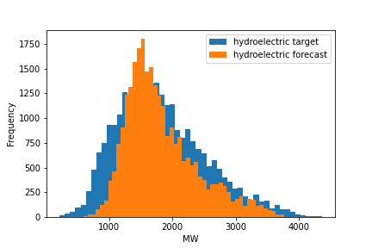
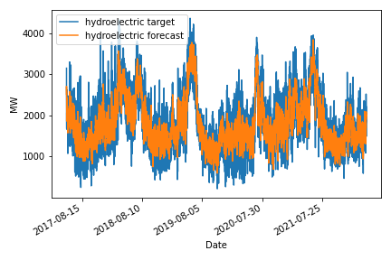
Results hydro
 | Mean | Std | Skew | Kurtosis | Variation
target | 1826 | 703 | 0.6 | 0.02 | 0.38
forecast | 1826 | 565 | 0.94 | 0.5 | 0.3

Slide 19
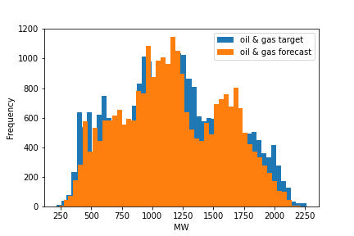
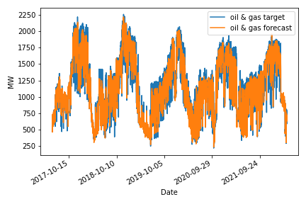
Oil gas
 | Mean | Std | Skew | Kurtosis | Variation
target | 1167 | 450 | 0.12 | -0.81 | 0.38
forecast | 1167 | 418 | 0.08 | -0.84 | 0.35

Slide 20
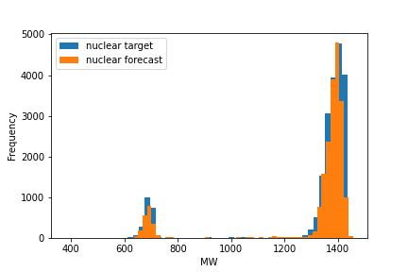
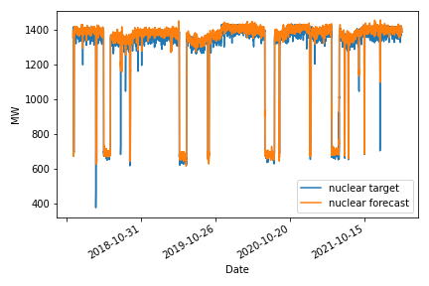
Results nucelar
 | Mean | Std | Skew | Kurtosis | Variation
target | 1311 | 215 | -2.47 | 4.34 | 0.16
forecast | 1311 | 212 | -2.5 | 4.49 | 0.16

Slide 21
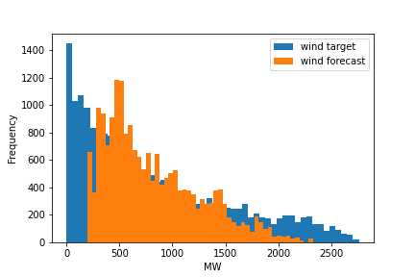
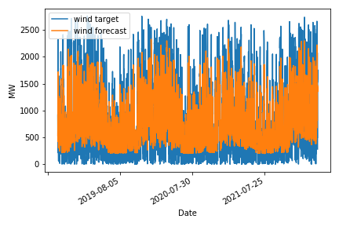
Results wind
 | Mean | Std | Skew | Kurtosis | Variation
target | 815 | 694 | 0.85 | -0.27 | 0.85
forecast | 814 | 450 | 0.84 | -0.03 | 0.55

Slide 22
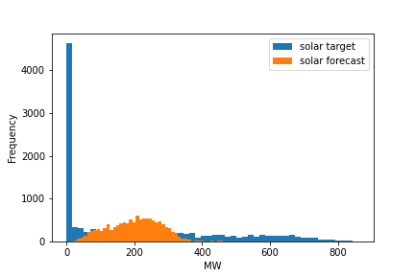
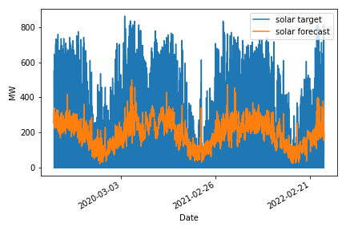
Results solar
 | Mean | Std | Skew | Kurtosis | Variation
target | 203 | 238 | 0.86 | -0.56 | 1.17
forecast | 202 | 77 | 0.2 | -0.28 | 0.38

Slide 23
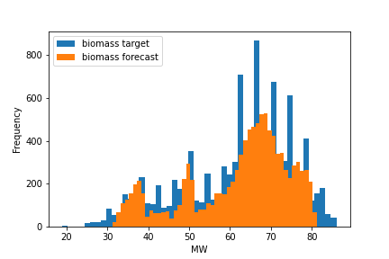
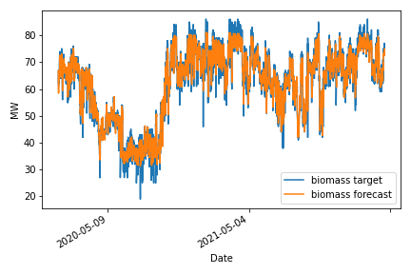
Results biomass
 | Mean | Std | Skew | Kurtosis | Variation
target | 62 | 13 | -0.68 | -0.3 | 0.21
forecast | 62 | 12 | -0.78 | 0.33 | 0.2

Slide 24
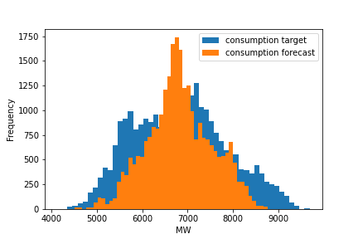
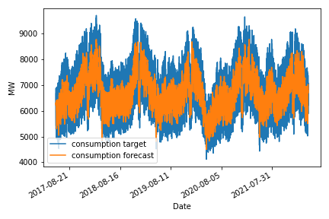
Results consumption
 | Mean | Std | Skew | Kurtosis | Variation
target | 6827 | 1031 | 0.18 | -0.62 | 0.15
forecast | 6827 | 717 | -0.01 | 0.22 | 0.1

Slide 25
conclusions

Slide 26
bibliography

