Slide 1
LinoSPAD2 Data Analysis Parallelization
Dmitirj Ševaev

Slide 2





Idea – split the work evenly between available cores. Each core works within its directory with its own files
100 files chunk
1000 files (76 MB each)
Read
Compute
Write

Slide 3
IN THEORY
“Embarrassingly” parallelizable task => perfect multiprocessing conditions
If ran on multiple devices => correct result
No shared memory, no locks, no read/write operations on shared files/variables
In theory nearly linear speed up with more cores
Amdahl’s law in mind

Slide 4
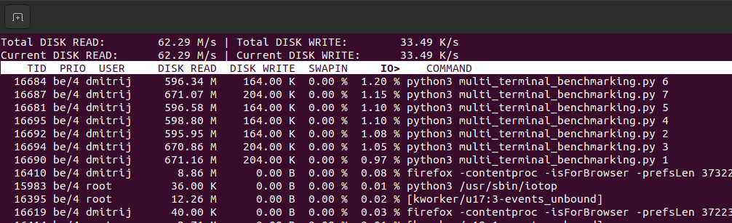
Profiling - iotop

Slide 5
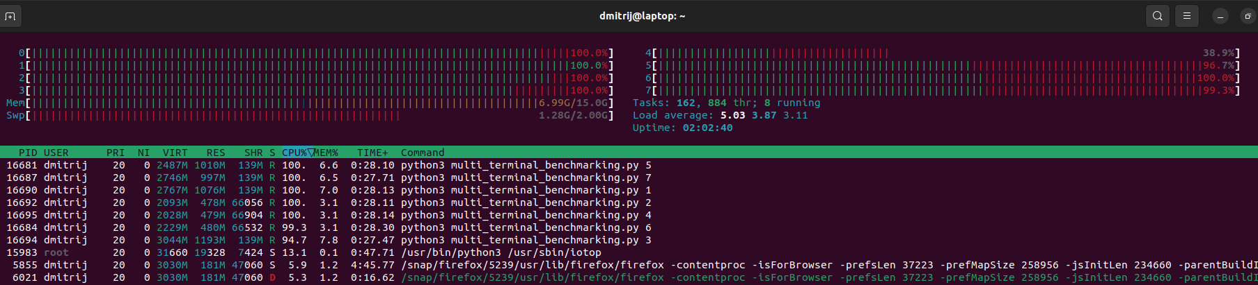
Profiling - htop

Slide 6
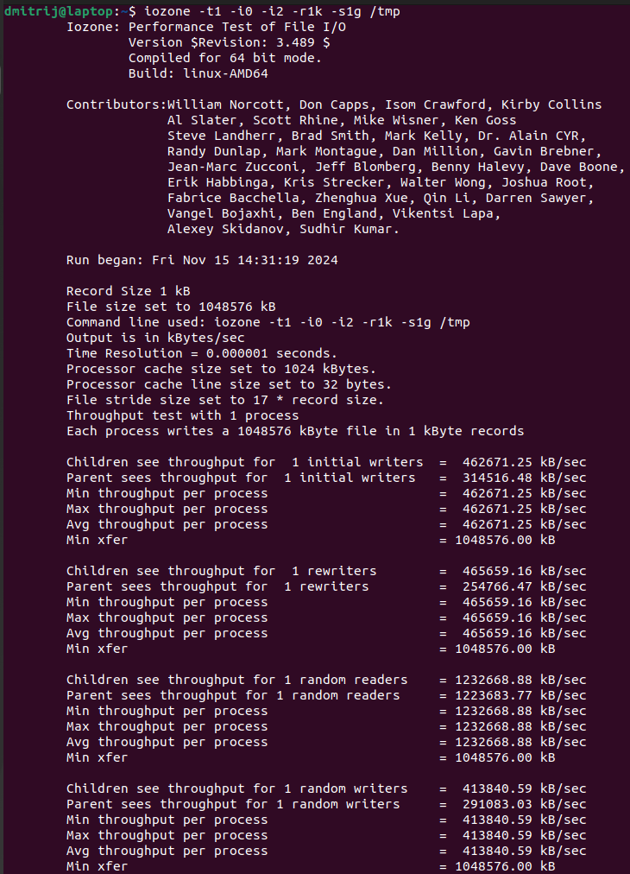
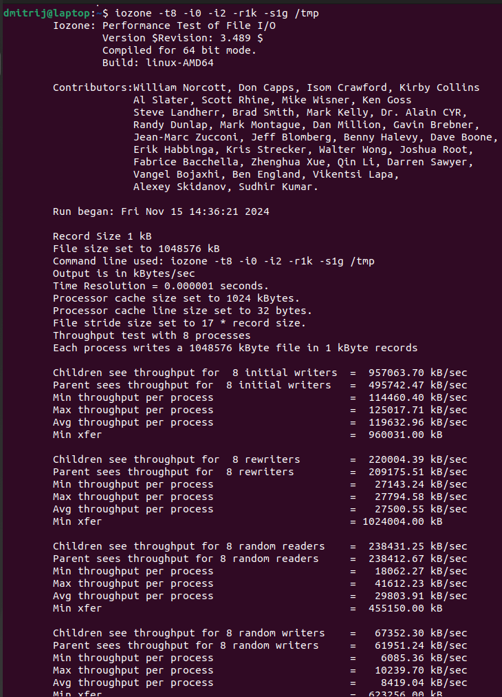
Disk capabilities – 1 process VS 8 processes

Slide 7
RESULTS
In existing Python code tried: multiprocessing, pool, multithreading, future/promise, executor, manager, manually creating, multi-terminal, GIL disabled, producer-consumer approach…
Profiled with htop, iotop, task manager, mnom, cProfile => all cores are used to 100%, tasks evenly spread, no high I/O latency/idle time (?), no high disk usage latency/idle time (?)
On windows PC: AMD Ryzen 5 7600X 6-Core Processor, 4.70 GHz, RAM 32,0 GB, Virtualization enbaled with 12 logical cores, SSD
On linux ubuntu 20.04 laptop: AMD® Ryzen 7 4700u with radeon graphics × 8, RAM 16,0 GB, SSD
Best results on windows PC:
Running time for 200 files sequentialy: 145 s
Running time for 200 files multiprocessing on 10 cores: 45 s (best configuration – multi terminal approach)
Speed up: 3,2 times vs expected nearly 10 times

Slide 8
IDEAS
Multiprocessing works on both devices (tested on arithmetical heavy CPU calculations)
Calculating dt’s is NOT the bottleneck
Writing results back is NOT the bottleneck
Reading files is PROBABLY the bottleneck
Probably OS/hardware limitations on concurrent files opening/reading
Last solution in mind: run the code on a server with concurrent I/O operations within files system friendly set up, simulate more computers/jobs running at the same time
Compare terabytes of data sequentially vs parallel
If no better speed up => next steps…

