Slide 1
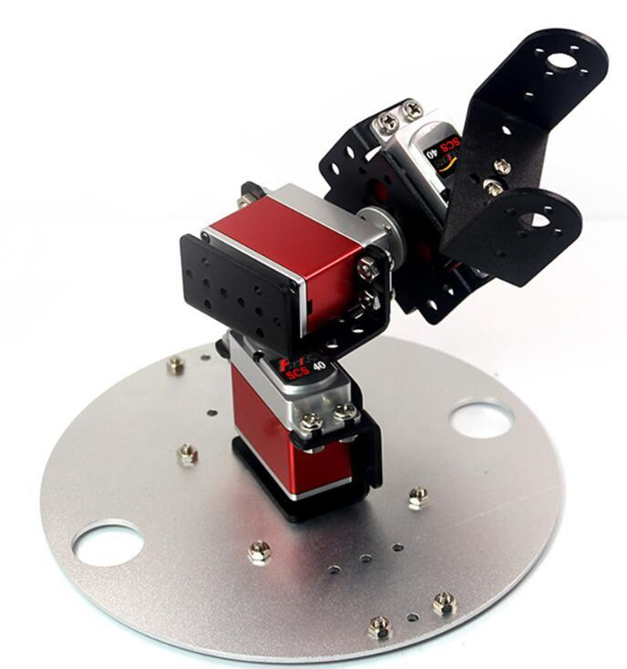
serial robots

Slide 2
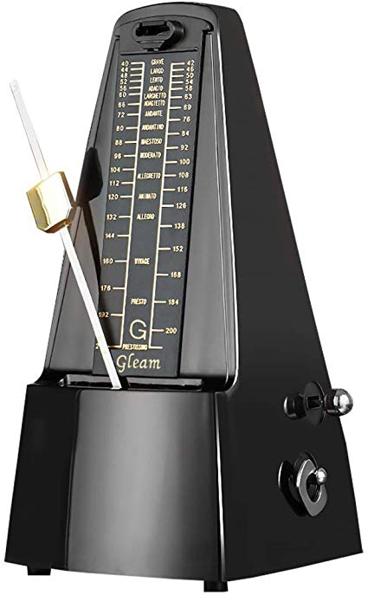
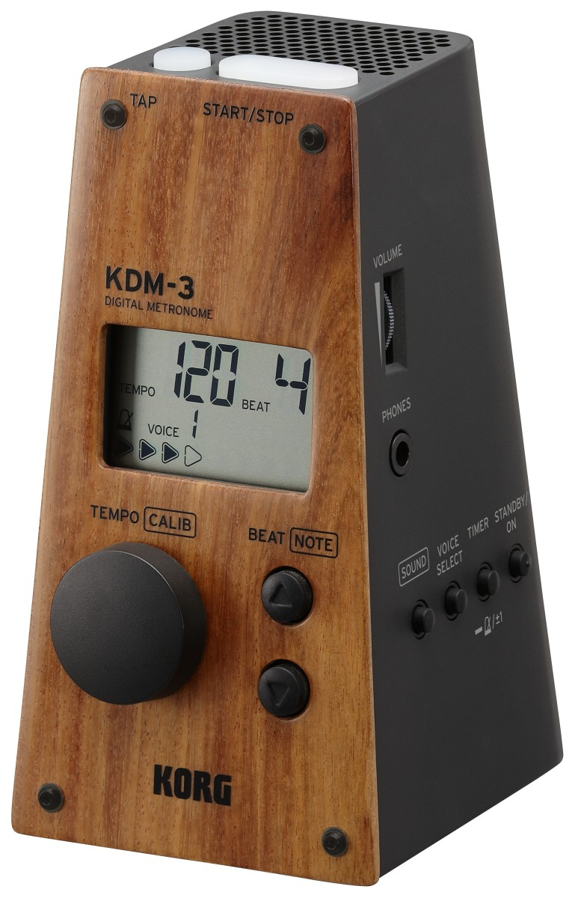
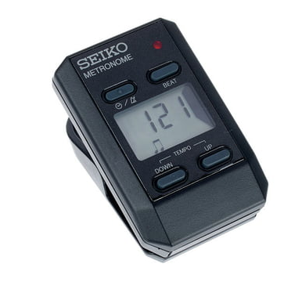
metronomes
produce audible click or other sound at a regular interval

Slide 3
my project
build own metronome
use microcontroller and accessory board

Slide 4
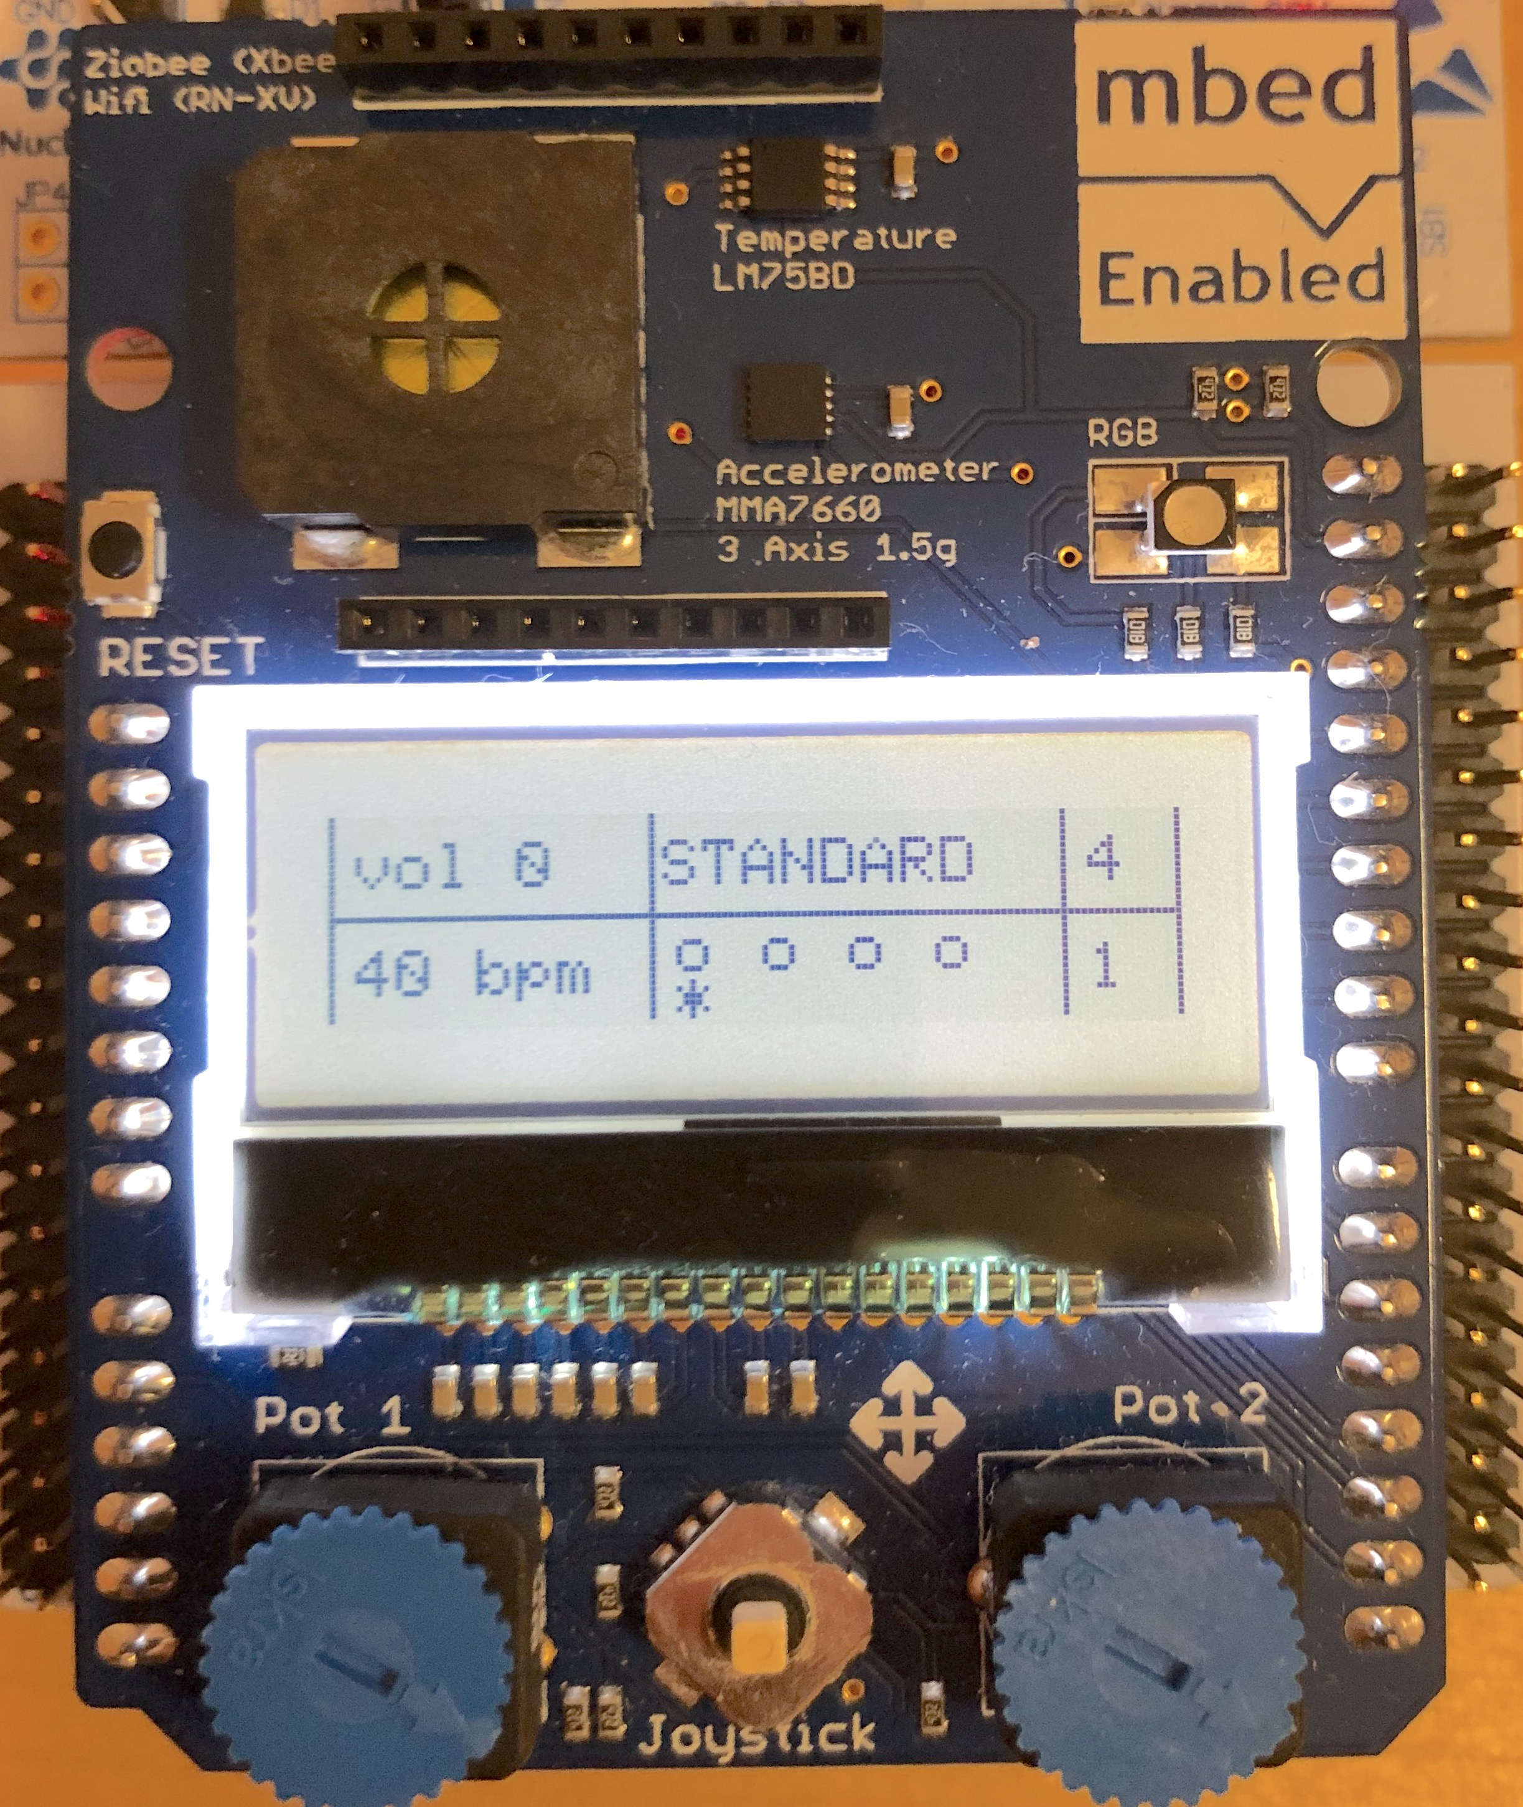
“GUI”
LED
speaker
mode
beats per bar
display values
current beat
change bpm
change volume
toggle mode, change beats per bar

Slide 5
inputs
digital buttons → EXTI
potentiometers → ADC
Button press triggers FLAG for button. While loop triggers action, if a certain FLAG is set.

Slide 6
outputs
display → given LCD driver using SPI
LEDs → GPIO
speaker → PWM signal

Slide 7
tasks
void update_volume();
void update_bpm();
void update_display();
void button_push(); // check flags
void beat_machine(); // beep and blink
What is most important? What can wait?
timing not so important
timing absolutely important

Slide 8
program flow
void update_volume();
void update_bpm();
void update_display();
void button_push(); // check flags
void beat_machine(); // beep and blink
What is most important? What can wait?
WHILE LOOP
TIMER INTERRUPT

Slide 9
some important functions

Slide 10

update_bpm() function
read analog input
calculate bpm within defined range (40 - 200 bpm)
calculate new prescaler value $prescaler= \frac{60⋅clockspeed}{bpm⋅period(ARR)}$
set new prescaler value using TIM6->PSC

Slide 11
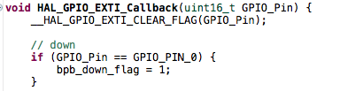
external interrupts (buttons)
one task: set flags

Slide 12
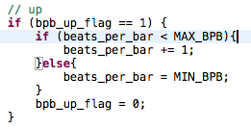
button_push() function
checks button flags
acts if a flag is up
resets flag

Slide 13
beat_machine() and beat functions
normal beep
beat_machine()
STANDARD
What mode is active?
increment beat
beat += 1
or beat = 1
PRONOUNCED
every 1st beat has higher pitched beep

Slide 14
results / demonstration

