Slide 1

Project: Cab Data Analysis
Submitted by: Sevde Büşra Bayrak
Date : 16 May 2022
Data Glacier Internship/Week3

Slide 2

Outline
Data Summary
Problem Statement
Data Analysis With Some Hypothesis
Conclusion

Slide 3
Problem Statement
There is a private firm called XYZ in the USA. This firm wants to investment in Cab industry because of the growth in Cab industry. That’s why it is crucial to understand the market before taking an actionfor their Go-to-Market(G2M) strategy.
Objective: We will investigate which company is the most valuable to invest, relationship between users accross the locations

Slide 4
Data Information
We have four dataset to analyze.
Cab Data: this file includes details of transaction for 2 cab companies
City Data: this file contains list of US cities, their population and number of cab users
Customer Data: this is a mapping table that contains a unique identifier which links the customer’s demographic details
Transaction Data: this is a mapping table that contains transaction to customer mapping and payment mode

Slide 5
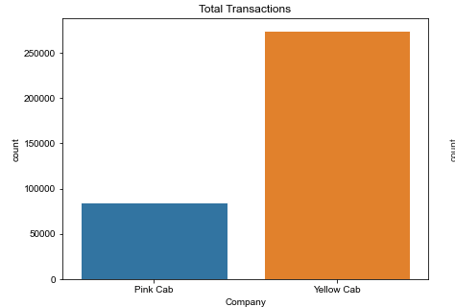
Which Company has more transaction?
We can see that it is more profitable to invest Money to Yellow Cab because it has more transaction.

Slide 6
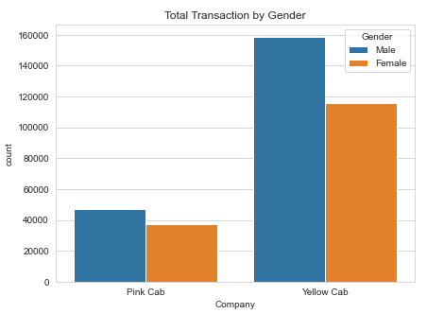
Is there a specific gender type specific company?
We can see that while male prefer to use both campany more than girls. Most of the users of yellow cab comprise of man.

Slide 7
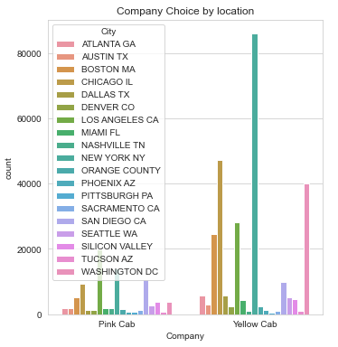
Which company is mostly used in which city?
In New York yellow Cab company is more prefered in the USA.

Slide 8
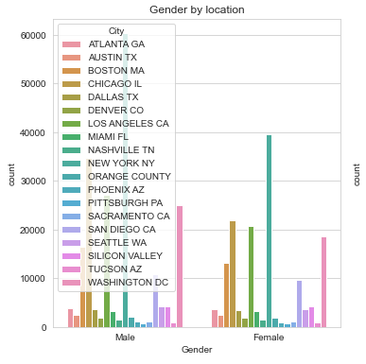
What is the relationship gender and location?
Again we observe that male use more can than girls in New York.

Slide 9
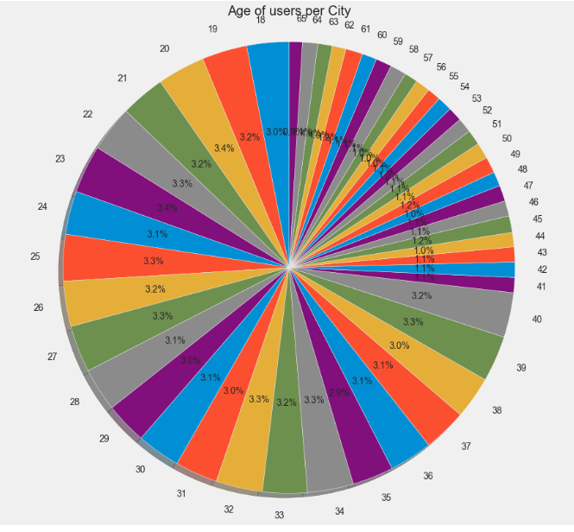
What is the age of users who use cab?
People who are young and middle aged inçline to use cab more than old people.

Slide 10
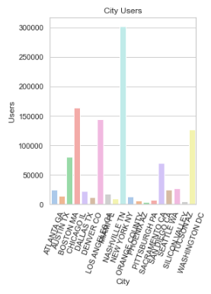
Which city has more users?
It is not hard to guess! New York has more users.

Slide 11
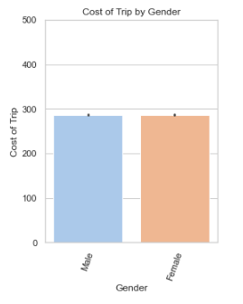
Is there a difference between male and female about paying to the trip?
Probably you guesed that women pay more ☺

Slide 12
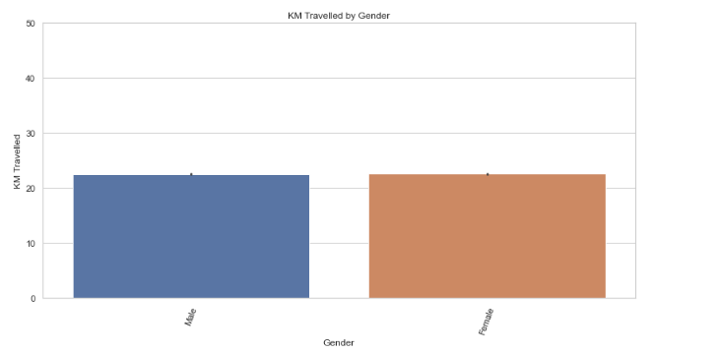
Who travelled more? Men or Women?
Probably you guesed that women travelled more ☺

Slide 13
Conclusion
We can deduce from analysis that Yellow cab has more transaction, and more users; therefore, yellow cab is better than pink cab company.
We did not see difference between gender type but we observed that location is important. Specifically, New York city has more users in Yellow company; therefore location is important.
Another point is age. People who are young and middle aged tend to use more cab. For investment age should be considered.

Slide 14
Thank You

