Slide 1
异构网络表示学习

Slide 2
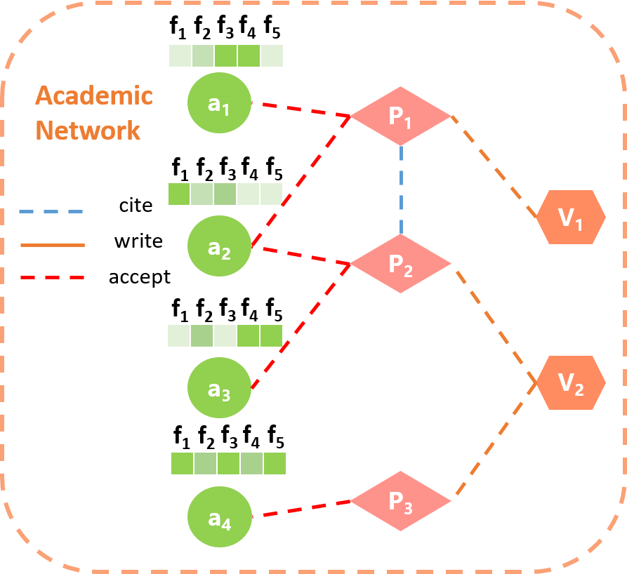
meta-path based random projection embedding
y₁
y₂
y₃
y₄
P₁
P₂
P₃
a₁
P₁
APPA
a₂
P₂
RP
a₃
attribute-based attention
P₃
a₄
P₁
P₂
P₃
y₁
y₂
y₃
y₄
a₁
a₁
APA
a₂
a₂
a₃
RP
a₃
a₄
a₄
V₁
V₂
y₁
y₂
y₃
y₄
P₁
a₁
APVPA
P₂
a₂
P₃
RP
a₃
a₄
y₁
y₂
y₃
y₄
a₁
attribute embedding
a₂
f₃
f₄
f₅
a₃
f₁
f₂
y₁
y₂
y₃
y₄
a₄
a₁
a₁
a₂
a₂
final embedding
a₃
RP
a₃
a₄
a₄
attribute matrix

Slide 3
attribute-based attention
attention
score
y₁
y₂
y₃
y₄
a₁
a₂
a₃
softmax
a₄
final embedding
dot-project attention
dot-project
attention
y₁
y₂
y₃
y₄
y₁
y₂
y₃
y₄
y₁
y₂
y₃
y₄
y₁
y₂
y₃
y₄
a₁
a₁
a₁
a₁
embedding
a₂
a₂
a₂
a₂
a₃
a₃
a₃
a₃
a₄
a₄
a₄
a₄
AOA
APA
APVPA
attribute

Slide 4
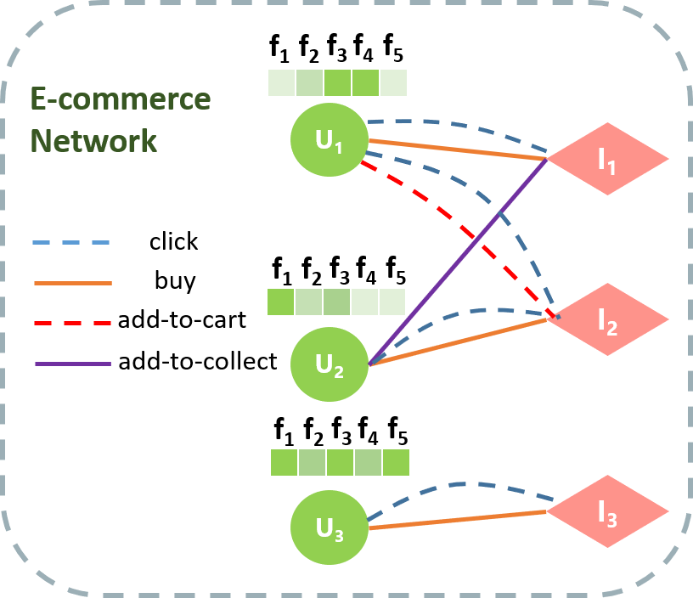
meta-path based random projection embedding
I₁
I₂
I₃
y₁
y₂
y₃
y₄
U₁
click
U₁
U₂
RP
U₂
U₃
U₃
I₁
I₂
I₃
y₁
y₂
y₃
y₄
attribute-based attention
U₁
buy
U₁
U₂
U₂
U₃
RP
U₃
I₁
I₂
I₃
y₁
y₂
y₃
y₄
U₁
add-to-cart
U₁
U₂
U₂
U₃
RP
U₃
I₁
I₂
I₃
y₁
y₂
y₃
y₄
U₁
U₁
add-to-collect
U₂
U₂
U₃
RP
U₃
y₁
y₂
y₃
y₄
a₁
attribute embedding
a₂
f₃
f₄
f₅
a₃
f₁
f₂
y₁
y₂
y₃
y₄
a₄
a₁
a₁
a₂
a₂
final embedding
a₃
RP
a₃
a₄
a₄
attribute matrix

Slide 5
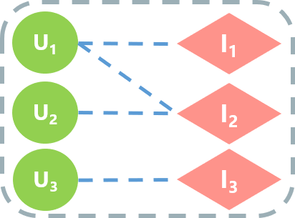
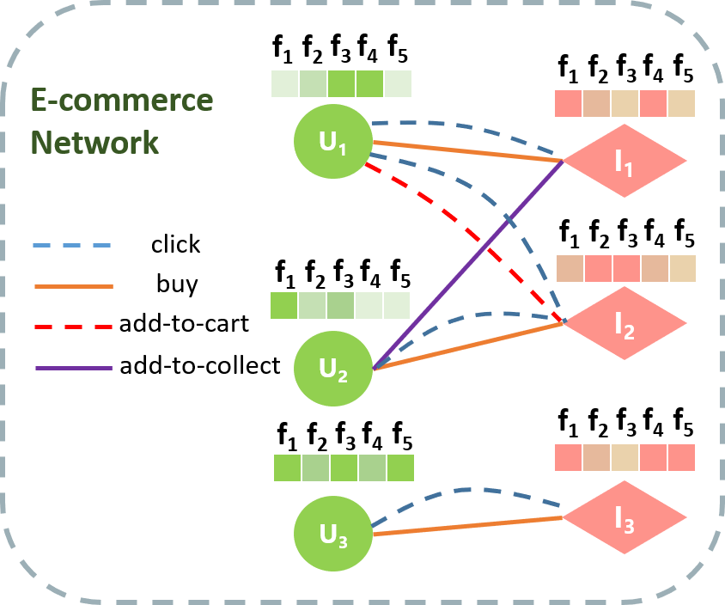
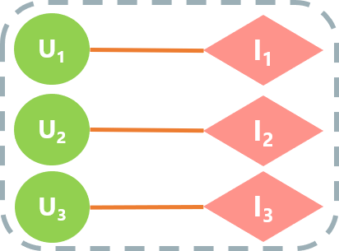
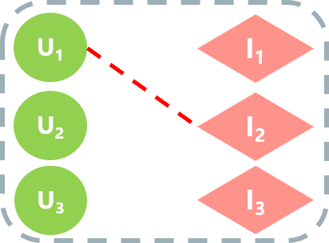
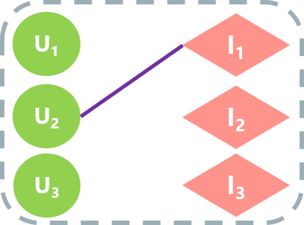
user embedding
attribute embedding
meta-path embedding
user attributes
item-based embedding
fused embedding
U₁
U₂
U₃
click
U₁
U₂
U₃
item
attention
buy
cart
attribute
attention
I₁
I₂
I₃
collect
I₁
I₂
I₃
item attributes
item embedding
attribute embedding
meta-path embedding
fused embedding

Slide 6
Data
datasets | # Relation | # nodes | # edges | # n-types | # edge-types | Meta-paths
DBLP | Paper-Paper | 781,108×781,108 | 4,191,677 | 2 | 2 | PP, PAP, APA
 | Paper-Author | 781,108×671,674 | 2,189,665
Alibaba | click | 986,512×9,456,959 (users × items) | 172,645,345 | 2 | 4 | UIU(4 types)
 | buy |  | 5,946,795
 | add-to-cart |  | 18,301,796
 | add-to-collect |  | 5,342,781

Slide 7
Alibaba | 10 | 11 | 12 | 13 | 14 | 15 | 16 | 17 | 18 | 19 | 20
click | 12,810,429 | 13,137,060 | 13,283,901 | 14,933,475 | 14,116,151 | 18,013,613 | 21,841,265 | 17,629,127 | 21,084,333 | 13,082,240 | 12,713,751
buy | 324,053 | 334,550 | 335,674 | 253,052 | 219,663 | 190,955 | 1,607,093 | 654,383 | 1,273,114 | 351,645 | 402,613
cart | 1,178,300 | 1,209,545 | 1,231,258 | 1,444,398 | 1,384,207 | 1,966,016 | 2,743,091 | 2,020,397 | 2,621,959 | 1,242,572 | 1,260,053
collect | 427,830 | 440,695 | 441,405 | 482,903 | 461,293 | 590,922 | 590,040 | 511,961 | 566,572 | 418,584 | 410,576

Slide 9
异构网络
f₁
f₂
f₃
f₄
f₅
f₁
f₂
f₃
f₄
f₅
Academic Network
a₁
P₁
f₁
f₂
f₃
f₄
f₅
f₁
f₂
f₃
f₄
f₅
f₁
f₂
f₃
f₄
f₅
f₁
f₂
f₃
f₄
f₅
E-commerce Network
cite
U₁
V₁
I₁
write
a₂
P₂
accept
click
f₁
f₂
f₃
f₄
f₅
f₁
f₂
f₃
f₄
f₅
f₁
f₂
f₃
f₄
f₅
f₁
f₂
f₃
f₄
f₅
f₁
f₂
f₃
f₄
f₅
buy
add-to-cart
I₂
a₃
V₂
add-to-collect
U₂
f₁
f₂
f₃
f₄
f₅
f₁
f₂
f₃
f₄
f₅
f₁
f₂
f₃
f₄
f₅
f₁
f₂
f₃
f₄
f₅
a₄
P₃
I₃
U₃

Slide 10
异构网络
f₁
f₂
f₃
f₄
f₅
Academic Network
a₁
P₁
f₁
f₂
f₃
f₄
f₅
f₁
f₂
f₃
f₄
f₅
E-commerce Network
cite
U₁
V₁
I₁
write
a₂
P₂
accept
click
f₁
f₂
f₃
f₄
f₅
buy
f₁
f₂
f₃
f₄
f₅
add-to-cart
I₂
a₃
V₂
add-to-collect
U₂
f₁
f₂
f₃
f₄
f₅
f₁
f₂
f₃
f₄
f₅
a₄
P₃
I₃
U₃

Slide 11
异构网络
f₁
f₂
f₃
f₄
f₅
E-commerce Network
U₁
I₁
click
U₁
I₁
buy
f₁
f₂
f₃
f₄
f₅
add-to-cart
I₂
U₂
I₂
add-to-collect
U₂
U₃
I₃
f₁
f₂
f₃
f₄
f₅
U₃
I₃

Slide 12
异构网络
f₁
f₂
f₃
f₄
f₅
a₁
f₁
f₂
f₃
f₄
f₅
f₁
f₂
f₃
f₄
f₅
write
f₁
f₂
f₃
f₄
f₅
P₁
belong
f₁
f₂
f₃
f₄
f₅
write
accept
O₁
V₁
belong
a₂
f₁
f₂
f₃
f₄
f₅
write
f₁
f₂
f₃
f₄
f₅
f₁
f₂
f₃
f₄
f₅
P₂
f₁
f₂
f₃
f₄
f₅
write
accept
O₂
belong
a₃
f₁
f₂
f₃
f₄
f₅
V₂
f₁
f₂
f₃
f₄
f₅
accept
belong
P₃
a₄
write

Slide 13
f₁
f₂
f₃
f₄
f₅
a₁
write
P₁
belong
f₁
f₂
f₃
f₄
f₅
write
accept
O₁
V₁
belong
a₂
write
f₁
f₂
f₃
f₄
f₅
P₂
write
accept
O₂
belong
a₃
V₂
f₁
f₂
f₃
f₄
f₅
accept
belong
P₃
a₄
write

Slide 14
meta-path based random projection embedding
O₁
O₂
y₁
y₂
y₃
y₄
a₁
a₁
a₂
AOA
a₂
attribute-based attention
a₃
RP
a₃
a₄
a₄
P₁
P₂
P₃
y₁
y₂
y₃
y₄
a₁
a₁
APA
a₂
a₂
a₃
RP
a₃
a₄
a₄
V₁
V₂
y₁
y₂
y₃
y₄
P₁
a₁
APVPA
P₂
a₂
P₃
RP
a₃
a₄
y₁
y₂
y₃
y₄
a₁
attribute embedding
a₂
f₃
f₄
f₅
a₃
f₁
f₂
y₁
y₂
y₃
y₄
a₄
a₁
a₁
a₂
a₂
final embedding
a₃
RP
a₃
a₄
a₄
attribute matrix

