Slide 1
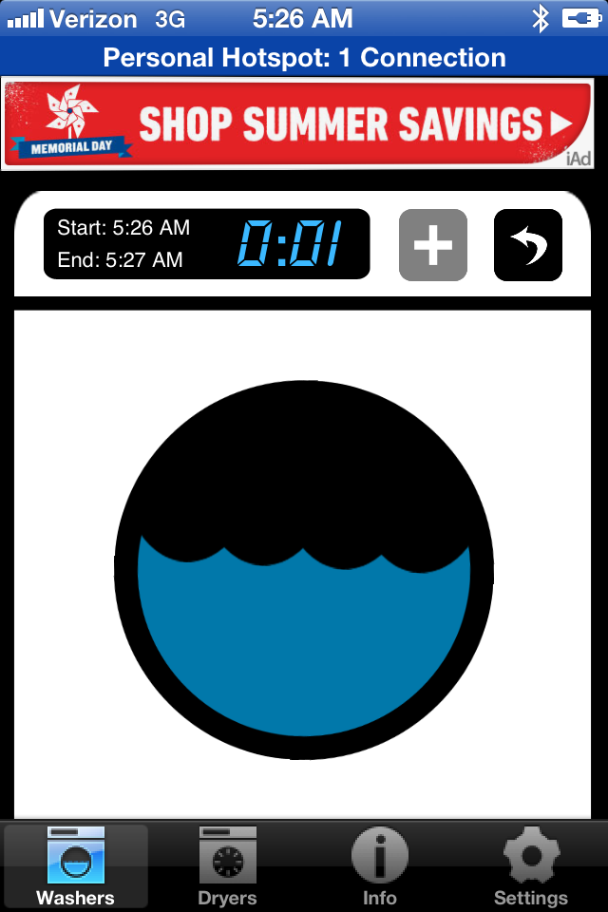
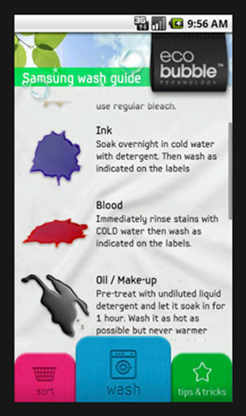
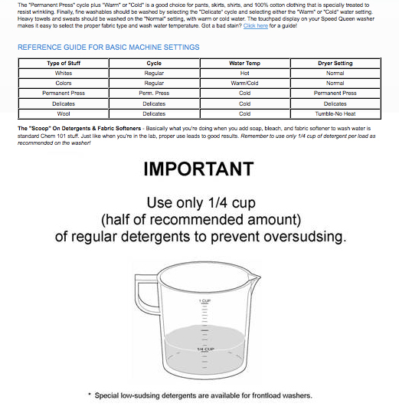
These days, you can find a handful of smartphone apps -- on top of many more print and online books, articles and publications -- indexed by any one (or more) of the following information topics related to laundry assistance:
‘laundry tips’
‘stain removal’
‘wardrobe management’

Slide 2
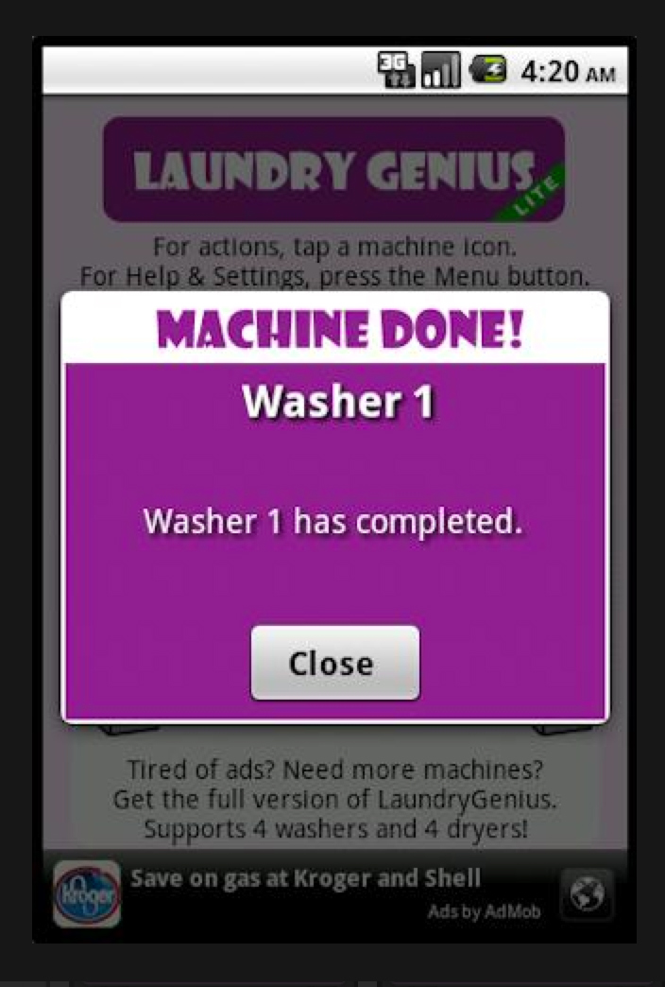
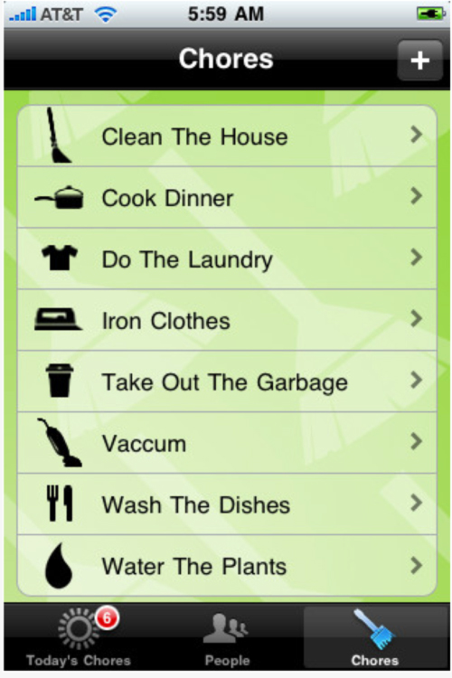
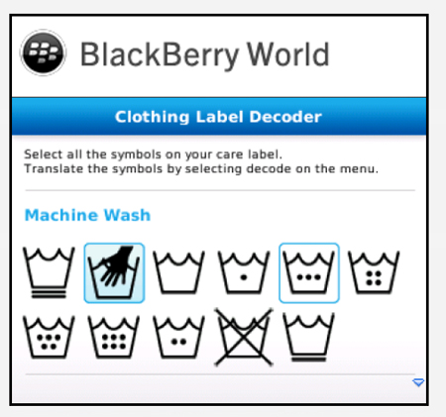
These days, you can find a handful of smartphone apps -- on top of many more print and online books, articles and publications -- indexed by any one (or more) of the following information topics related to laundry assistance:
‘laundromat locations’
‘washer/dryer timers’
‘garment care tag symbols’

Slide 3
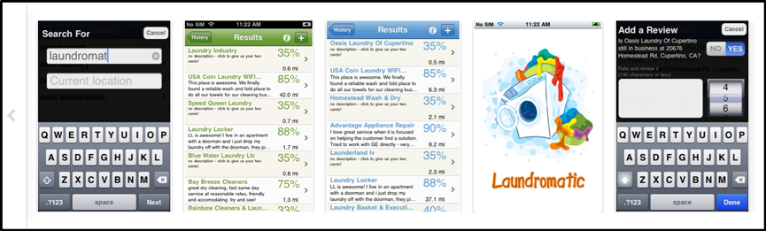
Surely, many of these offerings are quite handy -- and in many cases, essential -- resources for aiding college students, newlyweds, and other audiences with some frequently asked questions in the course of their laundry duties.

Slide 4
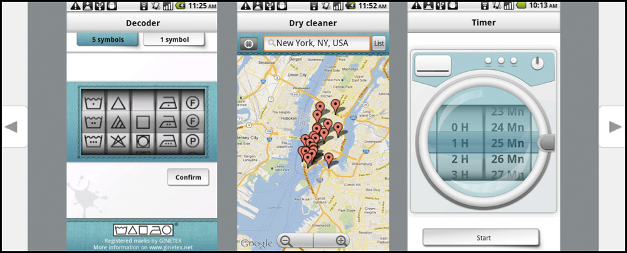
Surely, many of these offerings are quite handy -- and in many cases, essential -- resources for aiding college students, newlyweds, and other audiences with some frequently asked questions in the course of their laundry duties.

Slide 5
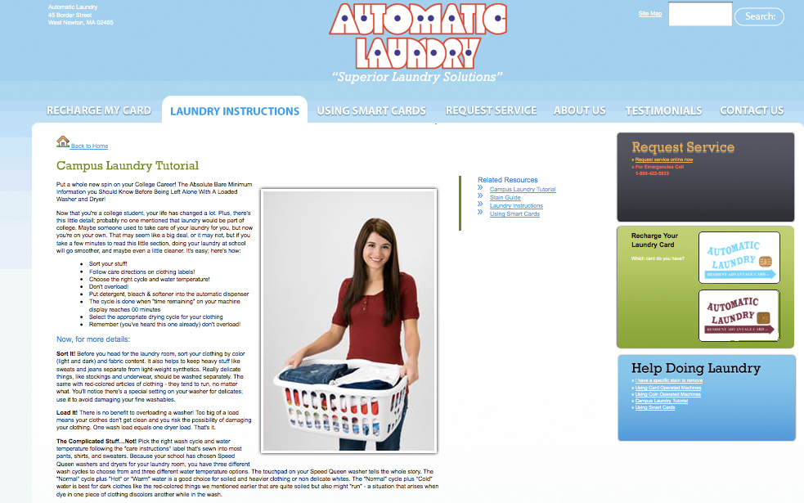
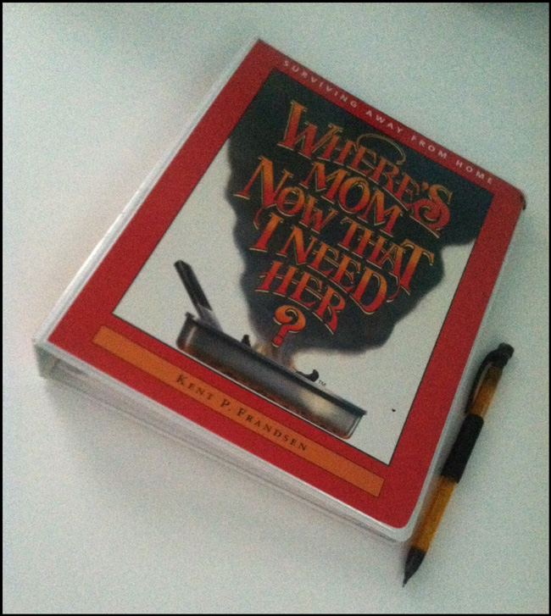

Slide 6
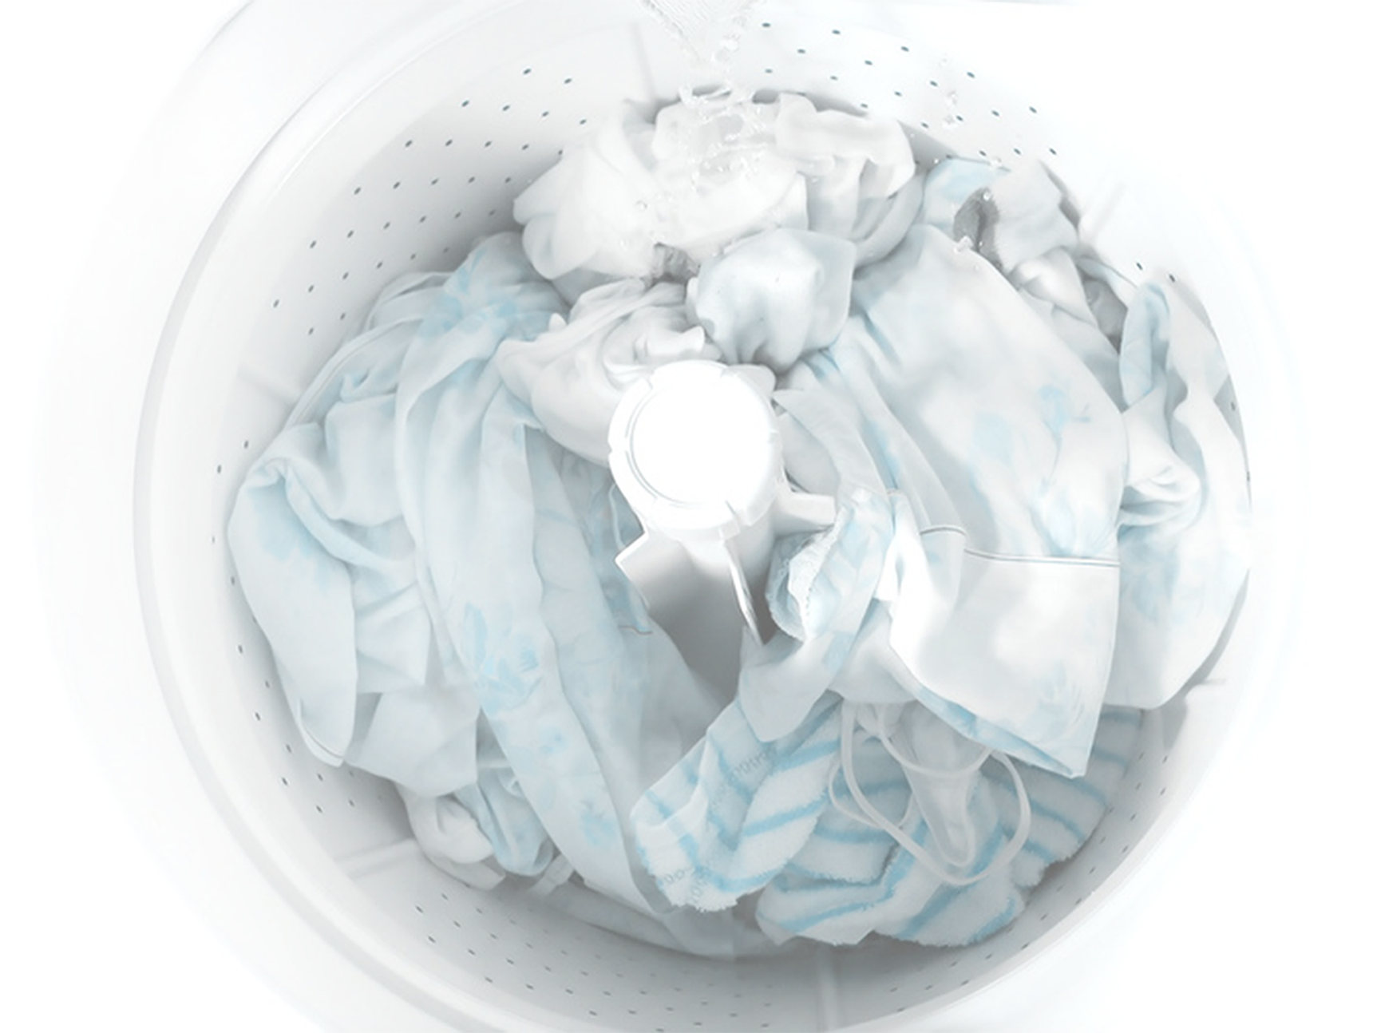

Slide 7
But for many people, when it comes down to preventing and managing

Slide 8
But for many people, when it comes down to preventing and managing unforeseen accidents that occur in the wash or inside the dryer…

Slide 9
…What all of these articles and widgets are lacking is some form of more helpful and specific advisory information that would be oriented to users’ very own laundry basket items, experience level, habitual preferences, and situational problem-solving needs.

Slide 10
(Those and other dynamics of a person’s laundry routine are relative to his or her unique lifestyle and wardrobe -- but they are key considerations in the effort to create a user-centric laundry assistant application.)

Slide 11
The overly simplistic content structure, or else the textbook format of the existing “Laundry Guide” resources that are available today has continued to substantially limit the degree of interaction/interactivity that would be needed between the user and the source in order to promote genuine, accessible troubleshooting and task automation services for doing laundry.

Slide 12
We at seven28, LLC have conceptualized the
Laundri-Map - Pocket Laundry Assistant app for the
stated objective of helping the average person
make better sense of the more
subjective aspects of laundry

Slide 13
…Like sorting loads into accurate piles for compatible and efficient wash loads.

Slide 14
…Like sorting loads into accurate piles for compatible and efficient wash loads.
… And using only shrink-, bleed-, and fade-proof settings for water temperature and tumble speed, to wash and dry all of one’s articles of clothing,
in their many colors and fabrics.

Slide 15
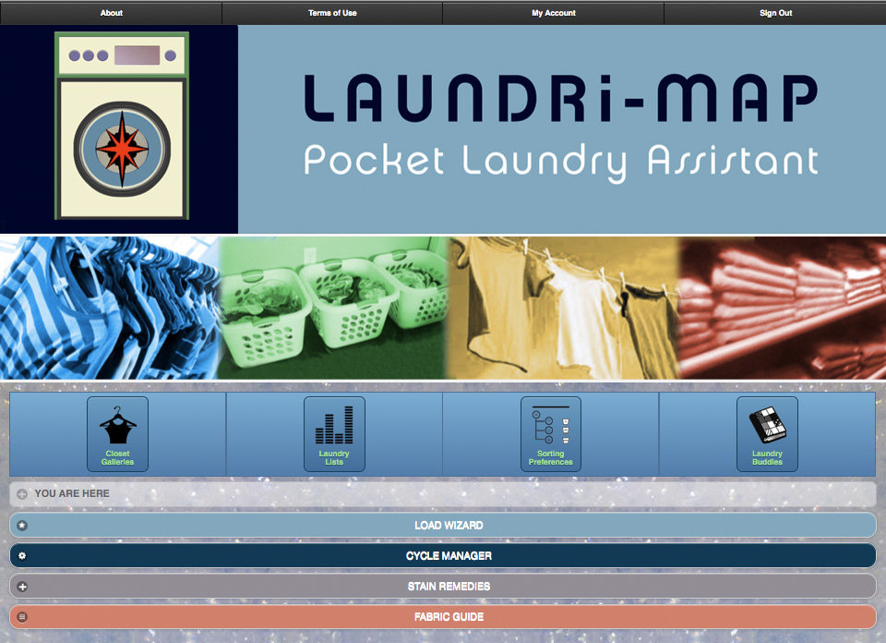

Slide 16
Quite unlike any existing laundry related apps or other resources, the innovative architecture and technical specifications designed by seven28, LLC for the forthcoming Laundri-Map - Pocket Laundry Assistant mobile/desktop application will permit synchronous interactions and information exchange between the user and the app interface…

Slide 17
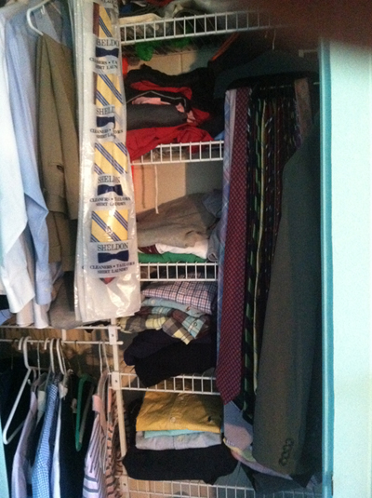
…For the purpose of generating personalized, customizable data records and step-by-step instructions which truly can take the confusion and guesswork out of doing laundry “the proper way”.
…For the purpose of generating personalized, customizable data records and step-by-step instructions which truly can take the confusion and guesswork out of doing laundry “the proper way”.

Slide 18
The unique selling points and competitive advantage of the interface design plan created for the Laundri-Map will lie in its incorporation of novel and responsive user-experience features like the “Closet Galleries” wardrobe inventory (database + photo gallery), the “Load Wizard” laundry sorting engine, and the “Fabric Guide” photographic identification key for classifying unlabelled clothing and other laundry items by their fabric content (along with suggested garment care instructions per each fabric type or blend).

Slide 19
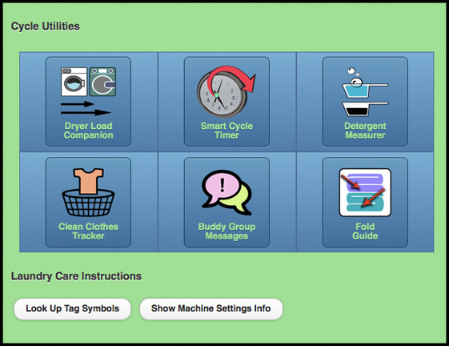
Along the way, a full set of user-friendly utility toolbars will provide handy reference information, problem-solving ideas, and automated functions for time management, reference, data storage, reference, productivity and even messaging functions to further guide the entire process of doing laundry.

