Slide 1

“Laundri-Map - Pocket Laundry Assistant” Mobile/Desktop Application
TARGET USER ANALYSIS
By KYLE ESTERLEY and KASEY WONDERGEM / seven28, LLC

Slide 2
TABLE OF CONTENTS
TARGET USER DEMOGRAPHICS & NEEDS……………3
USER PERSONA #1: “Seth”………………………………….4
USER PERSONA #2: “Jim”..……………………..………....5
USER PERSONA #3: “Naomi”………………………………6
USER SCENARIO…………………………………………….…..7
STAKEHOLDER OVERVIEW & DEFINITION…………..8
STAKEHOLDER GOALS & OBJECTIVES…………….…..9
WORKS CITED.………………………………………………….10

Slide 3
TARGET USER DEMOGRAPHICS & NEEDS
The targeted users for this mobile application make up a segment of the general population of iPhone and iPad users between the age of 18-65. These users generally are expected to reflect the following demographic characteristics which are reported to define the broader population of all iPhone/iPad users.
  The majority of all users have some college education but no college degree.¹
  Nearly half of all users are between the age of 18-34; nearly a quarter are between the age of 35-44.²
  53% of all users are male (47% are female).²
This product really holds value with countless college students; single, divorced or widowed males of middle age; and adult women who are employed in fashion design or retail sales occupations.
The intended users will find worth in the purchase of this laundry assistant software product if any of the following situations are recognized:
  …The need for a mobile application product that could operate as a comprehensive “wizard” for guiding the user step-by-step through the proper and most efficient processes for doing his or her laundry in real time.
  …The option to utilize this application to reference more technical or esoteric information related to fabric care or stain treatment indications specific to a given fabric type or chemical agent (“stain”).
  …The need for information exchange, rich and interactive media programming, and interactions between the user and the app server which can all be communicated and facilitated through the user’s smartphone or tablet.⁴

Slide 4
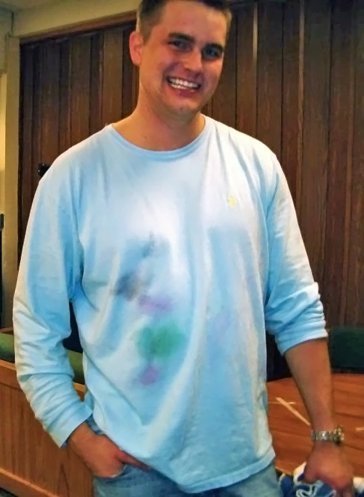
USER PERSONA #1: “Seth”
Age: 19
Occupation: College student (undergraduate, sophomore)
Personal Information:
Lives with three male roommates in an on-campus cottage for underclassmen at a state university
Description of Product Use:
In the interest of conserving their precious resources of detergent supplies, hot water, occupied washer and dryer space, and time allotted to doing chores, Seth and his roommates at the beginning of the semester implemented their own “house policy”: of sorting their collective dirty clothing and linens into each of the traditional five main groups – Lights, Darks, Brights, Whites and Delicates (please refer to citation [3.] under the “Works Cited” section of this document) – and then waiting until any one of these sorted piles has accumulated a sufficiently large quantity or volume of clothing to proceed with running a (“heavy”) wash cycle.
As the most “app-savvy” iPhone owner in the household, Seth has fallen into the role of overseeing the roundup, sorting and loading of his and his roommates’ laundry while the others are attending to other housework assignments. A few times per week, he uses the “Laundri-Map” app on his phone to “Create New”,”Open Saved”, and/or “Import [Merge]” Laundry Lists for organizing his and his roommates’ laundry and sorting it for washer or dryer loads, grouped according to the aforementioned sorting categories and machine cycle settings. After Seth has programmed the day’s dirty clothing/linen items into his phone – identifying the color, fabric content and product type for each, with just a few a clicks – he then adds this data to his ongoing Closet Galleries folder for laundry inventory that is integrated into the app, where he can pull any of those items up instantly and place them in a new list, the next time they need to be washed.
Previous Laundry Experience Level (on a 10-point scale, 10=highest): 2
Interactive Learning Aptitude Level (on a 10-point scale, 10=highest): 9

Slide 5

USER PERSONA #2: “Jim”
Age: 53
Occupation:
Account Manager for a small, privately owned advertising and communications agency
Personal Information:
Recently divorced; lives alone in a downtown condo
Description of Product Use:
Since his return to living as a bachelor and being responsible for doing his own laundry, Jim uses the “Laundri-Map” app on his iPad, typically two to three evenings in a given week – to instruct him in the proper laundry load grouping(s) and basic machine settings calculated for washing and drying a small assortment of his clothing that is currently soiled.
Previous Laundry Experience Level (on a 10-point scale, 10=highest): 0
Interactive Learning Aptitude Level (on a 10-point scale, 10=highest): 3

Slide 6
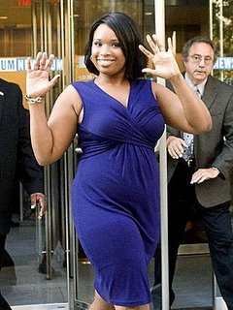
USER PERSONA #3: “Naomi”
Age: 32
Occupation:
Stay-at-home mother and freelance seamstress/clothing designer
Personal Information:
Lives with her husband of seven years and 5-year-old son in their suburban home; in her free time, creates and sews her own clothing designs to outfit her child and herself on a budget; and operates a small, home-based business to create custom garments, costumes and fashion accessories per the specifications of word-of-mouth clients
Description of Product Use:
When it comes to choosing just the right materials from many available options for use in a pattern, Naomi aims for decorative and exquisite fabrics – while also seeking to err on the side of low maintenance care requirements, since as a busy working mom she knows that neither she nor her clients have time or energy to spend on complicated washing or drying procedures.
During regular shopping errands at the fabric store, Naomi relies on the special feature of her iPhone “Laundri-Map” app which allows her to instantly look up specialty fabric types to check the care instructions recommended for each – before she proceeds to the checkout lane with her desired fabric supplies.
Previous Laundry Experience Level (on a 10-point scale, 10=highest): 9
Interactive Learning Aptitude Level (on a 10-point scale, 10=highest): 7

Slide 7
USER SCENARIO
The following fictional narrative is envisioned to explain a hypothetical scenario whereby the “average, typical” user discovered, located and used the product:
Mikaela, a first-year college student, was surfing the apps available from the App Store portal on her iPhone, with the immediate goal of finding one of the latest “outfit creator” fashion assistance apps that she had heard about from some of her friends in the freshman girls’ dorm. Among the first keywords she thought to enter in her quest for such an app was “clothing” – consequentially, the newly released “Laundri-Map Pocket Laundry Assistant” app appeared within the first pool of relevant featured app products, and although it wasn’t what she had had in mind, the name and thumbnail logo graphic caught her eye as she scrolled through the top hits. Clicking to expand the product description for this not-so-common sounding mobile wizard, Mikaela was intrigued by the features that the “Laundri-Map” claimed to offer; too bad that it wasn’t among the “FREE” downloads interspersing the other pay-to-install apps in the featured list. Still, she thought: for what seemed to offer a highly extensive package of interactive functions, combined within such a a conveniently handy and user-friendly app – the pricetag of a few bucks might not actually pose a problem, in this case…
Within about a week of purchasing and installing the “Laundri-Map” app to her iPhone, Mikaela made a full night of it at the laundry room in the lobby of her residence hall. For the first time all school year, she found herself going through a whole roll of quarters, with the aid of the laundry sorting and machine setting instructions which the app’s “Create/Add To Loads” features calculated for her; in order to get all of her dirty laundry – some of it months in the making – thoroughly sorted, properly cleaned, fully dried, and not even shrunk or discolored at any point!
Making pleasant conversation with some of the other girls who joined her in emptying or filling their own laundry baskets that evening, Mikaela spread the word about the new laundry aid that she had discovered for her iPhone. She even aided one of the other girls in selecting the right wash and rinse settings for cleaning a delicate cardigan sweater. Within weeks, the “Laundri-Map Pocket Laundry Assistant” had found a user base among a growing number of first-year college students in Mikaela’s dorm.

Slide 8
STAKEHOLDER OVERVIEW & DEFINITION
Apple’s App store is the leader among all mobile application markets. Over the past three years they have fought and succeeded against their rivals Blackberry and Android to maintain their lead in the number of users on their platform. Sought as primary stakeholders for the development of this mobile app, Apple understands the demand for rich and engaging mobile applications in today’s booming mobile economy.
The mobile craze has been unprecedented over the past year especially. Apple Inc. has kept close watch on these consumer trends and continues to fulfill public demand through the cutting edge technology used in designing iPhone and iPad product lines.
The “Laundri-Map Pocket Laundry Assistant” is designed as an interactive application for the iOS platform found on the iPhone and iPad devices. Apple stands to profit from the development of this app once it is licensed and made available for purchase through the company’s App Store, where users will be able to purchase and install the app for a minimal one-time download fee.

Slide 9
STAKEHOLDER GOALS & OBJECTIVES
Mobile and Web applications are not successful by random events or by chance. Only when a new release offers it’s consumers a purchase that makes sense will it find the success and popularity that Apple Inc. thrives off as a winning competitor. As the long running leaders in the industry, their stakes are exceptionally high, but as a result, their claims are extraordinary. With goals to continue dominating the world of information, one of Apple’s main objectives is to not only hold on to, but to strengthen their reputation within the market.
The following stakeholder goals and objectives will guide the strategic development of the “Laundri-Map Pocket Laundry Assistant” mobile application:
  The intention for the product is a mobile app that will be equally functional on iPhone and iPad devices and will integrate many rich and interactive features designed to make life a little easier. All information used comes from authoritative experts who have gained their insight through a variety of industries that deal with fashion/home care.
  Lifetime subscriptions are obtained with the small initial purchase price. The app will likely gain popularity within the broader market of iPhone and iPad users through word-of-mouth.
  The concept for the “Laundri-Map Pocket Laundry Assistant” is to serve as a guide and calculator for sorting and managing one’s personal laundry loads, according to proven guidelines and formulated settings for grouping items of laundry in various washing and drying cycles.
  The app is programmed to compute and offer back specific directions based on input from the users. The data is used to inventory, describe, tag and catalog their own items of clothing within an indexed database containing categorized information to identify each item. This “inventory” of clothing is visually displayed in a gallery within the app -- viewable with thumbnail images.

Slide 10
WORKS CITED
Alexander, Anson. “Smartphone Usage Statistics 2012.” AnsonAlex. 24 January 2012.
AnsonAlex.com. 1 February 2013.
< http://ansonalex.com/infographics/smartphone-usage-statistics-2012-infographic/ >
Frommer, Dan. “Actually, iPhone users tend to be richer and better educated than Android
users.” SplatF. 16 December 2011. Dan Frommer. 1 February 2013.
< http://www.splatf.com/2011/12/iphone-android-demos/ >
“Great laundry starts here.” Tide Stain Solutions. 2012. Proctor & Gamble. 1 February 2013.
< www.tide.com/en-US/article/laundry-starts-here.jspx >
Weevers, Ivo. “Seven Guidelines For Designing High-Performance Mobile User
Experiences.” Smashing Magazine, 18 July 2011. Web. 15 Feb. 2013.
< http://uxdesign.smashingmagazine.com/2011/07/18/seven- guidelines-for-designing-
high-performance-mobile-user-experiences/ >

