Slide 1
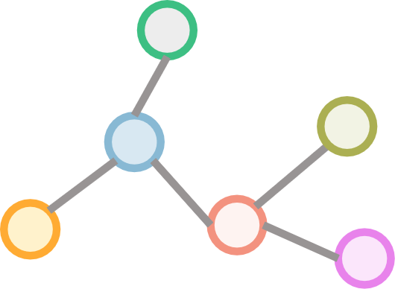
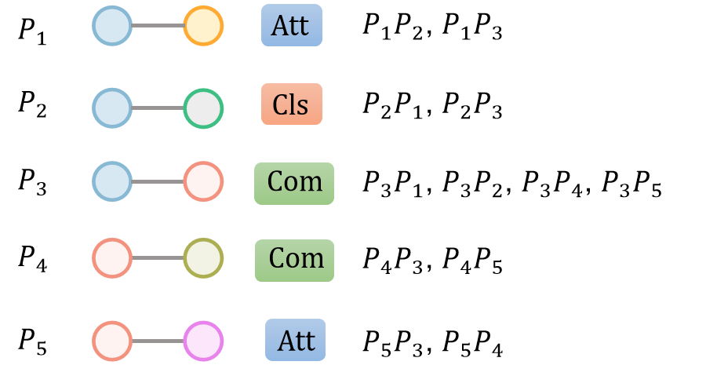



Graph Encoder
GCN
+
Text Decoder
$$G_{data}$$
$${triple}_{1}$$
TMM Encoder
…
+
TMM
$${triple}_{n}$$

Slide 2






Graph Encoder
GCN
+
Text Decoder
$$G_{data}$$
Transformer Decoder
TMM Encoder
…
Transformer Encoder
…
TMM
[CLS]
$$e_{1}$$
$$r_{1}$$
$$e_{1}^{’}$$
$$Att$$
$$P_{1}P_{2}$$
$$P_{1}P_{3}$$
$$Att$$
[SEP]
[SEP]

Slide 3
Graph Encoder
GCN
+
Text Decoder
$$G_{data}$$
Transformer Decoder
TMM Generator
TMM Encoder
…
Transformer Encoder
…
TMM
[CLS]
$$e_{1}$$
$$r_{1}$$
$$e_{1}^{’}$$
$$Att$$
$$P_{1}P_{2}$$
$$P_{1}P_{3}$$
$$Att$$
[SEP]
[SEP]

Slide 4
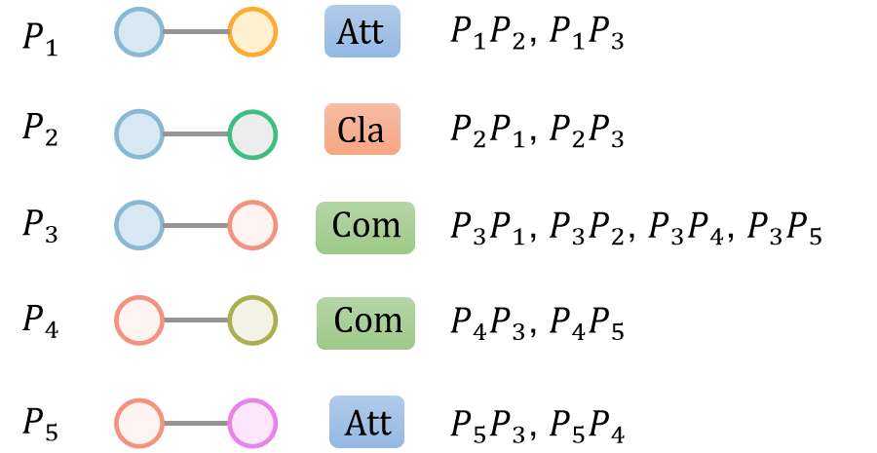
Graph Encoder
GCN
+
Text Decoder
$$G_{data}$$
Transformer Decoder
TMM Generator
TMM Encoder
…
Transformer Encoder
…
TMM
TMM

Slide 5
Graph Encoder
R-GCN
+
Text Decoder
$$G_{data}$$
Transformer Decoder
TMM Generator
TMM Encoder
…
Transformer Encoder
…
TMM
TMM

