Slide 1

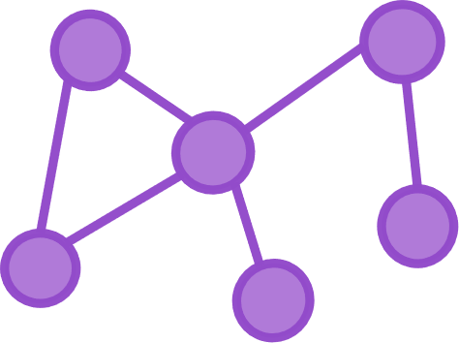


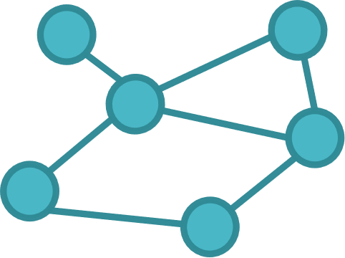








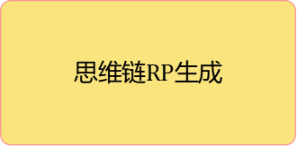



$${Reasoning Path}_{in}$$
$${Target Text}_{in}$$
文本生成
LLMs
Prompt
…
$$S_{top−k}$$
$${TMM}_{1}$$
$${Reasoning Path}_{3}$$
$${Target Text}_{1}$$
$${TMM}_{1}$$
$${Reasoning Path}_{2}$$
$${Target Text}_{1}$$
$${TMM}_{1}$$
$${Reasoning Path}_{1}$$
$${Target Text}_{1}$$
思维链$RP$生成
LLMs
Prompt
$$+ Target Text$$
$$G_{in}$$
…
$$G_{data1}$$
…
$$G_{datak}$$
…
$$Att | P_{1}P_{2}$$
$$Att | P_{1}P_{2}$$
…
$$Com | P_{1}P_{2}$$
$$Cls | P_{1}P_{2}$$
$$Com | P_{1}P_{2}$$
$$Cls | P_{1}P_{2}$$
$$Com | P_{1}P_{2}$$
$$Cls | P_{1}P_{2}$$
$$Att | P_{1}P_{2}$$
$$Att | P_{1}P_{2} …$$
$$Cls | P_{1}P_{2} …$$
$$Com | P_{1}P_{2} …$$
思维图$TMM$生成
……
$$G_{top−k}$$
相似度计算
……
GCN
GCN
池化层
池化层
池化层
池化层
图编码层
图编码层
图编码层
图编码层
$${ G}_{in}$$
$${ G}_{data1}…{ G}_{datan}$$

Slide 2
$${TMM}_{1}$$
$${Reasoning Path}_{3}$$
$${Target Text}_{1}$$
$${TMM}_{1}$$
$${Reasoning Path}_{2}$$
$${Target Text}_{1}$$
$$S_{top−k}$$
$${Reasoning Path}_{in}$$
$${TMM}_{1}$$
$${Reasoning Path}_{1}$$
$${Target Text}_{1}$$
…
$${Target Text}_{in}$$
1st Prompt：
思维链推理路径生成
LLMs
2nd Prompt
1st Prompt
2nd Prompt：
上下文学习知识注入方法
$$+ Target Text$$
$$G_{in}$$
…
$$G_{data1}$$
…
$$G_{datak}$$
…
$$Att | P_{1}P_{2}$$
$$Att | P_{1}P_{2}$$
…
$$Com | P_{1}P_{2}$$
$$Cls | P_{1}P_{2}$$
$$Com | P_{1}P_{2}$$
$$Cls | P_{1}P_{2}$$
$$Com | P_{1}P_{2}$$
$$Cls | P_{1}P_{2}$$
$$Att | P_{1}P_{2}$$
$$Att | P_{1}P_{2} …$$
$$Cls | P_{1}P_{2} …$$
$$Com | P_{1}P_{2} …$$
思维图$TMM$生成
……
$$G_{top−k}$$
Similarity Score
知识图谱检索
……
GCN
GCN
池化层
池化层
池化层
池化层
图编码层
图编码层
图编码层
图编码层
$${ G}_{in}$$
$${ G}_{data1}…{ G}_{datan}$$

Slide 3


$${TMM}_{1}$$
$${Reasoning Path}_{3}$$
$${Target Text}_{1}$$
$${Reasoning Path}_{in}$$
$${TMM}_{1}$$
$${Reasoning Path}_{2}$$
$${Target Text}_{1}$$
$$S_{top−k}$$
$${TMM}_{1}$$
$${Reasoning Path}_{1}$$
$${Target Text}_{1}$$
…
$${Target Text}_{in}$$
1st Prompt：
思维链推理路径生成
LLMs
2nd Prompt
1st Prompt
2nd Prompt：
上下文学习知识注入方法
$$+ Target Text$$
$$G_{in}$$
…
$$G_{data1}$$
…
$$G_{datak}$$
…
$$Att | P_{1}P_{2}$$
$$Att | P_{1}P_{2}$$
…
$$Com | P_{1}P_{2}$$
$$Cls | P_{1}P_{2}$$
$$Com | P_{1}P_{2}$$
$$Cls | P_{1}P_{2}$$
$$Com | P_{1}P_{2}$$
$$Cls | P_{1}P_{2}$$
$$Att | P_{1}P_{2}$$
$$Att | P_{1}P_{2} …$$
$$Cls | P_{1}P_{2} …$$
$$Com | P_{1}P_{2} …$$
三元组思维图$TMM$生成
……
$$G_{top−k}$$
Similarity Score
知识图谱检索
……
R-GCN
R-GCN
池化层
池化层
池化层
池化层
图编码层
图编码层
图编码层
图编码层
$${ G}_{in}$$
$${ G}_{data1}…{ G}_{datan}$$
知识图谱（目标域）
知识图谱样例集（源域+目标域）

