Slide 1
【一阶段】 思维链提取
【二阶段】 思维链提示生成
输入
Knowledge Graph：
P1 | (Harry Potter, genre, novel) | Cls | P1P2, P1P3
…
P5 | (J.K. Rowling, birthYear, 1965) | Att |P5P3, P5P4
…
Target text：
British writer J.K. Rowling was born in 1965…
Prompt：
Please generate helpful reasoning path to
LLMs
输出

Slide 2
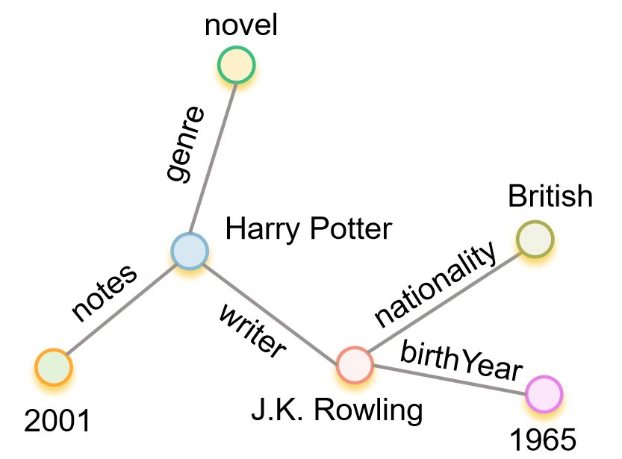
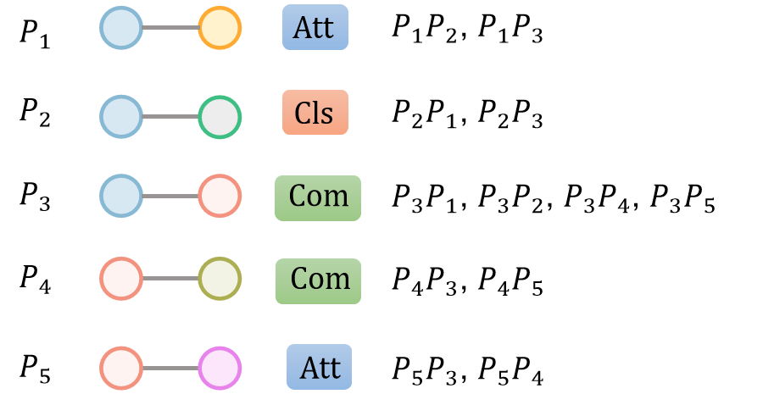







【一阶段】 思维链提取
【二阶段】 思维链提示生成
输入
输入
$$G_{data1}$$
$$TMM$$
$$TMM$$
Step1：Interpreting Triples
……
Step2：Extracting Intermediate Reasoning
……
Step3：Draft A Coherent Narrative
……
$$Instruction$$
LLMs
$$Reasoning Path$$
$$Reasoning Path$$
$$Instruction$$
输出
LLMs
Step1：Interpreting Triples
Triple P1: "Harry Potter" is related to ……
Step2：Extracting Intermediate Reasoning
"Harry Potter" is classified as a novel, so the core subject of our text will ……
Step3：Draft A Coherent Narrative
Start with the person, J.K. Rowling, since she's central to all the triples ……
$$Target Text$$
输出
Target Text：
British writer J.K. Rowling was born in 1965, and she wrote a novel entitled "Harry Potter" that was first noted in 2001.

Slide 3
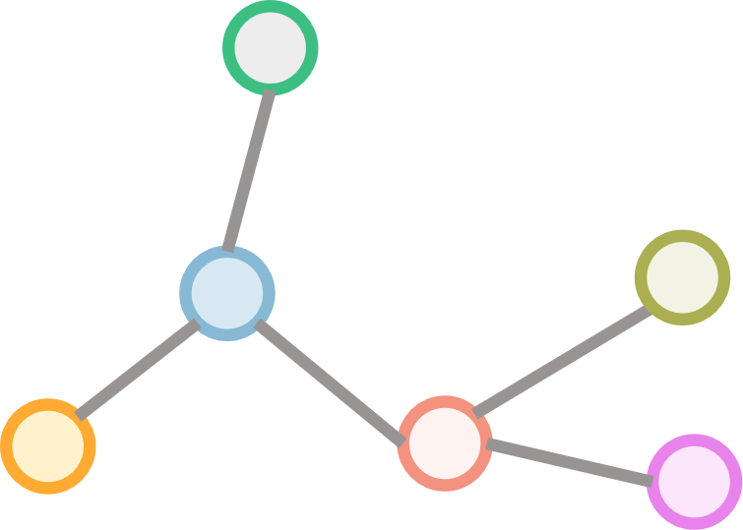






【一阶段】 思维链提取
【二阶段】 思维链提示生成
输入
输入
$$G_{data1}$$
$$TMM$$
$$TMM$$
Step1：Interpreting Triples
……
Step2：Extracting Intermediate Reasoning
……
Step3：Draft A Coherent Narrative
……
$$Prompt$$
LLMs
$$Reasoning Path$$
$$Reasoning Path$$
$$Prompt$$
输出
LLMs
Step1：Interpreting Triples
Triple P1: "Harry Potter" is related to ……
Step2：Extracting Intermediate Reasoning
"Harry Potter" is classified as a novel, so the core subject of our text will ……
Step3：Draft A Coherent Narrative
Start with the person, J.K. Rowling, since she's central to all the triples ……
$$Target Text$$
输出
Target Text：
British writer J.K. Rowling was born in 1965, and she wrote a novel entitled "Harry Potter" that was first noted in 2001.

Slide 4
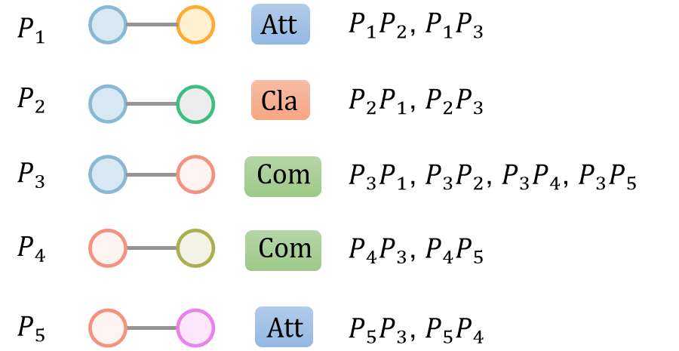






$$G_{datai}‘s TMM$$
$${Target Text}_{i}$$
British writer J.K. Rowling was born in 1965, and she wrote a novel entitled "Harry Potter" that was first noted in 2001.
$$TMM$$
输入
$$Prompt：[T]$$
LLM
$$Reasoning Path$$
输出
推理链路生成
Step1：Interpreting Triples
Triple P1: "Harry Potter" is related to ……
Step2：Extracting Intermediate Reasoning
"Harry Potter" is classified as a novel, so the core subject of our text will ……
Step3：Draft A Coherent Narrative
Start with the person, J.K. Rowling, since she's central to all the triples ……

Slide 5





…
…
$$G_{datai}‘s TMM$$
$$G_{in}‘s TMM$$
$${Reasoning Path}_{i}$$
Step1：Interpreting Triples
……
Step2：Extracting Intermediate Reasoning
……
Step3：Draft A Coherent Narrative
……
$${Target Text}_{i}$$
British writer J.K. Rowling was born in 1965, and she wrote a novel entitled "Harry Potter" that was first noted in 2001.
top-k cases
$$Prompt：[T]$$
LLMs
$$Reasoning Path + Target Text$$
$$Reasoning Path$$
$$Target Text$$
Step1：Interpreting Triples
……
Step2：Extracting Intermediate Reasoning
……
Step3：Draft A Coherent Narrative
……
British composer Granville Bantock was born in 1868, and he wrote an incidental music piece entitled "Dance of the Seven Veils" that was first played on stage in 1918.

Slide 6
…
…
$$G_{datai}‘s TMM$$
$$G_{in}‘s TMM$$
$${Reasoning Path}_{i}$$
Step1：Interpreting Triples
……
Step2：Extracting Intermediate Reasoning
……
Step3：Draft A Coherent Narrative
……
$${Target Text}_{i}$$
British writer J.K. Rowling was born in 1965, and she wrote a novel entitled "Harry Potter" that was first noted in 2001.
top-k cases
LLMs
$$Reasoning Path$$
$$Target Text$$
Step1：Interpreting Triples
……
Step2：Extracting Intermediate Reasoning
……
Step3：Draft A Coherent Narrative
……
British composer Granville Bantock was born in 1868, and he wrote an incidental music piece entitled "Dance of the Seven Veils" that was first played on stage in 1918.

