Slide 1
✨Shimmer✨
User Guide

Slide 2
What is Shimmer
Shimmer allows the Skope magnetic field probe computer to retrieve the field, calculate the shim currents that will correct it, and send those currents to the MRShim laptop where they are applied.
Who is responsible for this? See the colophon.

Slide 3
Contents
These are hyperlinks! ctrl-click to jump
Installation
Configuration
Pre-shimming
Connecting the clients
Dynamic shimming
Manual control
Modifying Matlab
Troubleshooting
How to use:
Each section starts with a description of its contents.
All commands look like this and should be entered exactly as written.

Slide 4
SECTION: Installation
Where to find the shimmer files
Where to put them on the computers

Slide 5
Installation
In the shared area, there is a shimmer-fresh-copy directory (folder), this contains a fresh, complete copy of shimmer. Please do not overwrite this.
Copy this directory onto the Skope (into C:\users\skope\Documents\) and MRShim computer (into C:\), rename the directory on each computer to “shimmer”.

Slide 6
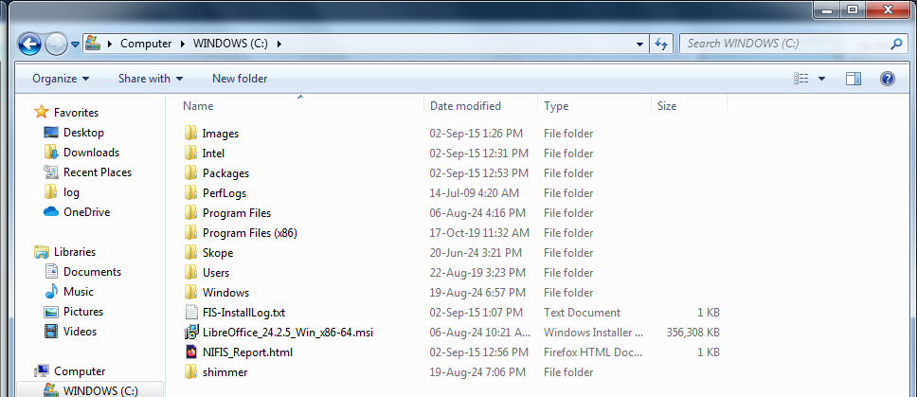
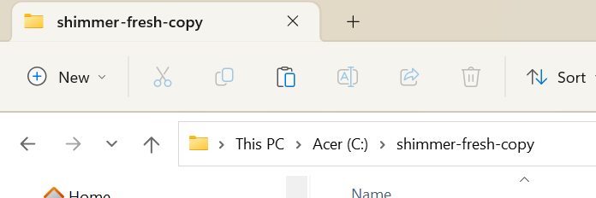
Installation
Correct installation locations:

Slide 7
SECTION: Configuration
How to use ipconfig
How to find your address
Which ports to use
Where to put the finished file, and what to name it

Slide 8
Configuring the network
If you don’t know what a port, socket or address is please read the explanation in the troubleshooting section.
This step requires knowing which clients are on which computer. The default configuration is:
Skope computer: server, matlab, console1
MRShim laptop: mrshim, console2

Slide 9



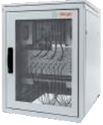

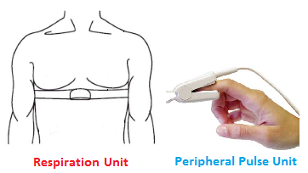
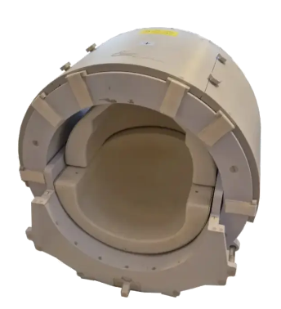
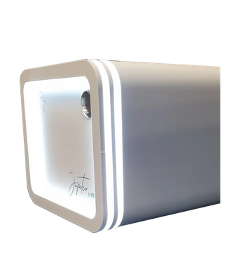

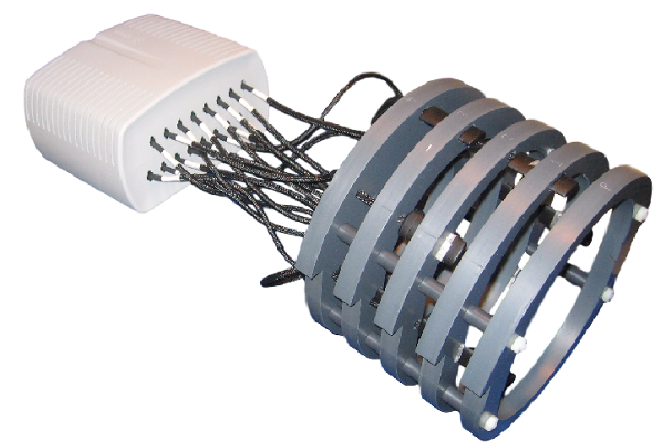
Outline key:
Red: Skope
Green: MR Shim
Yellow: Scanner
Green background: part of shimmer
Network diagram with file formats
OUT
TTL
Field map
OUT
.PAR
IN
IN
7T Scanner
Arche
coil_tmp.npy
✨Server✨
GetDataByBlock()
OUT
Matlab Client
OUT
Clip on Camera Head (CCH)
.scan
Console Client 1
IN
OUT
Jupiter amplifiers and Elara coil
MRShimClient
IN
TTL
Console Client 2
OUT
IN
Based on a diagram by Dr. Laura Bortolotti

Slide 10
Configuring the network
For each computer:
Open a command prompt/terminal.
Run ipconfig and find the longest output under ‘ethernet’. Note down the address next to IPv4.
In network_description.ini, change the address of each client on that computer, to the address you just noted down.

Slide 11
Configuring the Network
The output of ipconfig is on the next slide:
Rename network_description_7t.ini to network_description.ini (this is the file name shimmer looks for).
Copy the file (via the shared area) into the shimmer directory on each computer. Both computers need exactly the same file, as it lets them work out which client has connected.

Slide 12
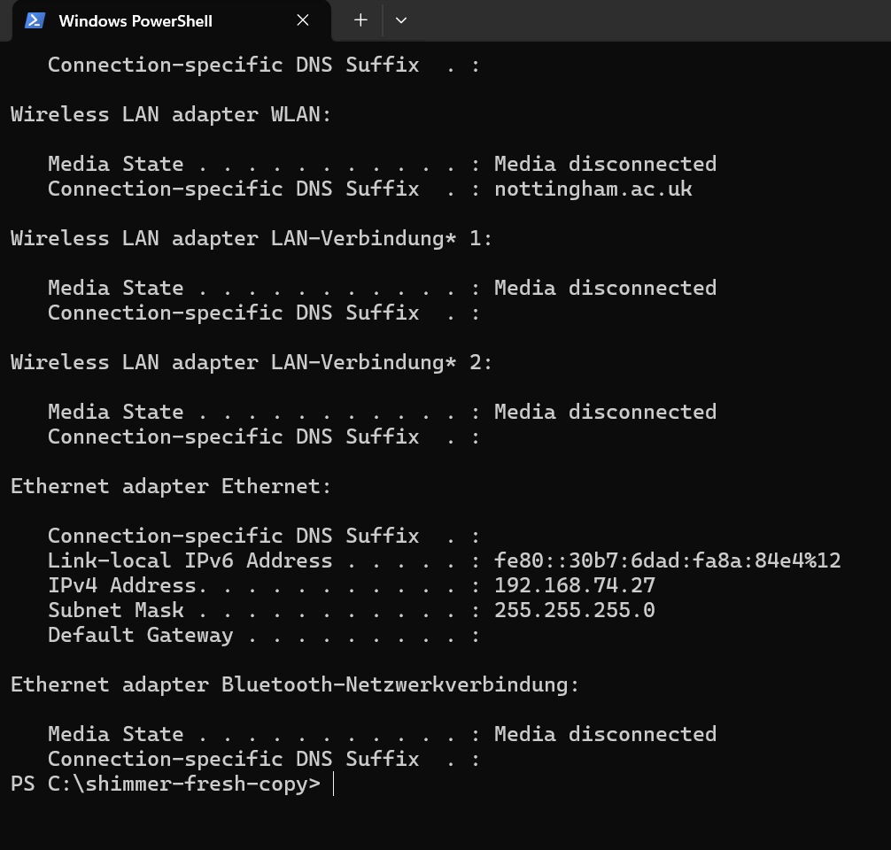
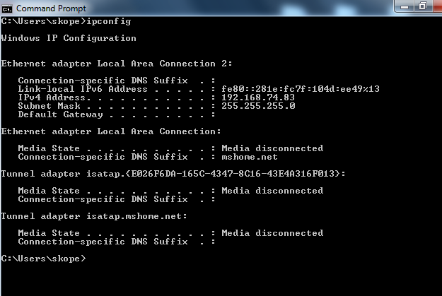
Configuring the Network
MRShim:
Your address may be different!
Skope:

Slide 13
SECTION: Pre-shimming
To make this recipe, you will need:
A high-res field map
Arche’s coil_tmp.npy
A .scan file
Correct names and file locations

Slide 14
Pre-shimming
Perform a high resolution B0 map.
Copy the .PAR and .REC into the shared area.
Rename them both to field_map.par/field_map.rec.
Drag the .PAR into Arche and compute the required shims, then close Arche.
Copy the coil_tmp.npy file from the C:\mrshim\ directory into the shared area.

Slide 15

Pre-shimming
Open the Skope software and perform an offresonance and positions calibration.
Ensure you save the calibration and use it going forward.
Collect some data, any data, any number of dynamics, any TR, we just need the .scan file which contains the position data.
Copy the .scan file from this scan (the others won’t have the correct position data) into the shared area.
This should not say ‘default’!

Slide 16
Pre-shimming
Copy the previous files from the shared directory into the ./shimmer/data/ directory on the Skope computer.
In matlab_client.m, change the ScanID variable (line 72) to match the ID of the .scan file (the integer at the start).
You are now ready to shim! :)

Slide 17
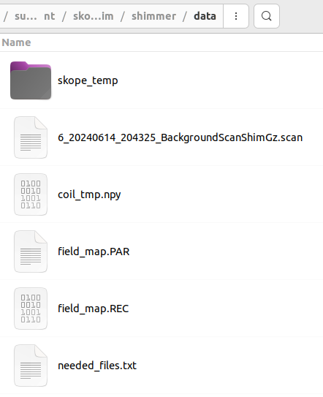
Correct File Structure
ScanID variable
From Skope FM
From Arche
B0 map
(Your icons and exact .scan will be different to mine)

Slide 18
SECTION: Connecting the clients
Navigating to the shimmer directories at the command line
Starting the server
Starting the console client
Connecting the MATLAB client
Starting the MRShim client
A quick way

Slide 19
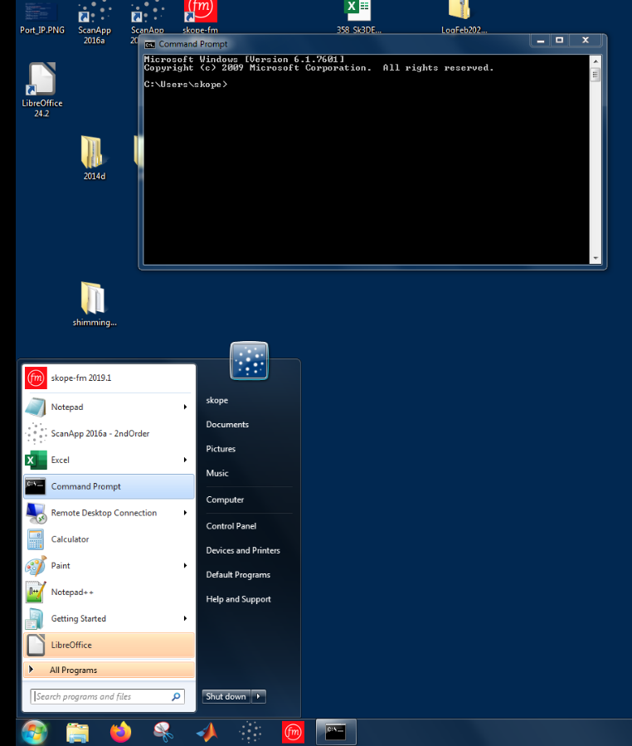
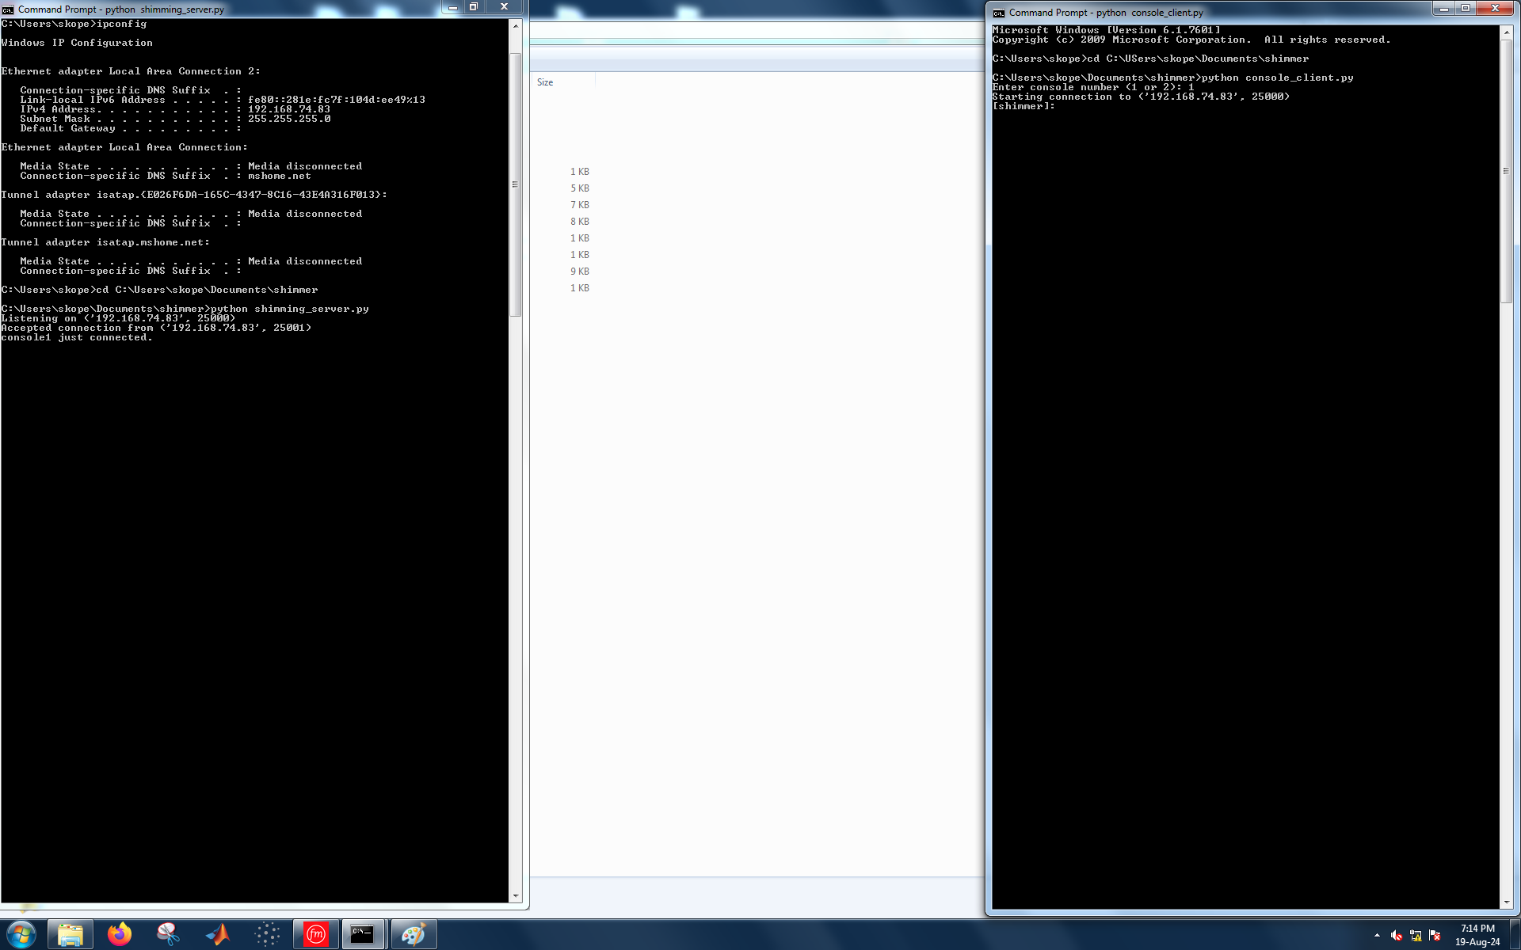
Skope computer:
Open two command prompts.
Navigate to shimmer directory using:
cd C:\Users\skope\Documents\shimmer

Slide 20
Skope computer
!! Ensure network description is correctly configured before starting the server !!
In one prompt, start the server with:
python .\shimming_server.py
Should see:
Fun fact! You can start the clients by double clicking on their .py file! Though if they crash, then the windows will close before you get a chance to look at the debugging info.

Slide 21
Skope computer
In another prompt, start a console client with:
python .\console_client.py
When prompted, enter 1 for the console number.
Should see:
and:
Fun fact! Once the server has started, you can connect the clients in any order.

Slide 22
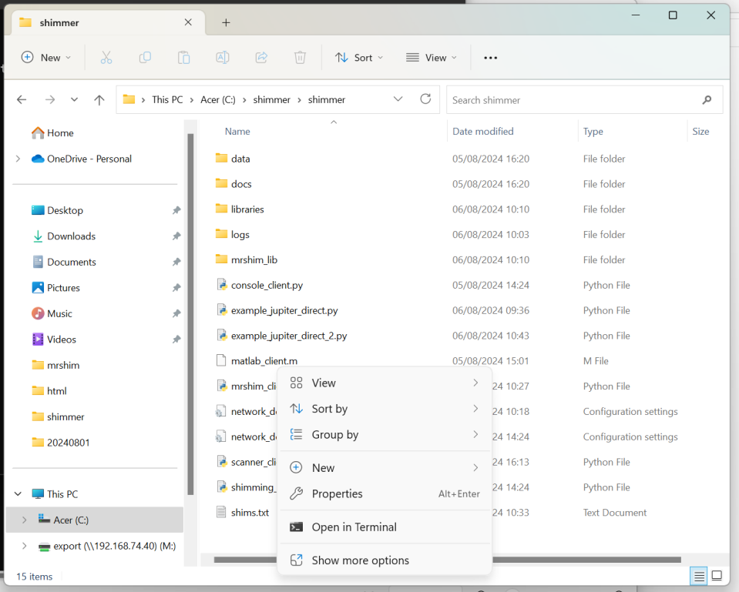
MRShim computer
Navigate in file explorer to shimmer directory:
Right click below file list
and click “Open in Terminal”
(Can also open a PowerShell
and navigate with cd)

Slide 23
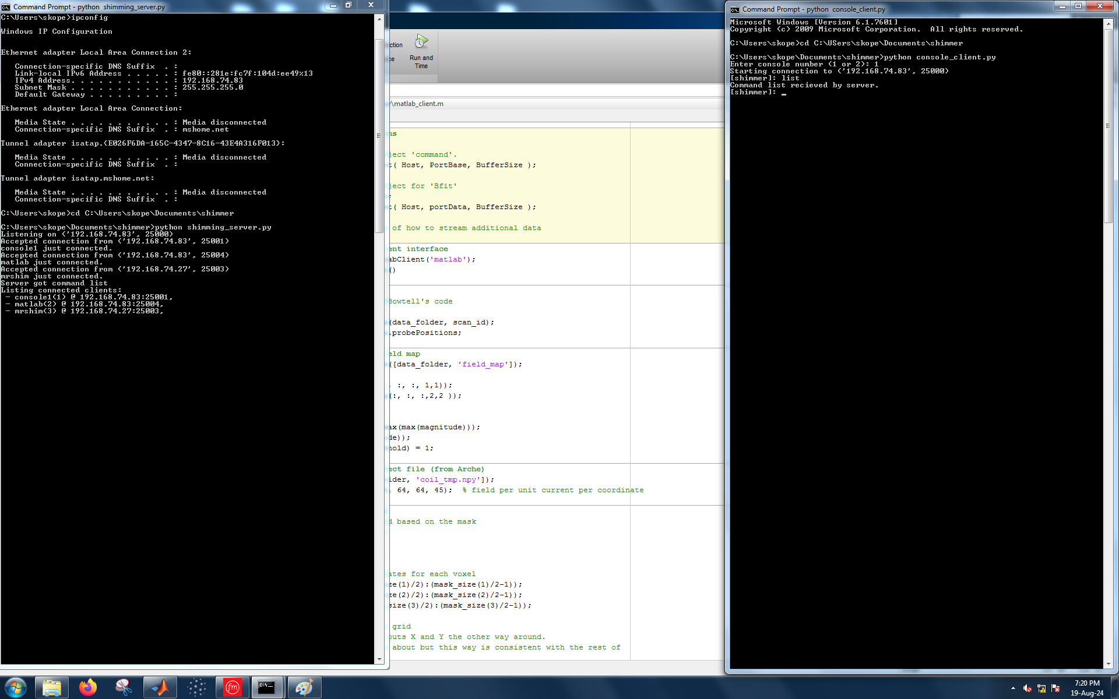
MRShim computer
!! Ensure JUPITER_PLUGGED_IN is set to True in mrshim_client.py if you want it to actually shim !!
Run python .\mrshim_client.py
Should see:
In this terminal, and at the server:
You could also double click!

Slide 24
MRShim computer
If it is connected to Jupiter, you should see the message: <screenshot of mrshim output>
!! Important !! Only one thing can be connected to the Jupiter amplifiers at once, so do not open Sinope or Oolong or Arche whilst the mrshim client is connected.
!! Important !! If this client or the server crashes, it may not disconnect from the Jupiter amplifiers and they may continue shimming. To force a disconnect and to zero the shims, connect with Sinope (which will then probably crash, but after it has set the currents to zero).

Slide 25
MRShim Computer
Optional: you can start a second console client (console number 2) on the MRShim laptop
Open another terminal window the same way as before.
Enter python .\console_client.py
When prompted, tell it 2.

Slide 26
Quick Way
On the Skope computer, double click on shimming_server.py to start it,
Double click on each of the clients
  Skope: console_client.py,
  MR Shim: mrshim_client.py
Issue with this way: if it crashes, it will just close the windows and you won’t be able to see why!

Slide 27
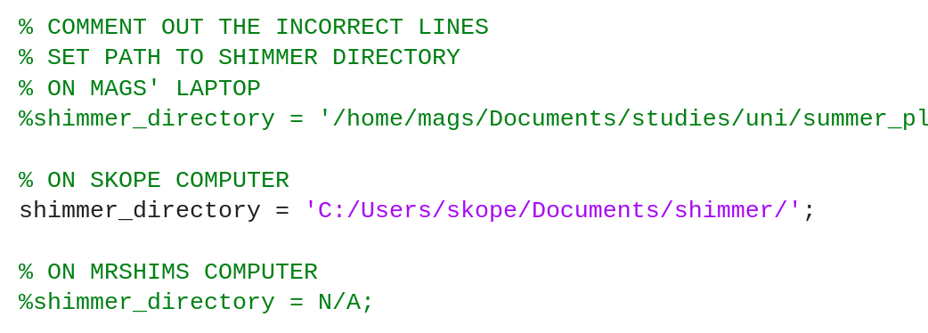
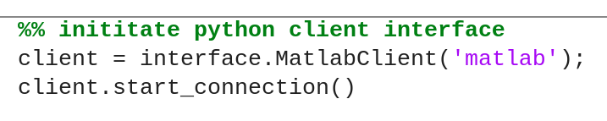
Skope computer
In MATLAB, navigate to the matlab_client.m file.
In the first block, ensure the correct shimmer_directory is uncommented
Run the first 6 sections
up to and including:

Slide 28
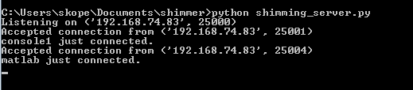
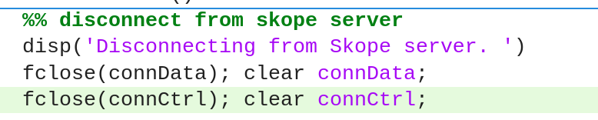
Skope computer
Should see:
And also the controls greyed out on Skope software
To disconnect from the Skope server and restore manual control, run the final block:

Slide 29
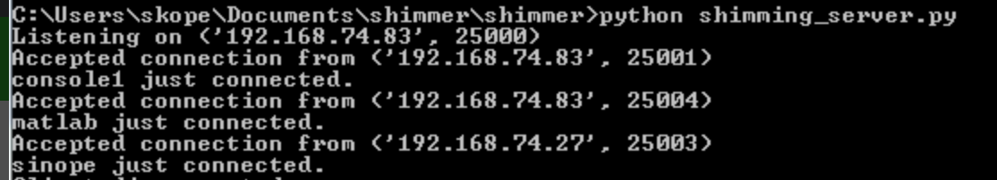
Skope computer
Before you start shimming, the server console should look like this:
You can also check which clients are connected by entering list at a console and checking the output on the server:

Slide 30
SECTION: Dynamic shimming
Starting the shimming with relay mrshim !start
Running the MATLAB script
Stopping the shimming, relay mrshim !stop

Slide 31
Any console
Enter at a [shimmer] prompt:
relay mrshim !start
This executes the “!start” command from MRShim, which enables shimming.
You should see on the MRShim terminal:

Slide 32
Matlab Client
Now the fun part! Time to start receiving Skope data and sending currents.
Run the MATLAB sections up to and including:
%% set scan def and get project path
Then run the next two blocks, as quickly after each other as it will let you.
The program is now in a loop, use the stop button at the stop of Matlab to stop acquiring Skope data and calculating currents,
(To pause shimming, use one of the consoles instead to send: relay mrshim !stop so the shim currents are set to 0)
(To keep the shims set at some value, use relay mrshim !hold

Slide 33
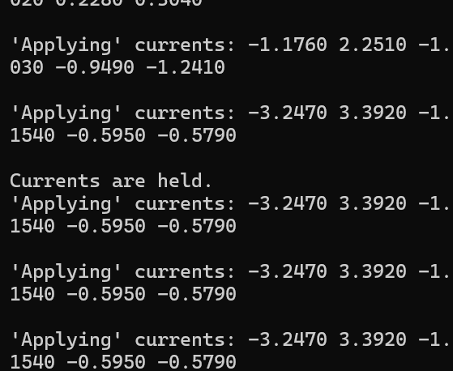
Matlab Client
In the command window you should see a status section that continuously updates.
In the MRShim client, you should see something like (but with more currents, and probably not stopped):
To make it hold the current shim values, use !hold
Currents being updated from MATLAB.
!hold command received.
Subsequent !shim commands just repeat the same currents, regardless of what is actually sent.
(Your output will be different if Jupiter is plugged in.)

Slide 34
How to stop
Run the command: relay mrshim !stop to set the currents back to zero.
Run the command: halt to disconnect all the clients and then stop the server.
(Run relay <client> disconnect to cleanly disconnect just one client.)

Slide 35
SECTION: Manual control
The difference between client and server commands
List of commands

Slide 36
Client vs Server Commands
This is the most complicated part of using shimmer.
Everything in shimmer is done with commands.
Some commands are executed by the client, and some by the server.
But all commands are entered at a console client (at the [shimmer]: prompt),
The way you make a non-console client execute a command is by relaying the client command to it from the console.
This is because the input() function of Python stops anything else from being done, so we can’t accept input on a client we need to do something else (like apply shims).

Slide 37
Client vs Server Commands
ALL client commands start with an exclamation mark(!), so you could say they start with a bang. Any input not starting with an exclamation mark is sent to the server.
I want to: | What you should type at a [shimmer] prompt:
Execute a server command | Type the server command (no !) and hit enter.
Execute a client command as this client | Type the command and hit enter, remember client commands start with a bang(!).
Execute a client command as another client | Relay the command to that client. Type: relay <client name> <command> and hit enter. Remember the ! on the command!

Slide 38
Client commands
The client commands. Start with a bang!
Not every client can execute every command, e.g., consoles can’t shim. The name in brackets is the name of the client that can execute that command. <> denotes parameters.
Command (client) | What it does
“!start <ramp time>” (mrshim) | Enable shimming (send shims to Jupiter.) If no ramp time (ms) is provided, uses the previous value. Initialised at 0. Ramp times are internally rounded to 0, 0.25, 0.5, 1, 2, 4, 8, 16 and 32ms.
!stop (mrshim) | Disable shimming (sets shims to 0)
“!shim <currents>” (mrshim) | Repeats the <currents> until it fills 24 channels, then sends them to Jupiter, currents should be integer numbers of milliamps, separated by spaces. If you give it no currents or bad currents it will just repeat the last set.
!reset (mrshim) | Reset the connection to the Jupiter amplifiers without stopping shimming.

Slide 39
Client commands
Command (client) | What it does
!status (mrshim) | Toggle printing Jupiter status messages whenever shims are applied.
!hold (mrshim) | Toggles whether it holds the previous currents and continuously applies those. Ignores any further !shim commands.
!echo <message> (all) | Prints <message> to the console. Used for debugging.
!debug (all) | Enables printing debug messages.
!reader (all) or no command at all at a console. | Sometimes you are waiting for a console to get a response from the server, but waiting for input() is blocking it. Run no command/run !reader to get any waiting packets.

Slide 40
Relay
Syntax: relay <client name> “<command>”
The relay command causes the client named to execute the command, just as though it had typed it itself.
The client names are those in network_description.ini and also those that appear at the console when they connect.
It is a server command (server routes the packet to the client), so there’s no bang, but if <command> is a client command, it does need the bang, because it is dealt with just as though it had been typed in.
Because input() is blocking, we can’t have an input() on the mrshim client (it is busy shimming) so this is how we get commands to it: relay mrshim “<command>”
The quote marks allow the parser to grab the whole command and not just the first word of it. If the command only has one word, then you don’t need it. (But if you’re shimming and have multiple currents… you’ll need the quotes!)

Slide 41
Server commands
The server commands. No ! to start.
Command (client) | What it does
list | Lists connected clients and their addresses.
status | Prints some server status info.
disconnect | Disconnects whichever client sent this.
halt | Disconnects all clients then stops the server. The cleanest way to close.
relay <client> <command> | Relays a command to another client, causing it to execute it itself. To relay a command with multiple parameters, put it inside quotes: “<command>”.

Slide 42
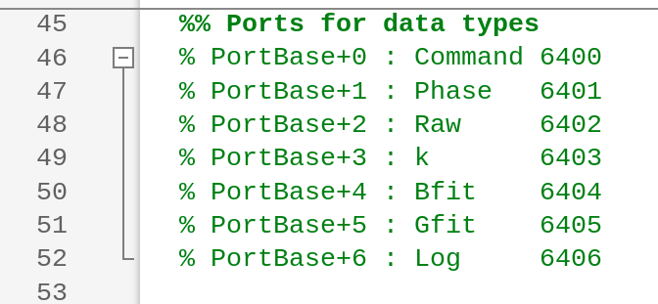
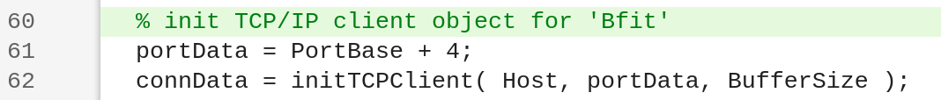
Modifying the Matlab
To ask Skope to send different data types, change the port number on line 61 to the corresponding port for that data. See the table on line 45 (both in matlab_client.m)
To change the data processing, modify the function in calculate_currents.m
Change this number to one of these

Slide 43
SECTION: Troubleshooting
There is some explanation of the error messages and basic networking terms.
Common problems:
Restarted shimmer and now the clients won’t connect
Clients still won’t connect! (computer restart may help)
It isn’t connecting to Jupiter
The server crashed!
A client crashed!

Slide 44
Understanding Error Messages
Look at the last line (the rest is a code trace).
It will probably say “Exception Raised” and then some text.
If it includes [OSError], it’s probably a network thing, otherwise it’s probably a Shimmer thing.
Either way, take a screenshot and send it to Mags (who is probably bored).

Slide 45
Sockets, Ports and Addresses
A socket is an abstraction representing the connection between two computers. They are created and managed by the operating system.
An address belongs to each computer on a network. Like a building address. It looks like 128.128.64.64
A single address can have many ports on it, like flats in the building. Each corresponds to a socket. Port numbers are usually arbitrary, but those lower than 4000 are reserved, and 8000 is special. They look like: :12345
So the full address of a socket looks like 128.128.64.64:12345 and this is what the other computer connects to.
Shimmer stores the address and ports of each client/computer in the network_configuration.ini file.

Slide 46
Restarted shimmer and now clients won’t connect
Cause: operating system is keeping sockets in the TIME_WAIT state.
Solution: wait for them to be freed (can take up to 2 minutes)
Check by running netstat at a windows (not shimmer) command prompt and seeing the status of the :2500x ports. If they are TIME_WAIT then they won’t connect. If they don’t appear in the list then they are free. If they are ESTABLISHED then something is using them (probably shimmer).

Slide 47
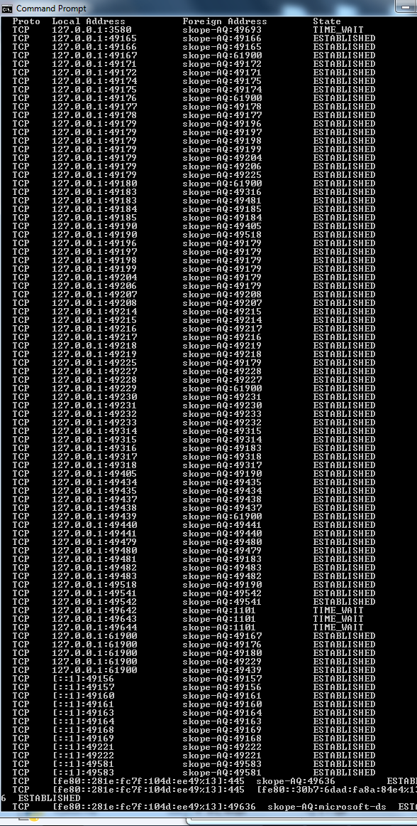
Output of Netstat
Clients will connect:
Clients won’t connect:
Lol, it wouldn’t do this whenever I tried to crash it to demonstrate.
You’ll have to look closely, but none of the 2500x ports are here in the TIME_WAIT state.

Slide 48
Clients still won’t connect!
Cause: the IPs may have changed or the ports may be in use by another process (somehow)
Ports:
  Fix: first, close shimmer and wait five minutes. Then run netstat in a command prompt and look at the output. If any of the :2500x ports are in use then they are being used by another process and shimmer won’t be able to use them.
  Change the port numbers in the network_configuration.ini file to any other set of numbers. Ensure you copy this new file to all the machines.

Slide 49
Clients still won’t connect!
Cause: the IPs may have changed or the ports may be in use by another process (somehow)
IPs:
  At each computer, run ifconfig at a windows command prompt and find the output that has the most lines under the word ethernet.
  Find the line saying IPv4 and copy that number down.
  Check it matches the address entry in network_description.ini for each client running on that computer.
  See configuration section of this guide.

Slide 50
It isn’t connecting to Jupiter
Check Jupiter is plugged in.
Check the JUPITER_PLUGGED_IN variable at the top of mrshim_client.py is set to True.
Check the device name in Sinope and ensure it matches that in mrshim_client.py, self.jupiter_ifname (line 46)
Ask Mags

Slide 51
The Server Crashed!
Fun fact! The server handles a lot of errors safely. It is only crashed if it boots you out to the Windows prompt.
Oh no! You’ll have to restart everything.
It may not have disconnected from the Jupiter amplifiers, so open Sinope and click connect to reset the connection and set the currents to zero. (If you are in the middle of a scan, you could skip this and try and reconnect without scaring the amplifiers, but I don’t know if it will work).
Take screenshots of any and all error messages and send them to Mags (ppyrt4@nottingham.ac.uk),
Close all the clients.
Start again. (Remember, sockets may be being held in the TIME_WAIT state so use netstat to check. See: client won’t connect after a restart)
Please do this so I can make it crash less in the future!

Slide 52
A client crashed!
Take screenshots of any and all error messages and send them to Mags (ppyrt4@nottingham.ac.uk)
Look at the server’s terminal and see if there’s a disconnect message.
If there isn’t, and you have a console available try running relay <client that just crashed> disconnect from a console and see if that tells the server the client has disconnected.
If there is, you should ‘just’ be able to reconnect the client (see clients won’t connect if it won’t).
Otherwise, you’ll have to halt the server and restart. Sorry.
Please do this so I can make it crash less!

Slide 53
Colophon (The End)
Who’s fault is all this?
Shimmer and this documentation was written by Magnus-Magdalene “Mags” Cooper Tavener (MMCT) (they/them) for a summer project at the Sir Peter Mansfield Imaging Centre, University of Nottingham, in 2024.
They can be reached at ppyrt4@nottingham.ac.uk or via Prof. Richard Bowtell or Dr. Laura Bortolotti (who were their supervisors).
The code for Shimmer should be in the same directory as this documentation was. If it is not, it is available on GitHub: https://github.com/seventeenmagpie/skope-mrshim/tree/main/shimmer
Take care out there <3

