Slide 1
SensorDuino
Arduino Uno & ESP8266 (NodeMCU)
By: Gerard van Seventer - 2017

Slide 2
Functionality & Requirements
Low cost
monitor water level in two tanks via magnetic switches (3 levels)
measures:
temperature
barometric pressure
air humidity
Light
optional:
magnetic switches (door/alarm/etc.)
relay output (drives waterpump when level is too high)
reports directly to Domoticz by calling JSON uri

Slide 3
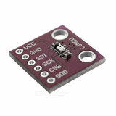
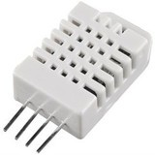
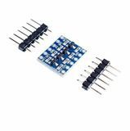
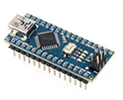
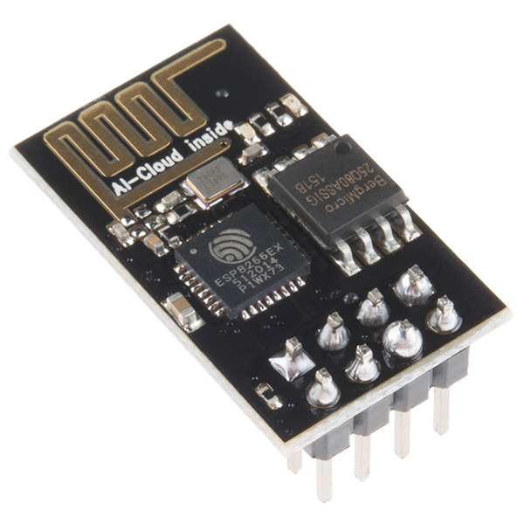
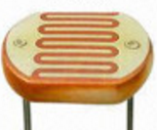
Components
Arduino Nano
ESP-01 (esp8266) as Wifi shield
ESP is running NodeMCU
Logic level converter 3.3v <-> 5v
2 x 3 Switches (Water level in 2 tanks)
BMP280 barometric pressure and temperature sensor
DHT22 moisture and temperature sensor
LDR Light dependent resistor

Slide 4
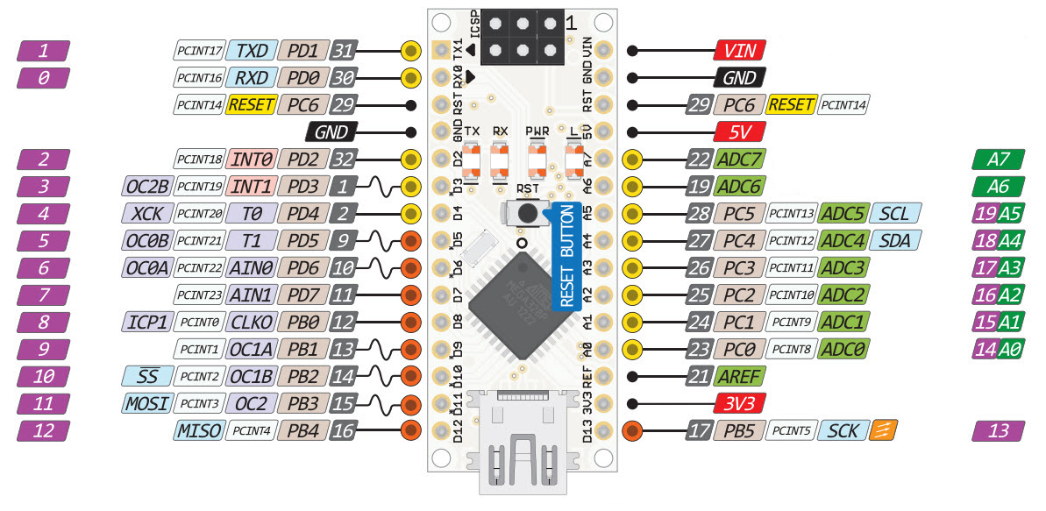
Arduino NANO Pinout

Slide 5
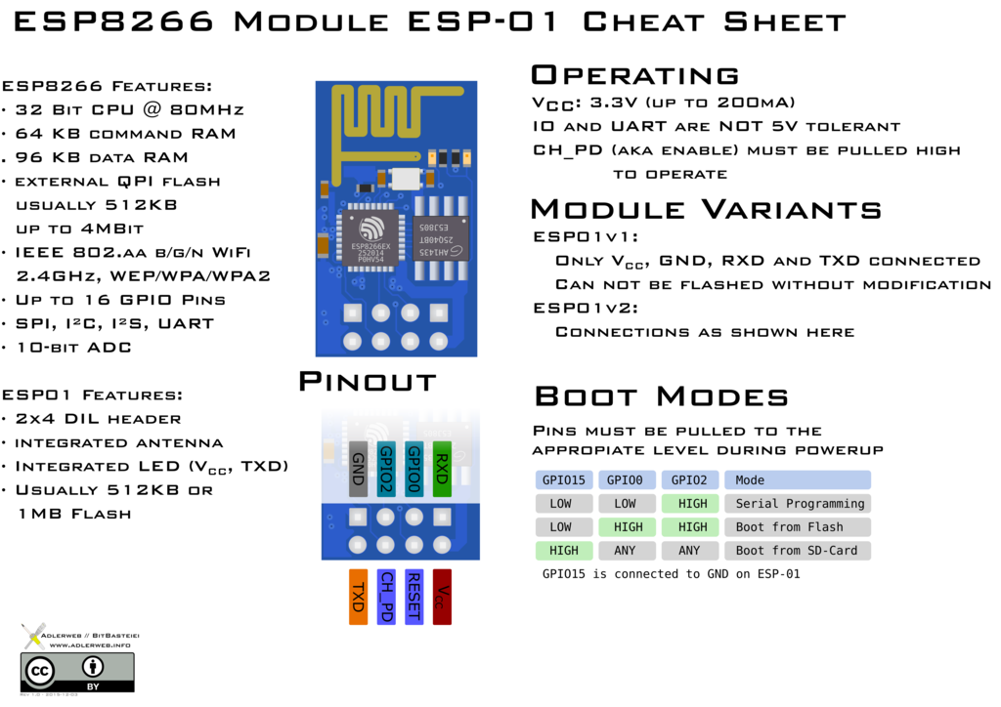
ESP-01

Slide 6
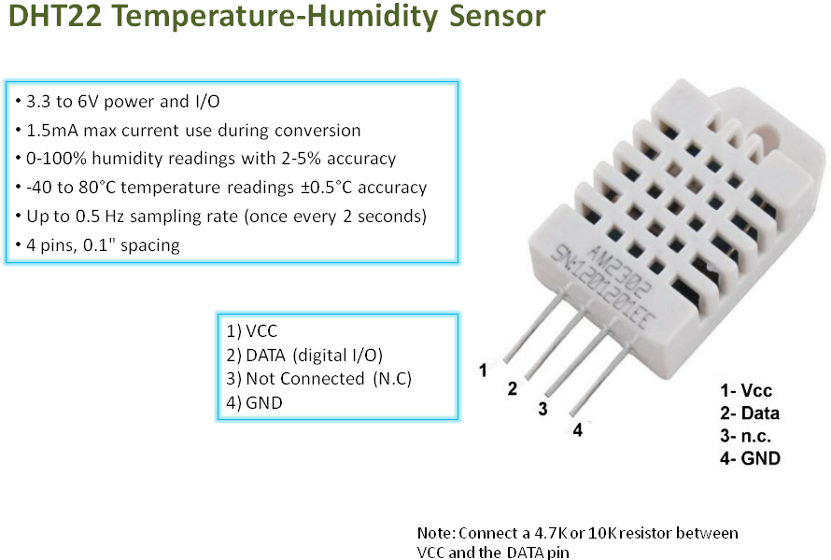
DHT22

Slide 7
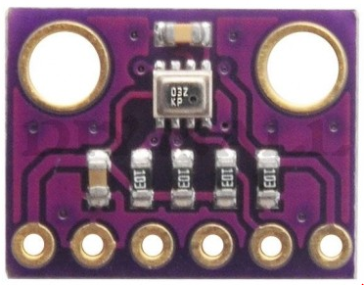
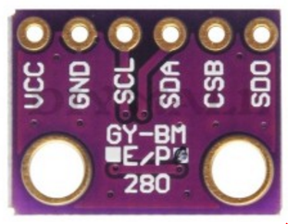
Barometric pressure & temperature
BMP280 via I2C
Newest high precision Bosch BMP280 barometric pressure & temperature sensor. Offers pressure measuring range of 300 to 1100 hPa with an accuracy of 0.01 hPa (higher accuracy than older BMP180 at 0.02 hPa resolution). Excellent for barometric pressure, elevation & vertical velocity speed measurements. It's based on piezo-resistive technology for high accuracy, ruggedness and long term stability. Comes with breadboard compatible 6-PIN header.
Includes barometric & temperature sensor
Connects to a microcontroller or Arduino via I2C bus (SCL->A5, SDA->A4) or SPI (SCL->SCK, CSB->MISO, SDA->MOSI, CSB->CS)
Two wire interface, SCL & SDA are 5V tolerant
Factory calibrated with the calibration coefficients stored in ROM
Voltage supply (VIN): 1.8V to 3.6V (3.3V typical)
Ultra low power consumption

Slide 8
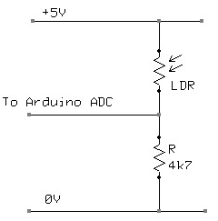
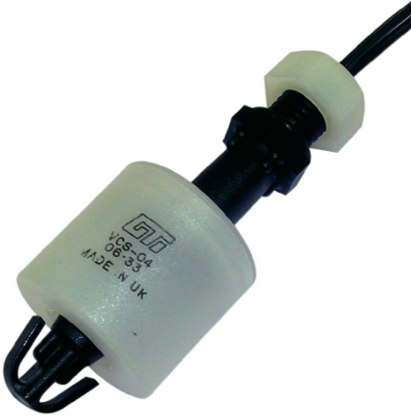
Other Sensors
LDR
Magnetic Switches
Opto isolated

Slide 9
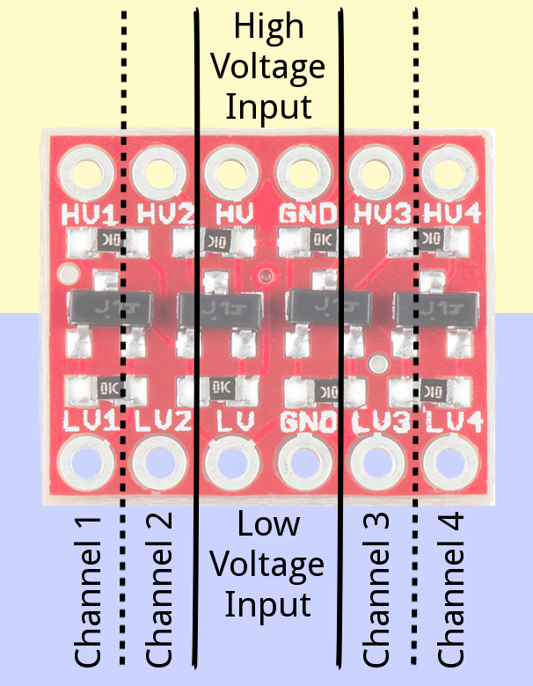
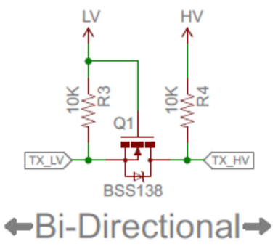
Logic Level Convertor 3.3V ←→5V

Slide 10
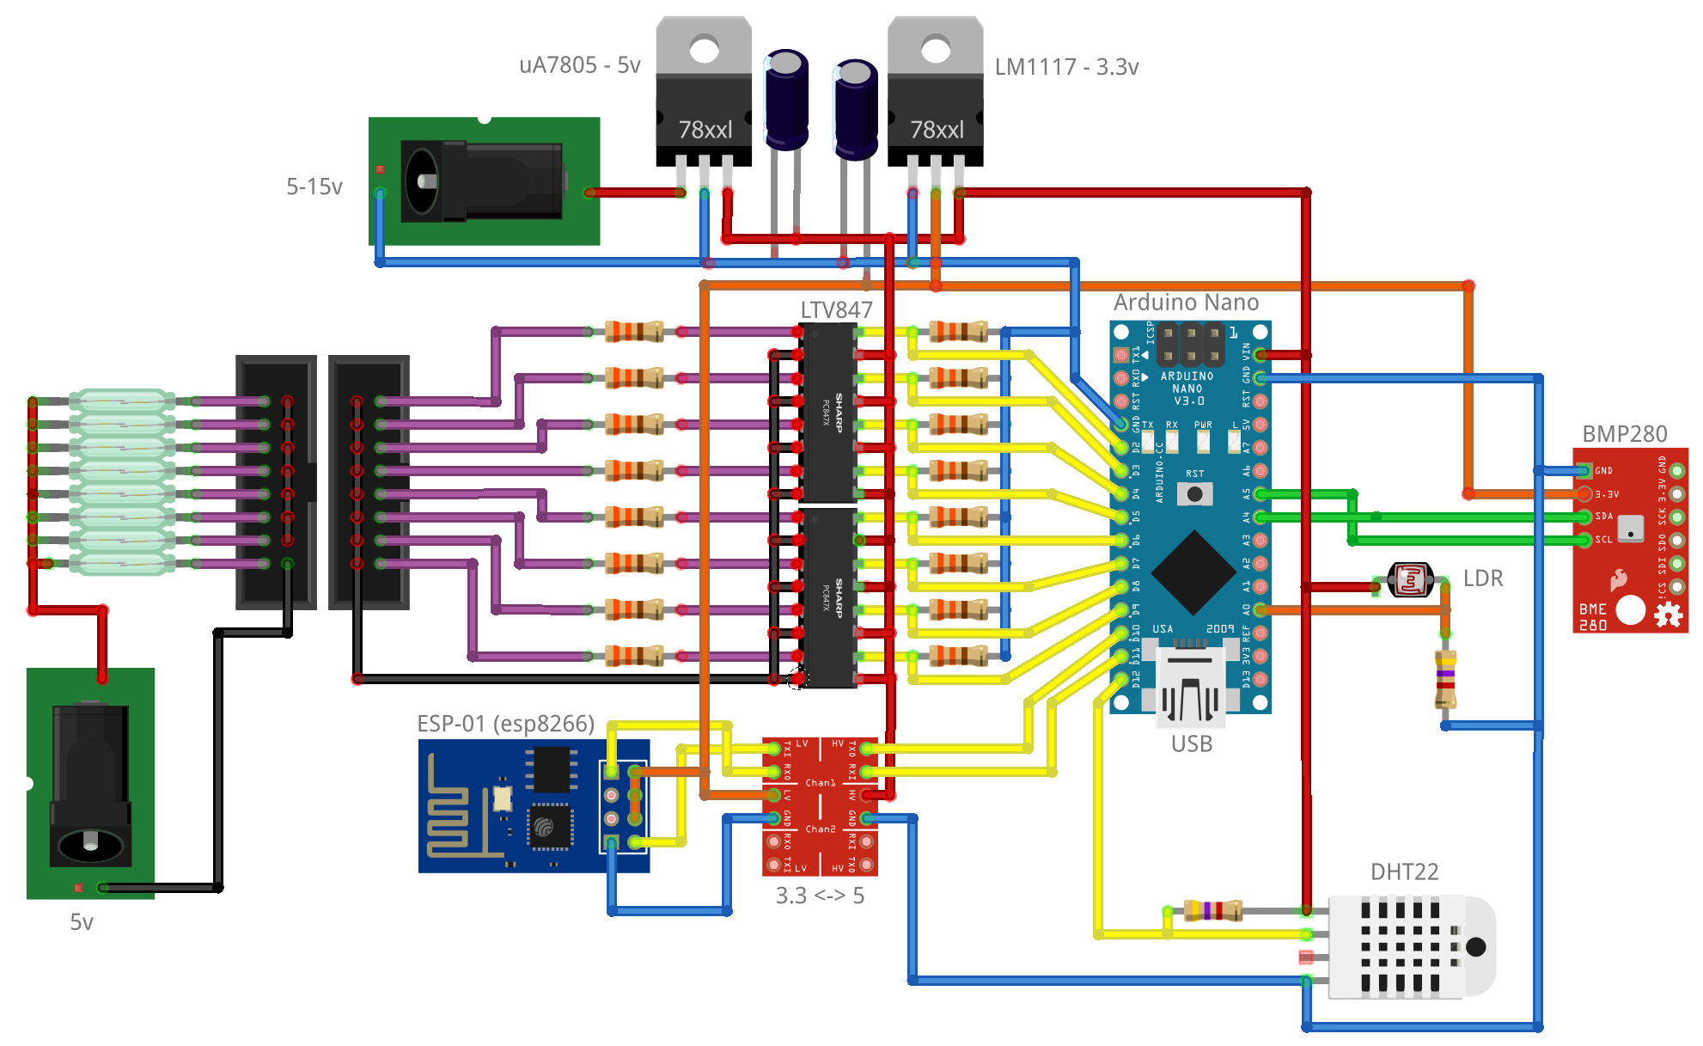
Schematic

Slide 11


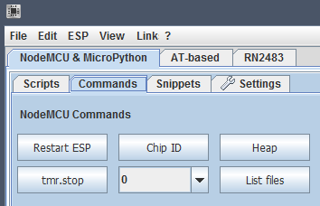
Software
Arduino IDE for programming Arduino NANO
NodeMCU on ESP8266
ESPlorer
if (Serial.available()) {
digitalWrite(13, HIGH);
ESP8266.write(Serial.read());
}
function getIP()
ip = wifi.sta.getip()
print(ip)
end

Slide 12
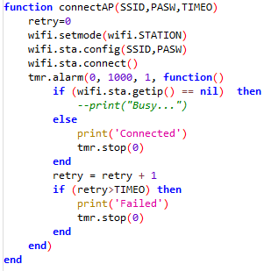
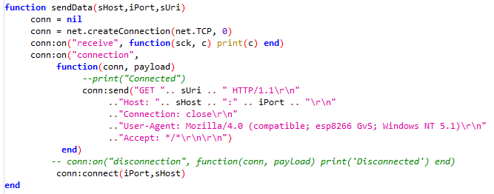
ESP8266 – NodeMCU API
UART is set to 9600 with no echo (uart.setup(0,9600,8,0,1,0))
Let ESP do some tasks by servicing some API’s like:
connectAP() – Connect tot access point
sendData() – Connect to host and send data

Slide 13
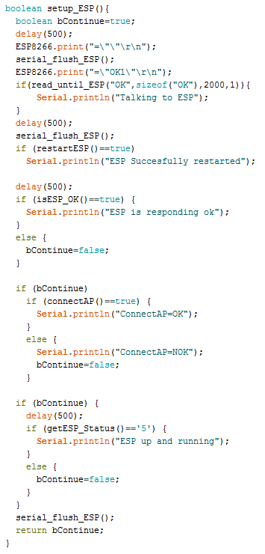
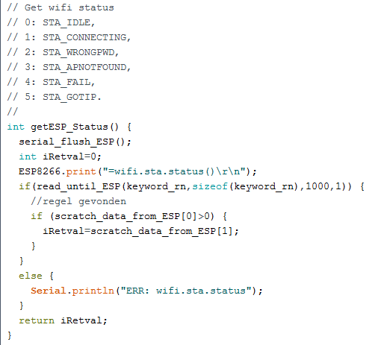
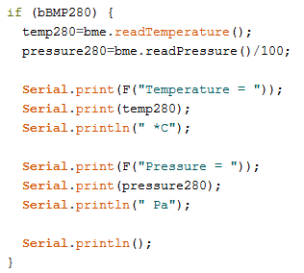
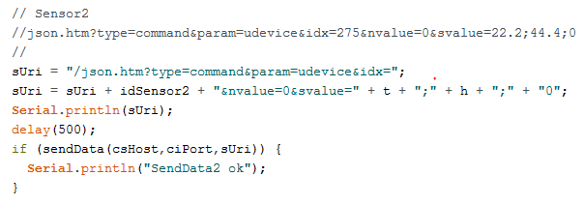
Arduino code

Slide 14
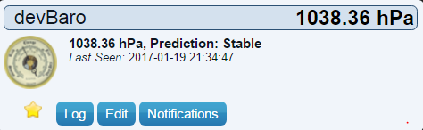
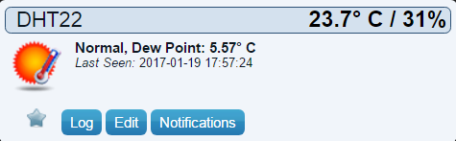
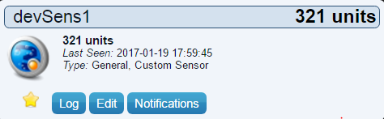
Flow
Power-up → Check ESP Ready → SetupESP() →connectAP()→ wait for connect
connectAP("MySSID","AP-Password",10)
getIP() 192.168.14.19
=wifi.sta.status() 5
checkSensors → sendData()
=sendData("192.168.14.100",8084,"/json.htm?type=command&param=udevice&idx=274&nvalue=0&svalue=1023")
/json.htm?type=command&param=udevice&idx=275&nvalue=0&svalue=24.30;31.50;0
HTTP/1.1 200 OK
Content-Length: 53
Content-Type: application/json;charset=UTF-8
Cache-Control: no-cache
Pragma: no-cache
Access-Control-Allow-Origin: *
{
"status" : "OK",
"title" : "Update Device"
}

Slide 15
ToDo
Save/load SSID & Passphrase to EEPROM
Add menu option
Enter “M” key for menu, will halt program and show menu
In Menu (shows current SSID and Passphrase(?))
Enter “S” to enter SSID. Read keyboard string <enter> ends input
Enter “P” to enter Pass. Read keyboard string <enter> ends input
Enter “W” to write SSID & Passphrase to EEPROM
Enter “Q” to quit menu and restart program (or restart Arduino?)

