Slide 1

Engaging with communities on energy, climate change and recycling issues
Chris Church
March 2016

Slide 2
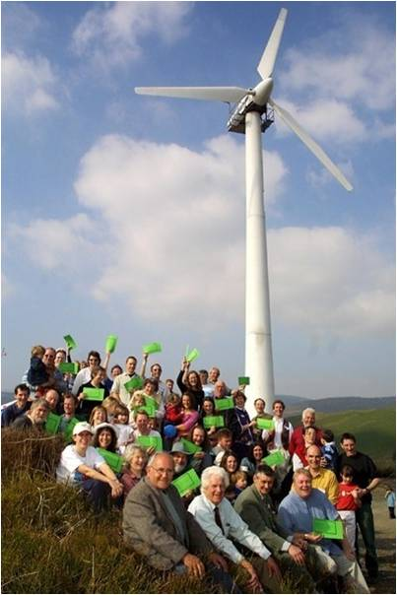
Today’s course…
Introduction: current issues and challenges
Climate change and recycling: some specific challenges for engagement
Awareness, Engagement and Action
Why work with communities?
A positive future?
Hard to reach?
Developing an
engagement plan
Evaluation

Slide 3
Please help today run smoothly
This is a busy course, so please
Respect each other and listen
Help keep to time
Mobiles on silent please

Slide 4
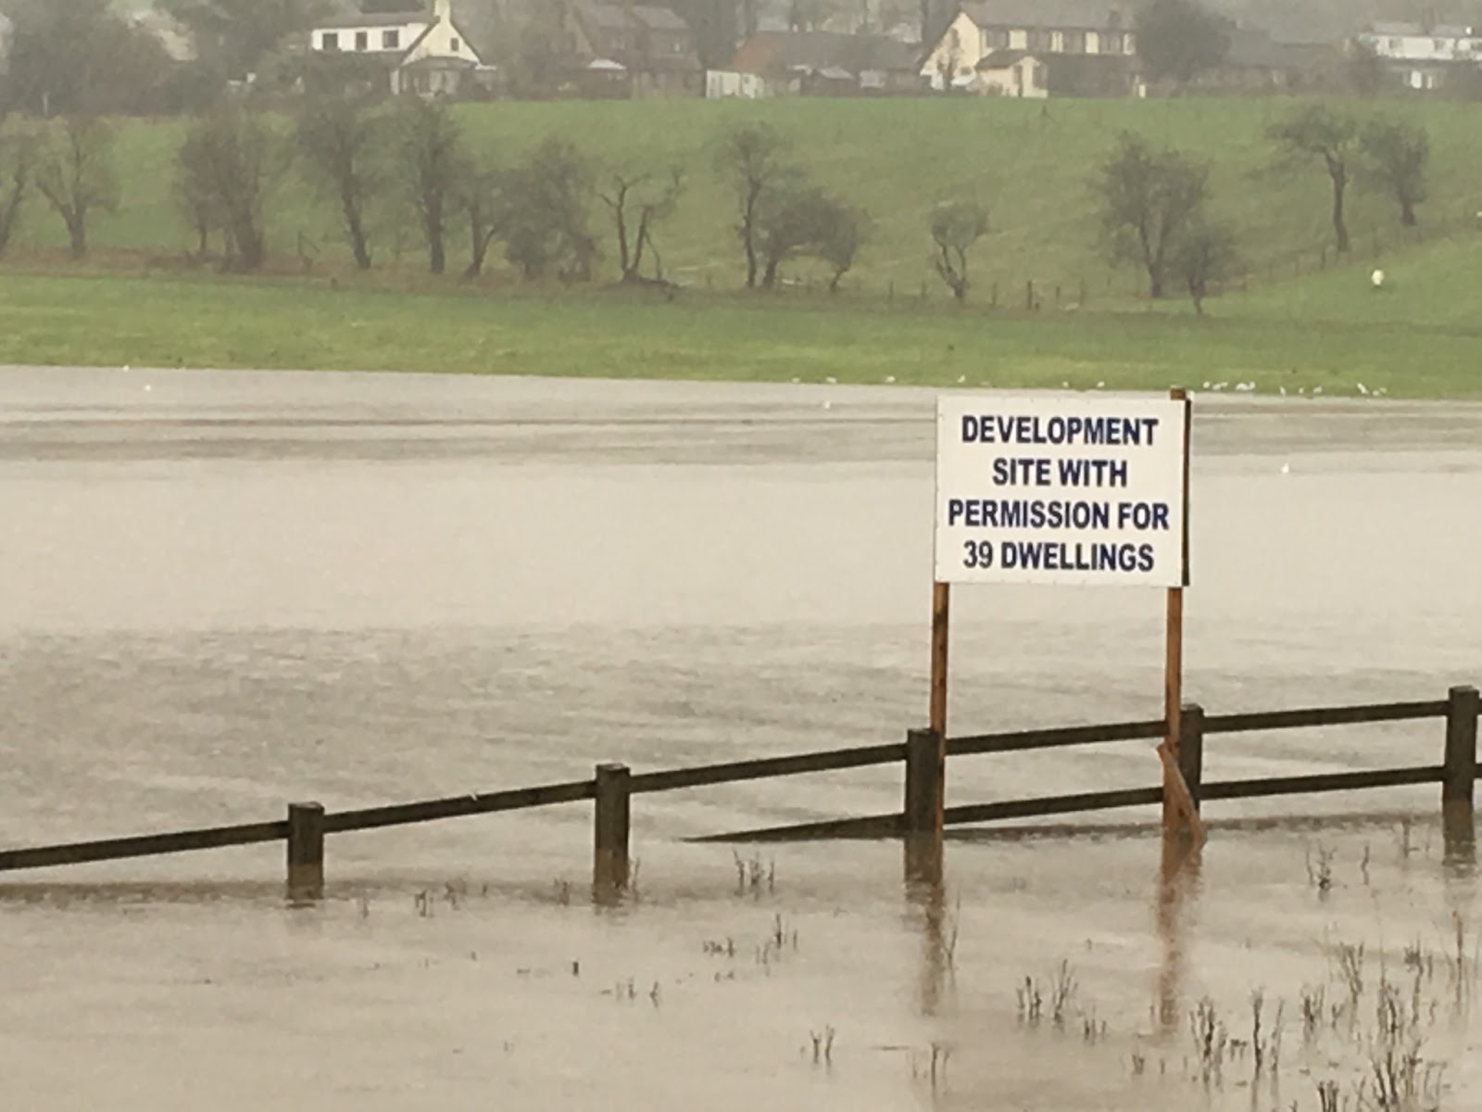
Current issues and challenges
Local action is high on many agendas
The Paris agreement has boosted the ‘climate profile’
Renewable energy issues
Fracking campaigns
Fuel poverty
Flooding – it’s happening!
‘Austerity’ issues affecting
local action

Slide 5
What does this mean for energy and climate change?
There is an opportunity for communities to face up to these major challenges and deliver a low carbon economy, better places to live and sustainable development.
But at present, there is still a lack of political will, supporting infrastructure, and ultimately,
Communities will need to want to do this!

Slide 6
If that is to happen...
Communities will need to:
Understand what they can do
Want to engage
Feel confident to start doing it
Know where to get information and examples
Be well supported

Slide 7
Communities, energy and climate
There are various types of activity where local action can really make a difference
Building engagement / Behaviour change
Local projects
Advocacy / campaigning
Each needs different approaches - be clear on how your activity is focusing.
This will affect your communications and engagement strategy

Slide 8
Climate and Recycling
It’s not always easy....
In groups, discuss / identify the specific issues that may make community engagement on these issues different to other local participative work.

Slide 9
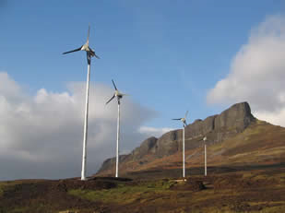
Engagement on Climate
How about:
Complex issues
Other priorities
Lack of trust
Changing agenda

Slide 10
Communities and Individuals
Engagement strategies may be similar but will not be the same.
Individuals: concerns about my future, my family, my income, my status
Collective: concerns about my neighbourhood, my society, our shared future
The value of collective / community action?
The potential for greater change
Sharing concerns, information, ideas
And???

Slide 11
Communication at different levels
We need to engage with people to move from
AWARENESS to
ENGAGEMENT to
ACTION
Each stage needs slightly different messages

Slide 12
So where do people stand on this?
Engaged
Sceptical Convinced
Uninterested

Slide 13
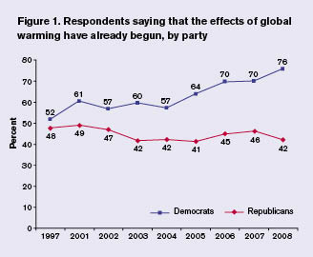
Denial and Scepticism…
It won’t go away but it will weaken
Positive action makes for engagement
Active denial is a political stance for many (and you wouldn't spend much time trying to get a Corbyn supporter to vote Tory…)
Work with what you’ve got!

Slide 14
Developing community engagement
From the very start, be clear on:
Who are you working with?
Who do you want to work with?
What’s your key message?

Slide 15
The key point of engagement...
Is something like:
“Mmmm... That sounds interesting and relevant to me.....”
How do we get that reaction?

Slide 16
It’s all about communication…
No it’s not!
Good comms are vital, BUT it’s also about
Your audience and their concerns
Clear desired outcomes
How those outcomes impact on the target community – the long-term changes

Slide 17
Persuasive Communication
Audience segmentation: Right message for right person
Communication channels: People are more likely to trust their peers than the Government
Positive messages: Messages arousing guilt and fear can lead people to “switch off” mentally.
Non-environmental messages: some audiences may find non-environmental messages (such as saving money or health benefits) more engaging.
Consistency: Messages are most effective if sustained over time

Slide 18
Good engagement – some key issues
We need:
A good story
Face to face work
Passionate leaders / motivators
Personal angles
Recognition / rewards

Slide 19
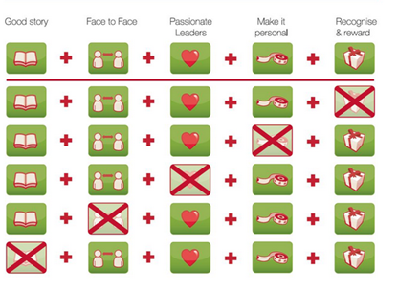
Good engagement – some key issues.
Actually
we need all
of these:

Slide 20
Engagement, values and incentives
There are differing views on how far we seek to offer incentives and how far we should appeal too people’s values
Two perspectives are often portrayed as opposites…

Slide 21
Community-based Social Marketing
Social Marketing is a planned process for influencing change
“direct, personal contact among community members and the removal of barriers” (we’re all in this together!)
The use of prompts (stickers, posters etc.); commitments (pledge card); developing ‘norms’; engaging messaging and images.
‘Fostering Sustainable Behaviour’ and the work of Doug McKenzie-Mohr - www.cbsm.com – sums this up

Slide 22
Common Cause
“The case for working with our cultural values”
“ civil society organisations can find common cause in working to activate and strengthen a set of helpful 'intrinsic' values, while working to diminish the importance of unhelpful 'extrinsic' values”.
“ all communications and campaigns serve to activate and strengthen particular values - and these may be either helpful, or unhelpful”
Comments: “A fascinating and challenging report “
Comments: “Woolly and confusing”

Slide 23
Can these work together?
Values
Incentives

Slide 24
Time for a break….

Slide 25
Why work with communities - rather than individuals?
What do you see as the positive points?
What are the problems?
What are the areas of confusion?
List three points for each category

Slide 26
What do we mean by involvement?
Words such as Involvement, Consultation and Participation are used, often interchangeably
Involvement is a general term, covering all the ways in which local people take part in discussions and planning.
Consultation occurs when local people are asked for their views about a proposal or a project that someone else has developed, or about a service they are using.
Participation occurs when people are invited to be involved in planning and developing work and can help shape it from the start. This is effective ‘engagement’.

Slide 27
The benefits of engagement
Research done for UK Govt. suggests that, “at its best, community involvement can enable:
processes to be speeded up;
resources to be used more effectively;
product quality and feelings of local ownership to improve;
added value to emerge;
confidence and skills to increase for all; and
conflicts to be more readily resolved.”

Slide 28
Engagement and Participation
People in any community have many different roles:
Beneficiaries / users of services
Consultees
Sources of independent action
Deliverers of services
Long term partners
How do these relate to your energy work?

Slide 29
So who are “the community”?
Probably the most difficult question you will have to answer!
A ‘Community’ can be difficult to define
Us? ‘Anyone who isn’t us’!
Usually seen as: small, well defined localities and the people in them
But there’s more:

Slide 30
Types of community
Three types of community :-
Communities of place - defined by locality
Communities of interest – defined by common attributes
Communities of identity - defined by a shared feeling of identity, interaction and common bond.
Faith, culture and ethnicity may be ‘interest’ or ‘identity’.

Slide 31
Defining community
One useful definition is:
A community is a group of people with something in common - a belief, a location, a purpose, or a need - who wish to work as, or be identified as, a group for sharing, and/or mutual gain, or simply to feel that they belong.
Know who is applying the label!

Slide 32
The elements of community:
the individual citizens who share a common set of attributes or locality
the community groups and organisations in which these individuals organise
the networks which link the community groups and organisations together

Slide 33
Getting started on community work
Community engagement - done for a reason:
As part of a project or programme
To help move towards a decision
To…
Community work may be
Project-based
Longer-term development work

Slide 34
Starting work in a new location
Before you start…
Understand the place as well as the people.
Find the people who know the area.
Find the community groups.
What’s happening at present?
What needs to happen?

Slide 35
Stakeholder analysis – from words to reality
Stakeholders - people or organisations with an interest (stake) in the action or decision being taken
Carrying out a 'stakeholder analysis' helps see who really is who in the locality.
May have an interest in delivering a programme, or in the results of the programme.
'Having an interest' is not the same as 'showing an interest'!

Slide 36
Developing an engagement plan
If you want to engage any community or community you need a plan…
What community and why?
What advantages and what problems?
What other organisations?
Where do we start?

Slide 37
Where do we start?
Beginning the conversation – where and how?
Existing meeting?
Other existing activity?
What are the ways in which an ‘outsider’ or ‘semi-outsider’ can start to link in to a community or community organisation?
But, before we develop our plan, there’s one issue....

Slide 38
But we don’t want to engage!
In groups: from your own experiences, list some reasons why community groups may not want to engage with a new work area (such as but not exclusively) climate change
Write each reason on a separate sheet of paper

Slide 39
Some key issues
Planning for engagement is an essential part of the overall project plan
Budget for time and resources (the ‘percentage for participation’!)
It’s not just building involvement, it ‘s maintaining it
Discover, recognise and learn from what is going on in the area already and work with it

Slide 40
Thinking ahead – a ‘low carbon future’
Tell the story, and make it real for a community
Base it on what’s there now (70% of 2050’s homes exist now
Develop a ‘vision for 2050’: use carefully planned visioning based specifically on a locality
If that’s what we want in 2050, then what do we need by 2020? (and by 2015?)

Slide 41
So what will be great about 2050?
In groups, list three benefits for a local community that will come from cutting emissions by 80%.

Slide 42
So why is it hard to sell these ideas?
An optimistic message is not always an easy one to get across...

Slide 43
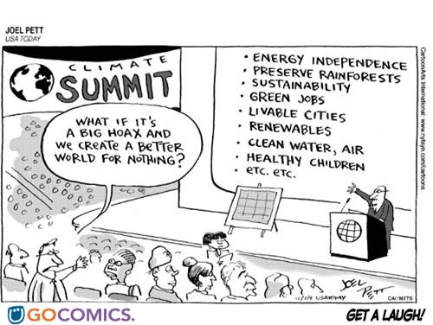
Think positive!
:

Slide 44
Hard to reach?
Often engagement focuses on those who are not yet engaged….
Who are we trying to reach and why?
Why are people (or groups) hard to reach?

Slide 45
Working with Diversity
Any area-based ‘community’ is made up of many different communities. Different approaches will be needed to involve these communities.
Get guidance on diversity issues for where you are working
Work with community leaders may help for some groups

Slide 46
Diverse Communities – what do we mean?
Often it’s BAME (Black, Asian, and Minority Ethnic) communities. Some groups also include an ‘R’ on the end of this to include Refugees).
But also diversity in terms of: Faiths.......
Disability............
Age...........
Gender........
Sexual orientation........
And…?

Slide 47
Working with diverse groups
Many groups are described as ‘hard to reach’:
The first step towards work with diverse groups is to notice them! Some groups are often almost invisible within their communities.
If you are going to work seriously with such groups, then relevant staff ought to be properly trained.

Slide 48
Three key issues
CONNECTION – Finding the ways in
COMMUNICATION - Paying attention to process
CREATIVITY – building skills and finding new ways to work

Slide 49
CONNECTION
Talk to individuals – build trust and acceptance – find a way in
Start the conversation
Recognise that it takes time
Accept that there will be obstacles
Be realistic and plan this stage

Slide 50
COMMUNICATION
The process of engagement can be as important as the outcomes.
If you are not sure, ask
Respond and meet groups on their own terms
Translation may help but is not always necessary.
Respect what is already going on

Slide 51
CREATIVITY
Work creatively to sustain your activities :
Draw out inspiration from what is already there
Build skills, confidence and ownership
Encourage creativity
Value volunteers
Celebrate success!

Slide 52
Why should we get involved?

Slide 53
Starting engagement
Listen! Understand the community and their concerns
Start will local concerns – the state of the neighbourhood may be a good place to start
Choose an ‘entry point’ to climate issues (e.g. energy bills, future planning; floods?)
Set up clear links from their concerns to your issues

Slide 54
Maintaining engagement
This is an issue for the rest of our lives.
Community projects are seen to come and go. How do we build engagement for the long-term?
Some key points:
Make this something we like and want to do!!
Short-term and long-term goals – a plan
Record what happens to show progress
Review and refresh
If your work is project-based, what’s the next project?

Slide 55
Tell us a (climate) story
Every story has a starting point - what’s yours?
That story needs to resonate with the audience (and their values) – the starting point is critical:
Changing climate?
Changing weather?
Flooding?
Fuel bills?
Clean energy ?
Less pollution?

Slide 56
Let’s take your issues
Working in groups let’s plan for developing the best possible engagement

Slide 57
Action Planning for engagement on climate change
What do you want to achieve?
(Project? Engagement? Campaign?)
What’s the aim (in 1 sentence)?
Who are the key parts of the community?
What’s in it for them?
Where are you going to start?
How will you evaluate success?

Slide 58
So what’s going to make an impact?
Any group and its’ members have limited time and resources
They have skills, interests and aspirations
We want to build engagement
We only have limited resources…
(So let’s look at what’s easy / realistic)

Slide 59
What kind of approaches might we use? (and how easy / effective will they be?)
Difficulty
Impact
Identify 4 or more ways to get the target community involved and engaged, map them on the grid and develop one

Slide 60
Your Plan....
What do you want to achieve?
(Project? Engagement? Campaign?)
What’s the aim (in 1 sentence)?
Who are the key parts of the community?
What’s in it for them?
Where are you going to start?
How will you evaluate success?

Slide 61
In summary
Good engagement starts long before you meet the target audience
The right story for the right audience…
Along with the face to face work, getting the leaders engaged, finding the personal angles and being clear on the outcomes of success.

Slide 62
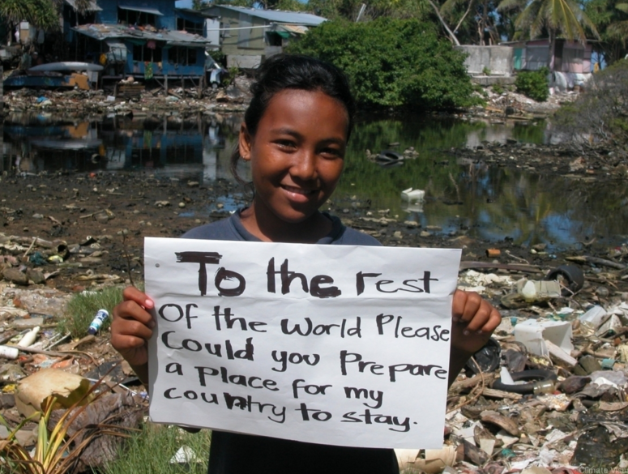

Slide 63
And that’s it… Thank you!
For content information contact:
Chris Church chrischurch@cooptel.net
For bespoke courses and future dates email:
jelliott@talkaction.org
or call + 44 7947 616844

