Slide 1
WWU Board Game Survey and Analysis
Are there any inciteful relationships between peoples’ demographics and how they enjoy board games?
By: Dario Leyva-Brown, Marie Lawler, Seven Lewis
Group 9
Notes:
Introduce the team and project name

Slide 2
Why?
Demographic research is important for:
Promoting equality across society
This includes the board gaming
Targeted Advertisement
Improving Board Game Accessibility and Design
Improves Sales
Promotes Equality
Random Survey allows for:
Discovery of trends on WWU campus
Extrapolating patterns to the total population of WWU
Notes:
High level description of the project motivating why we should care about the research

Slide 3
Overview
Gather Survey Data from WWU Students
Download Raw .xlsx from Microsoft Forms
Load into Juypter Notebook
Perform Data Cleaning and Curation on Raw Data
Perform Exploratory Analysis on Cleaned Data to Discover Trends
Build Predictive Machine Learning Model Based on Discovered Trends
Notes:
High level description of the project motivating why we should care about the research

Slide 4
Original Data, Data Cleaning, and Curation
Survey Questions produce the Features of the Data Set
Survey Outline can be found at: https://github.com/sevenwwu/sevenwwu.github.io/blob/main/write-ups/milestone_one_delieverable/surveyoutline.md
Original Data was structured by Microsoft Forms
Downloadable .xlsx is available
Data was primarily collected by asking random students on Campus
Curation:
Drop Metadata
Rename Questions to Concise Field Names
Transform Multi-Select Questions
Manual Bucketing of Area of Study Freeform Responses
Shorten Categorical Strings for Easier Analysis
Assign Order to some Categorical Variables
Notes:
Description of the original data

Slide 5
Curated Data Feature Outline
Demographic info includes survey responses for:
Student/Faculty Member Status
Gender Identity
Age
Race
Employment Status
Corrective Vision
Religiosity
Area of Study
Board Game info includes survey responses for:
Enjoyment of Board Games
# of Board Games Owned
Frequency of Board Game Play
Style of Player
Desirable Gameplay Elements
Enjoyed Board Games
Scale Rating of Chess
Desirable Board Game Genres

Slide 6
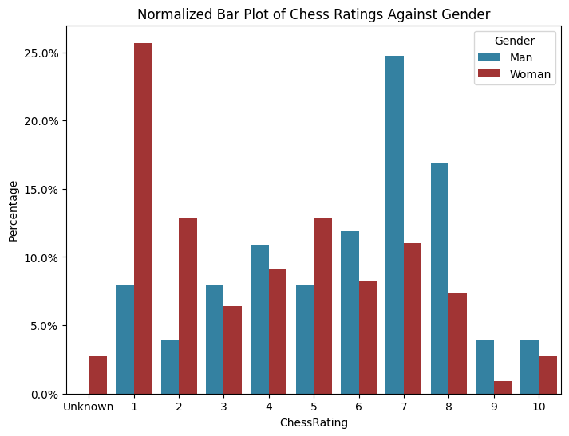
Concepts/Approaches
Exploratory Analysis:
Developed Functions to Sift through the Feature Rich Data
Produce normalized Bar Plots for many combinations of features
“Other”-ing function for grouping low response categories for better visualization
Employed Clustering to discover highly-dimensional patterns

Slide 7
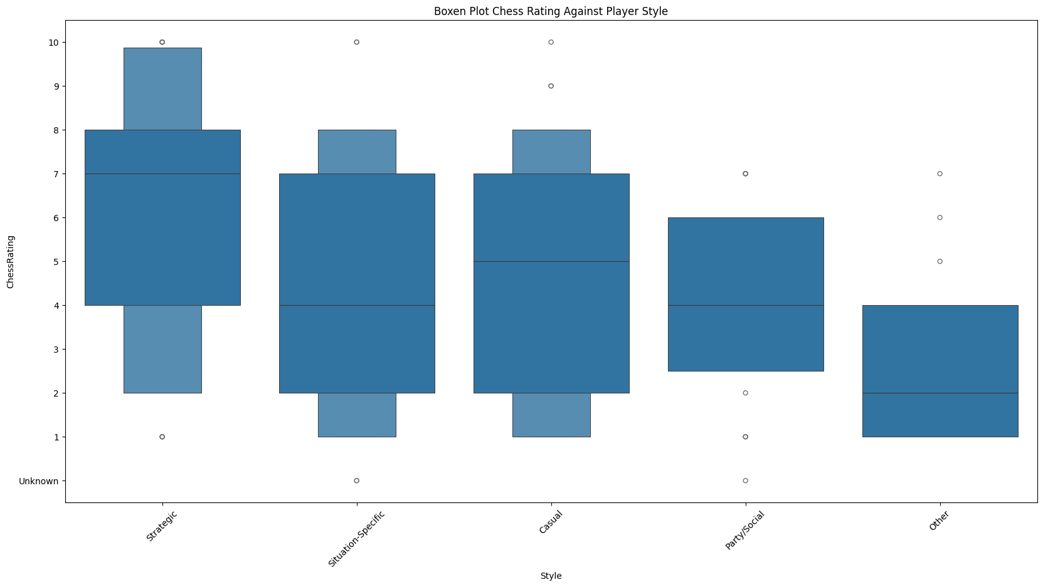
Discoveries (1/3)
Exploratory Analysis:
Player Style influences Chess Rating distribution
Strategic Players are generally favorable towards Chess
Situation-Specific and Casual Players are relatively indifferent
Party/Social and all other players never rated it higher than a 7

Slide 8
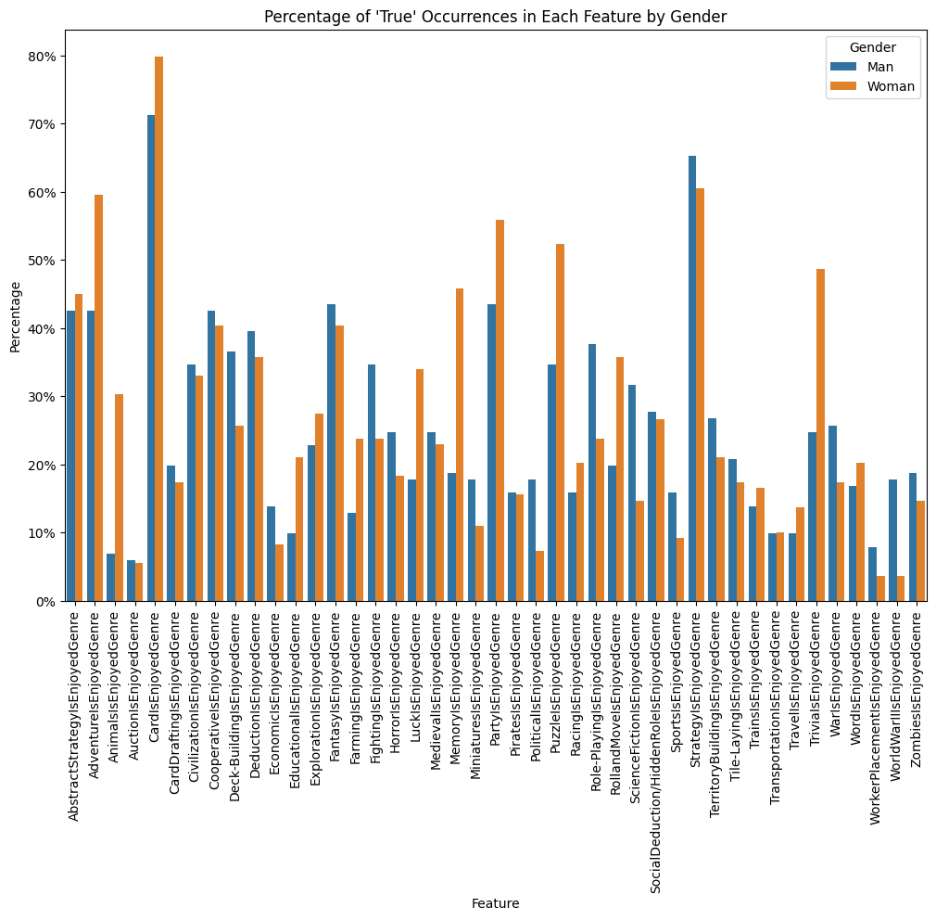
Discoveries (2/3)
Exploratory Analysis:
Graphing Gender Against Enjoyed Genres reveals:
Women are significantly more likely than Men to select:
“Animals”
“Puzzle”
“Party/Social”
“Memory”
“Trivia”
“Luck”
Men were significantly more likely than Women to select:
“Science Fiction”
“World War II”

Slide 9
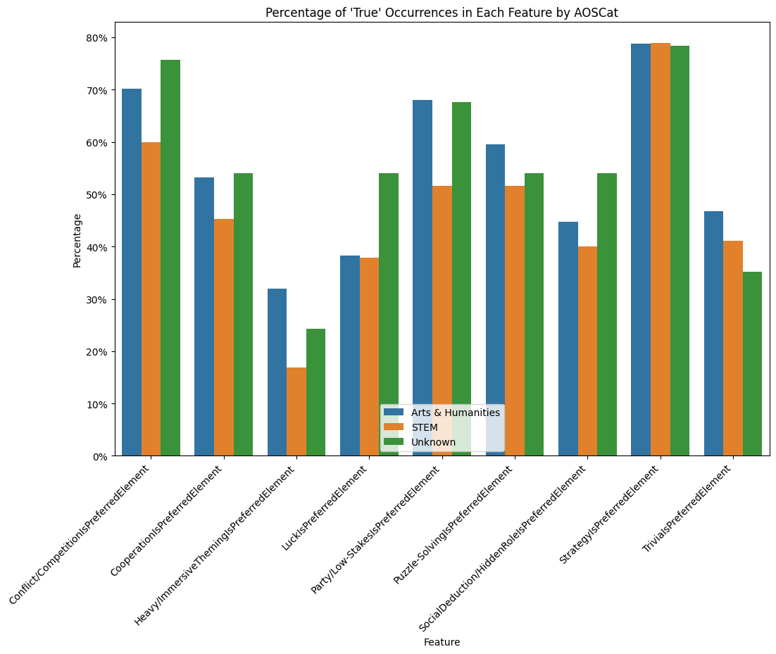
Exploratory Analysis:
Discoveries (3/3)
Area of Study is relatively indifferent to one’s selection of “Preferred Board Game Elements”
However, there are still notable points:
People w/ “Arts & Humanities” or “Unknown” Area of Study prefer “Conflict” and “Party/Low-Stakes” over “STEM”
“Arts & Humanities” prefers “Heavy/Immersive Theming” by nearly double compared to STEM

Slide 10
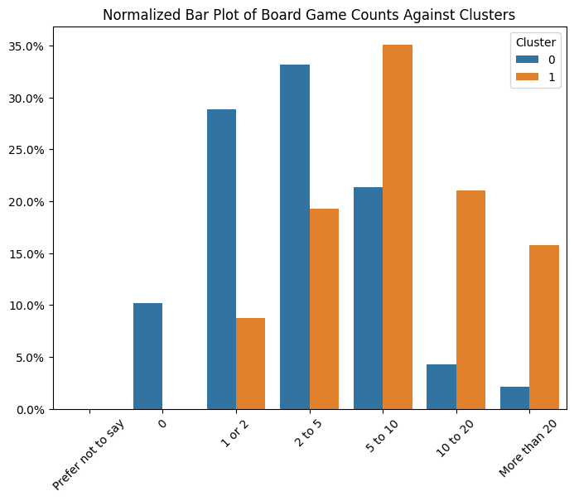
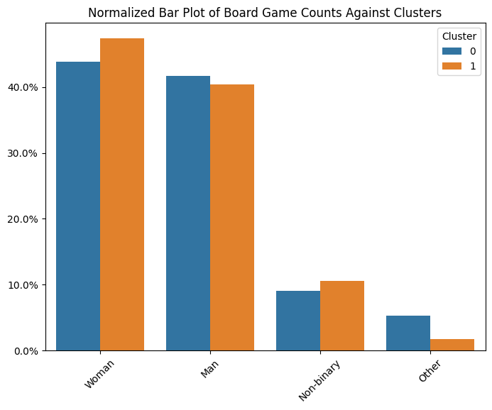
Clustering
Exploratory Analysis:
Employed K Means Clustering
Showed Clear Patterns for Two Distinct Groups of People
Cluster Distribution:
0 – 187
1 - 57
Emergent Label “Enthusiast”
Compared to the Non-Enthusiast group, the Involved Gamers:
Own more board games
Are more willing to play different types of games depending on the situation
Are more likely enjoy any given category of genre and gameplay element
Suggests a broader range of tastes than the more casual group
The Enthusiast Clustering is indifferent to one’s gender

Slide 11

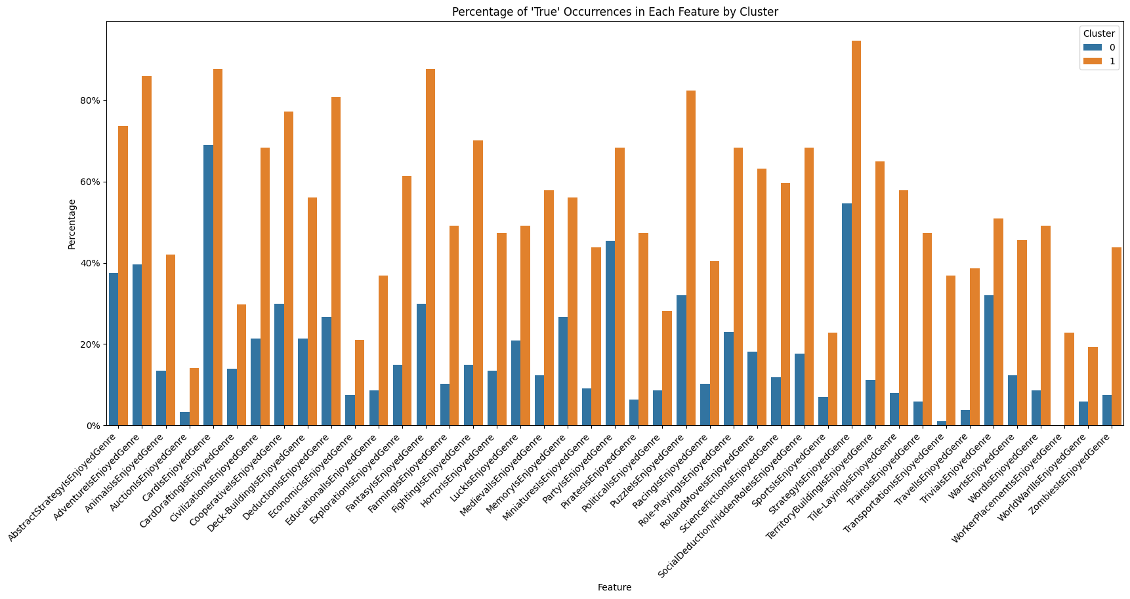
Clustering
Exploratory Analysis:

Slide 12
Classification Predictive Task
Attempt 1: Demographics Predict Board Game Stats
Insufficient Amount of Data Diversity for Meaningful Results. Only valid demographic features:
'Gender', 'Age', 'AOSCat', 'Religiosity'
Performed Slightly Above Baselines
For Example, Predict Chess Rating:
Attempt 2: Board Game Stats Predict Gender
Significantly Higher Data Depth and Diversity
X – All Board Game Features ('EnjoysBoardGames', 'BoardGamesOwned’, 'FrequencyOfPlay', 'Style', 'ChessRating', 'PreferredElements', 'EnjoyedGenres')
y – Gender (excluding Non-Binary Responses)
80/20 – Train/Test Data Splits with 4-Fold Cross Validation
Accuracy Metric used for Scoring
Baselines: Most_Frequent and Uniform
Model | Score (average across 3 folds)
Linear Regression (with Ordinal Encoding of y) | R²: -0.18
Logistic Regression | Accuracy: 0.217
Uniform Baseline | Accuracy: 0.133

Slide 13
Classification Predictive Task (cont’d)
Models | % Accuracy (average across 4 fold cross validation)
Most Frequent Baseline | 51.8%
Uniform Baseline | 53.0%
Logistic Regression | 73.2%
K Neighbors Classifier | 59.5%
Decision Tree Classifier | 57.1%
Random Forest Classifier | 64.3%
Tuned Random Forest Classifier | 72.0%
Hyper-Parameterized Random Forest Classifier
Used RandomizedSearchCV
_best_params: {'n_estimators': 2000, 'min_samples_split': 10, 'min_samples_leaf': 1, 'max_depth': 110, 'bootstrap': True}
Applied Tuned Random Forest Classifier Test Set
78.6% Accuracy Score
Most Frequent Accuracy: 52.4%
Uniform Accuracy: 42.9%
 | Predicted Man | Predicted Woman
True Man | 15 | 5
True Woman | 4 | 18

Slide 14
Potential Directions with Additional Time
Additional Survey
Perhaps Increase Response Total to 500 or 1000
Allow for improved accuracy and predictive power of our current model
Allow for better attempt of initial goal: Predicting Board Games with Demographics
More exploratory analysis
This data set is very feature rich and there is likely interesting patterns that have been overlooked
Analysis of the “EnjoyedBoardGames” feature

Slide 15
Questions?

