Slide 1
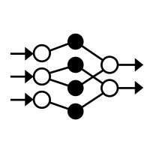

Projekt
Deep Learned Ranking im Triathlon
CAS MaIn, Modul Deep Learning, 14.04.2020
Finn Stein & Severin Trösch

Slide 2
Inhalt
Ziel & Methode
Resultate
Learnings

Slide 3
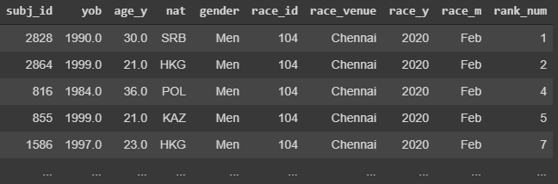
Daten & Ziel
Resultate aus Triathlon-Weltcuprennen seit 1989:
Ziel: Ranking anhand Startliste vorhersagen
10 Features
26’041 Beob. aus 1489 Rennen
Zielvariable Rang

Slide 4
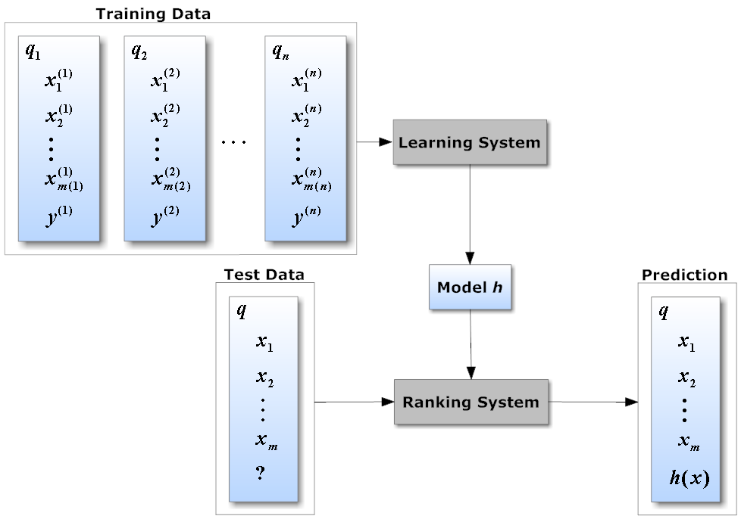
Learning to rank
Ziel: Ordnen einer Liste nach Relevanz (z.B. Suchresultate anhand Query)
Unterschied zu «normalem» ML: Relative Ordnung wichtig, absolute Score egal…
Notes:
What is RankNet, LambdaRank and LambdaMART?
RankNet, LambdaRank and LambdaMART are all LTR algorithms developed by Chris Burges and his colleagues at Microsoft Research. RankNet was the first one to be developed, followed by LambdaRank and then LambdaMART.
In all three techniques, ranking is transformed into a pairwise classification or regression problem. That means you look at pairs of items at a time, come up with the optimal ordering for that pair of items, and then use it to come up with the final ranking for all the results.
Here are some high-level details for each of the algorithms:
RankNet
RankNet was originally developed using neural nets, but the underlying model can be different and is not constrained to just neural nets. The cost function for RankNet aims to minimize the number of inversions in ranking. Here an inversion means an incorrect order among a pair of results, i.e. when we rank a lower rated result above a higher rated result in a ranked list. RankNet optimizes the cost function using Stochastic Gradient Descent.

Slide 5
Modelle
Classification Algorithms (Bseline I)
Hierarchical Tree
Random Forest
Logistic Regression
Support Vector Machine
Regression Net (Baseline II)
FCNN Regression (→ Input sortieren nach predicted Ranking)
Ranking Algorithm
RankNet

Slide 6
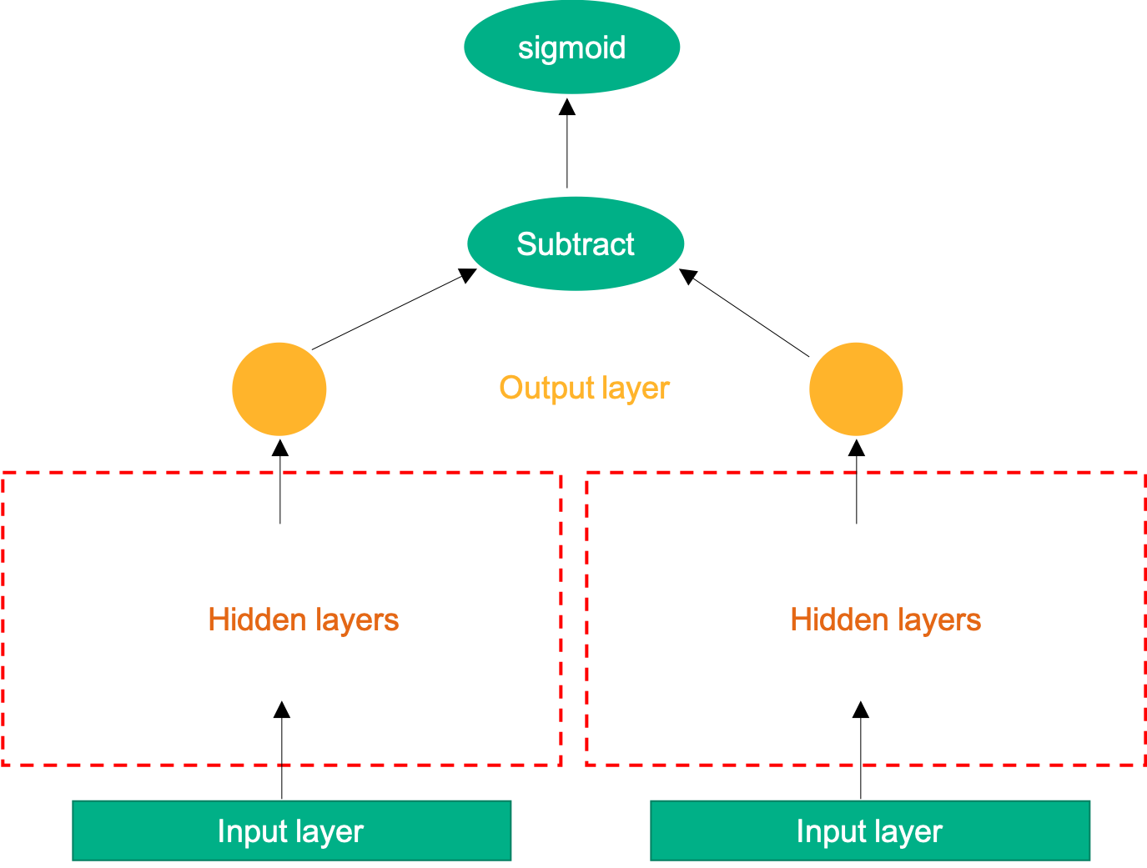
RankNet
Trainingsdaten werden nach Query (Renn ID) aufgeteilt
Jedes Paar in Query wird in «relevant» (R) und «nicht-relevant» (NR) aufgeteilt (nach Rang)
FCNN wird (separat) mit R und NR-Input trainiert
Netz-Outputs von R und NR-Inputs werden subtrahiert
Sigmoid activation nach Subtract → ergibt P(R > NR)
Categorical cross entropy loss
«Serving»: Gelerntes Netz wird zur Vorhersage der Relevanz von Items verwendet
3 hidden layers:
128-64-32 Neurons,
Relu-Activation
3 hidden layers:
128-64-32 Neurons,
Relu-Activation
Input: Relevant
Input: Nicht-Relevant
Unser Ziel: Vergleich RankNet mit «Baseline-Modellen»
Notes:
What is RankNet, LambdaRank and LambdaMART?
RankNet, LambdaRank and LambdaMART are all LTR algorithms developed by Chris Burges and his colleagues at Microsoft Research. RankNet was the first one to be developed, followed by LambdaRank and then LambdaMART.
In all three techniques, ranking is transformed into a pairwise classification or regression problem. That means you look at pairs of items at a time, come up with the optimal ordering for that pair of items, and then use it to come up with the final ranking for all the results.
Here are some high-level details for each of the algorithms:
RankNet
RankNet was originally developed using neural nets, but the underlying model can be different and is not constrained to just neural nets. The cost function for RankNet aims to minimize the number of inversions in ranking. Here an inversion means an incorrect order among a pair of results, i.e. when we rank a lower rated result above a higher rated result in a ranked list. RankNet optimizes the cost function using Stochastic Gradient Descent.

Slide 7
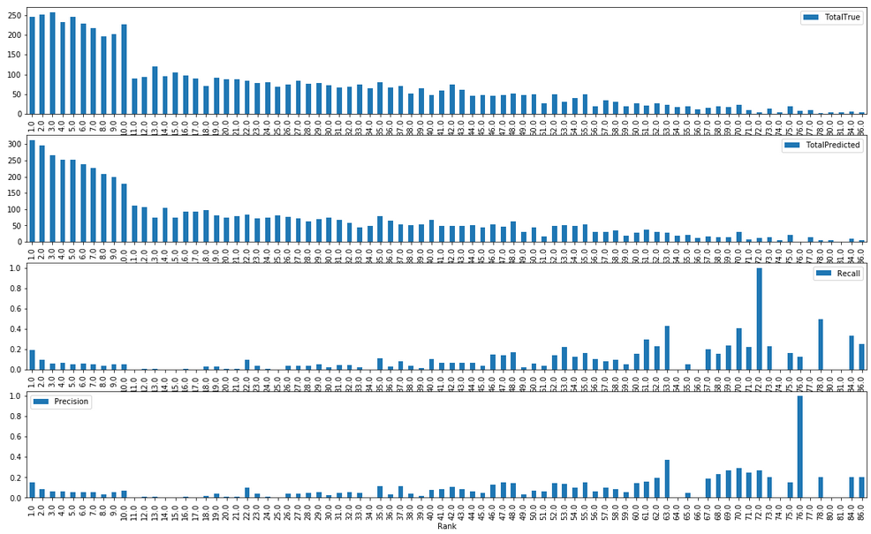
Resultate Classification
Modell | Model Score | NDCG | Comment
Decision Tree | 0.062 | NA
Random Forest | 0.067 | NA
Logistic Regression | 0.048 | NA | Had to remove several variables for the model to converge
Support Vector Machine | 0.048 | NA | Strong tendency to forcast only the classes that appear a lot in the dataset
Example Results for Random Forest
Sum True
Sum Predicted
Recall (%)
Precision (%)

Slide 8
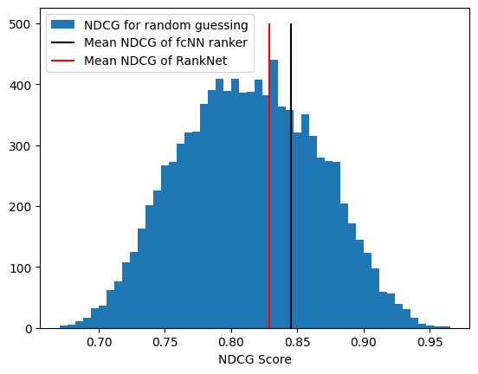
Resultate Neuronale Netze
Evaluation: NDCG [0, 1]
→ FCNN vs. RankNet:
Modell | NDCG
FCNN Regr. | 0.84
RankNet | 0.83*
*nur 500 Training-Races
Notes:
NDCG (Normalised Discounted Cumulative Gain):
Sum the true scores ranked in the order induced by the predicted scores, after applying a logarithmic discount.
Then divide by the best possible score (Ideal DCG, obtained for a perfect ranking) to obtain a score between 0 and 1.

Slide 9
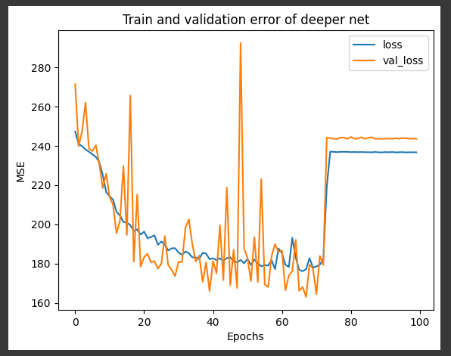
Learnings
Classsification Setting ungeeignet für Ranking Vorhersage (zu viel Informationsverlust)
In Settings mit extrem vielen Kategorien funktionieren Trees besser als LogReg oder SVM
RankNet schlechter als FCNN (wohl weil kleineres Training-Set)
→ RankNet nur für kleine Datensätze geeignet
Prepare for odd things:

Slide 10
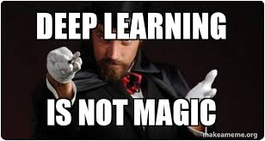
Fazit
Notes:
… it deepends ;-)

