Slide 1


Sjb institute of technology
Project Review – II
Presentation
On
“Helmet and Triple Riding Detection System”
By
Pradeep Maiyya (1JB14IS058)
Sharath Kumar (1JB14IS086)
Shreyas P V(1JB14IS092)
Vishwa Prakash H V(1JB14IS118)
Under the Guidance of
Prof. Poornima M
Dept of ISE
Department of Information Science and Engineering

Slide 2
Outline
Abstract
Brief Introduction
Architecture
Design Details
  Data Flow Diagram
  Class Diagrams
System Modules
  Modules completed
  Modules yet to be completed
Snapshots
References

Slide 3
Abstract
Motorcycle accidents have been rapidly growing throughout the years. Due to various social and economic factors, this type of vehicle is becoming increasingly popular. However, motorcyclists ignore the traffic rules and do not use it. Not using helmet could be fatal if accident occurs.
This project aims to design and develop a system which automatically detects motor cycle riders without helmet and triple riding using image processing of a live feed from surveillance camera. The extracted details are stored for appropriate future actions

Slide 4
Brief Introduction
The project aims to design and develop a system which detects motorcycle riders not wearing helmets. It also counts the number of riders and flags triple riding using image processing techniques.
The system first detects the moving objects in the video input and then tracks. It then classifies them as motorbikes or other vehicles. Finally it detects helmets and counts the number of riders on the bike.

Slide 5
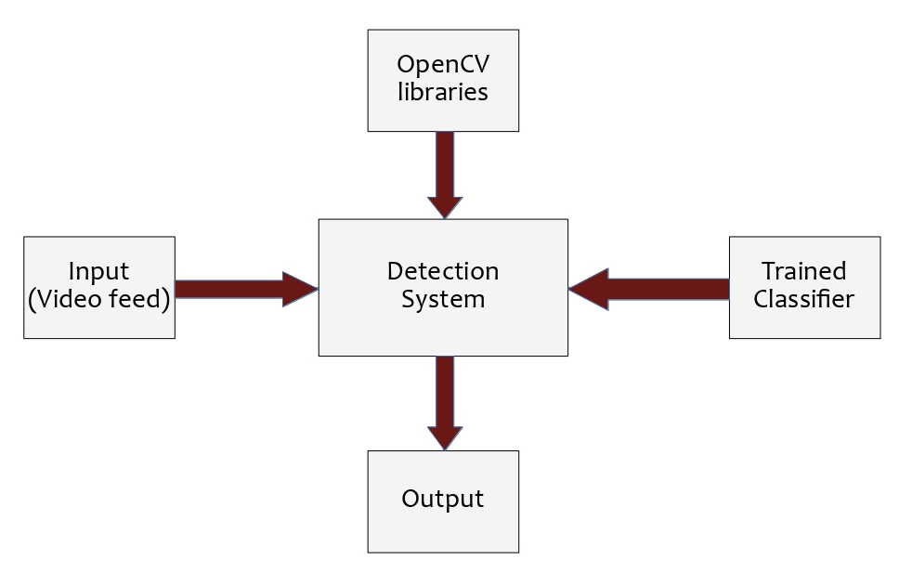
Architecture

Slide 6
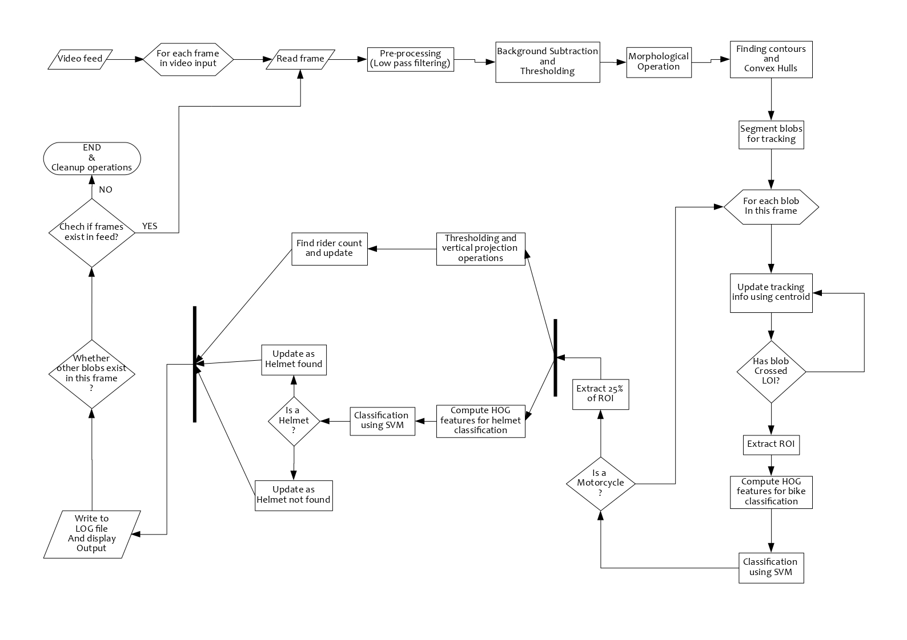
Data-flow Diagram

Slide 7
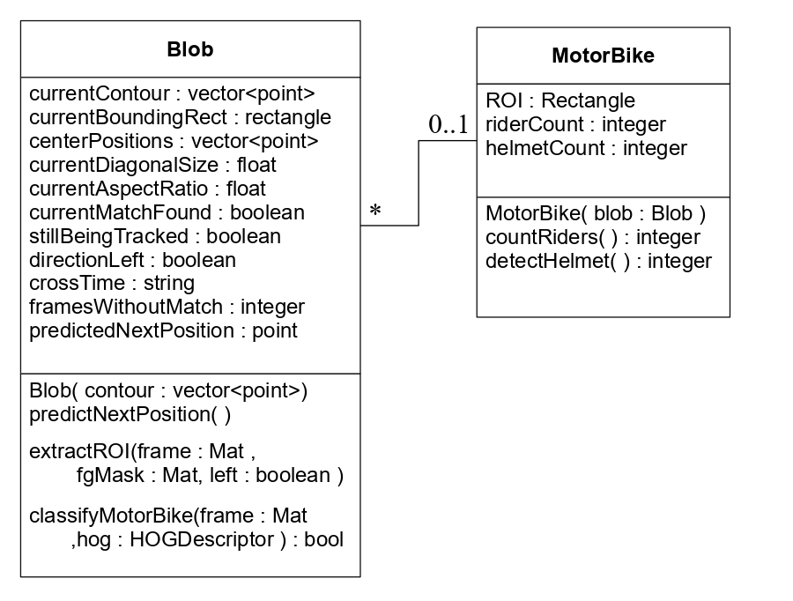
Class Diagram

Slide 8
Modules Completed
Module I
    Input fame, Background subtraction
    Noise Reduction using filters and Morphological operations
Module II
    Blob Segmentation
    Tracking blobs , detection of blob crossing LOI
Module III
    Classification of Blobs into Motorbike and Other Vehicles

Slide 9
Modules Pending
Module IV
    Extraction of ROI
    Detection of Helmets
    Counting Riders
Module V
    Writing Output to Log
    GUI to display output

Slide 10
Function Prototypes of
Completed Modules
void Blob::predictNextPosition(void);
This member function of the Blob class predicts the
next position of the blob by taking the weighted
average of previous 5 centroids
void matchCurrentFrameBlobsToExistingBlobs
(std::vector<Blob> &existingBlobs,
std::vector<Blob> &currentFrameBlobs);
This function matches the current frame blobs to the
existing blobs of the previous frame using nearest
predicted centroid.

Slide 11
bool checkIfBlobsCrossedTheLine
(std::vector<Blob> &blobs,
std::vector<Blob> &crossedBlobs,
int &intVerticalLinePosition,
std::ofstream &logfile);
Takes a vector of blobs and position of LOI, checks if the
centroid any blob has crossed LOI. Adds that blob to
vector ‘crossed blobs’ and also writes details on logfile
bool Blob::classifyMotorBike
(cv::Mat &frame, cv::HOGDescriptor &hog)
This member function of Blob class takes the current
Frame and trained HOGDescriptor as input. Detects
Motorbike along with confidence value ,
returns true/false

Slide 12
Snapshots

Slide 13
References
“Machine Vision Techniques for Motorcycle Safety Helmet Detection” - Rattapoom Waranusast, Nannaphat Bundon,Vasan Timtong and Chainarong Tangnoi , 2013
OpenCV Online Documentation : https://docs.opencv.org/
OpenCV By Example - David Millan Escriva, Prateek Joshi, Vinicius Godoy
Learning-OpenCV3 Computer vision in C++ with the OpenCV library - Adrian Kaehler & Gary Bradski

Slide 14
Thank You.

