Slide 1
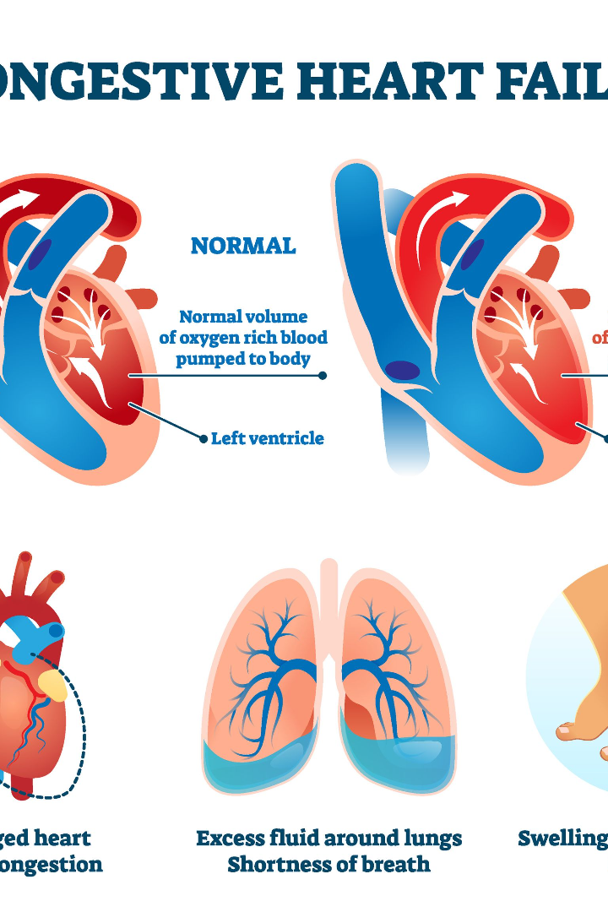

Heart Failure Prediction System using Django

Slide 2
MAJOR PROEJCT
Presented To :
Dr. Siddharth Swarup Rautaray, Associate Professor SCE, KIIT DU.
Presented By : Shashank Shekhar(2005691), Amit Kumar(2005638), Ankit Kumar(20051905), Aloukik Singh(2005431).

Slide 3
Project Field : Machine Learning using Python.
Project Title : Heart Failure Prediction System Using Django.

Slide 4

Understanding Heart Failure
According to the World Health Organization, 12 million deaths occur yearly due to heart disease. Load of cardiovascular disease is rapidly increasing all over the world in the past few years. Early detection of cardiac diseases can decrease the mortality rate and overall complications.

Slide 5
Overview
Our Heart Failure Prediction System is intended to assist patients in recognizing their heart state early and receiving treatment at an earlier stage, allowing them to avoid any serious conditions. We have designed this system using the Machine Learning model to predict the future possibility of heart disease by implementing the Logistic Regression algorithm.
The framework used in this project is Django. The Front End involves Html, CSS and JavaScript. The Back End involves MySQL Database. The Back End Language is Python.

Slide 6
Problem Statement
"Developing a robust machine learning model to predict the likelihood of heart failure in patients based on a comprehensive set of clinical and demographic features. The aim is to create a reliable system that assists healthcare professionals in early identification and proactive management of individuals at risk of heart failure, thereby improving patient outcomes and reducing the incidence of severe cardiac events."

Slide 7
Solution
Title : Heart Failure Prediction System (HFPS)
About Us : The scope of a Heart Failure Prediction System is broad, encompassing the entire patient population, from those who have no known risk factors to those who are already experiencing symptoms. The system can be integrated into various healthcare settings, such as hospitals, clinics, and primary care physician offices, and can be utilized by healthcare professionals to support clinical decision-making.

Slide 8
Features
USER -
● Register:
­ The user would need to register first to log in.
● Login:
­ The user can log in using their credentials.
● Prediction:
The users have to provide the below inputs for the system to predict if there is any heart failure or not.
­ Age: [years]
­ Sex: [M: Male, F: Female]
­ Chest Pain Type: [TA: Typical Angina, ATA: Atypical Angina, NAP: Non-Anginal Pain, ASY: Asymptomatic]
­ Resting Blood Pressure: [mm Hg]
­ Serum Cholesterol: [mm/dl] etc.

Slide 9
The user can get to know the causes of heart failure and the diagnosis test required through the chatbot.
­ It can also provide links to nearby hospitals/clinics that specialize in heart disease.
● View Free Checkup Camps:
­ The user can look for Free Check-up Camps.
ADMIN -
● Login:
­ The admin can log in using their credentials.
● View Users:
­ The admin can view the list of users.
● Add free checkup camps details:
The admin can add free checkup camp details.

Slide 10
Heart Failure Prevention Strategies
1
Risk Factors
2
Diet and Exercise
3
Medication Management
Explore the lifestyle choices and medical conditions that contribute to the development of heart failure and how to mitigate them.
Learn about the importance of a heart-healthy diet and regular physical activity in preventing heart failure.
Understand the role of medications in preventing heart failure and the importance of adherence to treatment plans.
4
Regular Check-ups
5
Stress Management
Discover the significance of regular medical check-ups and screenings in identifying early signs of heart failure.
Explore stress-reducing techniques and their impact on heart health and the prevention of heart failure.

Slide 11

Logistic Regression: A Powerful Algorithm
1
Concept
Logistic regression is a statistical method used for binary classification, predicting the probability of a categorical outcome.
2
Model Training
Model training refers to the process of creating or teaching a machine learning model to make predictions or classifications based on input data.
Learn how to train a logistic regression model using labeled heart failure data for accurate predictions.
3
Evaluation
When evaluating the performance of a heart failure prediction model (or any binary classification model), several metrics are commonly used to assess its accuracy, reliability, and effectiveness in making predictions.

Slide 12
some key metrics-
Accuracy: Accuracy measures the proportion of correctly predicted outcomes (both true positives and true negatives) among all predictions made. While it's a simple metric, it might not be ideal for imbalanced datasets (where one class significantly outnumbers the other).
Precision and Recall: Precision represents the ratio of correctly predicted positive observations to the total predicted positives. It's a measure of the model's accuracy in predicting positive instances. Recall (or sensitivity) calculates the ratio of correctly predicted positive observations to all actual positives in the dataset. It measures the model's ability to identify all positive instances.
F1 Score: The F1 score is the harmonic mean of precision and recall. It provides a balance between precision and recall and is particularly useful when there's an uneven class distribution in the data.

Slide 13
How it works:
Linear Function: Logistic regression applies a logistic function (also known as the sigmoid function) to a linear combination of the input features. This function maps any real-valued number to a value between 0 and 1.
Sigmoid Function: The sigmoid function is a mathematical function that maps any real-valued number to a value between 0 and 1. It's often used in machine learning, particularly in logistic regression and artificial neural networks.
Decision Boundary: Based on the calculated probabilities, logistic regression predicts the class of the instance by applying a threshold. For instance, if the predicted probability is greater than 0.5, it may classify it as one class; otherwise, it classifies it as the other.

Slide 14


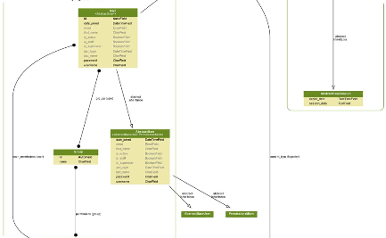
Developing with Django
Introduction to Django
Creating the App
Data Models
Explore the key features of Django and how it simplifies web development for the heart failure prediction system.
Step-by-step guide on setting up the Django project and creating the heart failure prediction app.
Design the necessary database models and configure them to store heart failure data for the prediction system.

Slide 15

Introduction with Django
Django is a high-level Python Web framework that encourages rapid development and clean, pragmatic design. Built by experienced developers, it takes care of much of the hassle of Web development, so you can focus on writing your app without needing to reinvent the wheel. It’s free and open source.

Slide 16
Features of Django
o Rapid Development
o Secure
o Scalable
o Fully loaded
o Versatile
o Open Source

Slide 17
Rapid Development
Django was designed with the intention to make a framework which takes less time to build web application. The project implementation phase is a very time taken but Django creates it rapidly.
Secure
Django takes security seriously and helps developers to avoid many common security mistakes, such as SQL injection, cross-site scripting, cross-site request forgery etc. Its user authentication system provides a secure way to manage user accounts and passwords.
Scalable
Django is scalable in nature and has ability to quickly and flexibly switch from small to large scale application project.

Slide 18
Fully loaded
Django includes various helping task modules and libraries which can be used to handle common Web development tasks. Django takes care of user authentication, content administration, site maps, RSS feeds etc.
Versatile
Django is versatile in nature which allows it to build applications for different-different domains. Now a days, Companies are using Django to build various types of applications like: content management systems, social networks sites or scientific computing platforms etc.
Open Source
Django is an open source web application framework. It is publicly available without cost. It can be downloaded with source code from the public repository. Open source reduces the total cost of the application development.

Slide 19
Wamp Server
Wamp is a Windows OS based program that installs and configures Apache web server, MySQL database server, PHP scripting language, phpMyAdmin (to manage MySQL database’s), and SQLiteManager (to manage SQLite database’s).
Wamp is designed to offer an easy way to install Apache, PHP and MySQL package with an easy to use installation program instead of having to install and configure everything yourself. WAMP is so easy because once it is installed it is ready to go. You don’t have to do any additional configuring or tweaking of any configuration files to get it running.

Slide 20
Demonstration of the Prediction System
User-Friendly Interface
Accurate Predictions
Real-time Feedback
Get instant feedback and insights on potential factors contributing to the predicted heart failure risk.
Experience the ease of navigating and interacting with the heart failure prediction system.
Witness the system's capability to accurately predict the risk of heart failure based on user input.

Slide 21

Conclusion and Future Work
Our Heart Failure Prediction System is intended to assist patients in recognizing their heart state early and receiving treatment at an earlier stage, allowing them to avoid any serious conditions. We have designed this system using the Machine Learning model to predict the future possibility of heart disease by implementing the Logistic Regression algorithm.
The scope of a Heart Failure Prediction System is broad, encompassing the entire patient population, from those who have no known risk factors to those who are already experiencing symptoms. The system can be integrated into various healthcare settings, such as hospitals, clinics, and primary care physician offices, and can be utilized by healthcare professionals to support clinical decision-making.

Slide 22
THANK YOU

