Slide 1
DEPARTMENT OF CSE — MVGR COLLEGE OF ENGINEERING (A)
Financial Literacy Programme
For Rural Youth
Community Project Review Presentation · PS090 · Education · BATCH-13D, Section D
2
4
50
37
REVIEWS
TEAM MEMBERS
TOTAL MARKS
PARTICIPANTS
Project In-charge: Dr. P. Rama Santosh Naidu & Mr. R. Ravi Kumar, Dept. of CSE · Community Partner: Govt. Junior College, Vizianagaram Town
2024–2028 Batch · B.Tech CSE · MVGR College of Engineering (A)

Slide 2
HOW THIS DECK IS ORGANISED
One Continuous Presentation, Start to Finish
01
A single, continuous deck
This presentation flows straight from Review 1 into Review 2 (Final) with no restart in between — our project identity is introduced once, on the Project Cover, and every slide after it builds on that.
02
Two reviews only
Review 1 (10 marks) — Problem Identification & Planning, already completed. Review 2 (40 marks, Final) — Progress, Execution & Final Evaluation: Report(/20) + Viva(/15) + Cert(/5).
03
"Cert" covers our proof of work
Our community-partner certificate where issued, and otherwise our survey reports, field photographs and documentation, stand as proof of the work completed.
Financial Literacy Programme · BATCH-13D · MVGR CSE
Slide 2 of 21

Slide 3
TABLE OF CONTENTS
What's Inside This Framework
# | Section | Title | When | Marks | Slides (guide)
00 | Project Cover | Shared identity — appears once | — | — | 1
01 | Review 1 | Problem Identification & Planning | Week 2–3 of Sem V | 10 | 8
02 | Review 2 · Final | Progress, Execution & Final Evaluation | Week 8–16 of Sem V | 40 | 10
Total: 50 marks across 2 reviews · Review 2 is FINAL — Report(/20) + Viva(/15) + Cert(/5).
"Cert" = the certificate issued by your community partner, OR — where one is not issued — your online/offline survey reports, photos, or other proof of work.
Community Project Review Presentation Framework · MVGR CSE
Slide 3 of 22

Slide 4
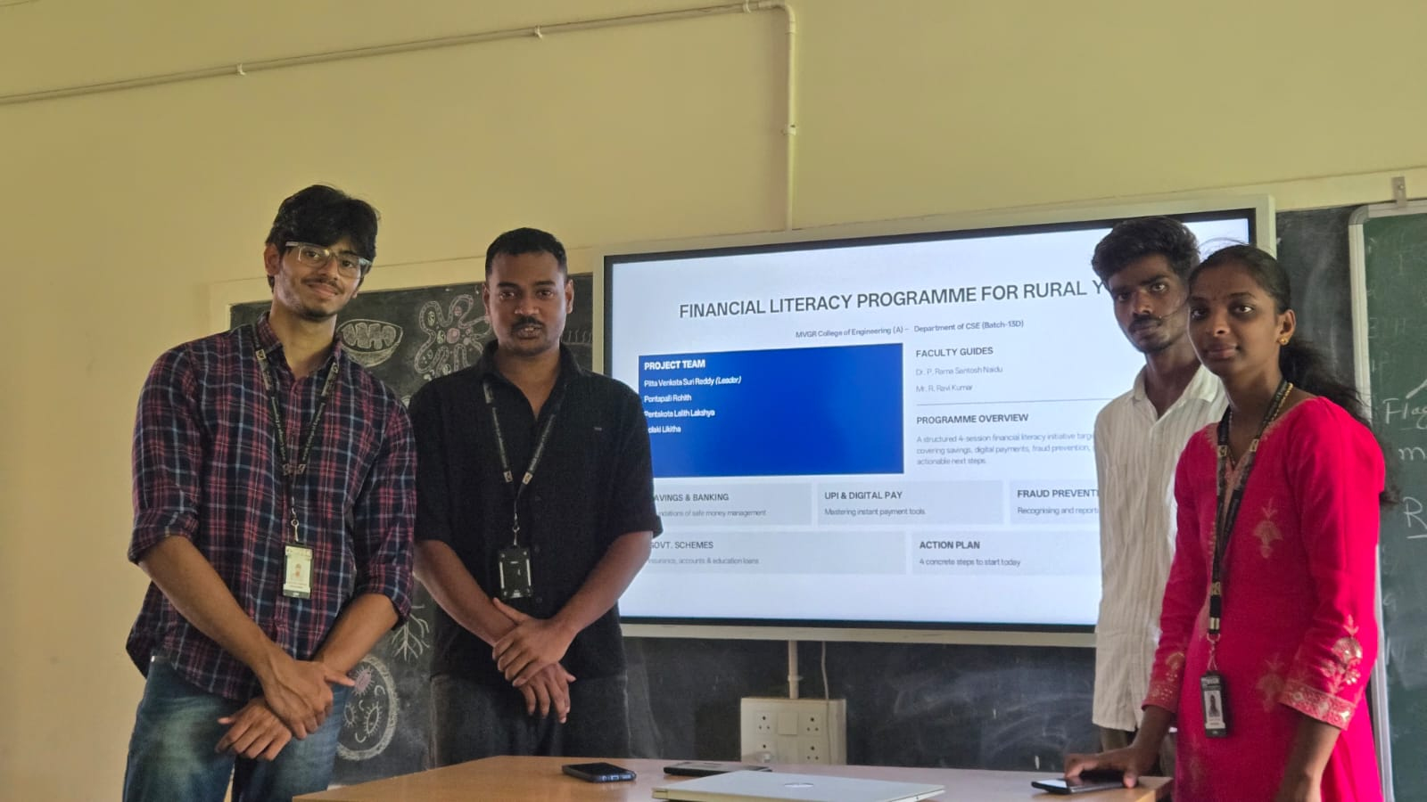
DEPARTMENT OF COMPUTER SCIENCE & ENGINEERING
MVGR COLLEGE OF ENGINEERING (A) ·
Financial Literacy Programme For Rural Youth
PROJECT OVERVIEW
Short Form: PS090 · Domain: Education
Entered once — carried through every slide
Equipping rural Class XII students with foundational financial literacy — savings, UPI safety, insurance & govt. schemes, and financial planning — with actionable next steps.
BATCH MEMBER DETAILS
BATCH ID BATCH-13D · Sec D
PROJECT IN-CHARGE Dr. P. Rama Santosh Naidu & Mr. R. Ravi Kumar
COMMUNITY PARTNER Govt. Junior College, Vizianagaram Town (Code: 02197)
Name | Roll No.
Pitta Venkata Suri Reddy (Batch Leader) | 24331A05N4
Pontapalli Rohith | 24331A05N6
Pentakota Lalith Lakshya | 24331A05M8
Polaki Likitha | 25335A0520
☑ Review 1 — PLANNING GATE → ☑ Review 2 — FINAL EVALUATION GATE
Both reviews complete — this deck covers the full project from planning to final execution.

Slide 5
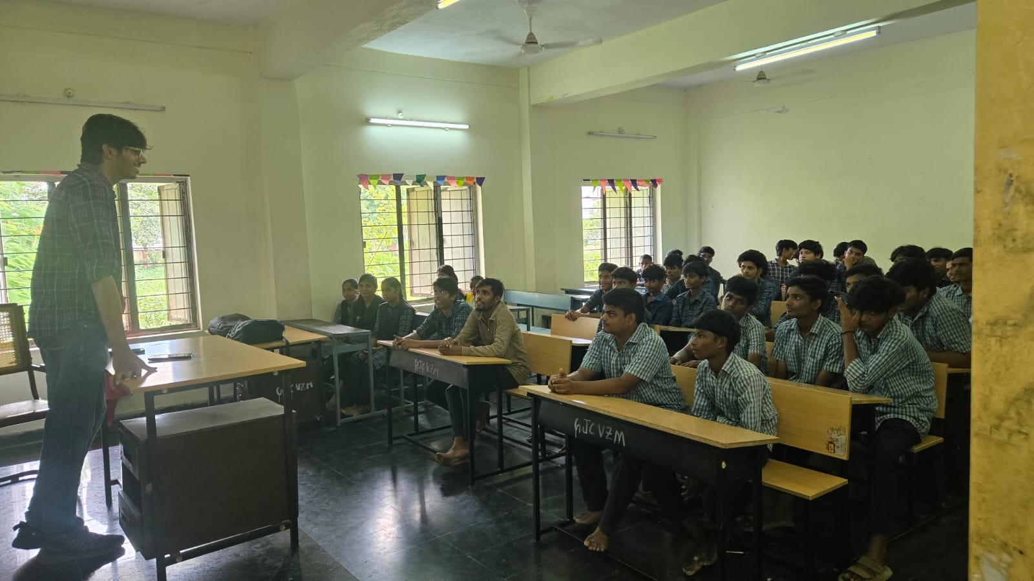
01
Problem Statement Recap
PLANNING GATE
REVIEW 1 · SLIDE 1 OF 8 · DECK SLIDE 5 OF 21
AT A GLANCE
PS090 · Financial Literacy Programme For Rural Youth
Domain: Education
BATCH-13D · Section D · 4 Members
Community Partner: Govt. Junior College, Vizianagaram Town
Guides: Dr. P. Rama Santosh Naidu & Mr. R. Ravi Kumar, Dept. of CSE
Review 1 — Problem Identification & Planning · Week 2–3 of Sem V
Review 1 — Problem Identification & Planning · Week 2–3 of Sem V

Slide 6
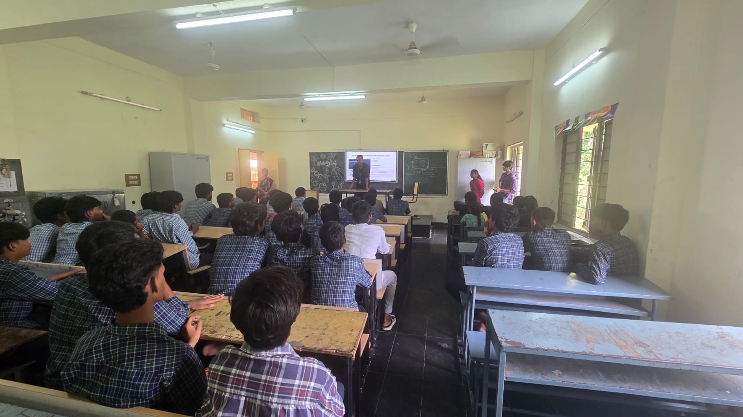
02
Problem Statement & Community Partner
PLANNING GATE
REVIEW 1 · SLIDE 2 OF 8 · DECK SLIDE 6 OF 21
AT A GLANCE
Class XII students in rural Vizianagaram have no formal exposure to financial concepts — savings, banking, UPI payments, insurance, or financial planning.
They are highly vulnerable to UPI fraud, phishing scams, and predatory financial schemes due to limited financial awareness.
Lack of financial planning knowledge affects their ability to manage scholarships, income, and financial decisions post-school.
Target Community: 37 Class XII students · Govt. Junior College, Vizianagaram Town · 26-09-2026
Review 1 — Problem Identification & Planning · Week 2–3 of Sem V
Slide 6 of 21

Slide 7
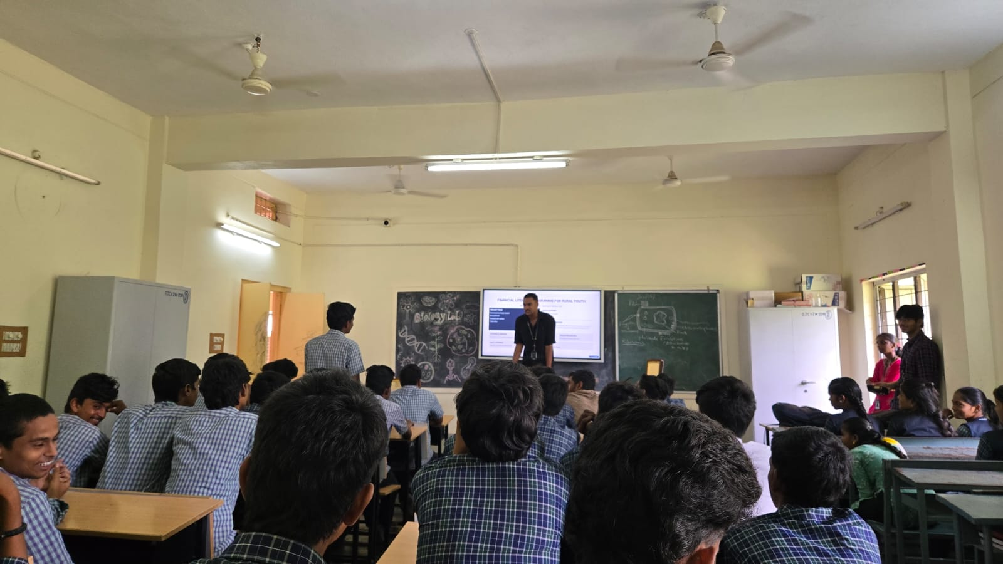
03
Why This Matters (Background & Significance)
PLANNING GATE
REVIEW 1 · SLIDE 3 OF 8 · DECK SLIDE 7 OF 21
WHY THIS MATTERS
Our preliminary survey confirmed that most Class XII rural students own mobile phones and may use UPI — but have zero formal financial education, making them easy targets for fraud and poor financial decisions.
Many students are unaware of basic banking (savings accounts, zero-balance Jan Dhan), safe digital payment practices (OTP scams, fake QR codes), insurance basics, or government schemes like PM Scholarship directly applicable to them.
This gap between owning a mobile phone and having financial confidence motivated this project — providing actionable knowledge before they enter the financial world.
Review 1 — Problem Identification & Planning · Week 2–3 of Sem V
Slide 7 of 21

Slide 8
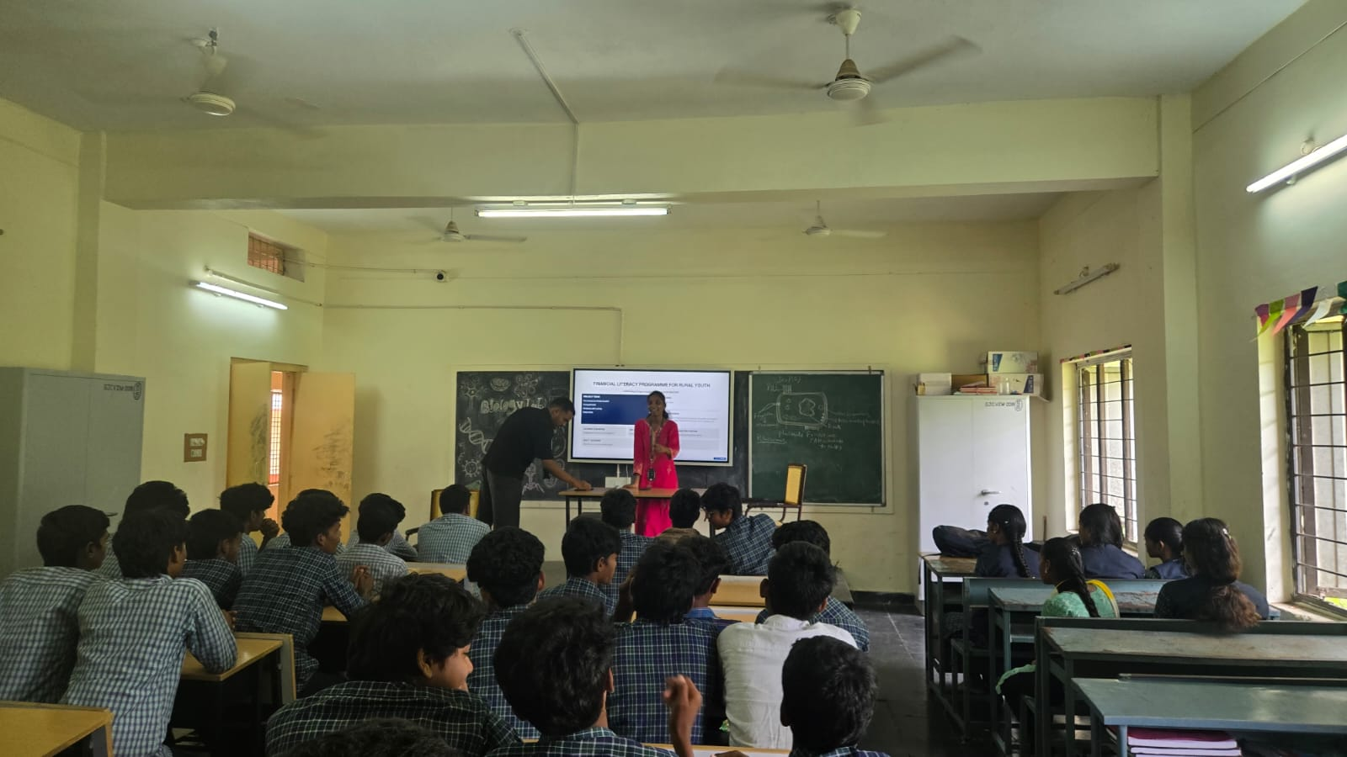
04
Objectives
PLANNING GATE
REVIEW 1 · SLIDE 4 OF 8 · DECK SLIDE 8 OF 21
OBJECTIVES
Assess the baseline financial literacy of 37 rural Class XII students through a structured 15-mark MCQ pre-test.
Deliver four structured modules: (1) Savings & Banking (2) UPI & Digital Payments Safety (3) Insurance & Govt. Schemes (4) Financial Planning & Budgeting.
Create awareness of UPI fraud, OTP scams, fake QR codes, phishing, and predatory lending through interactive sessions and real-world examples.
Measure knowledge gain through an identical 15-mark post-test and compare individual and class-average scores.
Distribute an actionable financial literacy handout so students can immediately apply their learning.
Review 1 — Problem Identification & Planning · Week 2–3 of Sem V
Slide 8 of 21

Slide 9
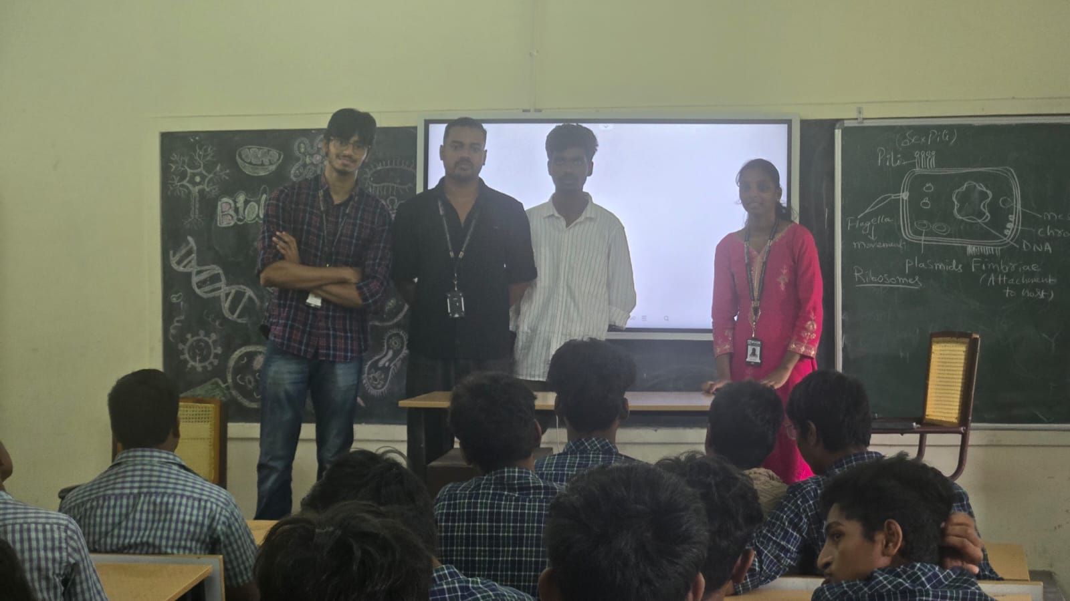
05
Methodology — Online Data Collection Plan
PLANNING GATE
REVIEW 1 · SLIDE 5 OF 8 · DECK SLIDE 9 OF 21
ONLINE / SECONDARY DATA
RBI Financial Literacy Guidelines — structured content on savings, banking, and responsible money management for rural and youth audiences.
SEBI Investor Education Resources — investor awareness and simple financial planning content for first-time participants.
NPCI/UPI Safety Advisories — official guidance on safe UPI usage, OTP protection, and how to identify phishing links and fake payment requests.
CERT-In Cyber Safety Resources — advisories on phishing, online fraud, fake QR codes, and digital financial crime affecting mobile banking users.
A structured classroom-based training approach was used with printed MCQ assessments (not Google Forms) since the target community was rural Class XII students.
Review 1 — Problem Identification & Planning · Week 2–3 of Sem V
Slide 9 of 21

Slide 10
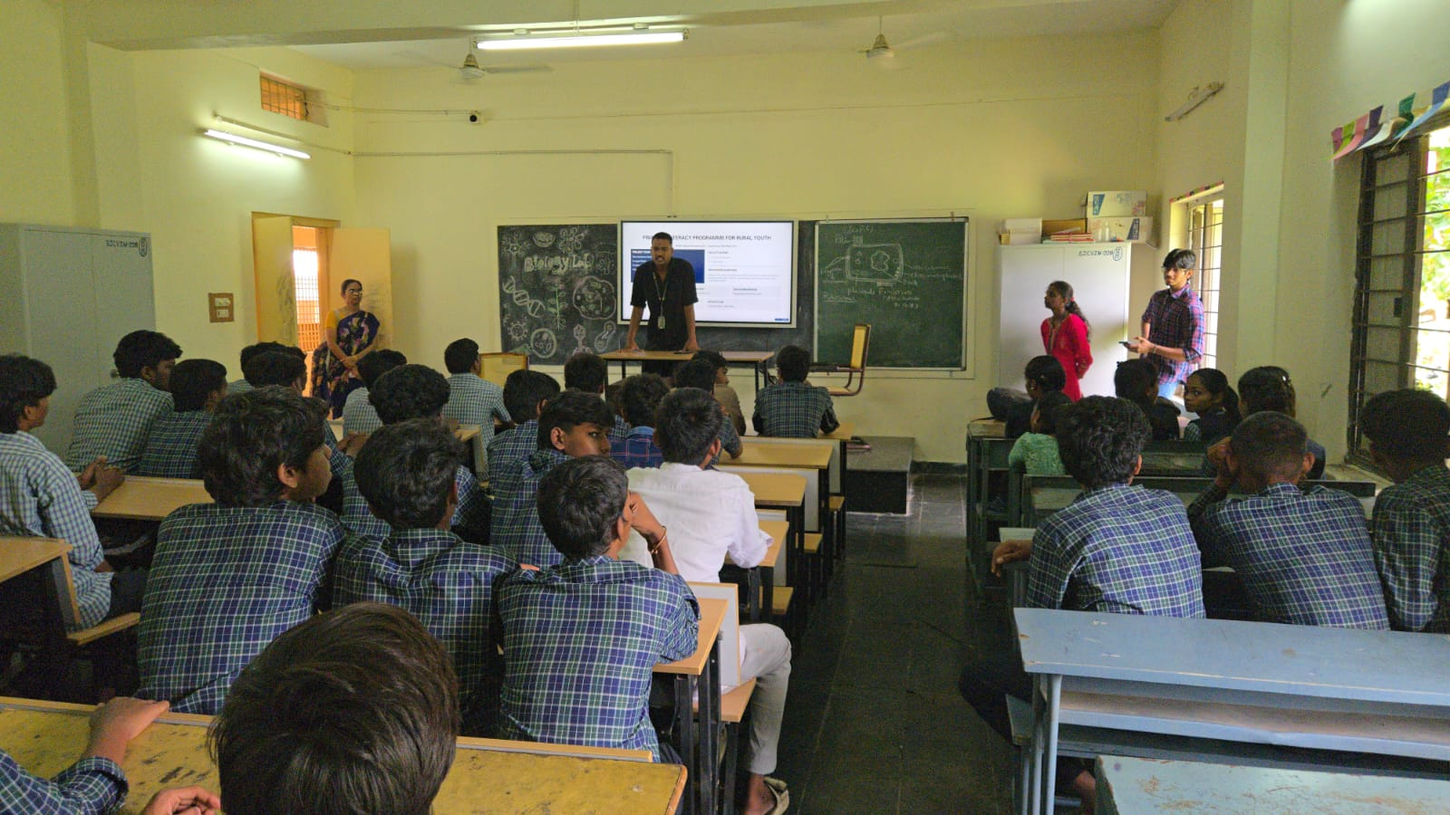
06
Methodology — Offline Field Work Plan
PLANNING GATE
REVIEW 1 · SLIDE 6 OF 8 · DECK SLIDE 10 OF 21
OFFLINE FIELD WORK PLAN
Phase 1 — Baseline Assessment: 15-mark MCQ pre-test administered to all 37 Class XII students to measure baseline financial knowledge before the session.
Phase 2 — 4-Module Training: Module 1 (Savings & Banking) → Module 2 (UPI & Digital Payments Safety) → Module 3 (Insurance & Govt. Schemes) → Module 4 (Financial Planning & Budgeting) — delivered interactively with real-world case examples.
Phase 3 — Post-Evaluation: identical 15-mark MCQ post-test administered after all 4 modules; individual student scores recorded and compared for knowledge gain measurement.
Field Visit: Govt. Junior College, Vizianagaram Town — 37 Class XII students — 26-09-2026 (approved non-working day).
Review 1 — Problem Identification & Planning · Week 2–3 of Sem V
Slide 10 of 21

Slide 11
07
Timeline & Expected Deliverable
PLANNING GATE
REVIEW 1 · SLIDE 7 OF 8 · DECK SLIDE 11 OF 21
REVIEW-WISE PLAN
FIELD VISIT · 26-09-2026
Govt. Junior College, Vizianagaram Town · 37 Class XII students · approved non-working day
01
02
REVIEW 1 · PLANNING
REVIEW 2 · FINAL
Community survey and needs assessment
Literature review and 15-mark pre-test design
Four-module content and training material
Field visit + four-module financial literacy session
15-mark pre/post tests, score analysis and documentation
Handout distributed to all 37 students
COMMUNITY DELIVERABLE
4-module session + actionable personal finance handout
Review 1 — Problem Identification & Planning · Week 2–3 of Sem V
Slide 11 of 21

Slide 12
08
Team Roles & Responsibilities
PLANNING GATE
REVIEW 1 · SLIDE 8 OF 8 · DECK SLIDE 12 OF 21
TEAM
01
PITTA VENKATA SURI REDDY
02
PONTAPALLI ROHITH
24331A05N4
24331A05N6
Batch Leader · Module 1
Session Lead · Module 2
Leads the team; delivers Savings & Banking; prepares reports and presentations
Delivers UPI & Digital Payments Safety; manages device demos and real-time Q&A
03
PENTAKOTA LALITH LAKSHYA
04
POLAKI LIKITHA
24331A05M8
25335A0520
Community Engagement · Module 3
Data Analysis Lead · Module 4
Delivers Insurance & Govt. Schemes; coordinates student participation and feedback
Delivers Financial Planning & Budgeting; administers pre/post-test and analyses scores
All four members contributed to field delivery, documentation, and final project completion.
Review 1 — Problem Identification & Planning · Week 2–3 of Sem V
Slide 12 of 21

Slide 13
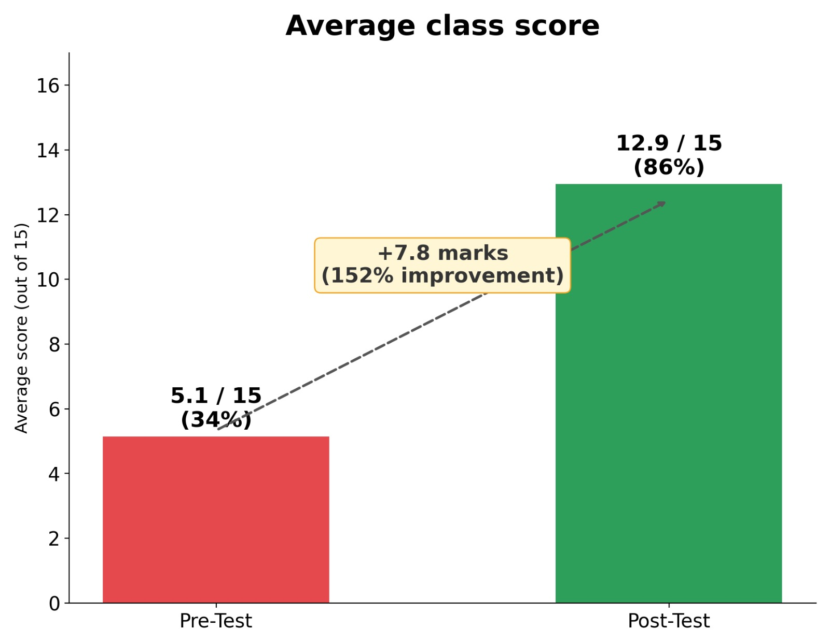
01
Review 1 Feedback Actioned
FINAL EVALUATION GATE
REVIEW 2 · SLIDE 1 OF 9 · DECK SLIDE 13 OF 21
Review 1 Feedback Query | Action Taken & Outcome
1. Finalize Community Partner & Cohort | Partnered with Govt. Jr. College VZM; enrolled 37 Class XII students (100% participation).
2. Measurable Assessment Plan | Used 15-mark pre/post test. Avg score improved from 34% (5.1) to 86% (12.9) (+152% gain).
3. Field Evidence & Documentation | Completed visit on 26-09-2026. Documented with geotagged photos & partner certificate.
4. Community Deliverable | Designed & distributed personal finance summary handouts to all 37 students.
Review 1 Feedback Query | Action Taken & Outcome
1. Finalize Community Partner & Cohort | Partnered with Govt. Jr. College VZM; enrolled 37 Class XII students (100% participation).
2. Measurable Assessment Plan | Used 15-mark pre/post test. Avg score improved from 34% (5.1) to 86% (12.9) (+152% gain).
3. Field Evidence & Documentation | Completed visit on 26-09-2026. Documented with geotagged photos & partner certificate.
4. Community Deliverable | Designed & distributed personal finance summary handouts to all 37 students.
PROGRESS SINCE REVIEW 1
Progress since Review 1: 100% complete. All 4 modules delivered, pre- and post-tests administered, all 37 student scores recorded and analysed.
Feedback from Review 1: finalise community partner, confirm student count, and design a measurable pre/post assessment.
Action taken: confirmed Govt. Junior College, Vizianagaram Town as partner; enrolled 37 Class XII students; designed 15-mark MCQ pre-test and identical post-test to measure knowledge gain.
Outcome: Pre-test avg 5.1/15 (34%) → Post-test avg 12.9/15 (86%). Every student improved. +7.8 marks, +152% knowledge gain — a clear, measurable impact.
Review 2 — Final Evaluation · Week 8–16 of Sem V (as scheduled by Admin)
Slide 13 of 21

Slide 14
02
Complete Methodology (Online + Offline) — As Executed
FINAL EVALUATION GATE
REVIEW 2 · SLIDE 2 OF 9 · DECK SLIDE 14 OF 21
METHODOLOGY — AS EXECUTED
Online / secondary data: RBI Financial Literacy Guidelines, SEBI Investor Education, NPCI/UPI Safety Advisories, CERT-In Cyber Safety Resources.
Offline field work: 15-mark printed MCQ pre-test administered; 4 structured financial literacy modules delivered interactively; post-test conducted; student Q&A facilitated; financial literacy handout distributed to all students.
Final field-visit log: 26-09-2026 · Govt. Junior College, Vizianagaram Town · 37 participants · full-day awareness session & assessment · approved non-working day.
Final sample & response: 37 students, 100% response rate (37/37). Pre-test avg: 5.1/15 (34%). Post-test avg: 12.9/15 (86%). All 37 students improved.
Review 2 — Final Evaluation · Week 8–16 of Sem V (as scheduled by Admin)
Slide 14 of 21

Slide 15
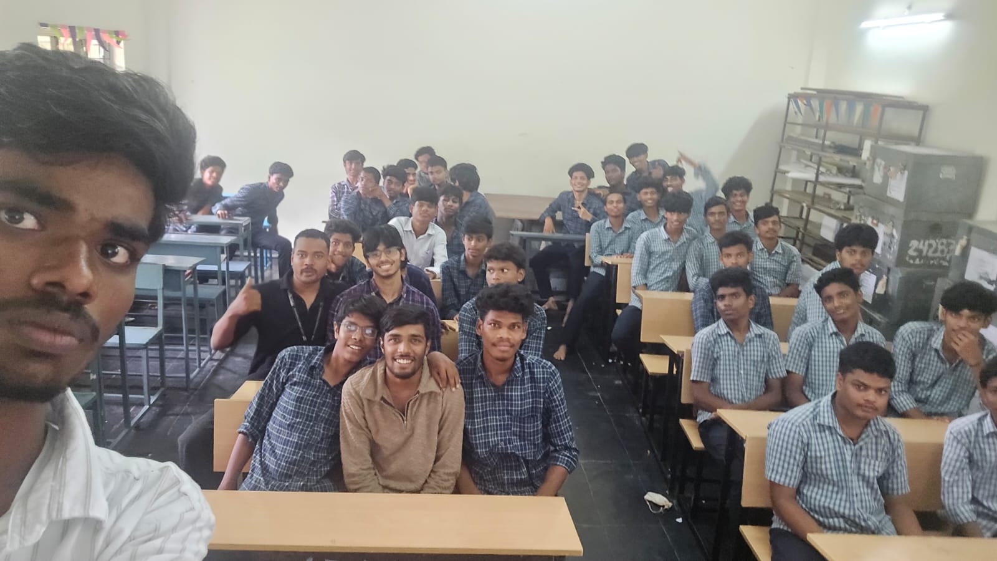
03
Field Work & Community Engagement — Full Summary
FINAL EVALUATION GATE
REVIEW 2 · SLIDE 3 OF 9 · DECK SLIDE 15 OF 21
FIELD SUMMARY
Field activity: full-day financial literacy awareness session at Govt. Junior College, Vizianagaram Town — 37 Class XII students — 26-09-2026, approved non-working day. Team delivered all 4 modules using interactive teaching with real-case fraud examples.
Community participation: 37 students actively participated, engaged with module content, asked questions on UPI safety and savings accounts, and completed both pre-test and post-test with 100% response rate.
Community feedback: students found UPI fraud prevention and govt. schemes modules most impactful. Several were unaware of PM Scholarship before the session. The session-end photograph reflects strong student engagement.
Review 2 — Final Evaluation · Week 8–16 of Sem V (as scheduled by Admin)
Slide 15 of 21

Slide 16
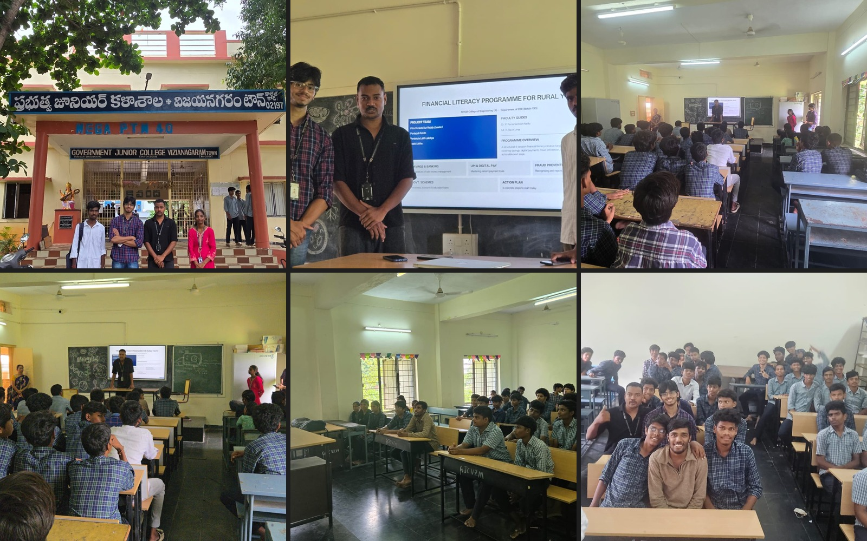
04
Field Evidence — Photos & Documentation
FINAL EVALUATION GATE
FIELD EVIDENCE
Field photographs from the Financial Literacy Programme conducted at Govt. Junior College, Vizianagaram Town on 26-09-2026, documenting session delivery and student engagement.
The session covered 37 Class XII students — photographs document module delivery, student participation in pre/post assessments, and team presentation in progress on the smart board.
Participation record: 37 students completed both pre-test and post-test and received the financial literacy handout.
Review 2 — Final Evaluation · Week 8–16 of Sem V (as scheduled by Admin)
Slide 16 of 21

Slide 17
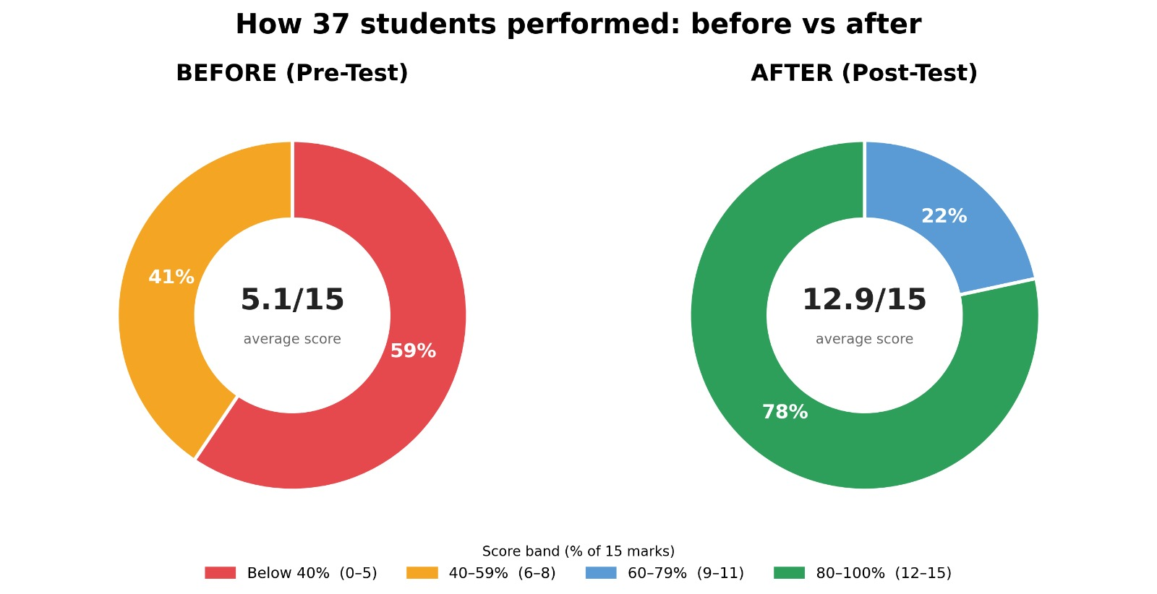
05
Data Analysis & Findings
FINAL EVALUATION GATE
REVIEW 2 · SLIDE 5 OF 9 · DECK SLIDE 17 OF 21
PRE / POST TEST FINDINGS
AVERAGE SCORE
AVERAGE PERCENT
STUDENTS > 80%
5.1 / 15
→
12.9 / 15
34%
→
86%
0 / 37
→
29 / 37
+7.8 marks
+52 points
78% after
SCORE DISTRIBUTION · 37 STUDENTS
BEFORE · PRE-TEST
<40%
40–79%
59%
41%
60–79%
80–100%
AFTER · POST-TEST
37 / 37 IMPROVED
22%
78%
Every student improved. Lowest post-test score: 11/15 (73%).
Knowledge gain: +152% relative to pre-test average
Before: 59% below 40%; after: 78% reached the 80–100% band.
Review 2 — Final Evaluation · Week 8–16 of Sem V (as scheduled by Admin)
Slide 17 of 21

Slide 18
06
Outcomes & Community Impact
FINAL EVALUATION GATE
REVIEW 2 · SLIDE 6 OF 9 · DECK SLIDE 18 OF 21
IMPACT
Equipped 37 rural Class XII students with foundational financial literacy — savings, banking, digital payments, insurance, and financial planning.
Educated students on UPI safety, OTP scam prevention, fake link identification, and safe digital payment practices — directly protecting them from financial fraud.
Created awareness of government schemes for students: PM Scholarship, education loans, zero-balance Jan Dhan accounts, and PM Suraksha Bima Yojana.
Measured knowledge improvement: class average went from 34% to 86% — a +152% increase — with all 37 students showing individual improvement.
Distributed actionable financial literacy handout so students can apply learning immediately and share with families.
Overall financial knowledge improved from 34% pre-test to 86% post-test. 78% of students scored 80–100% after the session.
Review 2 — Final Evaluation · Week 8–16 of Sem V (as scheduled by Admin)
Slide 18 of 21

Slide 19
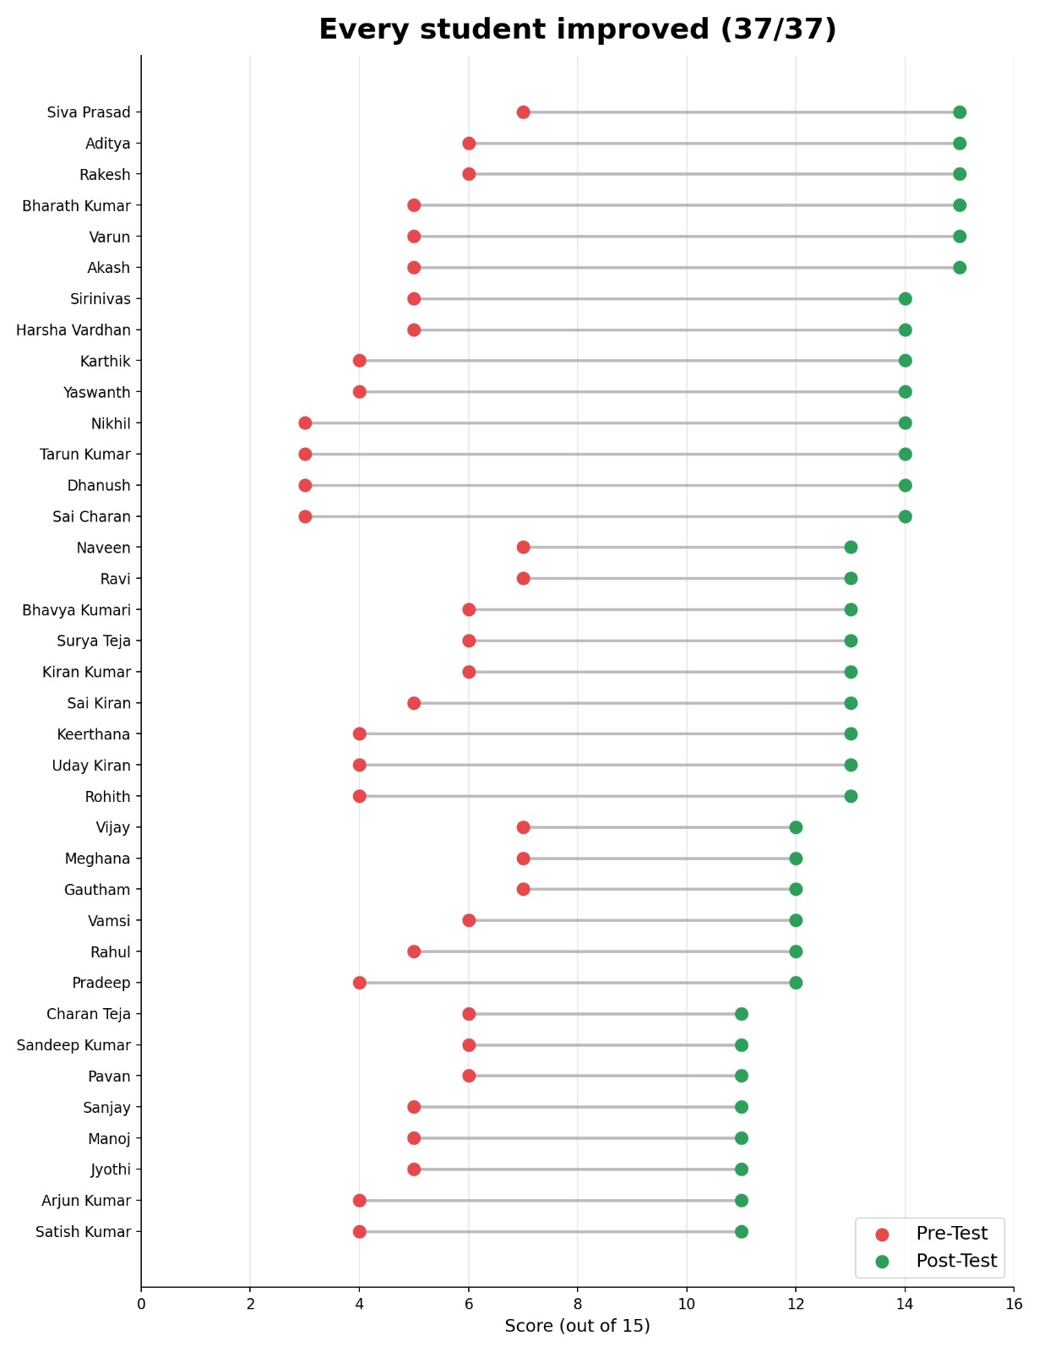
07
Challenges Faced & How They Were Resolved
FINAL EVALUATION GATE
REVIEW 2 · SLIDE 7 OF 9 · DECK SLIDE 19 OF 21
CHALLENGES & RESOLUTION
Mixed financial backgrounds: 37 students had varying household financial contexts. Resolved by using universal examples (UPI frauds, PM Scholarship) relevant to all students regardless of family income.
Language barrier: some students were more comfortable in Telugu. Resolved by bilingual delivery (English + Telugu) during modules and Q&A segments.
Attention across 4 modules: risk of disengagement in a long session. Resolved by using real news fraud cases as interactive examples and conducting a live UPI demonstration on a mobile phone.
Pre-test anxiety: some students nervous about the quiz format. Resolved by framing it as a knowledge check (not an exam) and assuring them results would not be shared with the school.
Score collection: manually verified all 37 pre and post answer papers, entered scores into Excel (PS090_PreTest_final.xlsx & PS090_post_test_final.xlsx), and cross-checked all totals.
Review 2 — Final Evaluation · Week 8–16 of Sem V (as scheduled by Admin)
Slide 19 of 21

Slide 20
08
Conclusions & Recommendations
FINAL EVALUATION GATE
REVIEW 2 · SLIDE 8 OF 9 · DECK SLIDE 20 OF 21
CONCLUSIONS
Achieved: all 4 financial literacy modules delivered to 37 rural Class XII students; class average improved from 34% to 86% (+152%); 100% student participation; every student improved.
Limitations: single-session training limits long-term retention; no formal follow-up mechanism; varying economic backgrounds create unequal starting points.
Recommendations: conduct quarterly follow-up quiz sessions; partner with school to include financial literacy in curriculum; produce Telugu-language version of the handout; extend programme to other rural junior colleges in Vizianagaram district.
Review 2 — Final Evaluation · Week 8–16 of Sem V (as scheduled by Admin)
Slide 20 of 21

Slide 21
09
Thank You / Q&A
FINAL EVALUATION GATE
REVIEW 2 · SLIDE 9 OF 9 · DECK SLIDE 21 OF 21
CLOSING
We sincerely express our gratitude to the Project In-Charges (Dr. P. Rama Santosh Naidu & Mr. R. Ravi Kumar), Head of the Department (Dr. Aruna Srinivas), Principal, Management, Project Review Panel (Dr. K. Sobha Rani, Mrs. M. Priyanka, Mrs. K. Hymavathi), and our Community Partner (Govt. Junior College, Vizianagaram Town) for their valuable guidance, support, and encouragement throughout this project.
Review 2 — Final Evaluation · Week 8–16 of Sem V (as scheduled by Admin)
Slide 21 of 21

