Slide 1
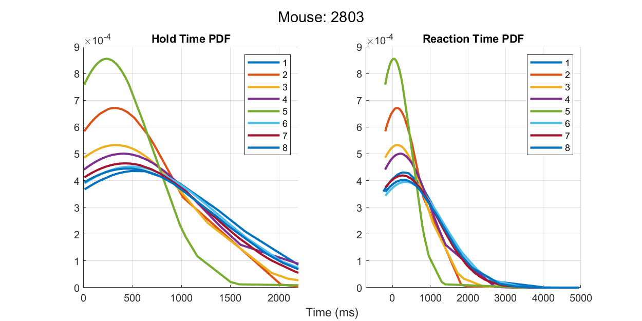
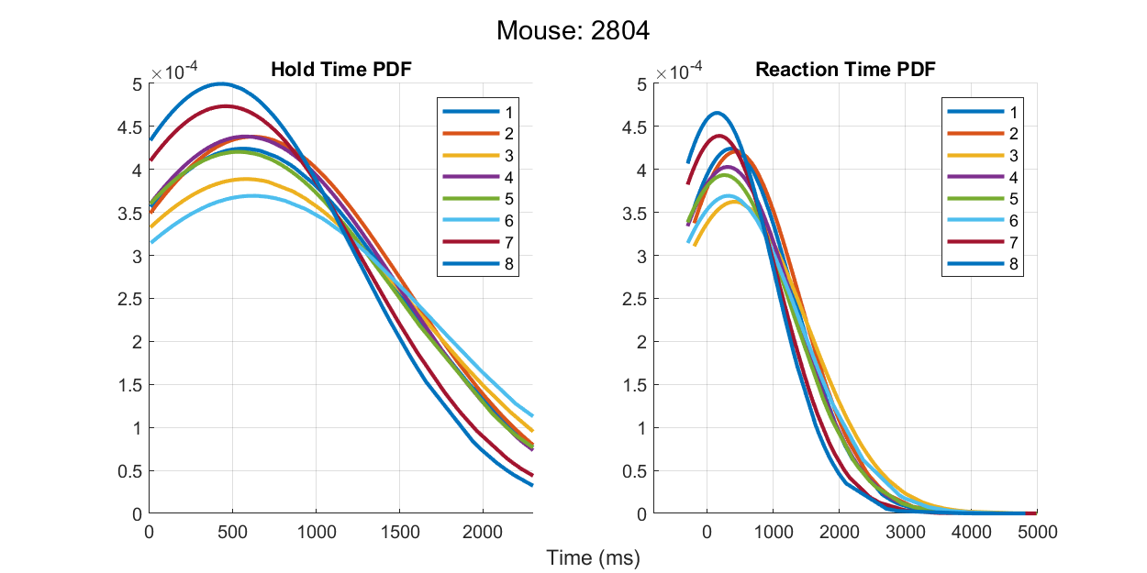
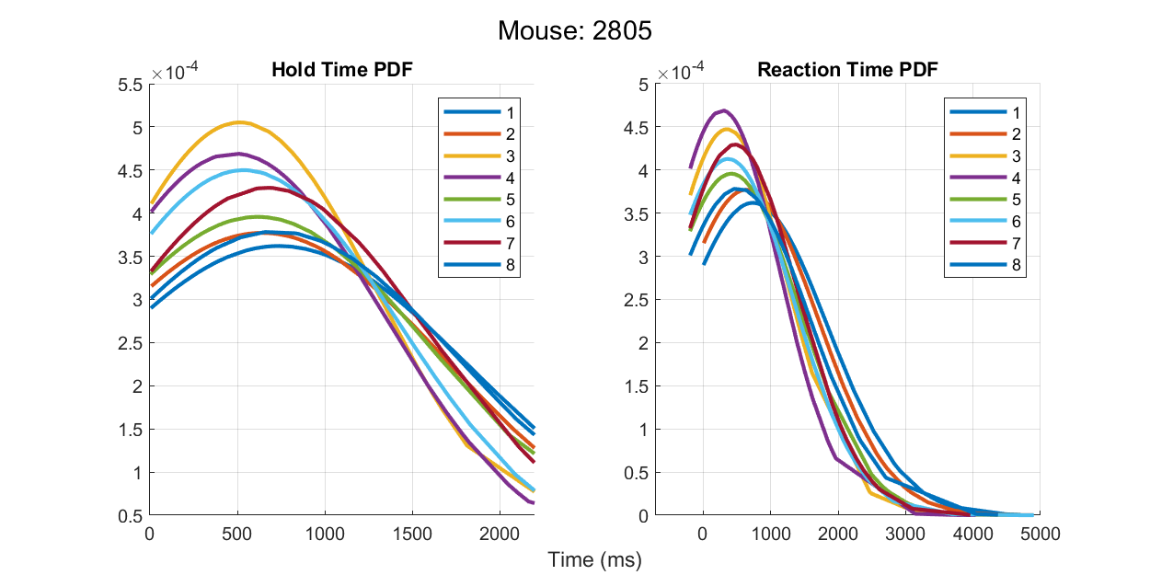
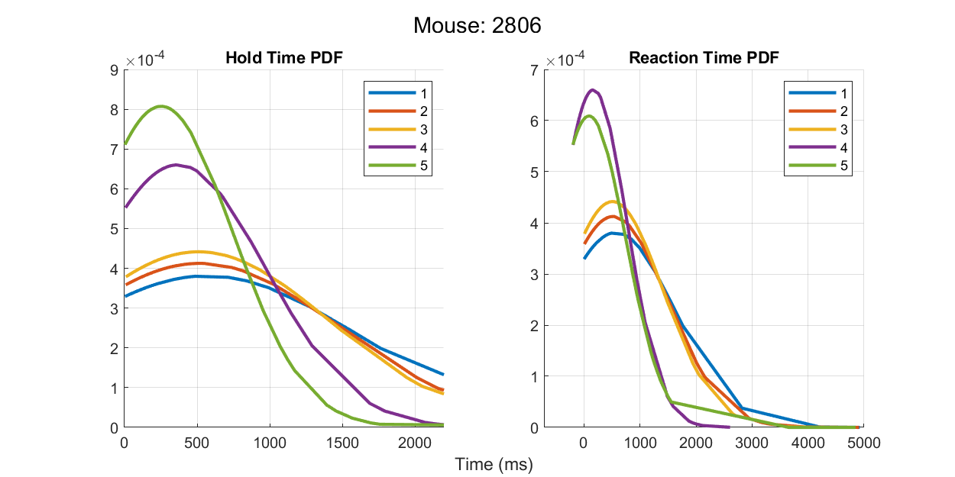
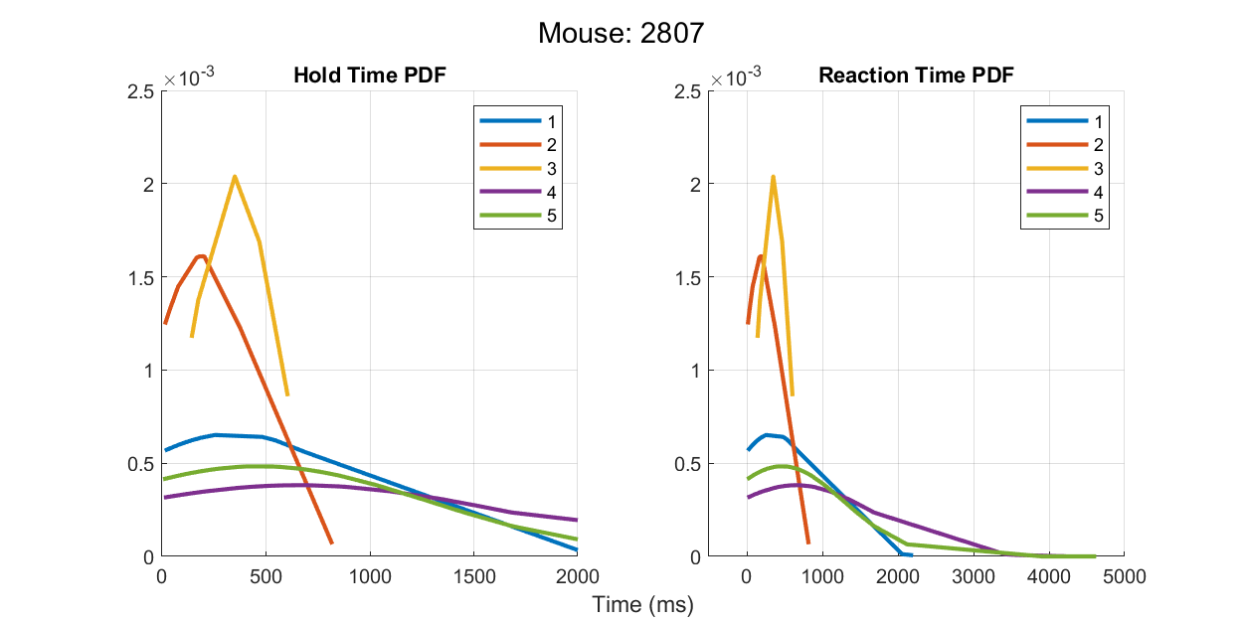
Probability density functions of Hold/React times for each mouse
Mouse 2803
fixedHold=300 for days 1 to 8
Mouse 2804
fixedHold=200 for days 1 to 3
fixedHold=300 for days 4 to 8
Mouse 2805
fixedHold=0 for days 1 to 2
fixedHold=200 for days 3 to 8
Mouse 2806
fixedHold=0 for days 1 to 3
fixedHold=200 for days 4 to 5
Mouse 2807
fixedHold=0 for days 1 to 5

Slide 2
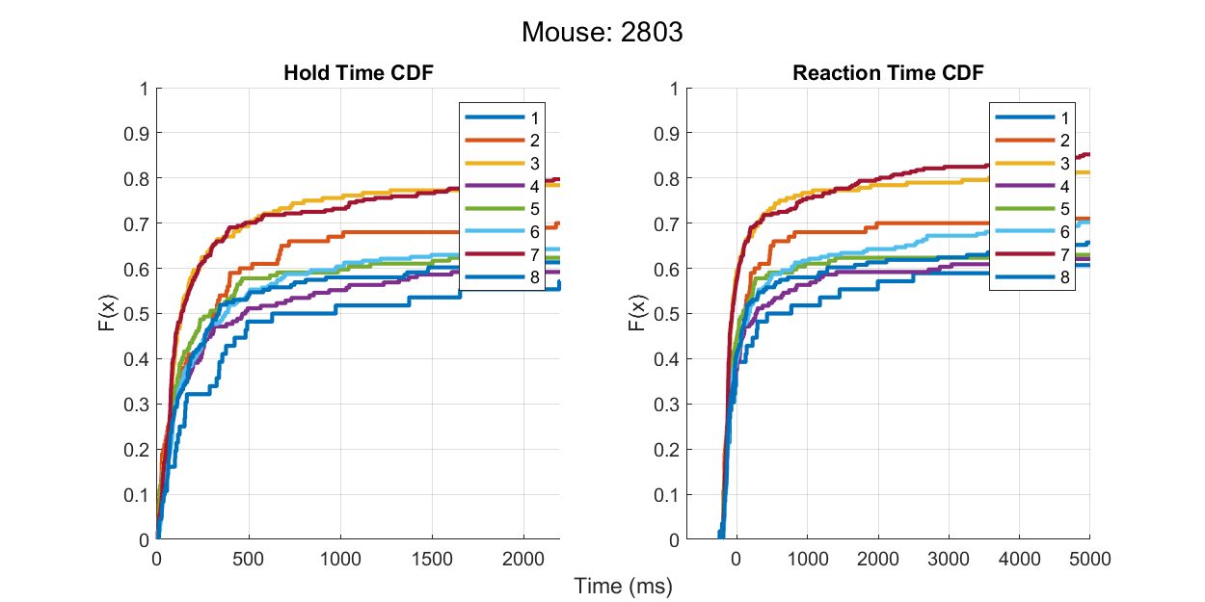
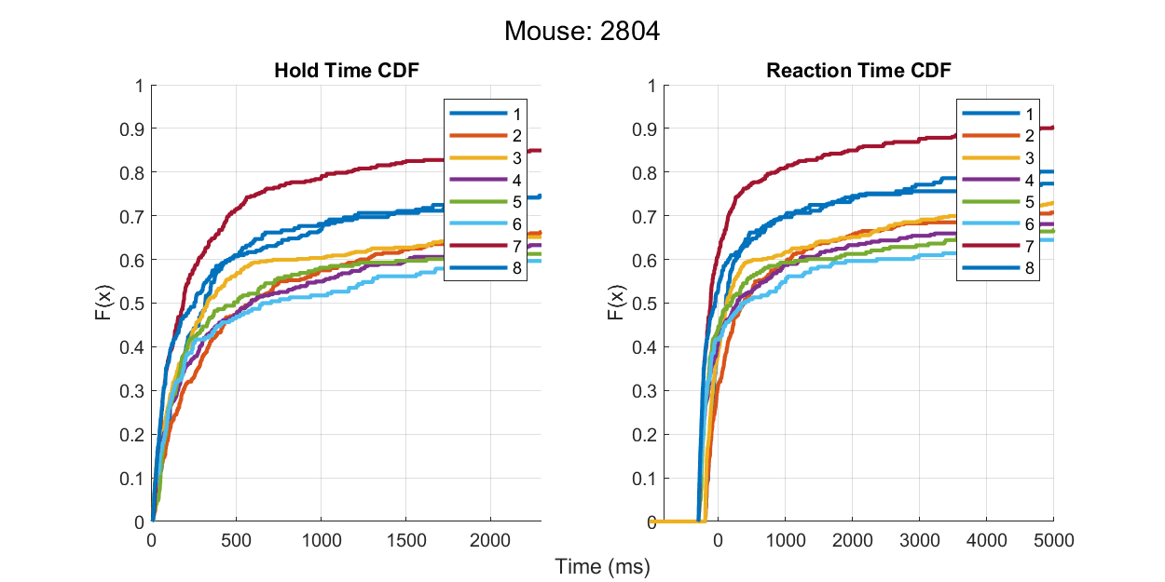
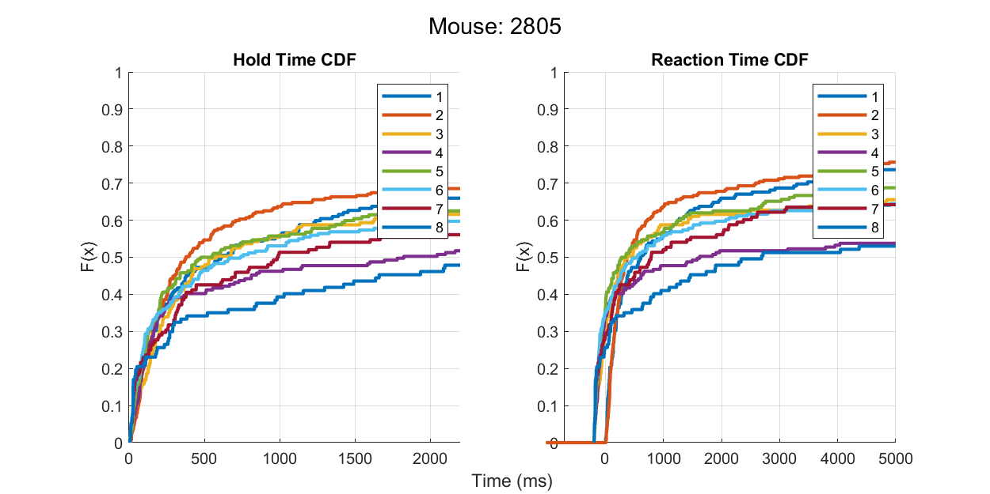
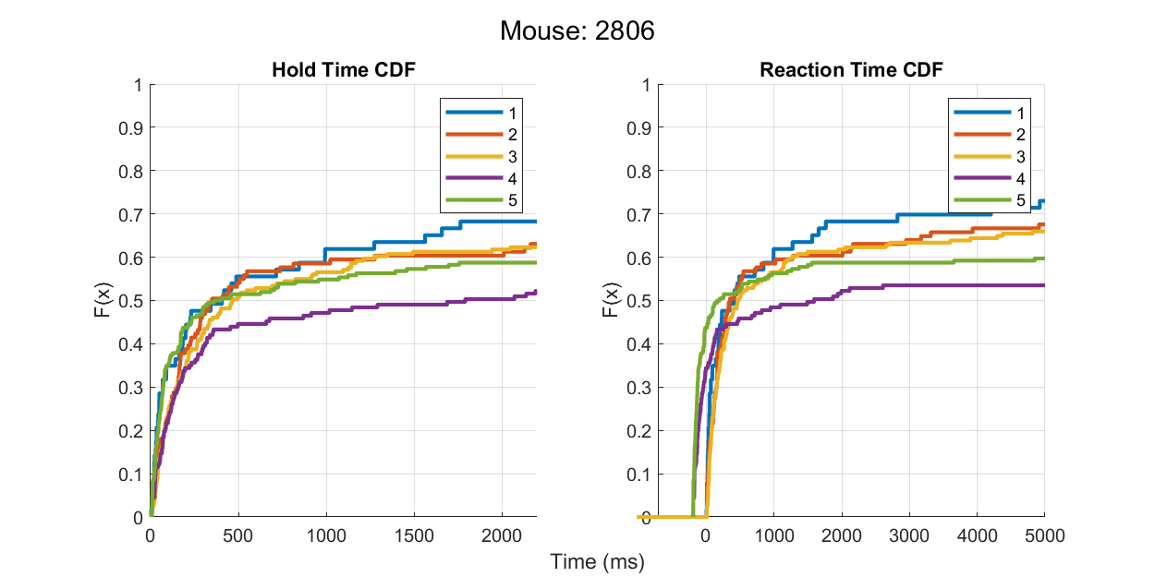
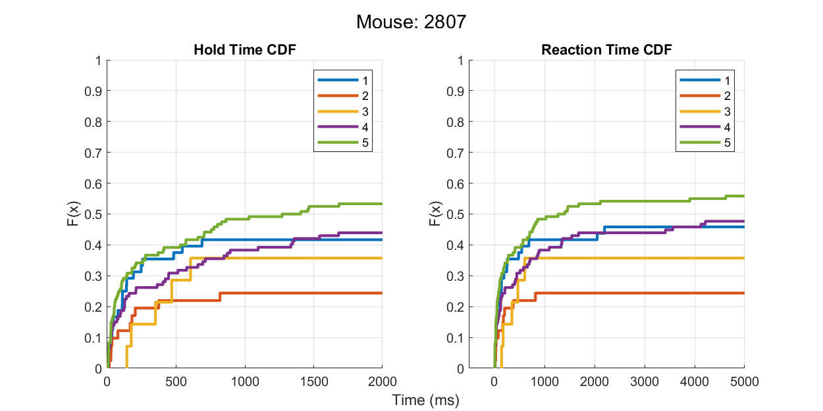
CDF of Hold/React times for each mouse
Mouse 2803
fixedHold=300 for days 1 to 8
Mouse 2804
fixedHold=200 for days 1 to 3
fixedHold=300 for days 4 to 8
Mouse 2805
fixedHold=0 for days 1 to 2
fixedHold=200 for days 3 to 8
Mouse 2806
fixedHold=0 for days 1 to 3
fixedHold=200 for days 4 to 5
Mouse 2807
fixedHold=0 for days 1 to 5

Slide 3
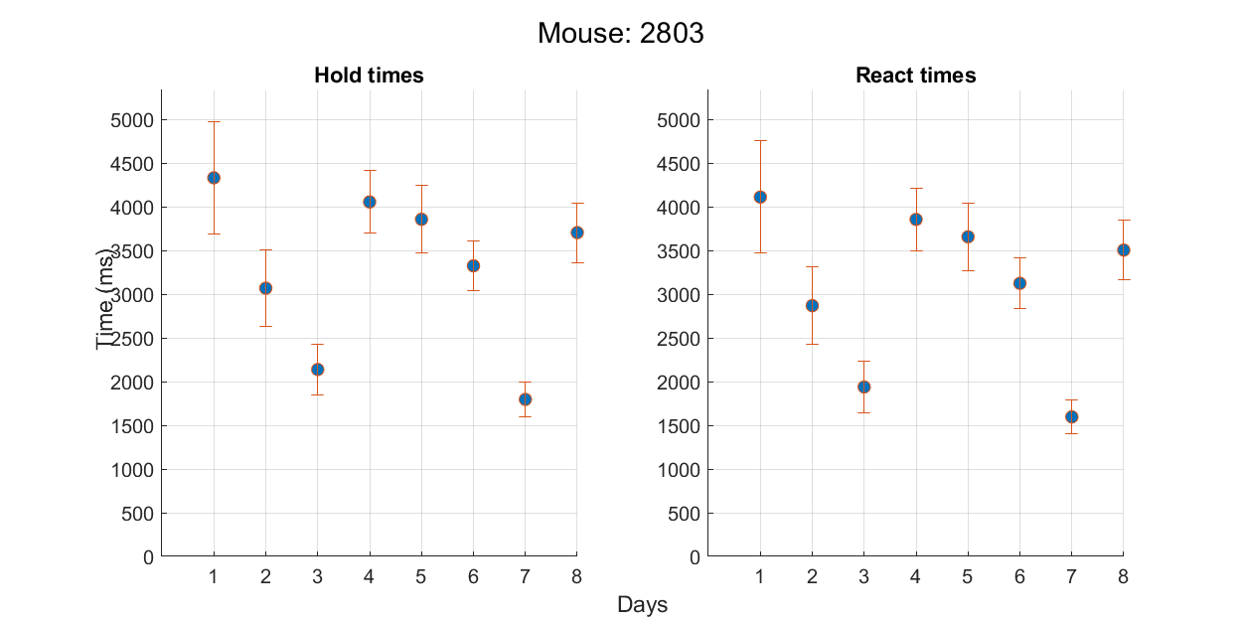
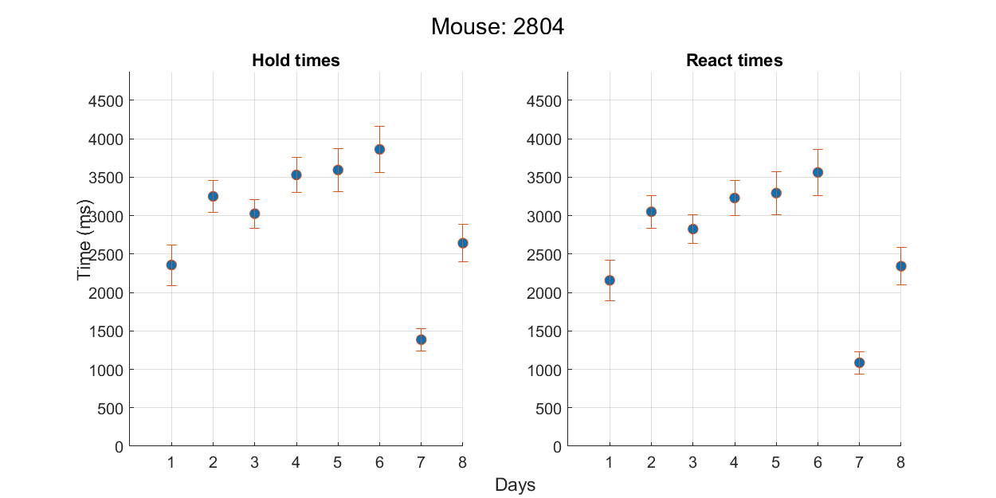
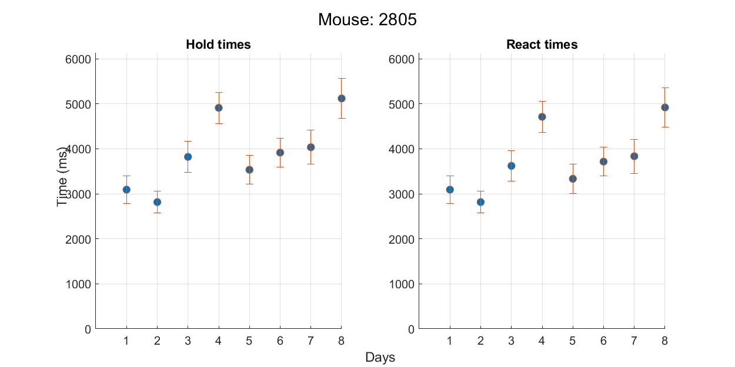
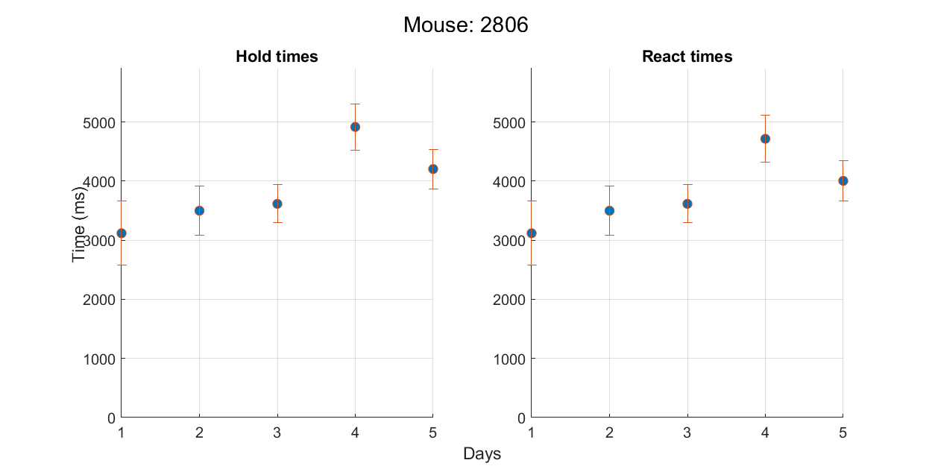
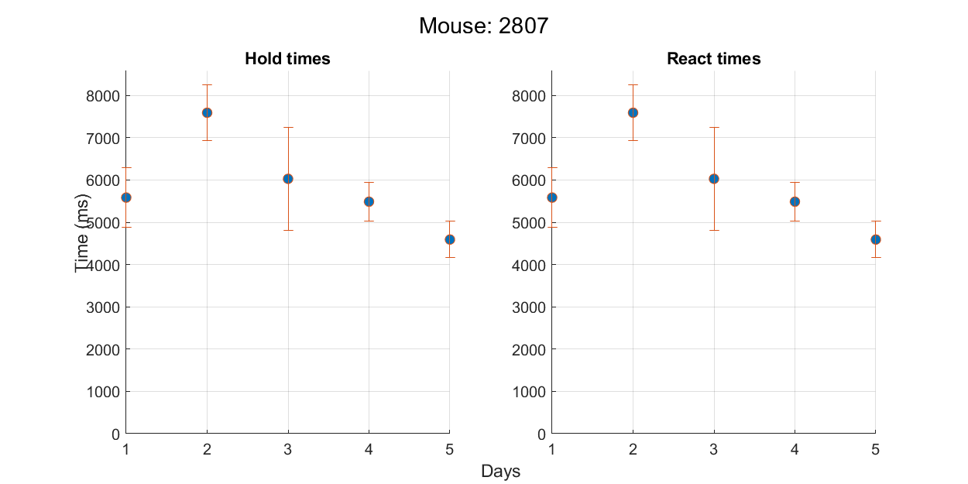
Daily mean (±sem) hold/react times for each mouse
Mouse 2803
fixedHold=300 for days 1 to 8
Mouse 2804
fixedHold=200 for days 1 to 3
fixedHold=300 for days 4 to 8
Mouse 2805
fixedHold=0 for days 1 to 2
fixedHold=200 for days 3 to 8
Mouse 2806
fixedHold=0 for days 1 to 3
fixedHold=200 for days 4 to 5
Mouse 2807
fixedHold=0 for days 1 to 5

Slide 4
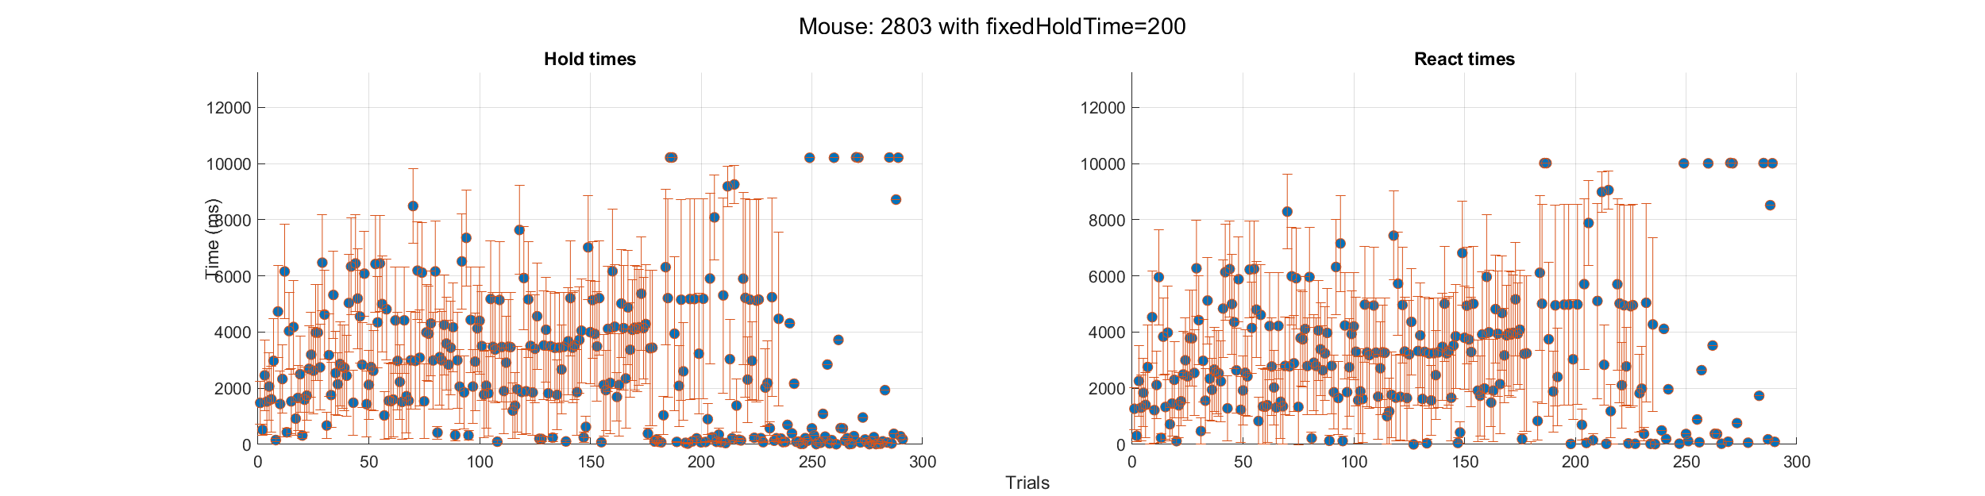
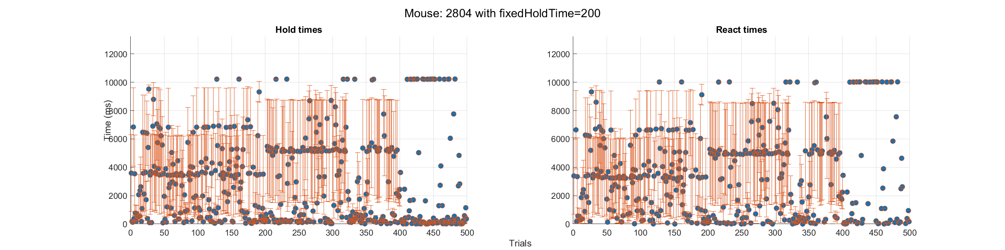
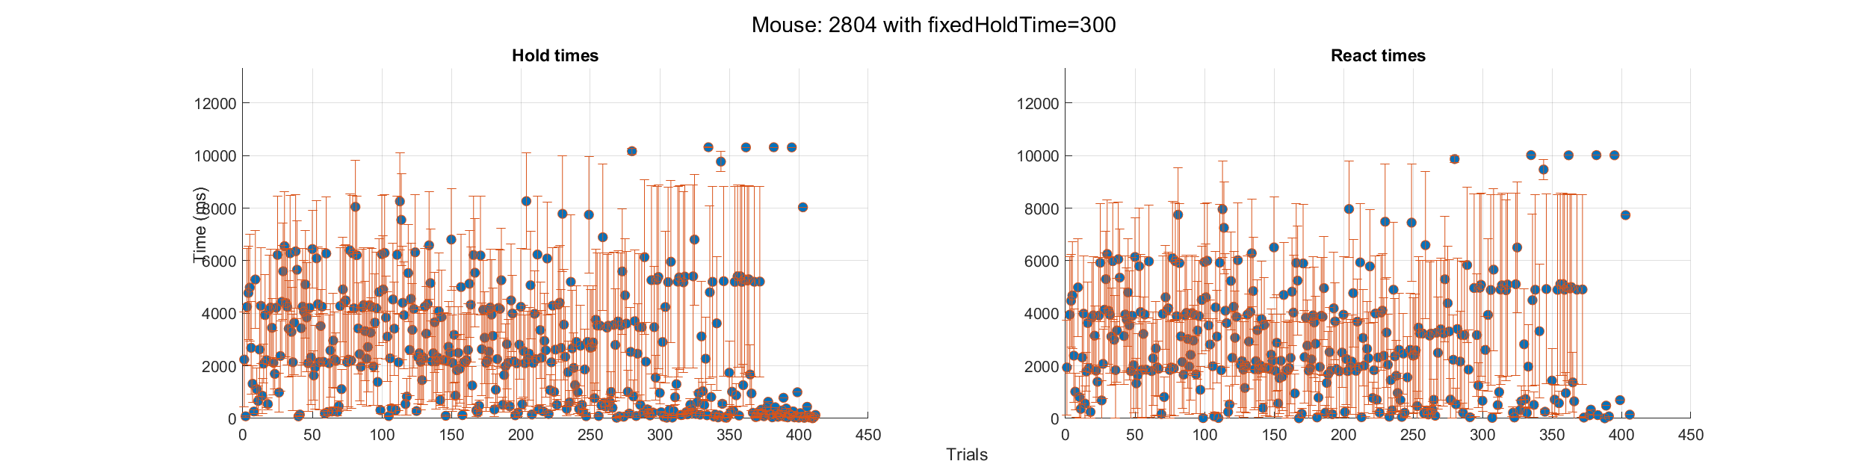
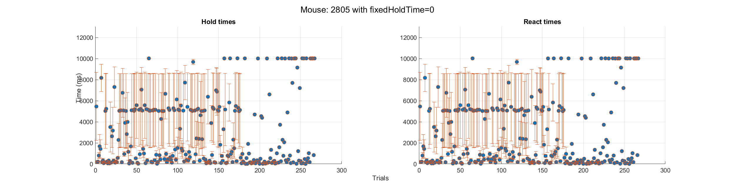
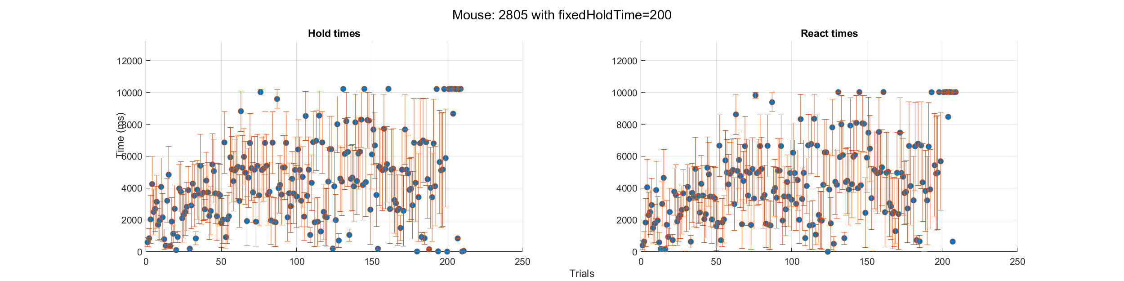
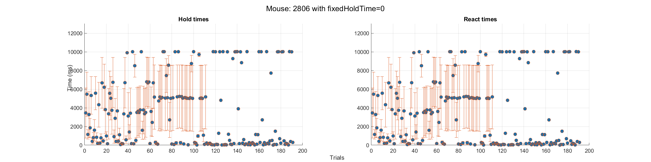
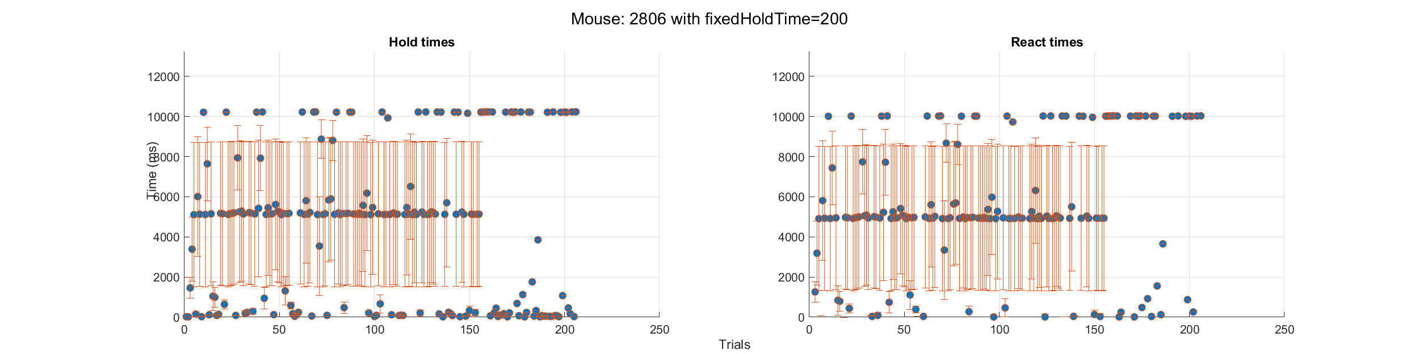
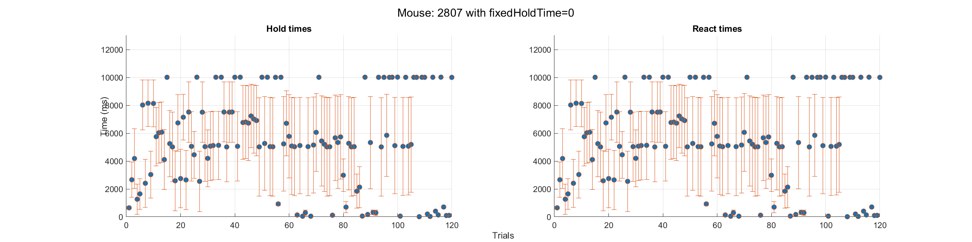
Mean (±sem) hold/react times across sessions

Slide 5
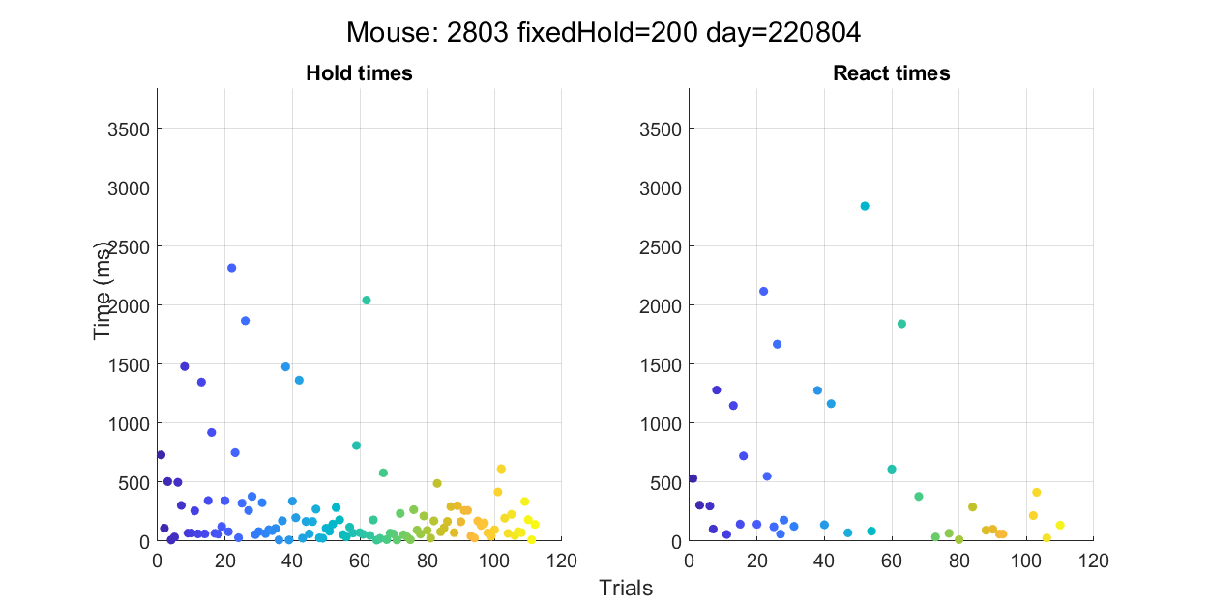
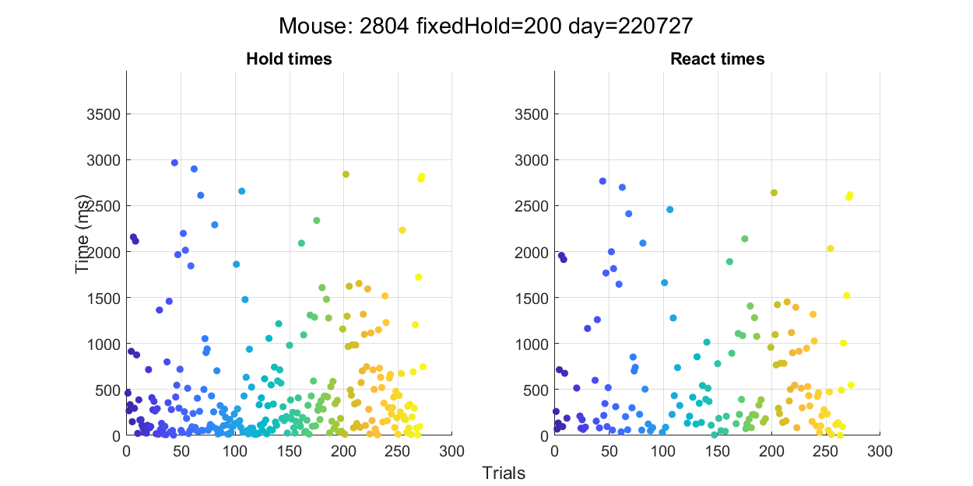
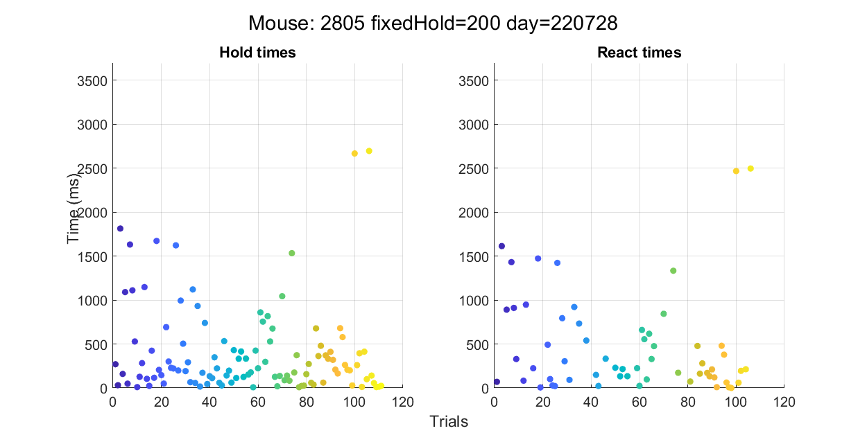
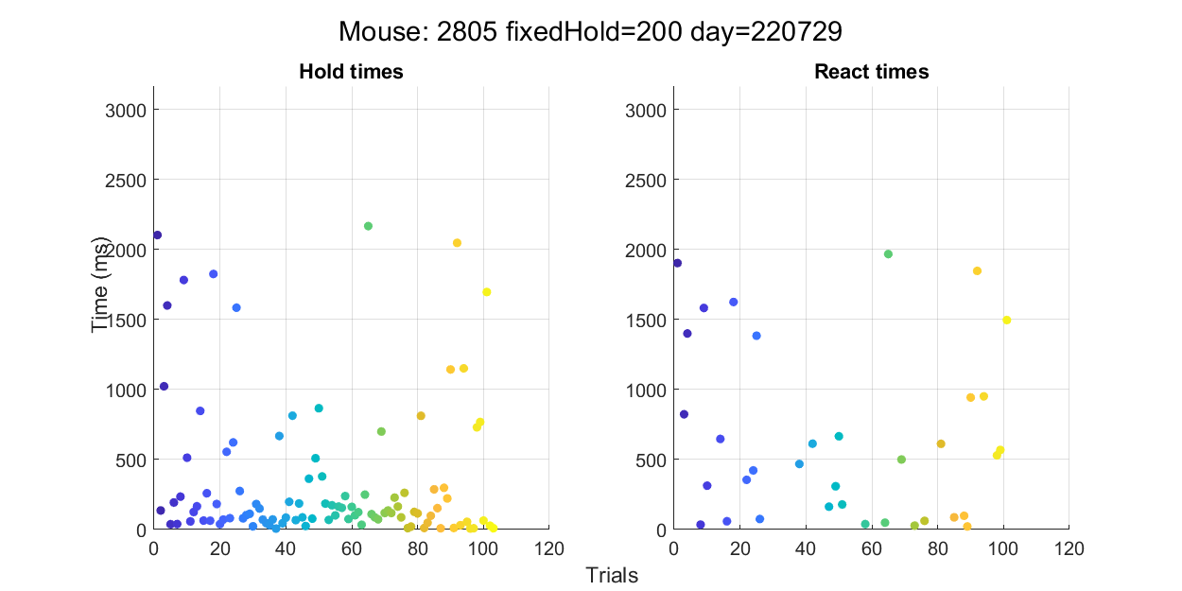
Representative examples of hold/react times for selected days
*Data points >3000 ms are excluded for visual purposes
A representative example:
Hold times started to decrease for the following days!

Slide 6
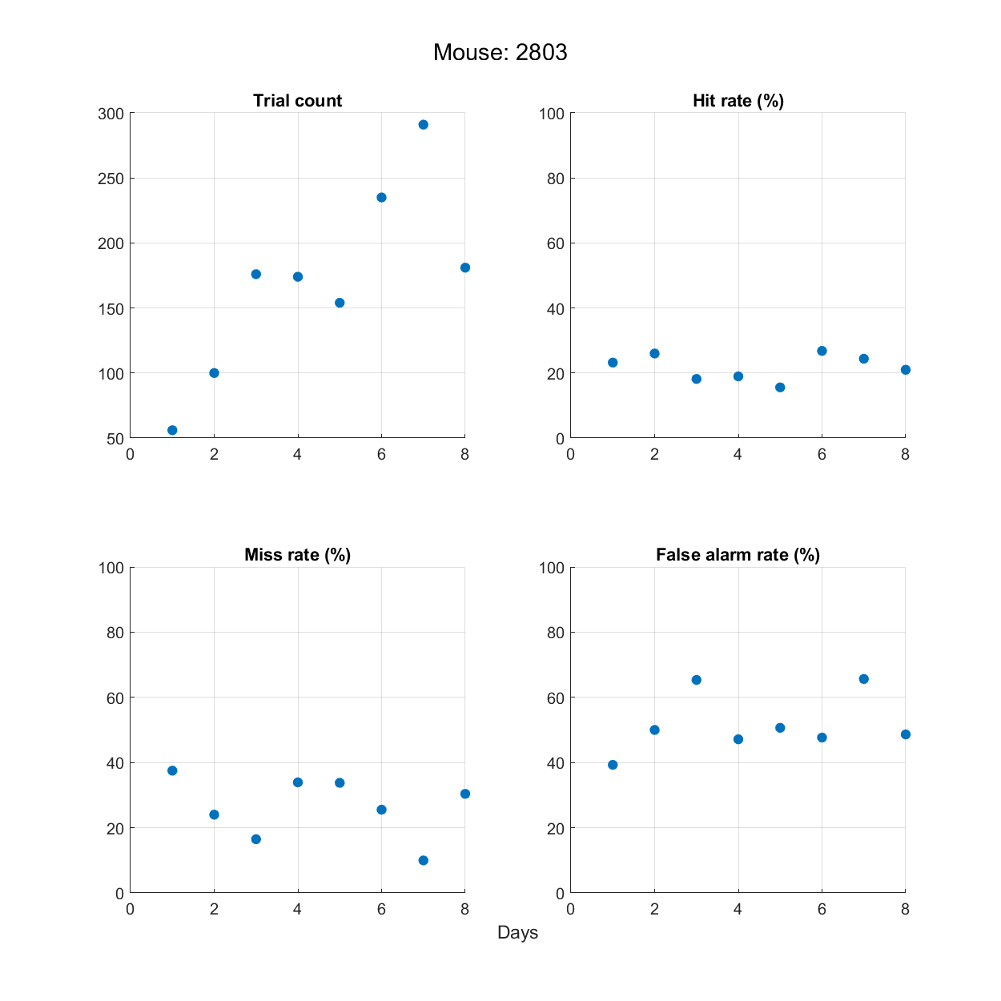
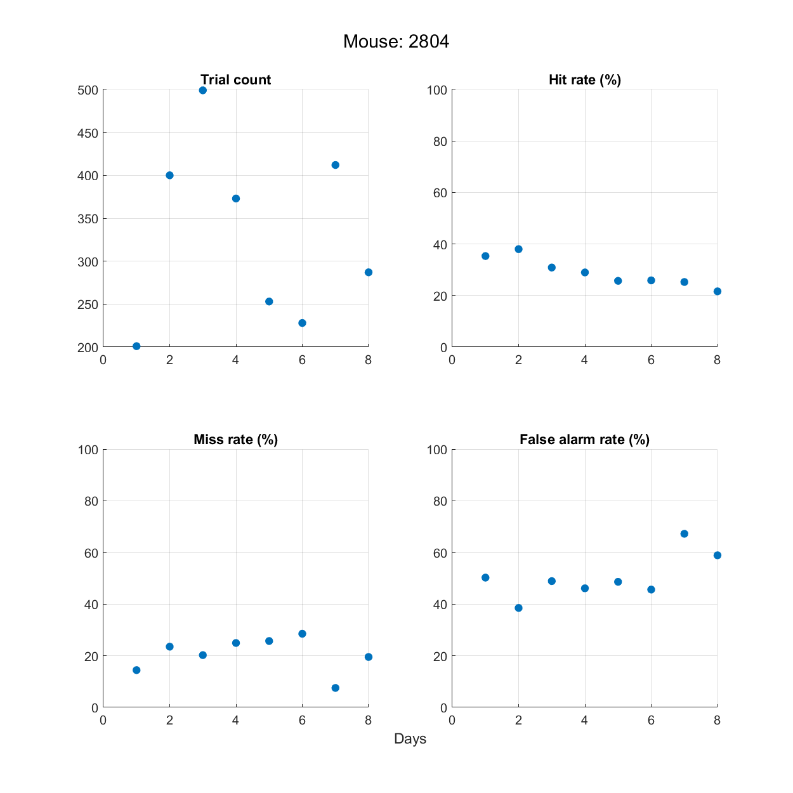
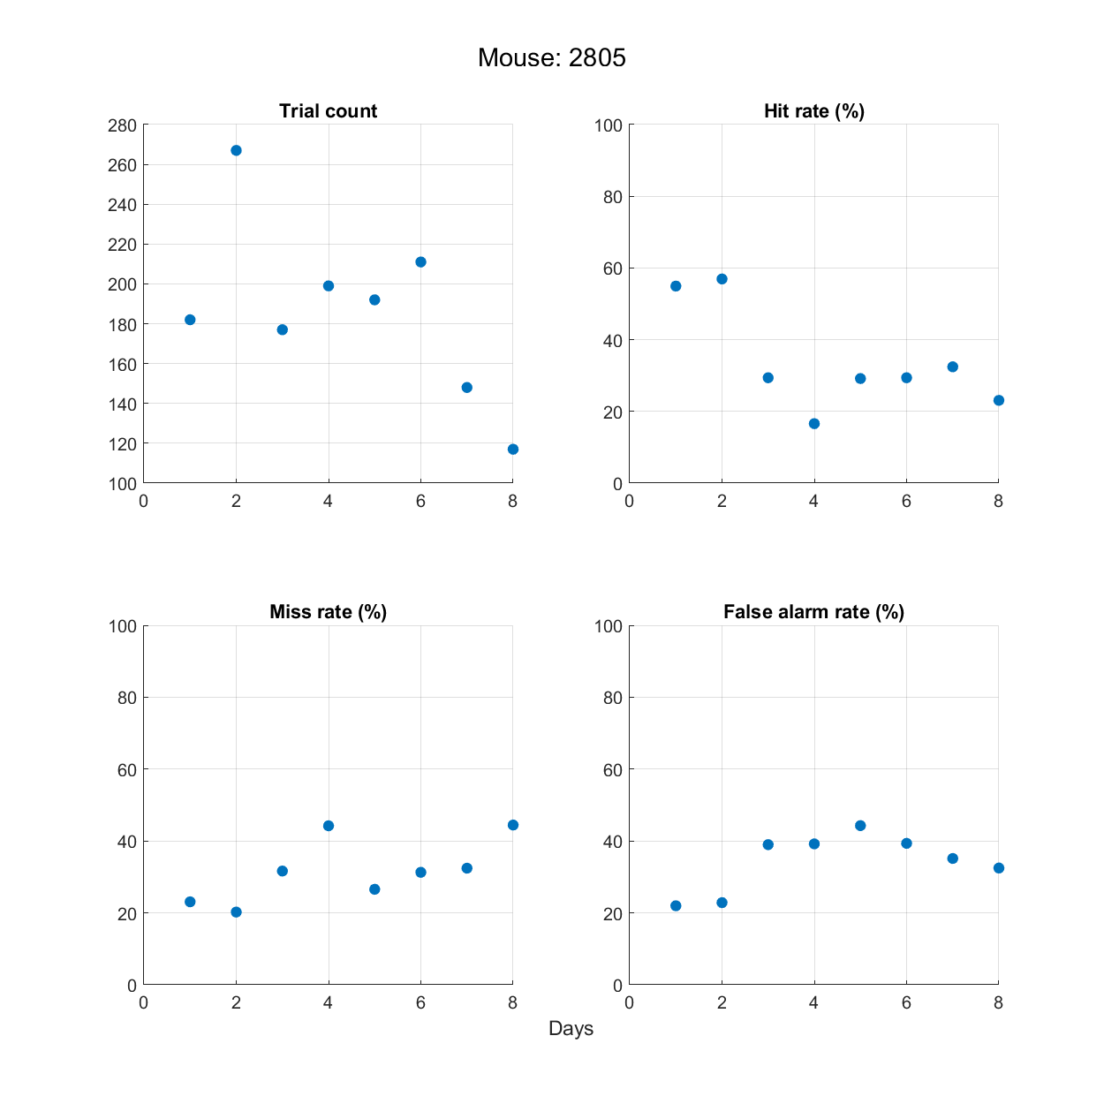
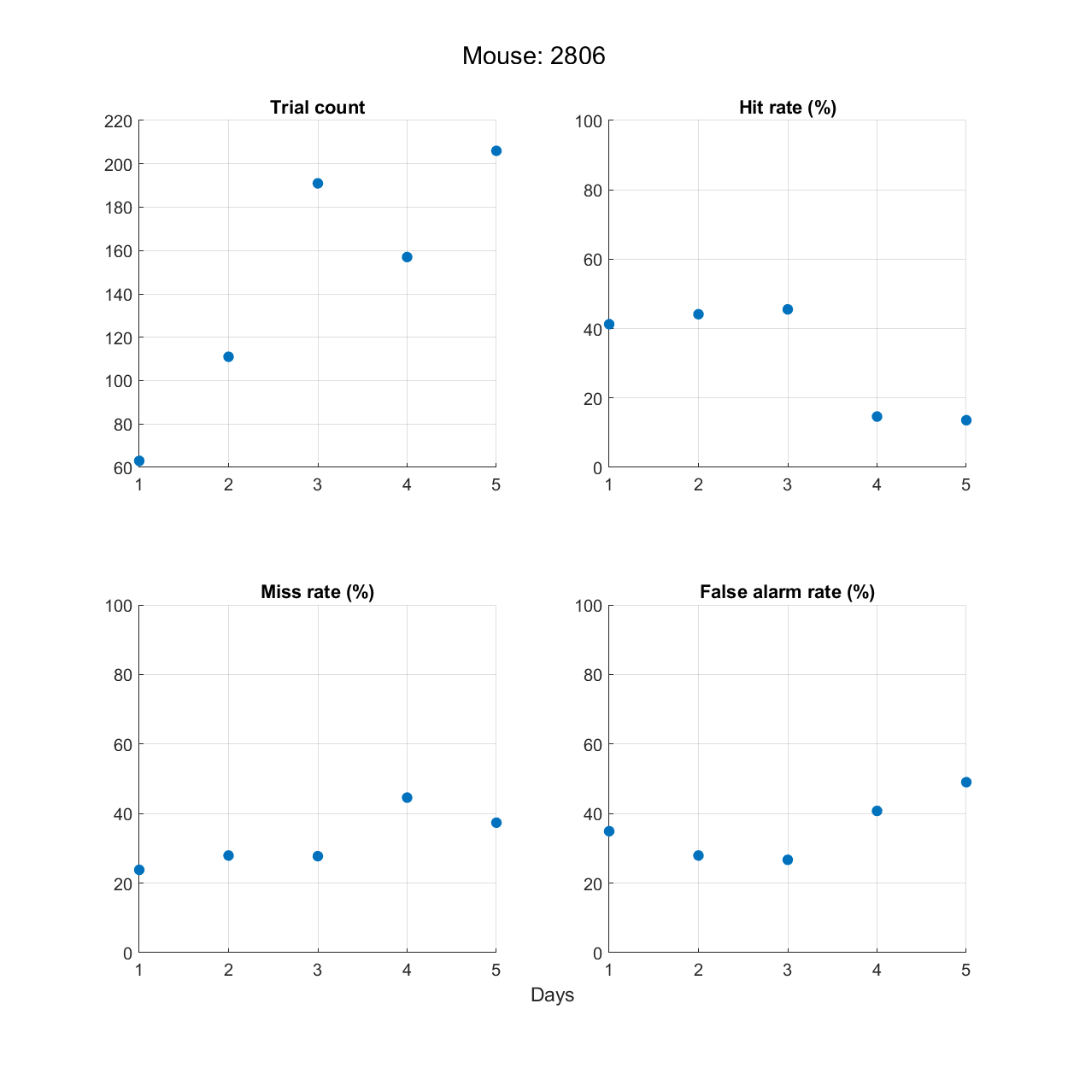
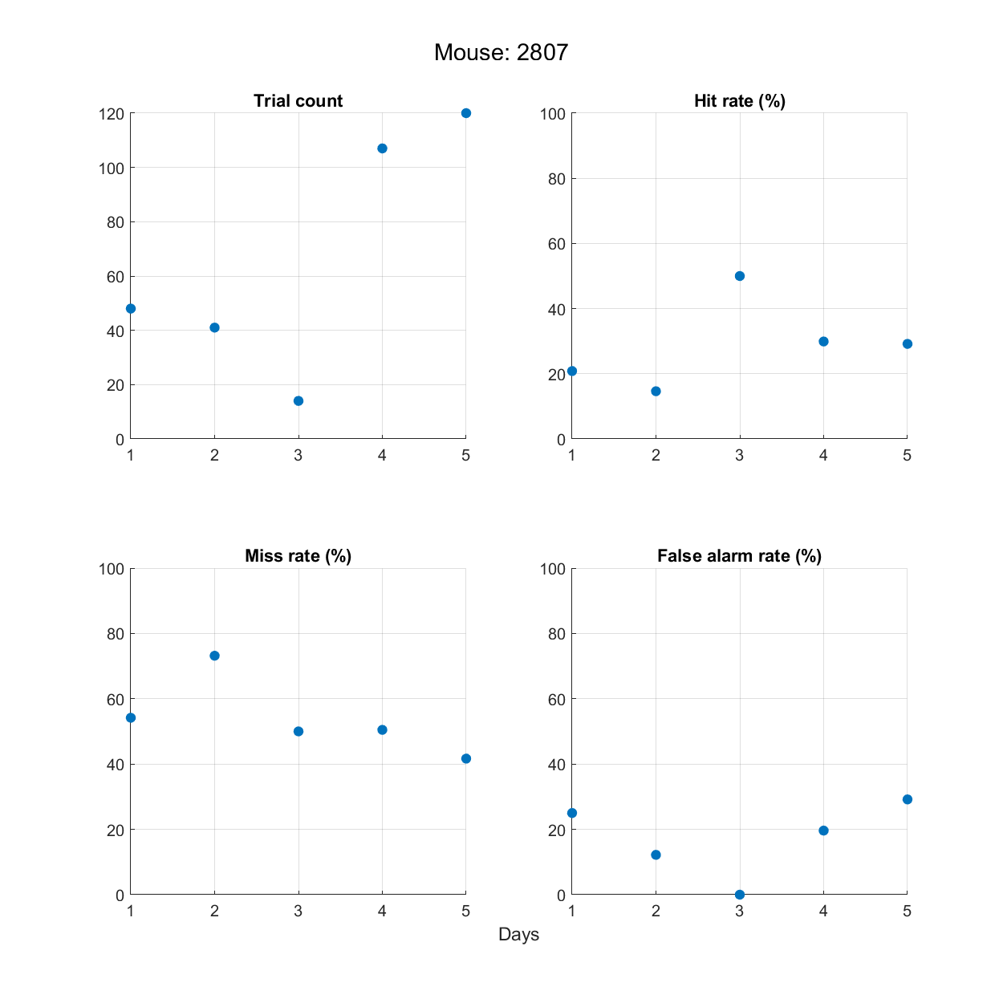
Behavioral performance outcomes during the training days
Mouse 2803
fixedHold=300 for days 1 to 8
Mouse 2804
fixedHold=200 for days 1 to 3
fixedHold=300 for days 4 to 8
Mouse 2805
fixedHold=0 for days 1 to 2
fixedHold=200 for days 3 to 8
Mouse 2806
fixedHold=0 for days 1 to 3
fixedHold=200 for days 4 to 5
Mouse 2807
fixedHold=0 for days 1 to 5

