Slide 1

Stock Price Prediction of a Sports Club Company - Galatasaray
Sevgi TOPRAK CETIN
CSIS-4260 Special Topics in Data Analytics
4/10/2024

Slide 2
Content
Data Information
Data Summary and Visualizations
Data Preparation
Modeling and Results
Conclusion

Slide 3
Data Information
First dataset Galatasaray Stock Prices contains historical data on daily stock prices between 1/1/14 and 3/18/24.
Columns: Date, Open, High, Low, Close, Adj Close and Volume (total: 6)
As Galatasaray is a Sports Club company, and football is the most popular sports in Turkey, Galatasaray’s football matches and results in different Leagues is chosen as second dataset (retrieved from: Galatasaray Match Results ).
Columns: LeagueName, Date, LeagueMatchNo, isHome, GF, GA, GD, PlaceInLeague, PlaceOfOp (total: 9)

Slide 4
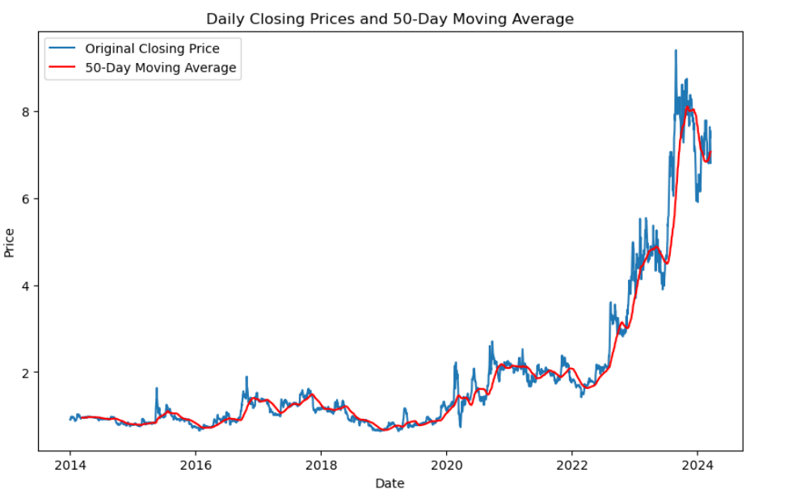
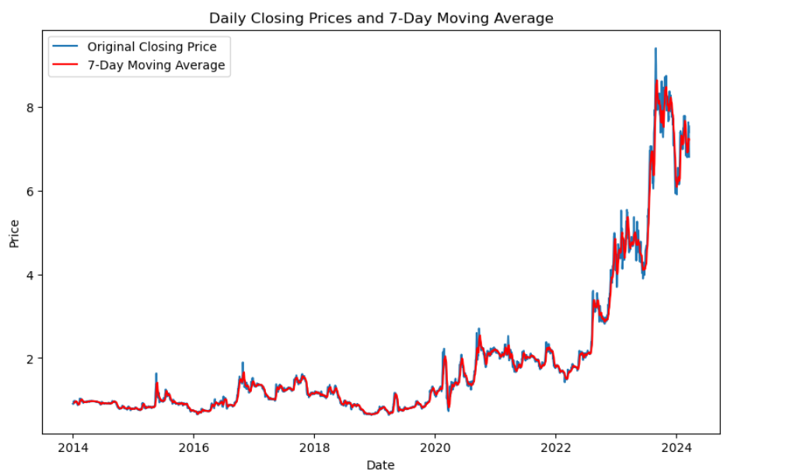
Data Summary and Visualizations
Notes:
the shorter-term moving average responds more quickly to price changes, while the longer-term moving average reflects a smoother trend.

Slide 5
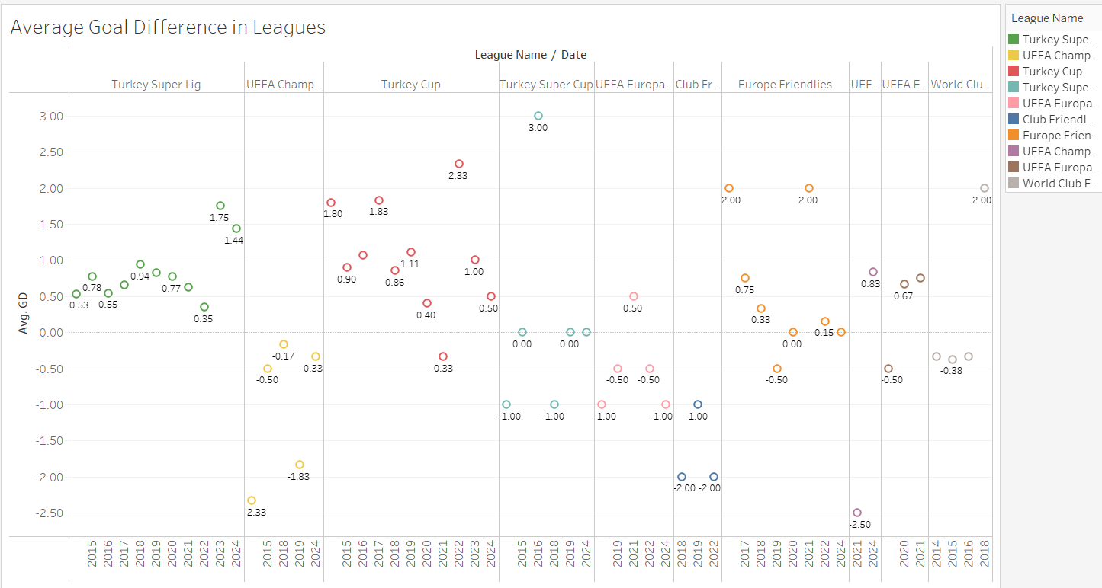
Data Summary and Visualizations

Slide 6
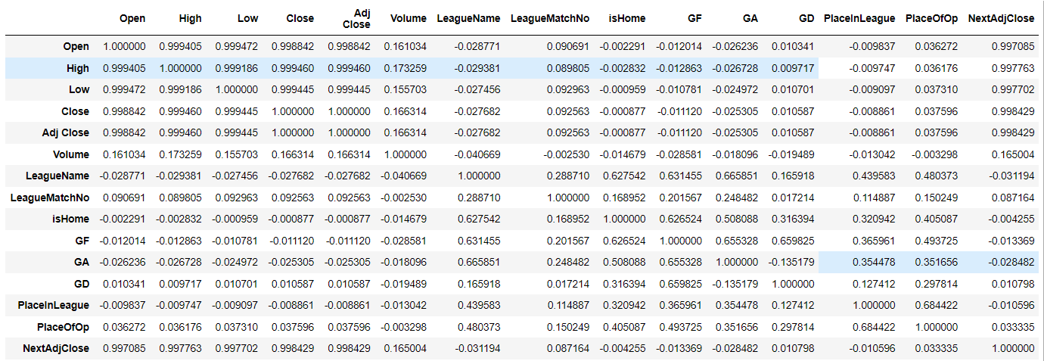
Data Summary and Visualizations

Slide 7
Data Preparation
First dataset was already clean, so there was no need to preprocess it much. Only, I inserted a new column into the dataframe as NextDayAdjClose.
The second dataset was scraped from a bet website. Cleaning and preprocessing in Python was challenging, therefore I used Excel’s functions.
The most important thing was to set Date as index, so that time-series models can be implemented on our dataset.

Slide 8
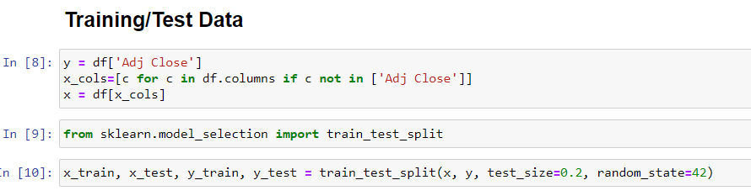
Data Preparation

Slide 9
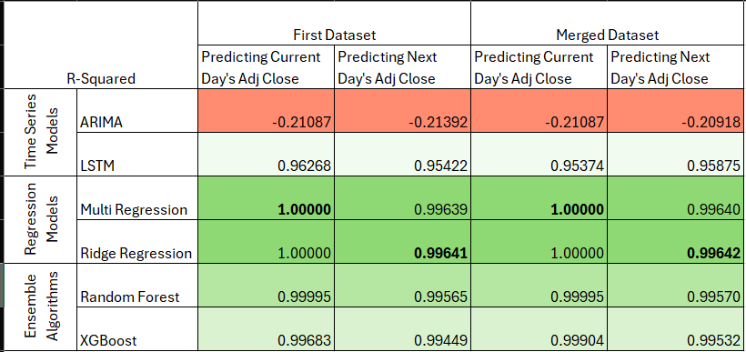
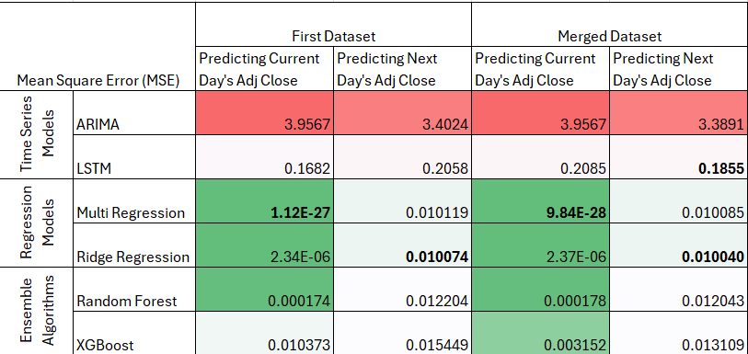
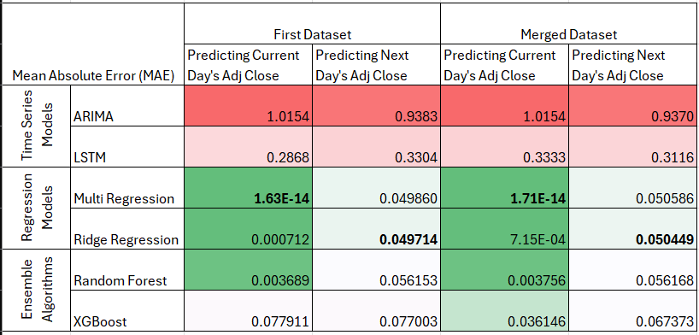
Modeling and Results - ARIMA
Inability to effectively model the complex time series patterns
Inability to capture unexpected events and seasonal effects
Non-stationary behavior dataset

Slide 10
Modeling and Results - LSTM
Capture long-term dependencies
Handle nonlinear relationships
Cope with temporal dynamics
Better at complex time series patterns
Not require manual feature engineering thanks to their automatic feature learning capabilities

Slide 11
Modeling and Results - Regression
Ability to handle the dataset's features more effectively, capturing the underlying linear relationships without the complexity
Due to high correlation between features of first dataset, Linear Regression performed better than Ridge Regression model for the first dataset.
Ridge Regression > slightly better than Linear Regression on merged dataset
Decreased correlation between features?

Slide 12
Modeling and Results – Ensemble Algorithms
Why better than LSTM?
Perform better with limited datasets
More resistant to overfitting
Capture the characteristics of the dataset more effectively
Why Random Forest was better?
More robust to noise and outliers
Capture interactions between various features better and learn complex relationships
Less sensitive to the size of the dataset and can perform well even on smaller datasets

Slide 13
Conclusion
For prediction of current day’s close price value, models perform better on the first dataset.
For prediction of next day’s close price value, models perform slightly better on the merged dataset.
Regression models perform best. While Linear Regression is better at current day’s close price prediction, Ridge Regression is very slightly better at next day’s.
The size, complexity, and correlation between features within a dataset are critical factors influencing model selection and performance.

