Slide 1
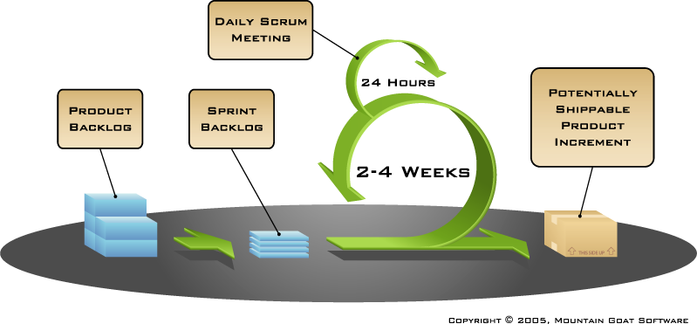
Results CS1 Task 11 – Sprint 1
Presentation group blue
Technik und Informatik / Medizininformatik

Slide 2
Development Phase with Scrum
Task 11

Slide 3
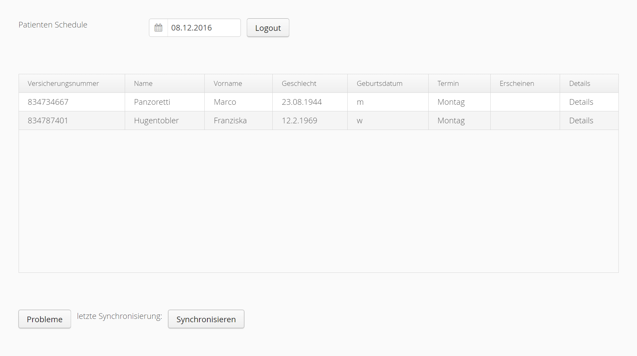
Evaluation, GUI design

Slide 4
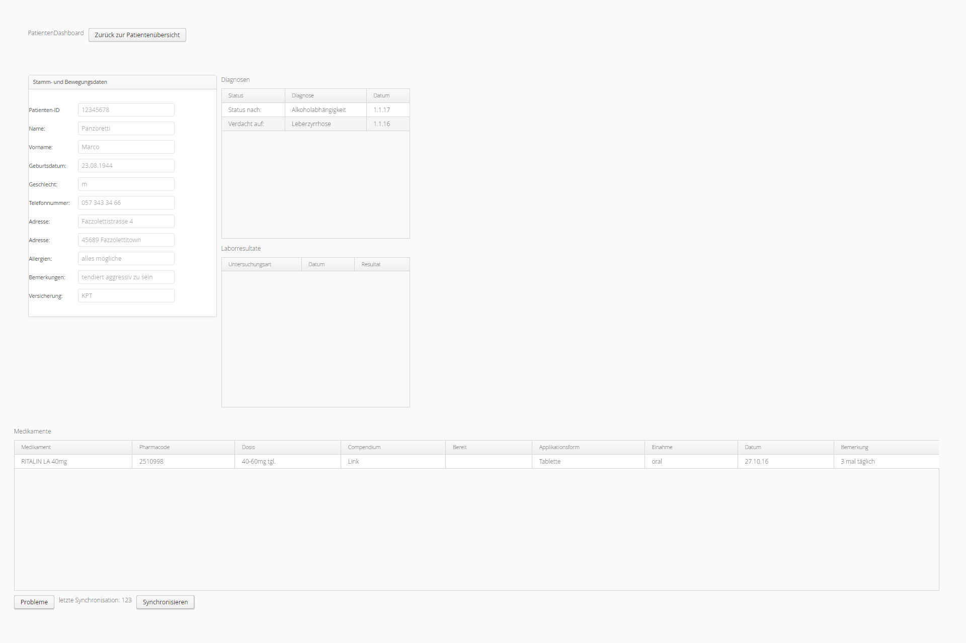

Slide 5
Code Design

Slide 6
Scrum process – Sprint 1
Sprint Review
1.1 | 1 | Database | testdatabase, based on the uml class diagramm, filled with exampledata | Database | lamlr1 | kammf1 | high | 12 | 10 | 8 | completed
1.2 | 1 | Schedule UI | Schedule UI | UI, Controller | telec1 | jolop1 | medium | 12 | 12 | 12 | in progress
1.3 | 1 | Java Classes skeleton | Uml to Java classes | Controller, JPA Classes | sevib1 | varan2 | high | 6 | 8 | 8 | completed
1.4 | 1 | Associations | Implementing Associations | Controller, JPA Classes | kammf1 | jolop1 | high | 6 | 6 | 4 | in progress
1.5 | 1 | Getter methods | JPA - getting methods | JPA Classes, Database | varan2 | dittp2 | low | 6 | 8 | 0 | deferred
Updated effort plan from 42h to 44h
JPA – getter methods: deferred

Slide 7
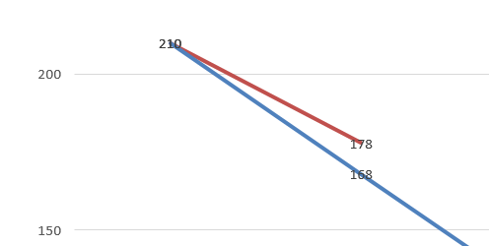
Scrum process – Sprint 1
Burndown chart
Remaining Effort: 178
Remaining Resources: 168

Slide 8
Scrum process – Sprint 2 Planning
Sprint 2 – Scrum Session
2 weeks – a total of 84 working hours
2.1 | 2 | Getter methods | JPA - getting methods | JPA Classes, Database | varan2 | dittp2 | high | 8 |  |  | not started
2.2 | 2 | Patient display | Shows in patient overview information about patient | Database, JPA, Controller,UI | dittp2 | varan2 | high | 12 |  |  | not started
2.3 | 2 | Medication display | Shows in medication overview information about medication | Database, JPA, Controller,UI | lamlr1 | jolop1 | high | 12 |  |  | not started
2.4 | 2 | Disgnosis display | Shows in disgnosis overview information about disgnosis | Database, JPA, Controller,UI | jolop1 | telec1 | medium | 12 |  |  | not started
2.5 | 2 | laboraty display | Shows in laboraty overview information about laboraty | Database, JPA, Controller,UI | kammf1 | dittp2 | medium | 12 |  |  | not started
2.6 | 2 | schedule view | Shows in schedule overview information about schedule | Database, JPA, Controller,UI | sevib1 | lamlr1 | high | 24 |  |  | in progress
4 additional hours for Effort Plan Updated
Experience from sprint 1

Slide 9
Danke für Ihre Aufmerksamkeit

