Slide 1
🚨 NLP CLASSIFICATION PROJECT
Disaster Tweet Classifier
Can a machine tell the difference between a real emergency and dramatic figurative language on Twitter?
STUDENT
PROGRAMME
DATE
Sevil Kücük
MSIT
February 27, 2026
📂 Load Data
🔍 EDA
🧹 Preprocess
🔢 TF-IDF
🤖 Train
📊 Evaluate
🎯 Tune
Notes:
Good morning. Today I'll walk you through my NLP project — a binary classifier that detects whether a tweet describes a real disaster or not. This project was completed for my MSIT programme using a labelled dataset from Kaggle. The pipeline covers everything from raw tweet cleaning through to hyperparameter-tuned machine learning models.

Slide 2
🚨 THE PROBLEM
Why Does This Matter?
Twitter is often the first platform where people report emergencies. But not every alarming tweet describes a real disaster:
🚒 Emergency Services
Agencies monitor social media for real-time disaster signals. Missed disasters cost lives.
🚨 REAL DISASTER
"Flash flood warning issued for downtown — evacuate immediately #flood"
📡 Media Monitoring
✅ NOT A DISASTER
News organisations need automated systems to filter genuine reports from casual language at scale.
"This spicy ramen is absolutely destroying me 💀🔥"
✅ NOT A DISASTER
"I'm literally dying of boredom in this lecture 😭"
🧠 The NLP Challenge
Figurative language — "I'm dying", "on fire" — makes this a genuinely hard classification problem.
Notes:
Let´s discuss first, why does this problem matter? Twitter is often the first place people report emergencies. Emergency services, news agencies, and disaster-relief organisations increasingly use social media monitoring to detect crises in real time. However, people also use disaster-related words figuratively all the time such as— 'I'm dying of boredom', 'this food is on fire'. A naive keyword search would generate enormous noise. Our goal is to teach a machine to distinguish real emergency reports from casual language.

Slide 3
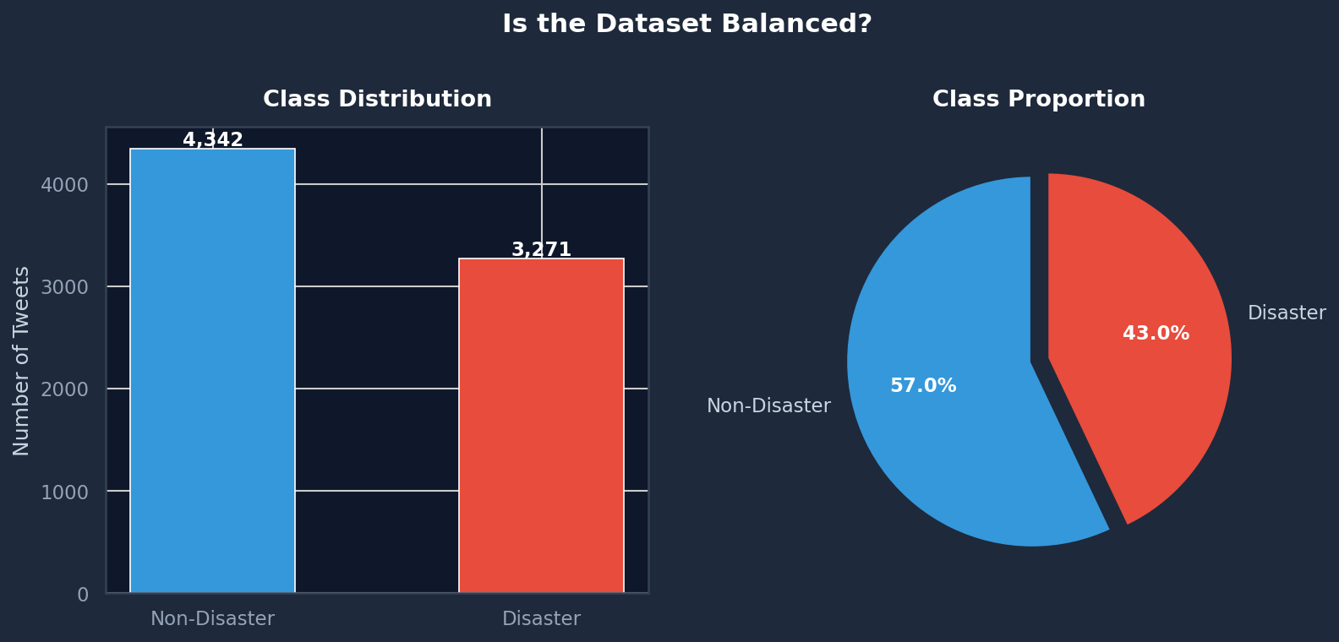
THE DATASET
Dataset Overview
7,613
2
4,342
3,271
Total Tweets
Classes (0 / 1)
Non-Disaster (57%)
Disaster (43%)
Fig 1. Class distribution — bar chart and pie chart
Notes:
Our dataset comes from the NLP Getting Started competition on Kaggle. It contains 7,613 labelled tweets — each marked as either disaster (1) or not (0). Looking at the class distribution charts, we have 4,342 non-disaster and 3,271 disaster tweets — it's a 57/43 split. This mild imbalance is important: a model that labels everything as non-disaster would get 57% accuracy without learning anything useful. This is why I use F1-score as my primary evaluation metric rather than raw accuracy.

Slide 4
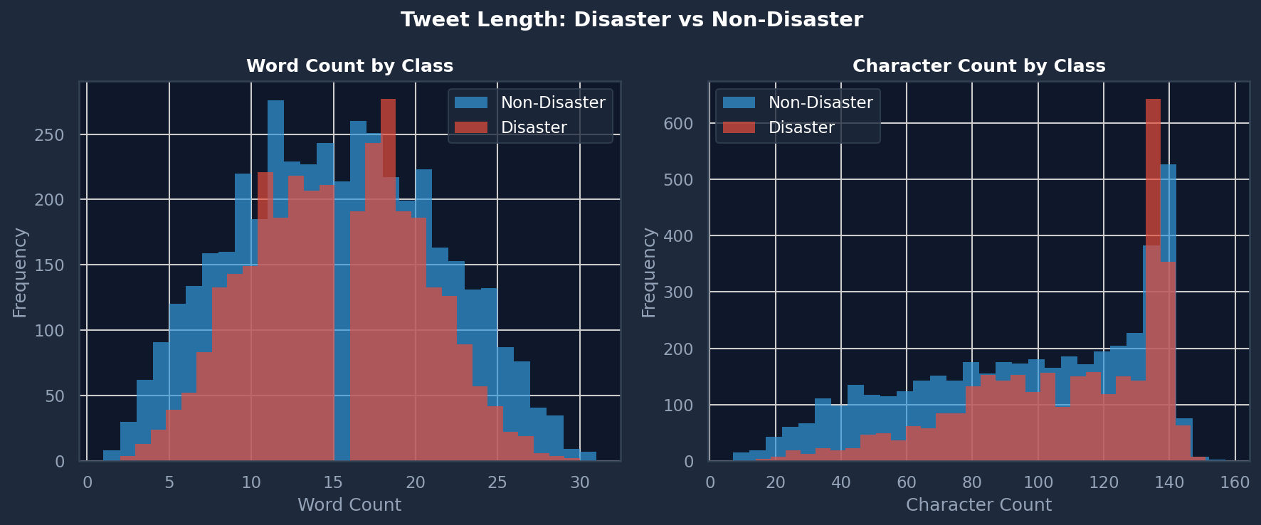
EDA — EXPLORATORY ANALYSIS
Tweet Length Analysis
📏 Key Finding
Disaster tweets are slightly longer on average — real reports include locations, casualty figures, and event details.
⚠️ Limitation
Distributions overlap heavily. Tweet length alone is NOT a reliable predictor — a length-only model would perform near random.
📐 Implication
We need word-level TF-IDF features rather than simple length metrics to distinguish the two classes.
Fig 2. Word count and character count distribution by class
Notes:
Before building any model, I explored the data to understand its properties. Looking at tweet length — disaster tweets tend to be slightly longer on average. Real disaster reports include specific details: locations, casualty figures, event names. However, the distributions overlap significantly. You can see from both the word count and character count histograms that length alone cannot distinguish the classes — we need word-level features.

Slide 5
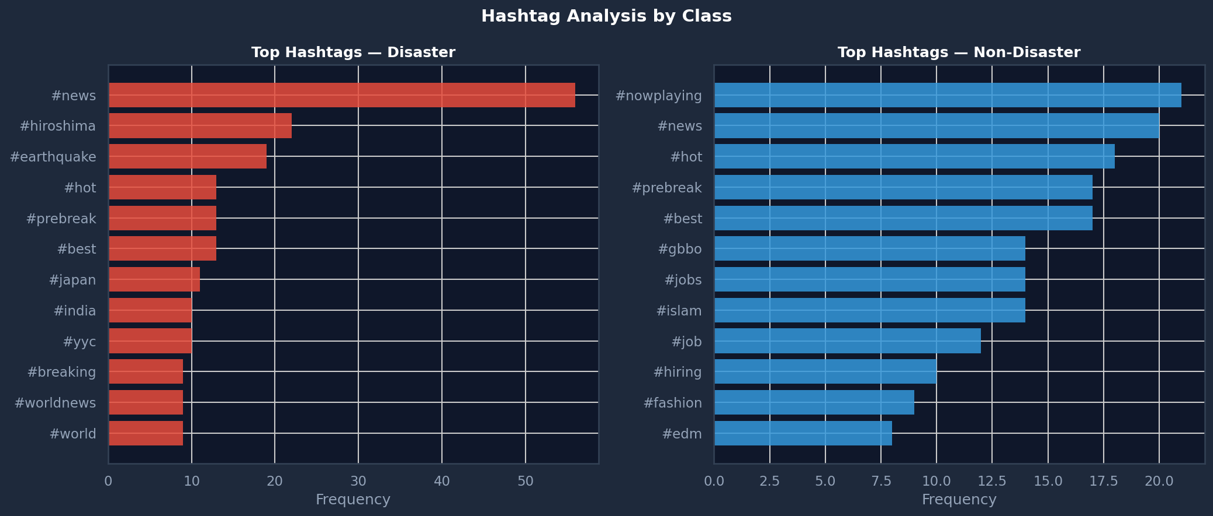
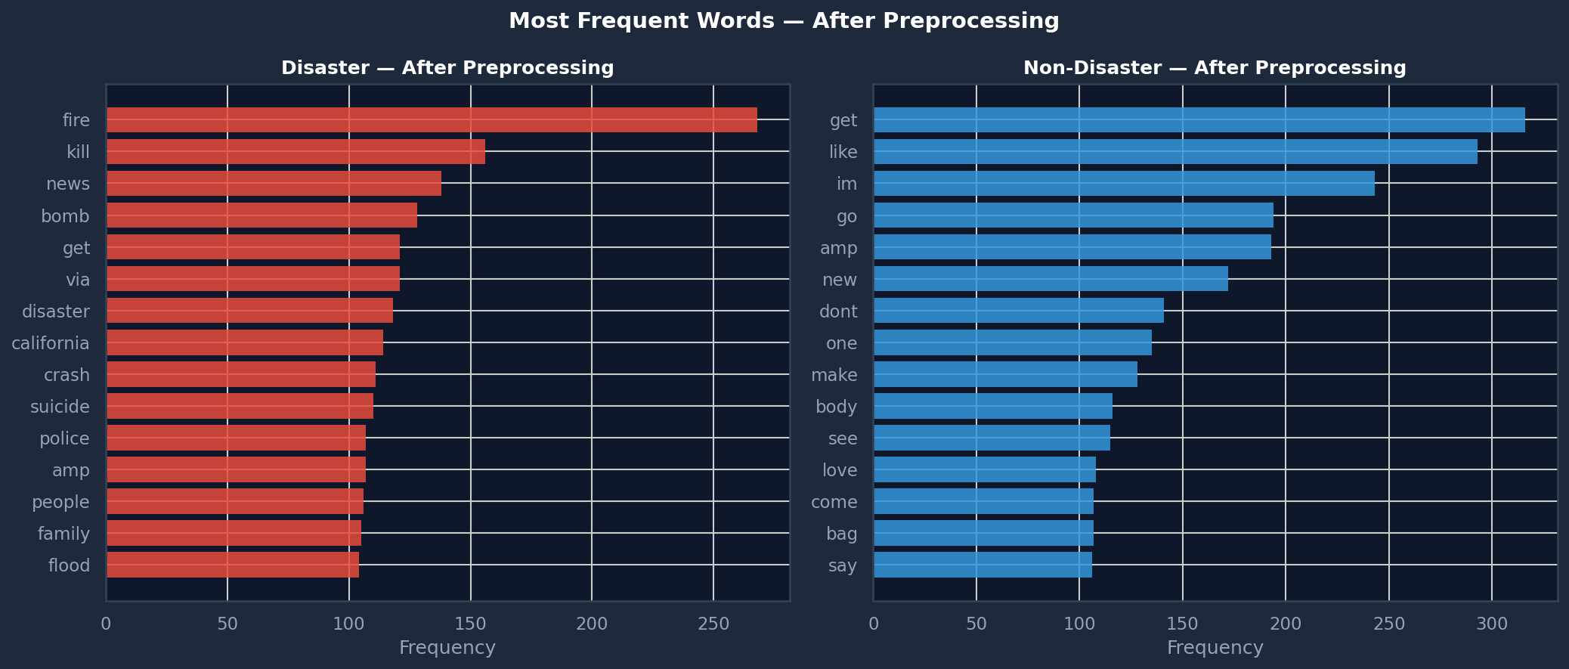
EDA — WORD & HASHTAG PATTERNS
Word Frequency & Hashtag Analysis
Fig 3. Top hashtags by class
Fig 4. Most frequent words after preprocessing
🔑 Key insight: Disaster tweets cluster around domain-specific hashtags (#wildfire, #flood, #earthquake). Non-disaster tweets use scattered, unrelated hashtags. This vocabulary gap is the primary signal our model exploits.
Notes:
These two plots show word frequency and hashtag analysis after preprocessing. The hashtag plot is particularly telling — disaster tweets cluster tightly around domain-specific hashtags: such as wildfire, flood, earthquake, breaking, disaster. Non-disaster tweets show scattered, unrelated hashtags. The word frequency chart shows the same separation — disaster vocabulary is specific and consistent. This vocabulary gap is the primary signal our model will learn to exploit.

Slide 6
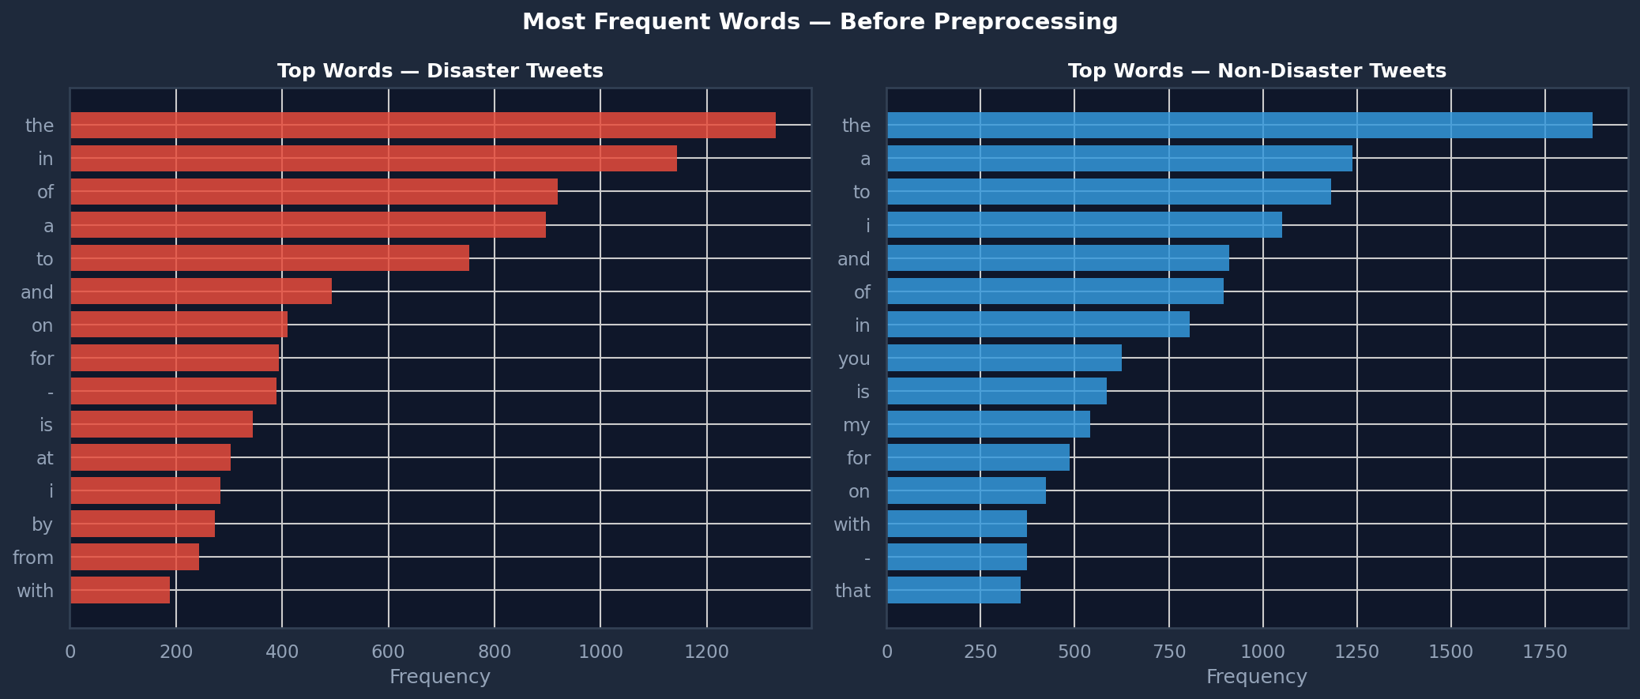
TEXT PREPROCESSING
Cleaning the Text — 6-Step Pipeline
1
Remove URLs & @mentions
http://t.co/… and @username carry no topic signal
2
Strip # symbol, keep word
#wildfire → wildfire
3
Lowercase + remove punctuation
Fire = fire; reduce vocabulary noise
4
Tokenise
Split sentence into individual word tokens
5
Remove NLTK stopwords
"the", "is", "a" appear everywhere — zero discriminative signal
6
POS-aware Lemmatisation
fires→fire, burning→burn, ran→run (context-aware)
Before: "BREAKING: 13,000 flee #wildfire https://t.co/x @CNN!"
After: "flee wildfire"
Fig 5. Before preprocessing: stopwords dominate both classes
💡 Why Lemmatisation over Stemming? Stemming: easily → easili (not a word) Lemmatisation: fires → fire | better → good
Notes:
Tweets are extremely noisy text — URLs, @mentions, emoji, informal spelling, hashtag symbols. I applied a 6-step preprocessing pipeline. The key decision here is using POS(Part Of Speech)-aware lemmatisation over stemming. Stemming is fast but crude — it cuts word endings using rules and can produce non-words like 'easili'. Lemmatisation uses vocabulary knowledge to return real dictionary words: fires becomes fire, running becomes run. With POS (Part Of Speech) context — knowing whether a word is a noun, verb, or adjective — the results are more accurate. The before/after comparison shows how dramatically the text simplifies.

Slide 7
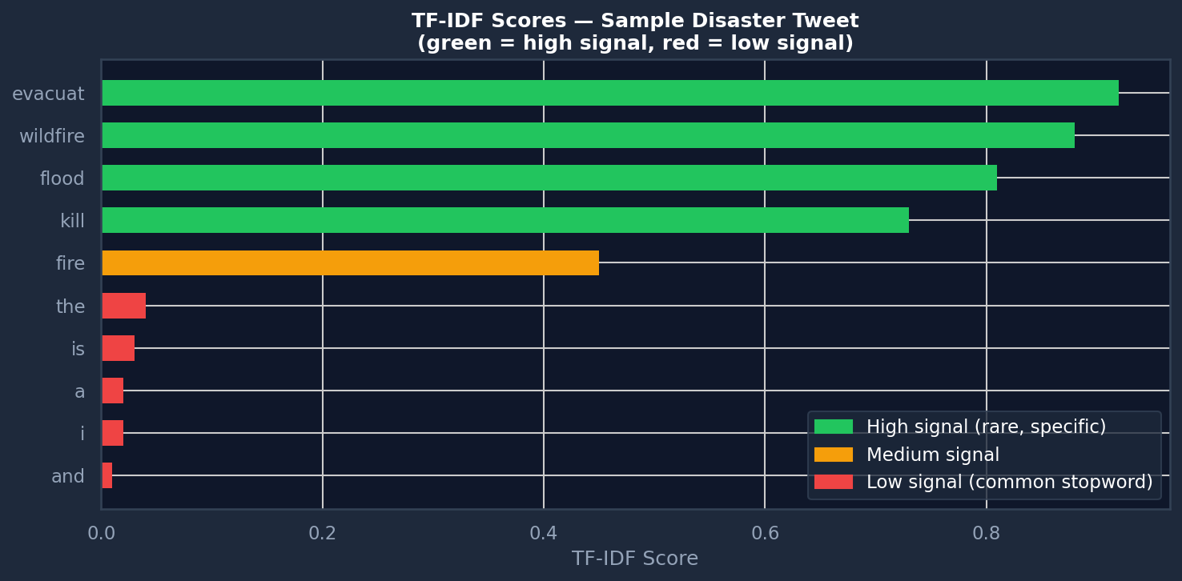
FEATURE EXTRACTION
From Words to Numbers: TF-IDF
TF-IDF Formula
score = TF(t,d) × log(N / df(t)) Words frequent in one tweet but rare across all tweets get a high score. "evacuate" in 5 tweets → HIGH. "fire" in 500 tweets → LOW.
Bigrams: Capturing Phrases
ngram_range=(1,2) adds two-word features. "flash flood", "not safe", "search rescue" are captured as meaningful units rather than two unrelated words.
Data Leakage Prevention
sklearn Pipeline fits TF-IDF only on training data. Fitting on the full dataset before splitting means the model has secretly seen test examples — invalid evaluation.
Fig 6. TF-IDF scores — specific words score high; stopwords near zero
Notes:
Machine learning models need numbers, not text. I used TF-IDF — Term Frequency Inverse Document Frequency. The key insight is in the IDF term: it down-weights words that appear in almost every tweet. The word 'fire' appears hundreds of times across the corpus — low TF-IDF score. The word 'evacuate' appears in only a handful of tweets — high score. This makes rare but specific words the dominant features. I also use bigrams — two-word phrases — so 'flash flood' and 'not safe' are captured as meaningful units.

Slide 8
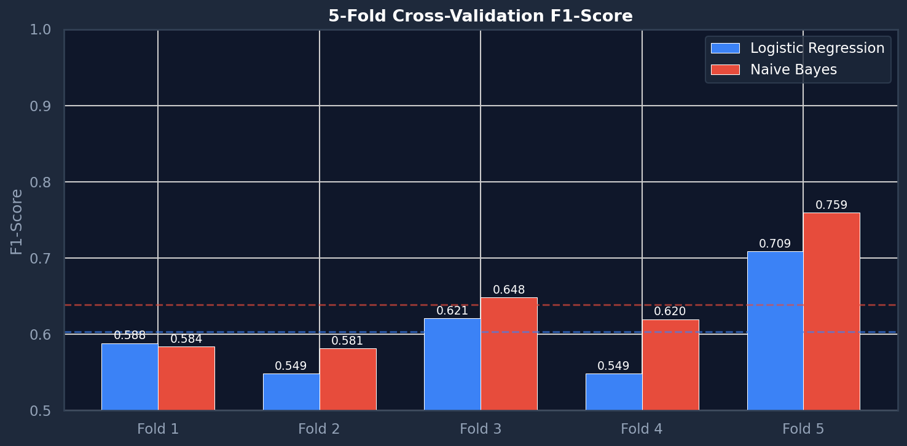
MODEL TRAINING
Model Selection & Cross-Validation
✦ Logistic Regression (primary model)
Strong, interpretable baseline for binary text classification. Learns a weight per TF-IDF feature — which words push the prediction toward "disaster"? Fast to train, easy to interpret.
Multinomial Naive Bayes (comparison)
Classic probabilistic NLP model. Assumes all words are independent — but "flash flood" is meaningful as a pair. This independence assumption hurts NB versus LR.
Fig 7. 5-fold CV F1-scores — both models stable across folds
Notes:
I trained two models: Logistic Regression with TF-IDF, and Multinomial Naive Bayes with a bag-of-words count vectoriser. Both are wrapped in a sklearn Pipeline, which is critical — it ensures the vectoriser is fit only on training data, preventing data leakage. The cross-validation chart shows F1-scores across 5 folds. Notice how stable both models are — the small variation between folds tells us our models generalise consistently and don't depend heavily on which specific tweets ended up in training.

Slide 9
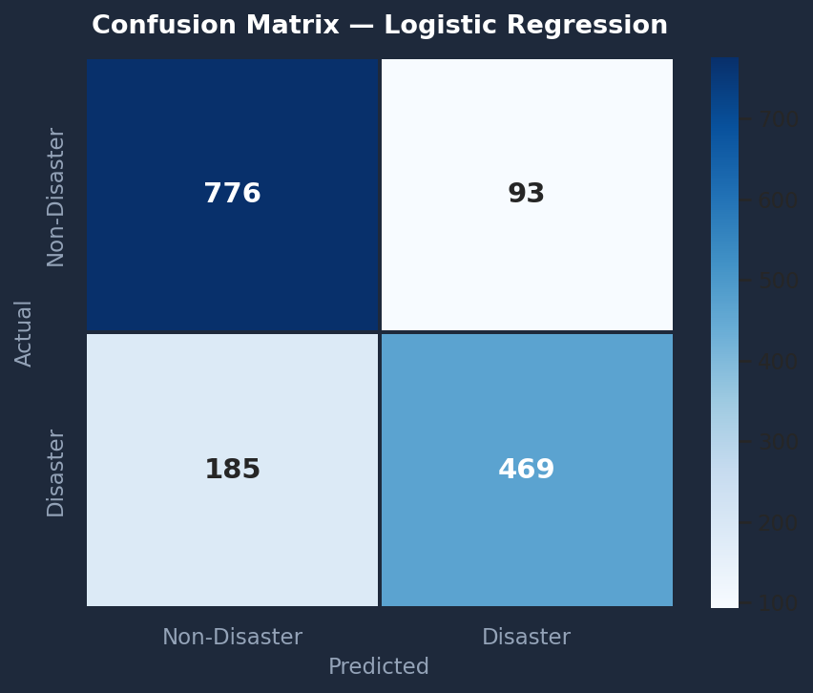
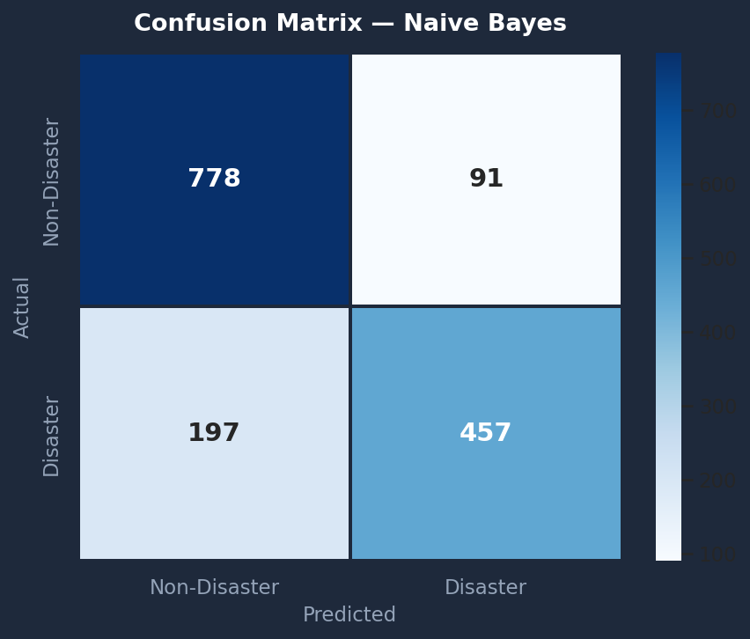

RESULTS — EVALUATION
Confusion Matrices
Fig 8a. Logistic Regression (baseline)
Fig 8b. Naive Bayes (baseline)
Fig 8c. LR Tuned (GridSearchCV)
📌 False Negatives (bottom-left) are most dangerous in a real emergency context — missing a real disaster means delayed response. The tuned model reduces both error types vs baselines.
Notes:
Here are the confusion matrices for all three models. A confusion matrix shows four outcomes: true positives, true negatives, false positives, and false negatives. In this context, false negatives — bottom-left cell — are the most dangerous. A false negative means the model said 'not a disaster' when it actually was one. In a real emergency response system, missing a real disaster could delay emergency services. The tuned model reduces both types of errors compared to the baselines.

Slide 10
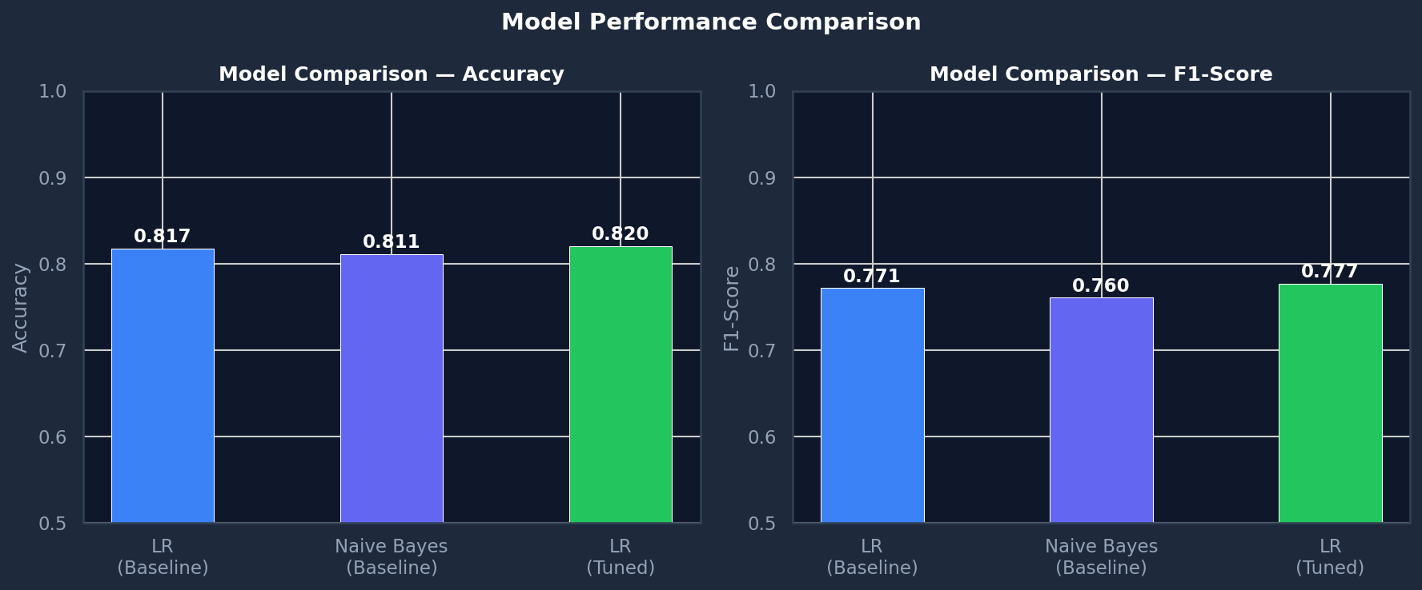
RESULTS — PERFORMANCE METRICS
Model Performance Comparison
82.0%
Accuracy
77.6%
F1-Score
MODEL
ACCURACY
F1
LR Baseline
0.8175
0.7714
Naive Bayes
0.8109
0.7604
LR Tuned ✓
0.8201
0.7765
Best params: {'clf__C': 1, 'tfidf__max_features': 3000, 'tfidf__ngram_range': (1, 1)}
Fig 9. Accuracy and F1-Score comparison across all models
Notes:
Looking at the final numbers — the tuned Logistic Regression achieves 82.0% accuracy and 77.6% F1-score on the held-out test set. Logistic Regression consistently outperforms Naive Bayes on this dataset. The key reason: Naive Bayes assumes all words are independent, but in real text, words co-occur meaningfully. GridSearchCV found that 3,000 features with unigrams and C=1 is optimal — showing that a smaller, well-regularised vocabulary actually generalises better.

Slide 11
ERROR ANALYSIS
Where Does the Model Fail?
False Positives — said "disaster", wasn't
🧠 Root Cause: No Context Understanding
⚠️ Model: DISASTER
TF-IDF treats words as independent tokens. It cannot understand that "on fire tonight" is figurative praise vs a real emergency. Bag-of-words has no concept of context or intent.
"I'm literally dying of boredom in this lecture 💀"
⚠️ Model: DISASTER
"This spicy food is absolutely destroying me 🔥"
⚠️ Model: DISASTER
"My mum's cooking is on fire tonight 🙌"
⚖️ Which Error is Worse?
False Negative — missed real disaster
False Negatives are more dangerous — missing a real disaster means delayed emergency response. A deployed system would tune toward higher recall, even at the cost of more false alarms.
🚨 Actual: DISASTER
"Residents urged to leave now. No time left."
🚀 What Would Fix This?
Transformer models (BERT, RoBERTa) produce contextual embeddings. "fire" in "building on fire" vs "you're on fire today" would produce different vector representations.
Notes:
Error analysis reveals the model's fundamental limitation. False positives typically involve figurative language — tweets using disaster vocabulary metaphorically. 'I'm dying of boredom', 'this food is on fire'. The model sees disaster-associated words and fires — because from a bag-of-words perspective, they look identical to real disaster tweets. False negatives are often tweets using unusual or vague language to describe a real event. This is an inherent limitation of TF-IDF: it operates on word counts without any understanding of context or intent.

Slide 12
KEY TAKEAWAYS
Summary & Conclusions
STAGE
CHOICE
WHY
✅ What Works Well
Preprocessing
Lemmatise + clean
Twitter noise
• LR + TF-IDF is a strong, efficient baseline • Pipeline prevents data leakage • GridSearchCV finds optimal parameters • Model generalises consistently across CV folds
Features
TF-IDF (unigrams)
Down-weights common words
Model
Logistic Regression
Strong & interpretable
Metric
F1-Score
Mild class imbalance
⚠️ Limitations
Tuning
GridSearchCV (3-fold)
Systematic, no leakage
• No semantic understanding of figurative language • Words treated as independent — context ignored • Mild class imbalance may bias predictions
82.0%
77.6%
Final Accuracy
Final F1-Score
🚀 Next Steps
Fine-tune a BERT model — contextual embeddings would handle sarcasm, metaphor, and negation far more accurately than TF-IDF.
Notes:
To summarise: I built a complete NLP pipeline from raw tweets to a tuned binary classifier. Every design decision was deliberate — from lemmatisation over stemming, to TF-IDF over bag-of-words, to F1-score over accuracy. The final model achieves 82.0% accuracy and 77.6% F1-score. The core limitation is the bag-of-words assumption — no understanding of context. The natural next step would be fine-tuning a BERT model, which produces contextual word embeddings that can distinguish 'building on fire' from 'you're on fire today'. Thank you for your time and listening.

