Slide 1

Modeling and Simulating Disease Outbreaks for Arbitrary Topological Systems
Based on: B. A. Prakash, D. Chakrabarti, N. Valler, M. Faloutsos, C. Faloutsos. Threshold conditions for arbitrary cascade models on arbitrary networks.
Severin Jäger, Thomas Hahn, Yannick Schubert

Slide 2

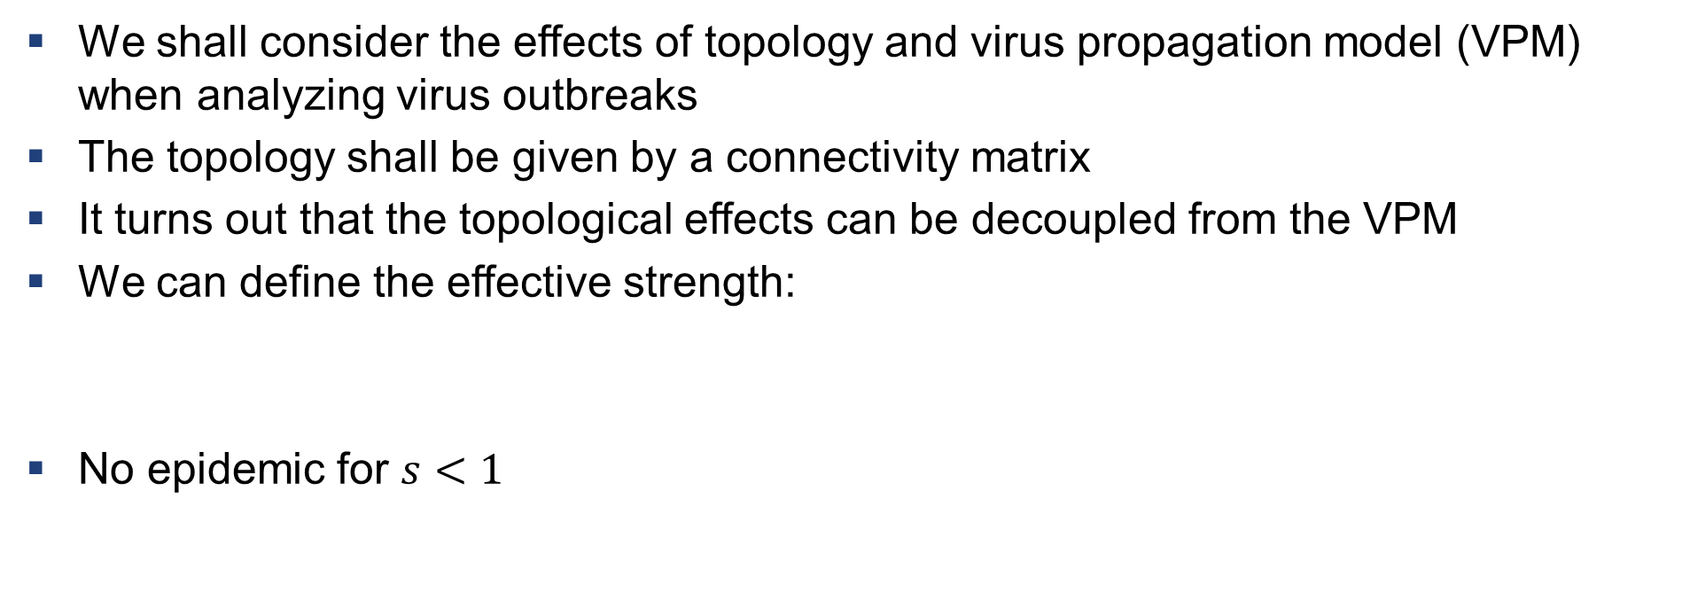
Underlying Theory Behind Our Project
We shall consider the effects of topology and virus propagation model (VPM) when analyzing virus outbreaks
The topology shall be given by a connectivity matrix
It turns out that the topological effects can be decoupled from the VPM
We can define the effective strength:
No epidemic for $s<1$
Severin Jäger, Thomas Hahn, Yannick Schubert

Slide 3
Proof Overview: Initial Conditions
We start out with our general model: S*I²V*
  Susceptible Class: Contains all of the susceptible states. All nodes that are elements of this class can be infected by neighbors.
  Infected Class: Contains two infected states (E,I). All nodes that are elements of this class are infected.
  Vigilant Class: Contains all of the vigilant states. All nodes that are elements of this class cannot be infected or cause infections.
Two Assumptions:
  Infections can only be spread through neighboring nodes
  There exists a “starting infected class”
Severin Jäger, Thomas Hahn, Yannick Schubert

Slide 4
Proof Overview: Outline
We can define a vector that completely describes our state at time t.
We shall then analyze the fixed points where no node is an infected state
If this fixed point is stable for small perturbations, we know that it shall not come to an epidemic
Severin Jäger, Thomas Hahn, Yannick Schubert

Slide 5

Goal of Our Project
Reproduce the results of the paper (for the SIR model, $s=λ_{1}∗\frac{β}{δ}$)
Push the model towards its boundaries
  Is the model still applicable for many/important initially infected nodes?
  Is the model still applicable for small networks?
Severin Jäger, Thomas Hahn, Yannick Schubert

Slide 6
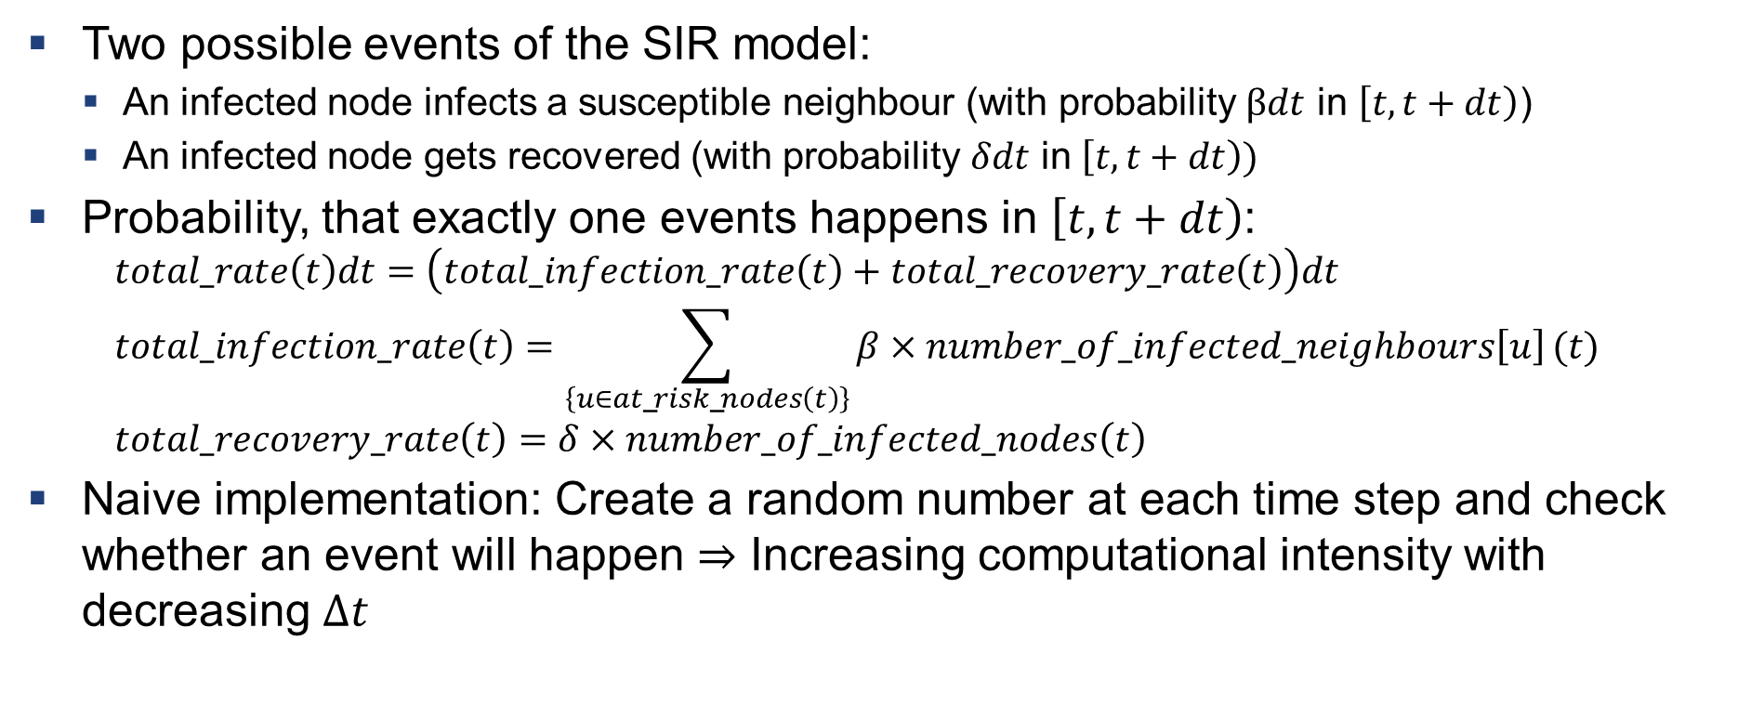
Simulating the Time Evolution of the SIR Model on Arbitrary Networks using the Gillespie Algorithm
Two possible events of the SIR model:
  An infected node infects a susceptible neighbour (with probability $βdt$ in $\left[t,t+dt\right)$)
  An infected node gets recovered (with probability $δdt$ in $\left[t,t+dt\right))$
Probability, that exactly one events happens in $\left[t,t+dt\right)$:
  $$total\text{_}rate\left(t\right)dt=\left(total\text{_}infection\text{_}rate\left(t\right)+total\text{_}recovery\text{_}rate\left(t\right)\right)dt \\ total\text{_}infection\text{_}rate\left(t\right)=\sum_{\left\{u∈at\text{_}risk\text{_}nodes\left(t\right)\right\}}{β×number\text{_}of\text{_}infected\text{_}neighbours\left[u\right]}(t) \\ total\text{_}recovery\text{_}rate\left(t\right)=δ×number\text{_}of\text{_}infected\text{_}nodes\left(t\right)$$
Naive implementation: Create a random number at each time step and check whether an event will happen $⇒$ Increasing computational intensity with decreasing $Δt$
Severin Jäger, Thomas Hahn, Yannick Schubert

Slide 7
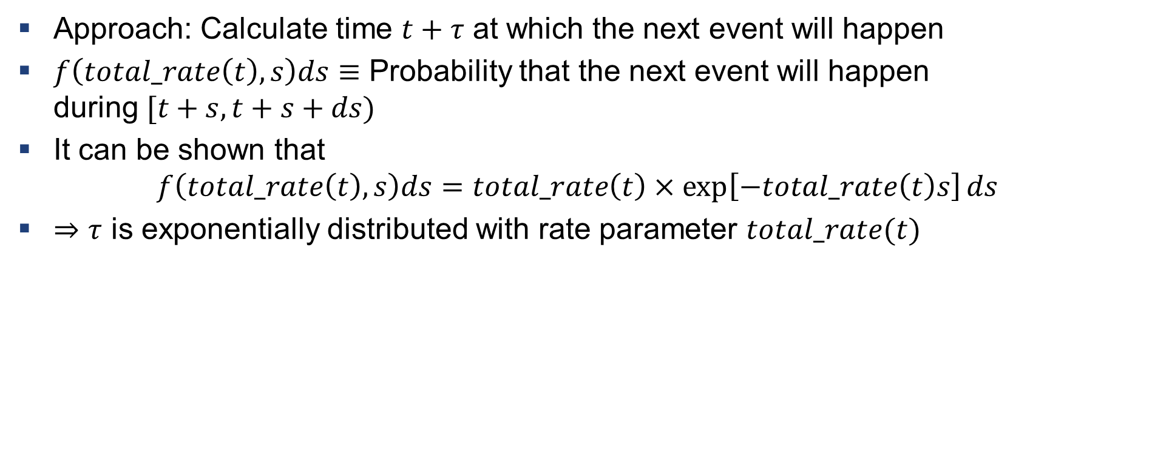
Simulating the Time Evolution of the SIR Model on Arbitrary Networks using the Gillespie Algorithm
Approach: Calculate time $t+τ$ at which the next event will happen
$f\left(total\text{_}rate\left(t\right),s\right)ds≡$ Probability that the next event will happen
during $[t+s,t+s+ds)$
It can be shown that
$$f\left(total\text{_}rate\left(t\right),s\right)ds=total\text{_}rate\left(t\right)×\exp\left[−total\text{_}rate\left(t\right)s\right]ds$$
$⇒τ$ is exponentially distributed with rate parameter $total\text{_}rate(t)$
Severin Jäger, Thomas Hahn, Yannick Schubert

Slide 8
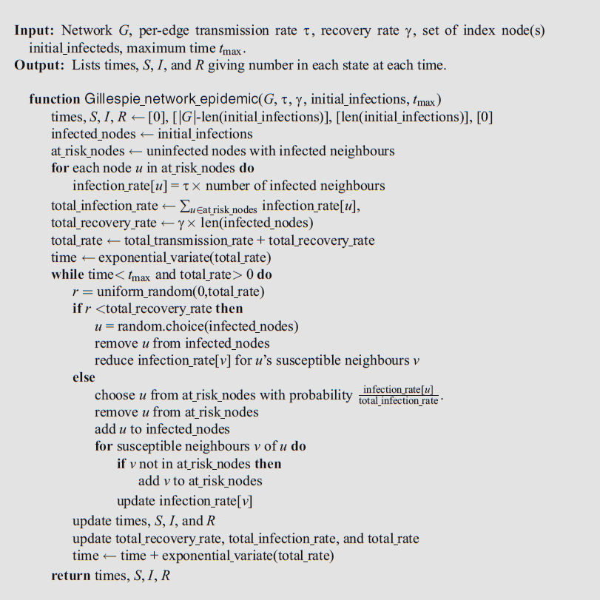
Pseudocode of the Gillespie Algorithm
1. Initialise the status of all nodes, compute all rates and the time at which the first event will happen
2. Compute which event will happen
3. Update the status of all nodes and all rates. Compute the time when the next event will happen and go to 2.
Severin Jäger, Thomas Hahn, Yannick Schubert
Taken from “Mathematics of Epidemics on Networks”

Slide 9
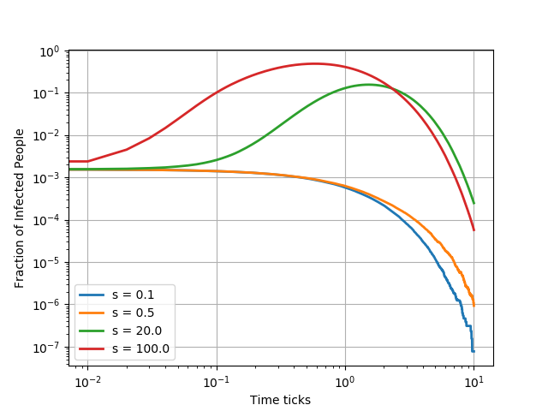
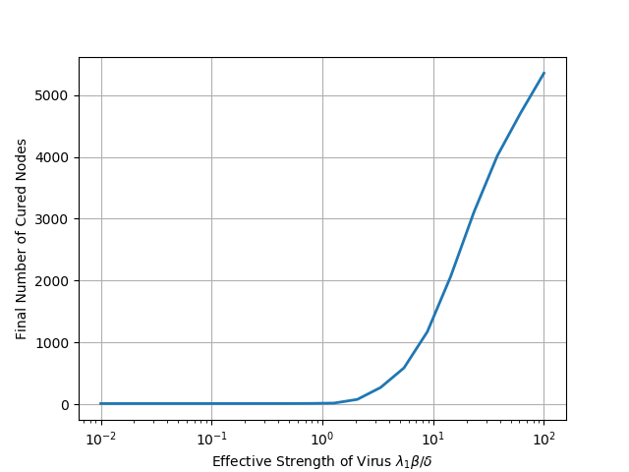
Simulation Results I
Reproduction of previous work
Data set AS-OREGON (6474 nodes)
10 random nodes initially infected
Severin Jäger, Thomas Hahn, Yannick Schubert

Slide 10
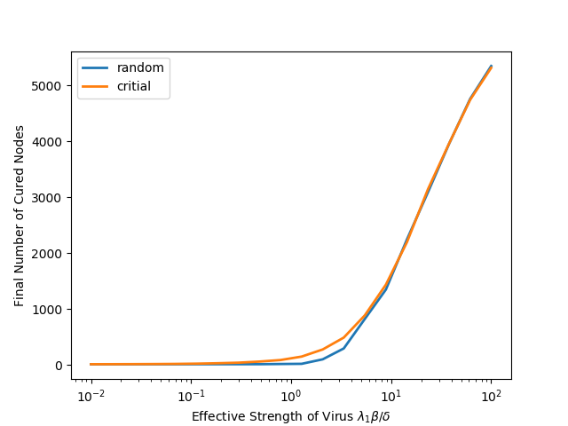
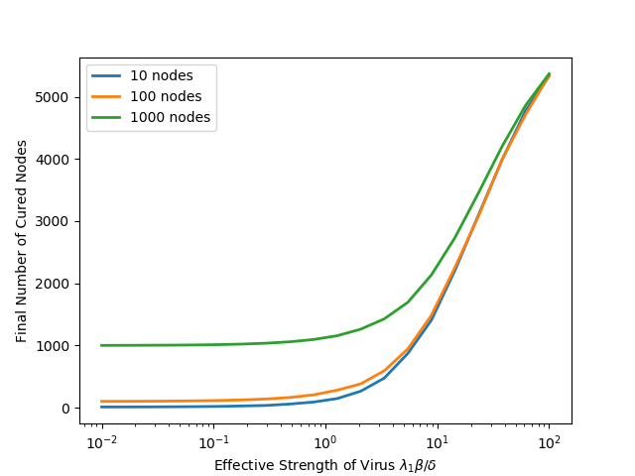
Simulation Results II
Challenging the model with different initial infections
Infection of nodes with highest eigenvector centrality (critical nodes)
Infection of more nodes
Severin Jäger, Thomas Hahn, Yannick Schubert

Slide 11
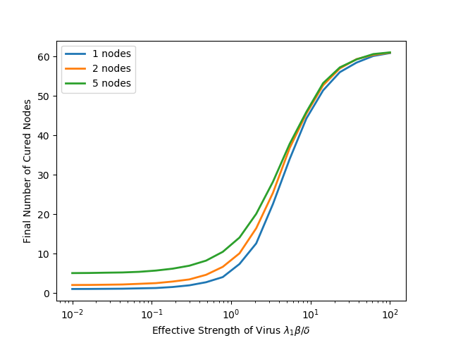
Simulation Results III
Challenging the model with a small network
Data set TERRORIST (62 nodes)
Infection of critical nodes (highest centrality)
Severin Jäger, Thomas Hahn, Yannick Schubert

Slide 12
Summary & Outlook
Model generally very robust
Valid for larger networks regardless of initial infection
Small networks push it towards its boundaries
Further research necessary
We only covered the SIR model
Influence of averaging
  Worst-case scenario more interesting for applications
Severin Jäger, Thomas Hahn, Yannick Schubert

Slide 13
Sources
B. A. Prakash, D. Chakrabarti, N. Valler, M. Faloutsos, C. Faloutsos. Threshold conditions for arbitrary cascade models on arbitrary networks. Knowledge and Information Systems manuscript No. KAIS-12-3483R1, 2012.
Istvan Z. Kiss, Joel C. Miller, Peter L. Simon. Mathematics of Epidemics on Networks, Volume 46, Page 382. Springer, Cham, 2017.
Hirsch MW. Differential Equations, Dynamical Systems and Linear Algebra. Morris W. Hirsch, Stephen Smale Robert L. Devaney, Stephen Smale, 1974.
Radek Erban, S. Jonathan Chapman, Philip K. MAINI. A practical guide to stochastic simulations of reaction-diffusion processes. https://arxiv.org/pdf/0704.1908.pdf.
Severin Jäger, Thomas Hahn, Yannick Schubert

